Slide 1

Unit 3: MY FRIENDS AND I
Lesson 1.1
Page 34

Slide 2
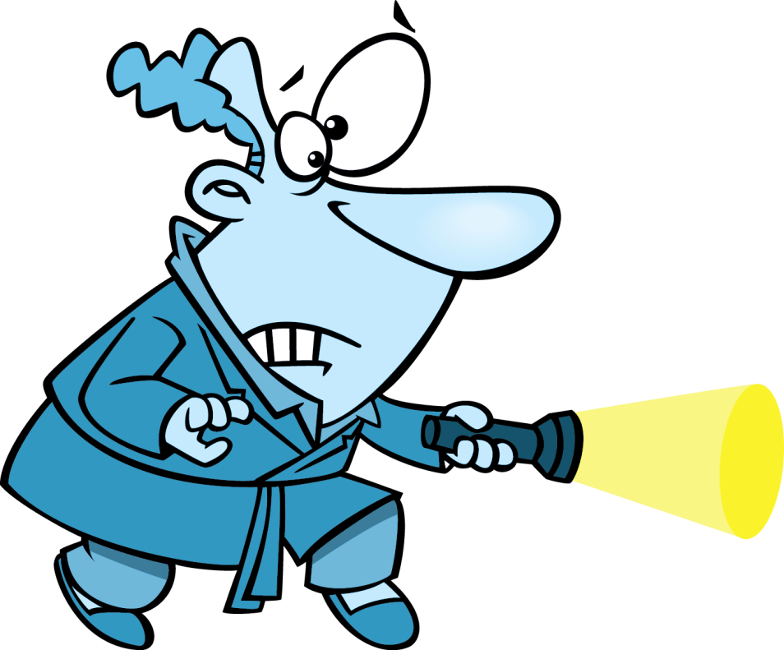

GUESS
AND
ACT

Slide 3
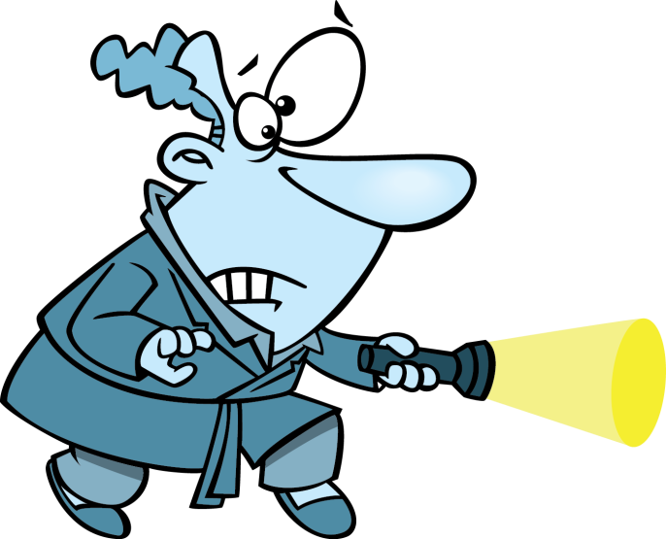
Click on the man with a torch and guess the hidden verb
walk
CHECK

Slide 4
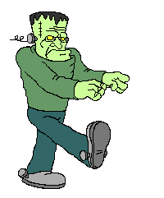

WALK
Walk like Frankenstein around the classroom.
CHECK

Slide 5
Click on the man with a torch and guess the hidden verb
cook
CHECK

Slide 6
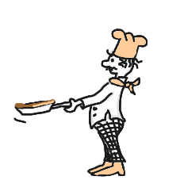
COOK
Act like cooking a pancake
CHECK

Slide 7
Click on the man with a torch and guess the hidden verb
smile
CHECK

Slide 8

SMILE
Smile to your classmates
CHECK

Slide 9
Click on the man with a torch and guess the hidden verb
drink
CHECK

Slide 10

DRINK
Mime the action
CHECK

Slide 11
Click on the man with a torch and guess the hidden verb
sing
CHECK

Slide 12
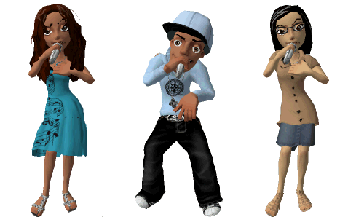
SING
Sing a song in English
EXIT
CHECK

Slide 13

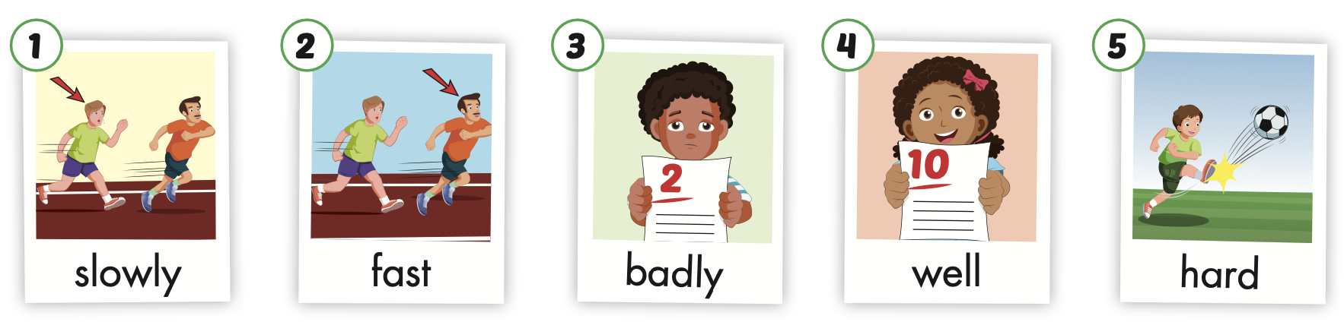
/ˈsloʊli/
chậm chạp
/fæst/
nhanh
/ˈbædli/
tồi, dở
/wel/
tốt, giỏi
/hɑːrd/
mạnh
Notes:
Click vào hình A. 1. Listen and point. Repeat để cho cả audio full chạy

Slide 14
Listen and choose

Slide 15


Listen and choose
slowly
fast
badly
A
B
C

Slide 16


Slide 17
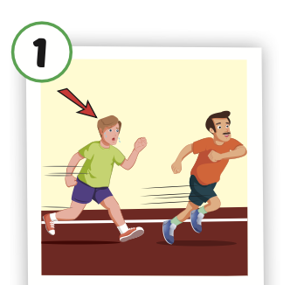
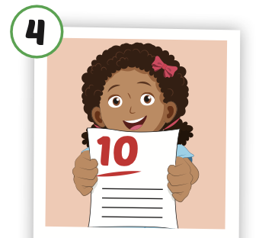
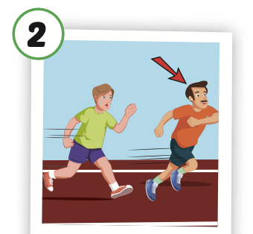
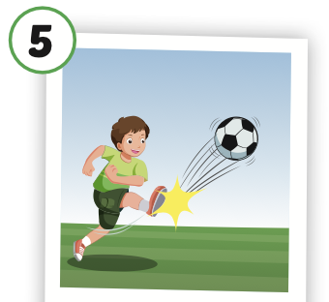
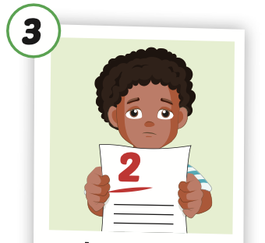
Look and say.

Slide 18
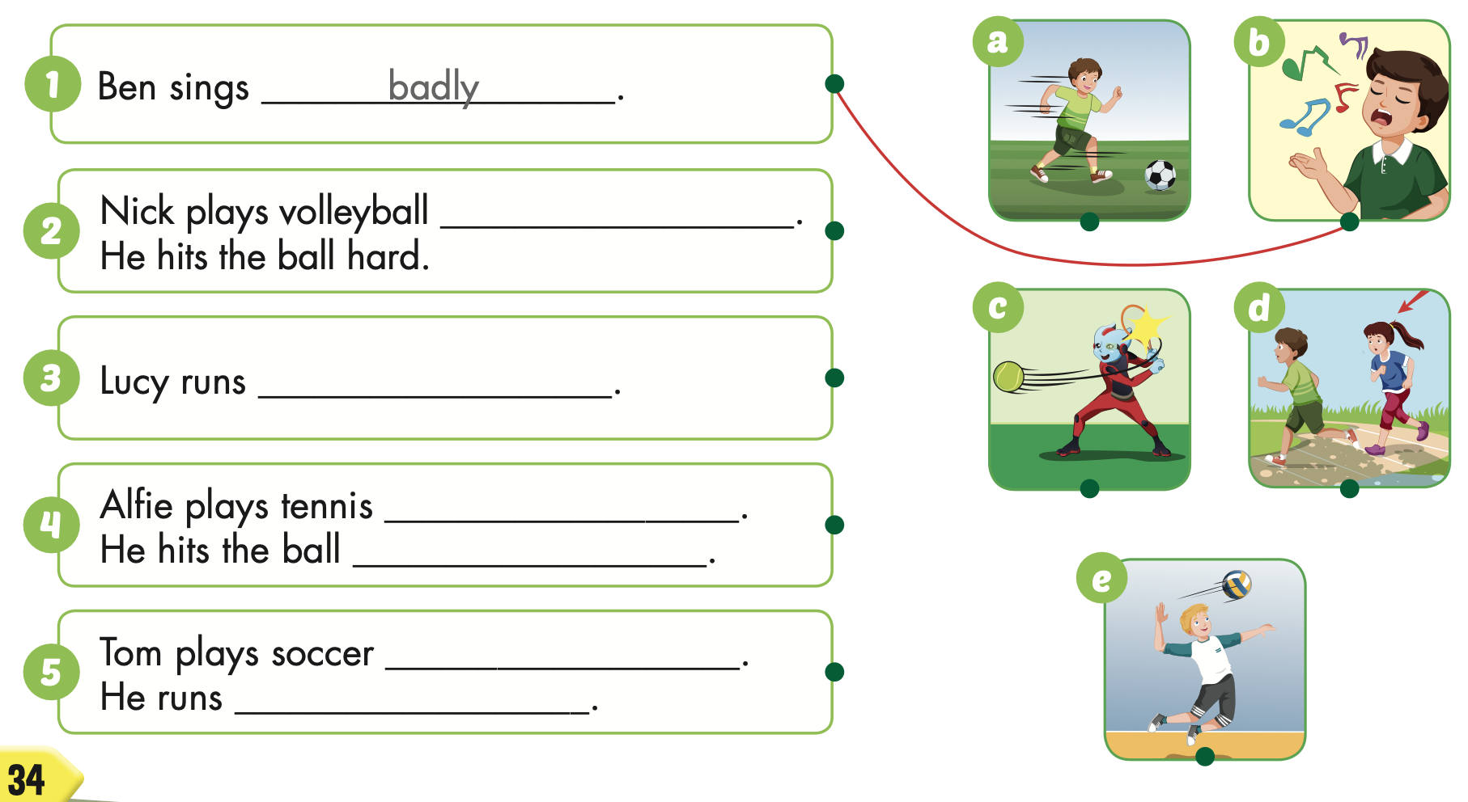

Structure
Ben sings badly.

Slide 19

well
slowly
well
hard
well
fast

Slide 20

Production

Slide 21

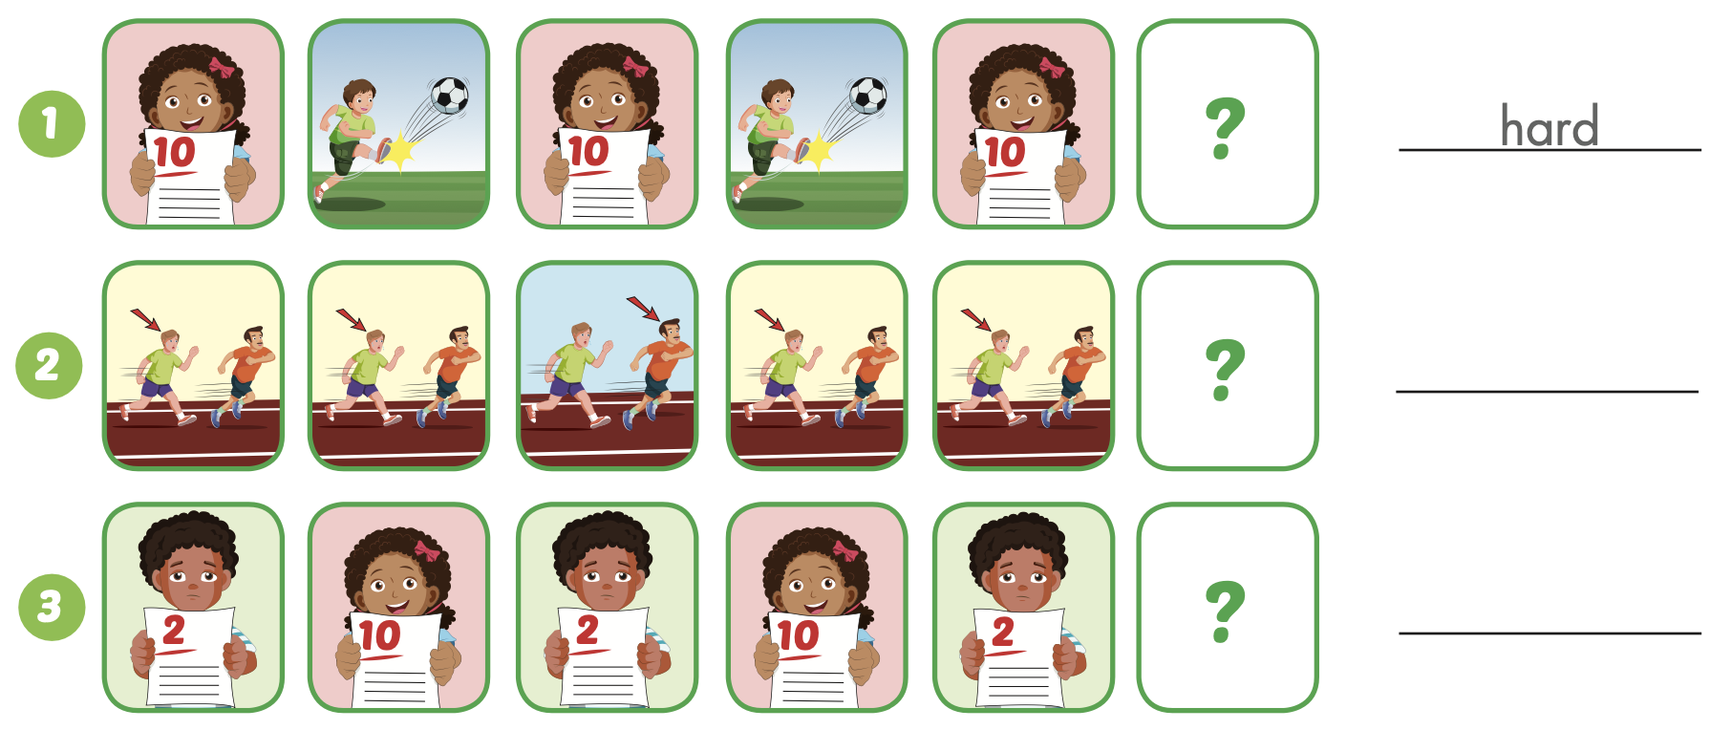
Extra Practice
WB, page 22
fast
well

Slide 22
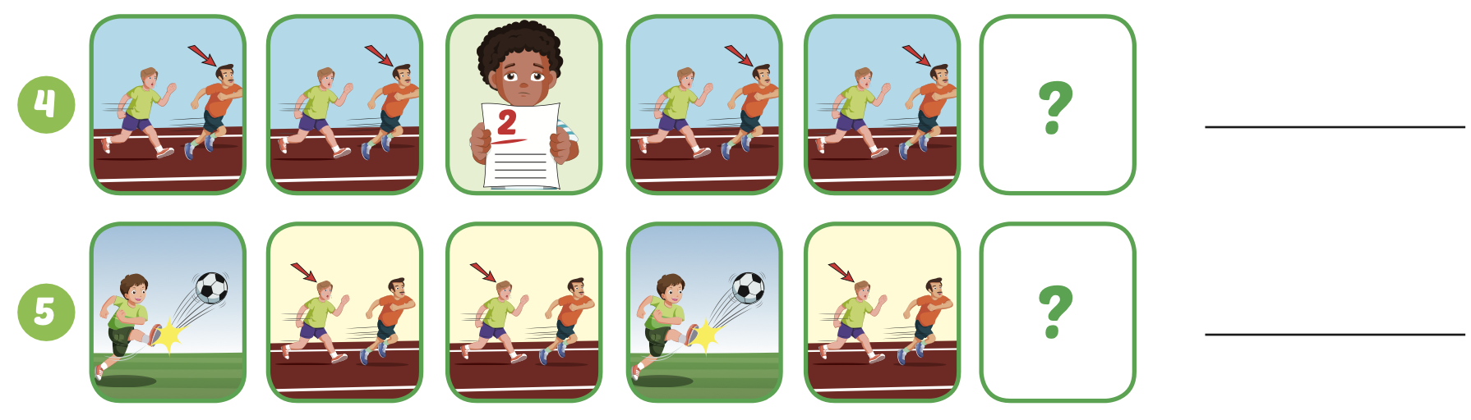
Extra Practice
WB, page 22
badly
slowly

Slide 23
Today’s lesson
Vocabularies
slowly,
fast,
badly,
well,
hard.
Structures/ Sentence patterns
Tom kicks the ball hard.

Slide 24
Homework
Practice the vocabularies and structure, and make sentences using them.
Do the exercises in Tiếng Anh 5 i-Learn Smart Start WB (page 22).
Do the exercises in Tiếng Anh 5 i-Learn Smart Start Notebook.
Prepare the next lesson (page 35 SB).
Play the consolidation games in Tiếng Anh 5 i-Learn Smart Start DHA App on www.eduhome.com.vn

Slide 25

Enjoy your day!

