Slide 1
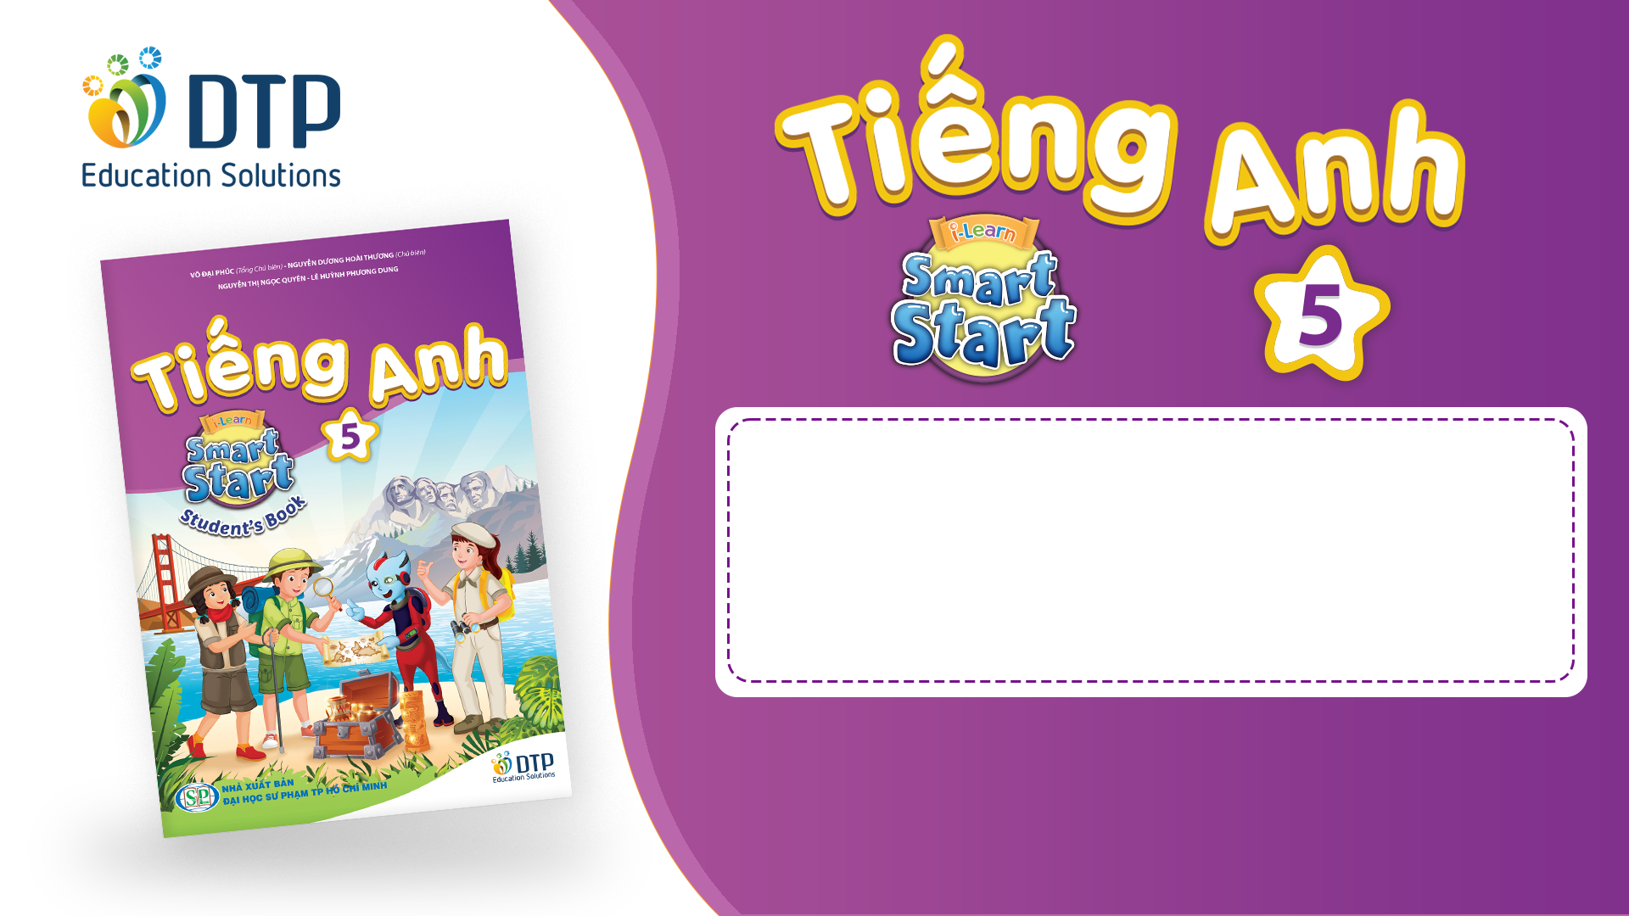
Unit 2: Holidays
Lesson 3.3
Page 28

Slide 2

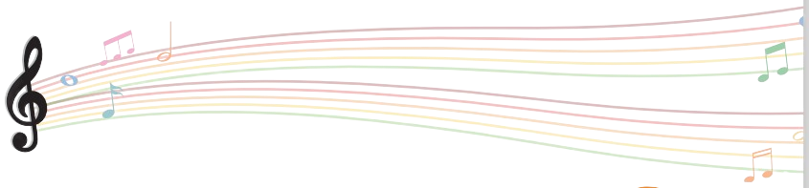
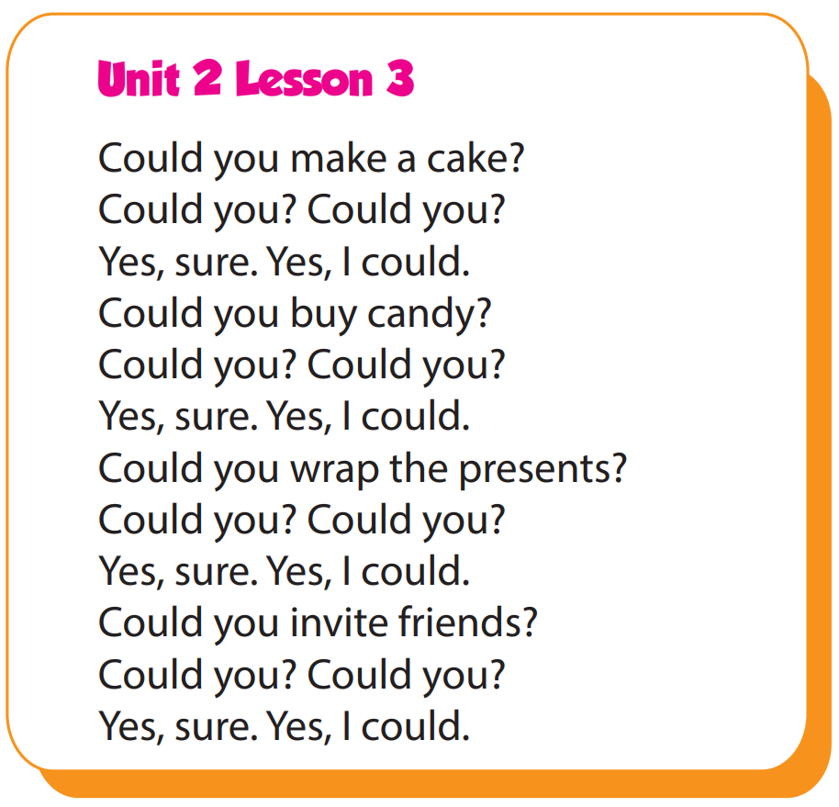

Slide 3

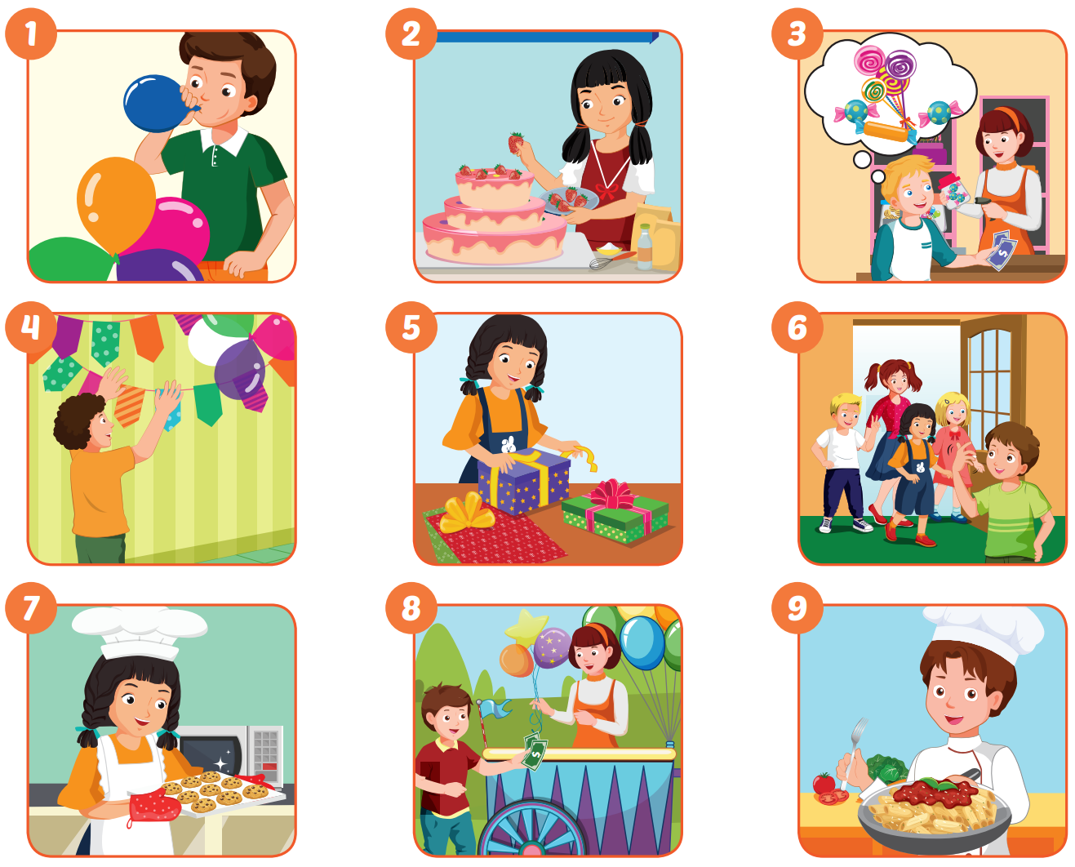




Slide 4

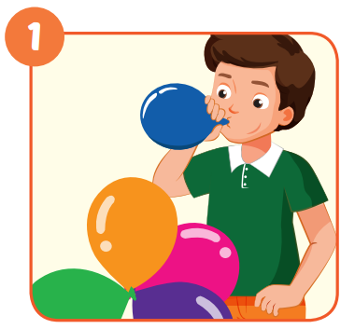
Could you blow up the ballons?
Yes, sure.

Slide 5
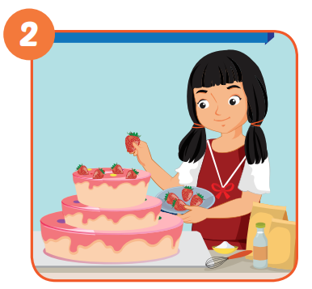
Could you make a cake?
Yes, sure.

Slide 6
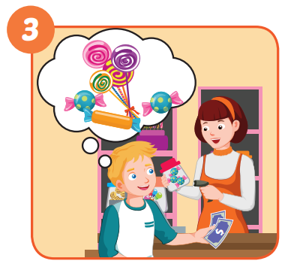
Could you buy candy?
Yes, sure.

Slide 7
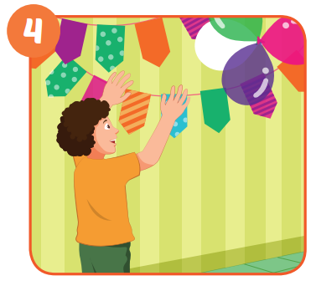
Could you put up colored paper?
Yes, sure.

Slide 8
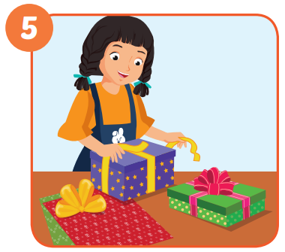
Could you wrap the presents?
Yes, sure.

Slide 9
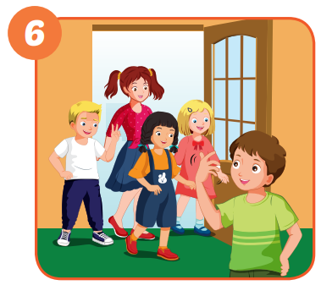
Could you invite friends?
Yes, sure.

Slide 10
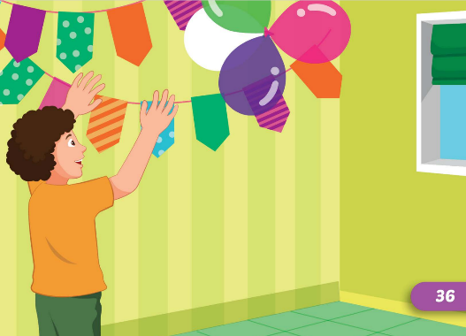
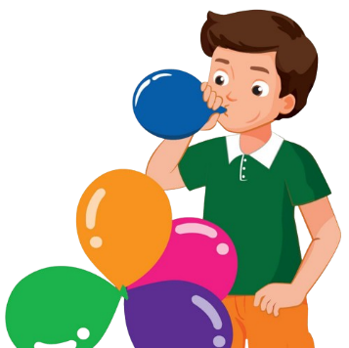
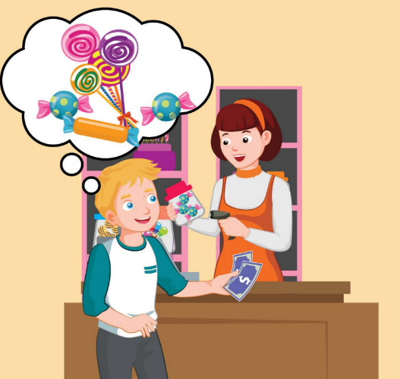
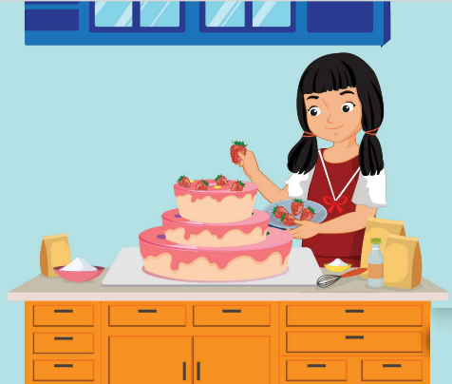
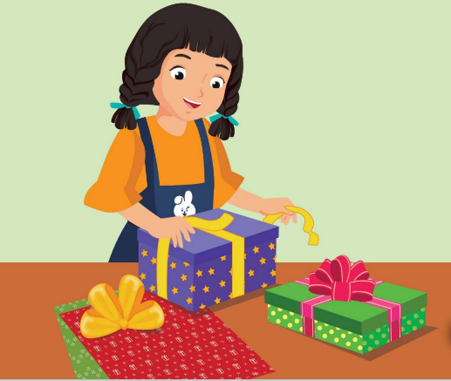
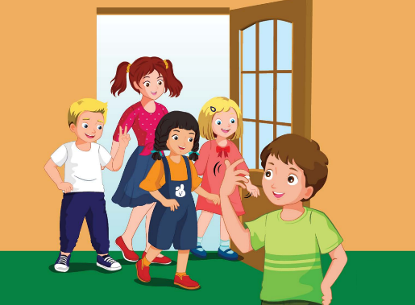
Could you...?
Yes, sure.

Slide 11


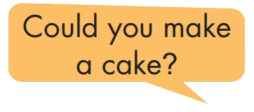
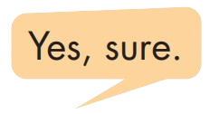
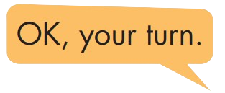

Slide 12

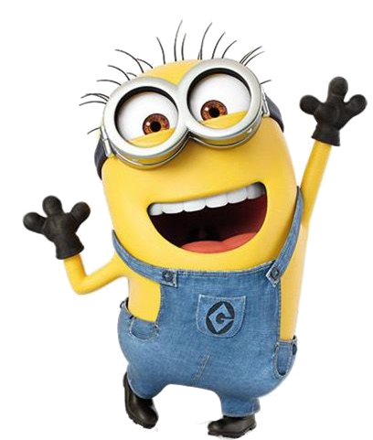
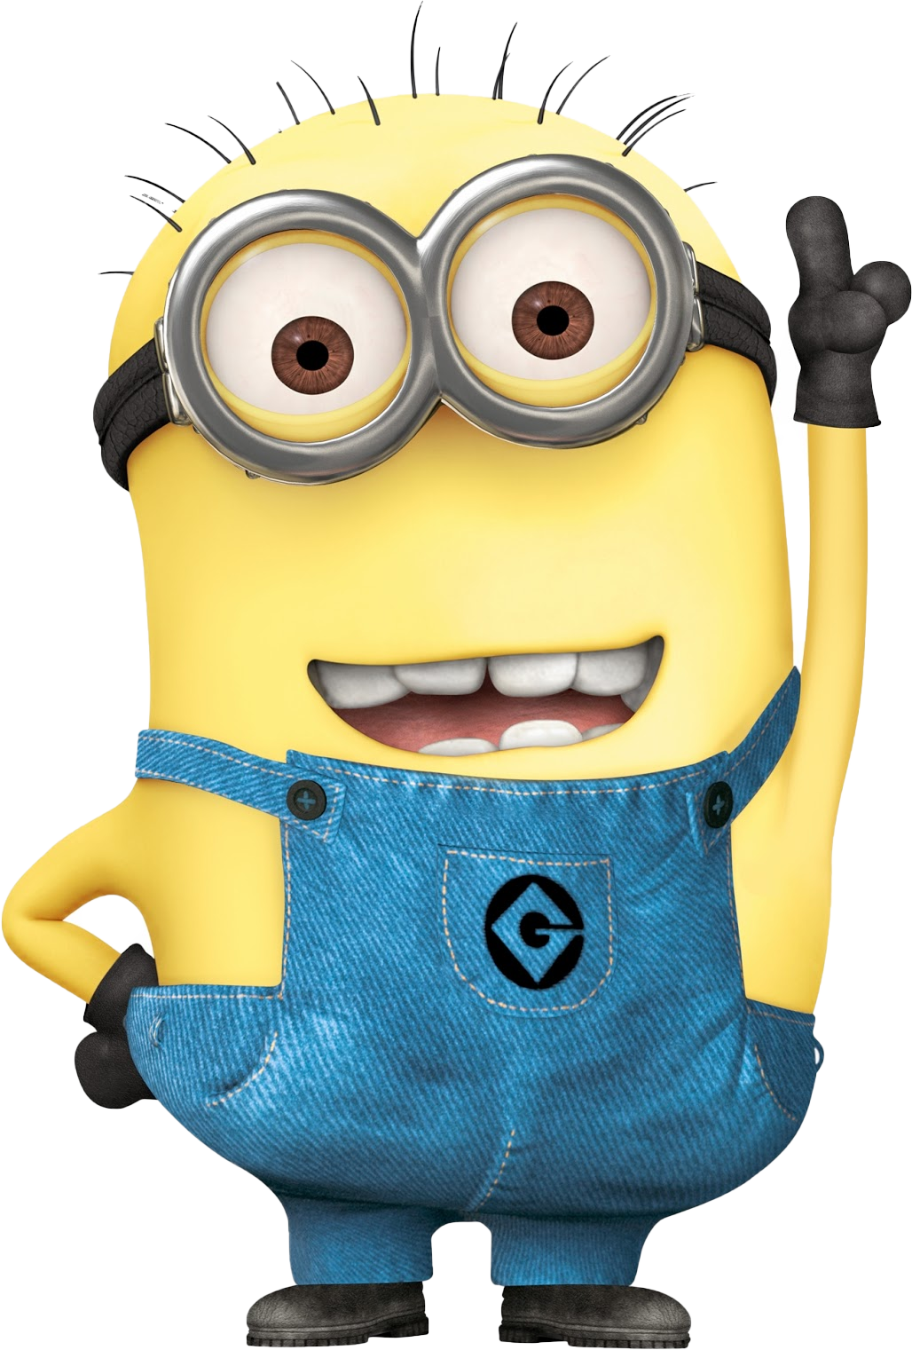

Slide 13

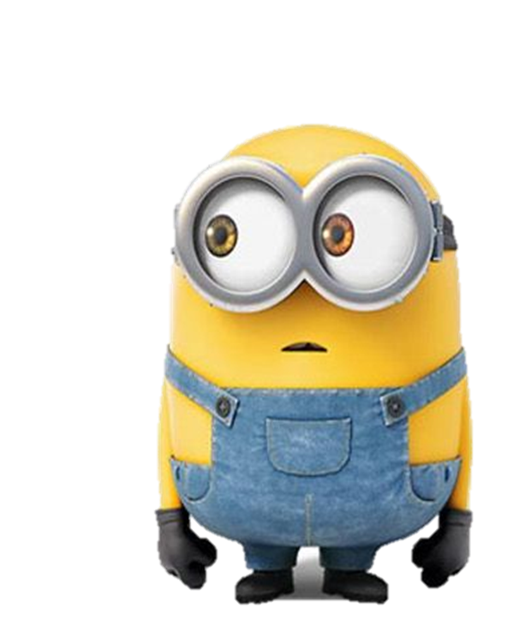
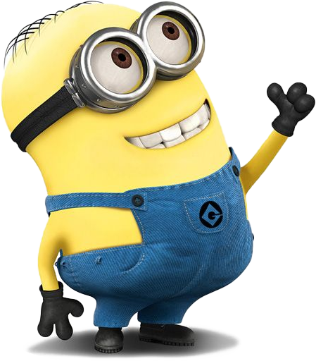



Could you _____.
Yes, sure.
wrap the presents
blow-up the balloons

Slide 14
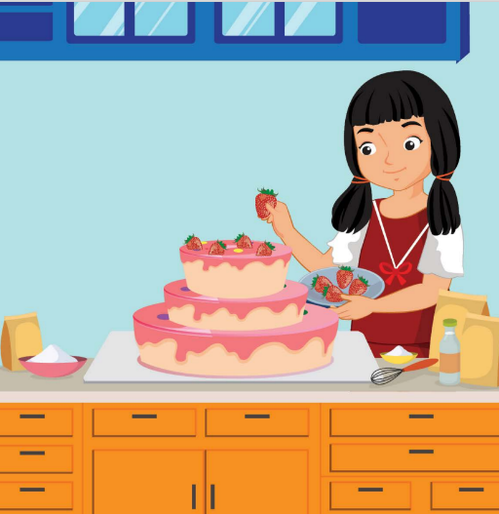
Could you _____.
Yes, sure.
make a cake
invite friends

Slide 15
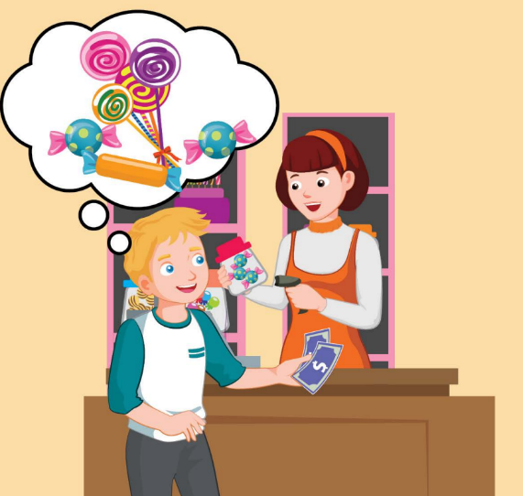
Could you _____.
Yes, sure.
make a cake
buy candy

Slide 16

Could you _____.
Yes, sure.
wrap the presents
invite friends

Slide 17

Could you _____.
Yes, sure.
make a cake
invite friends

Slide 18
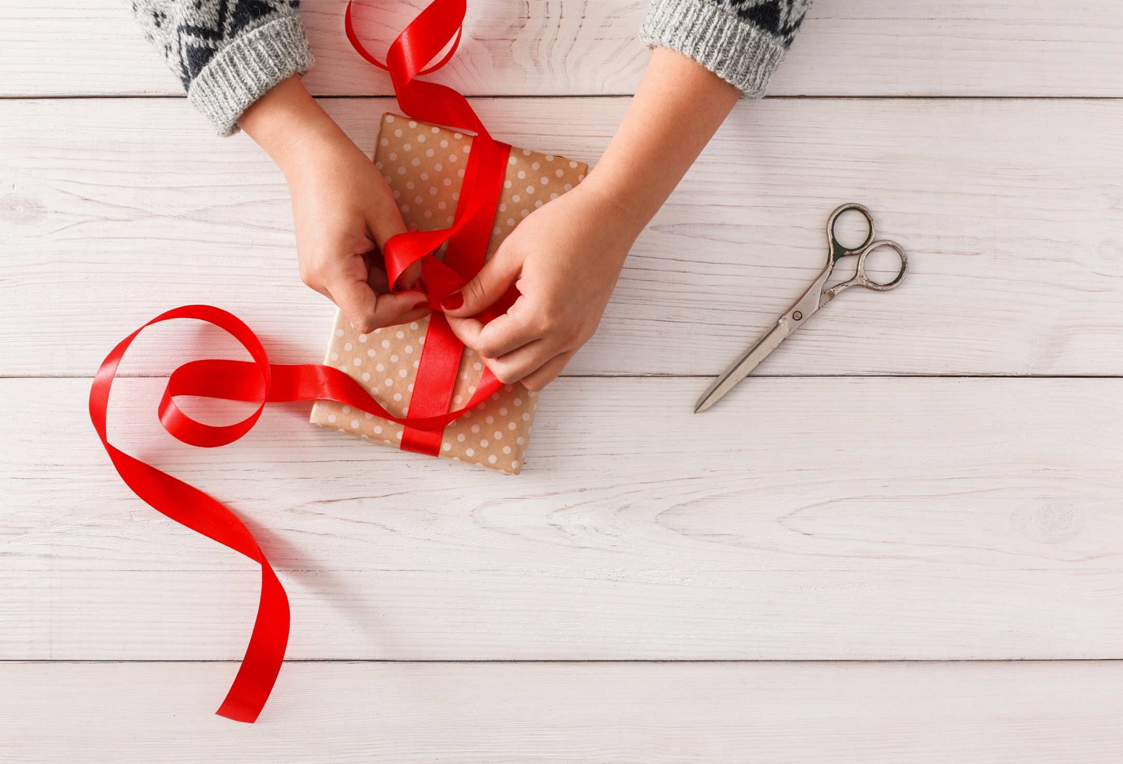
WRAP-UP

Slide 19
Homework
Practice the vocabularies and structure, and make sentences using them.
Do the exercises in Tiếng Anh 5 i-Learn Smart Start WB (page 15)
Do the exercises in Tiếng Anh 5 i-Learn Smart Start Notebook (page 12)
Prepare the next lesson (page 29 SB)
Play the consolidation games in Tiếng Anh 5 i-Learn Smart Start DHA App on www.eduhome.com.vn

Slide 20

Enjoy your day!

