Slide 1

Unit 2: Holidays
Lesson 3.2
Page 27

Slide 2


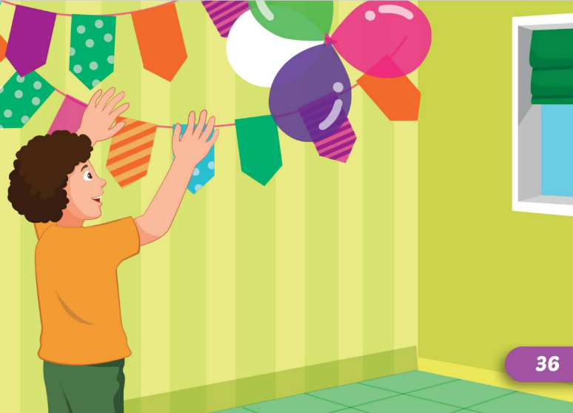

invite friends
put up colored
paper

Slide 3
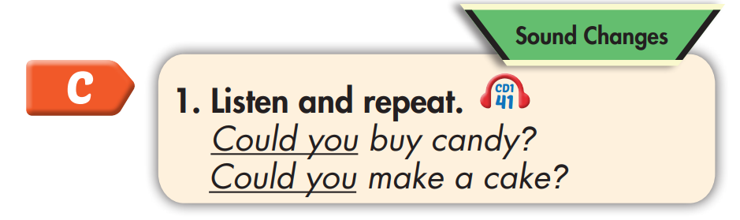

Could you buy candy?
Could you make a cake?

Slide 4


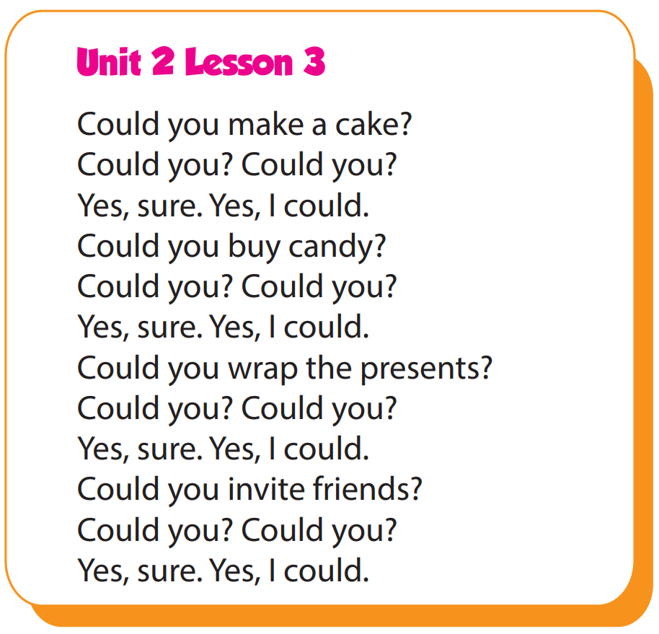

Slide 5
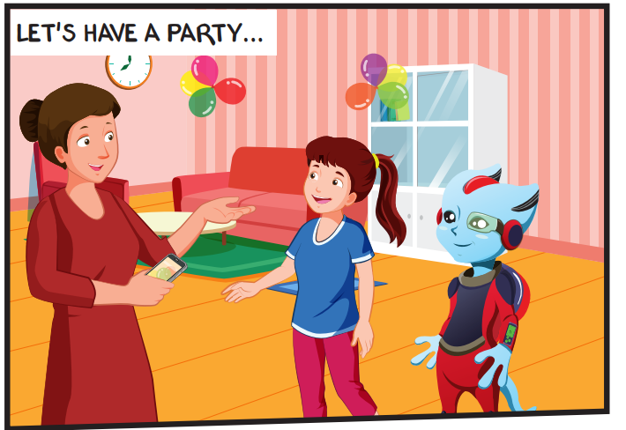
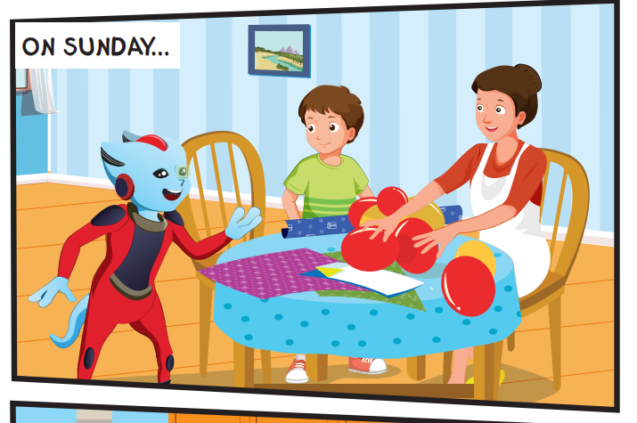
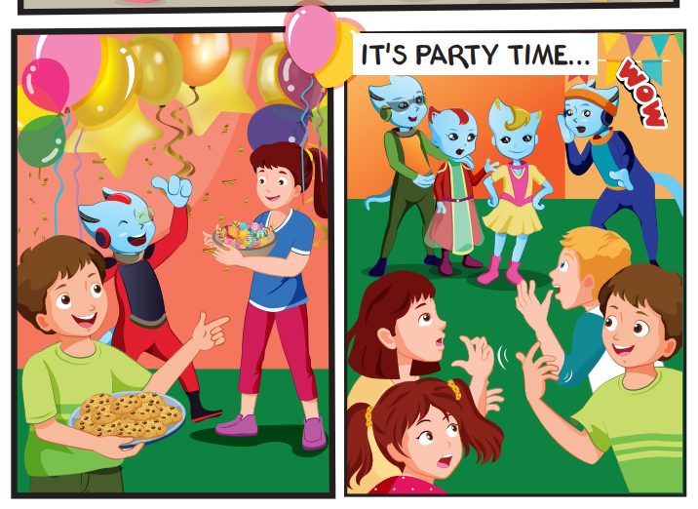
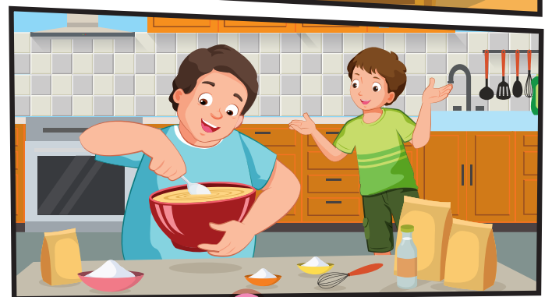
Who can you see?
Mr. and Mrs. Brown, Lucy, Tom, Alfie, their friends.
Where are they?
What are they doing?

Slide 6

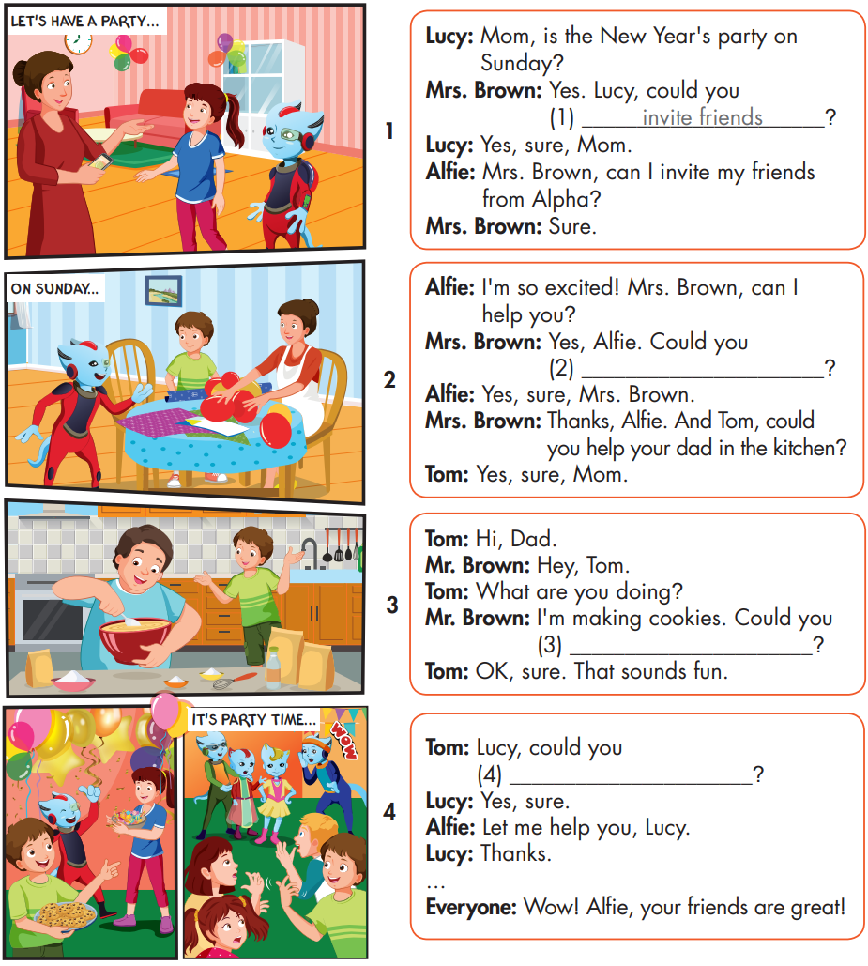

Slide 7
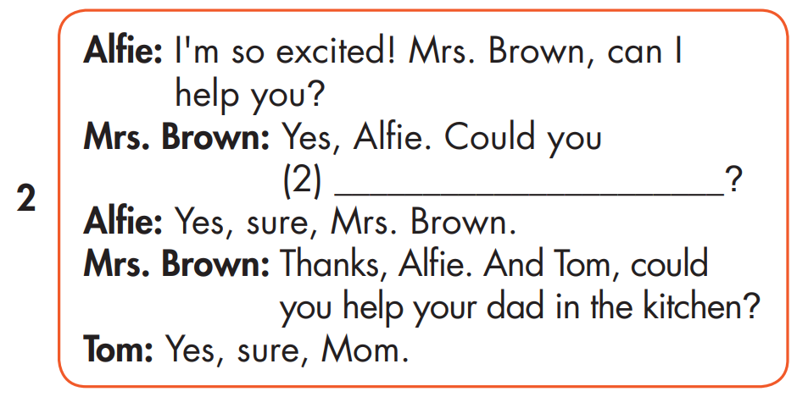
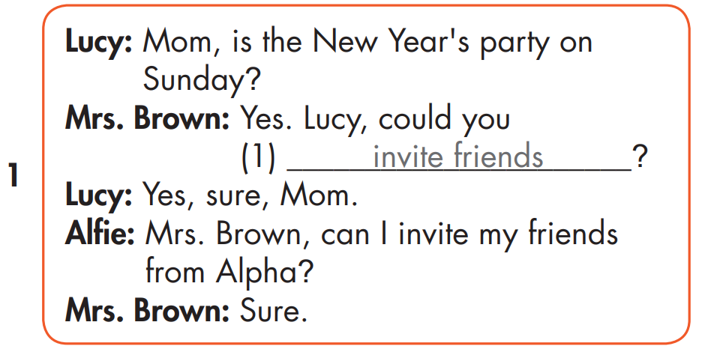
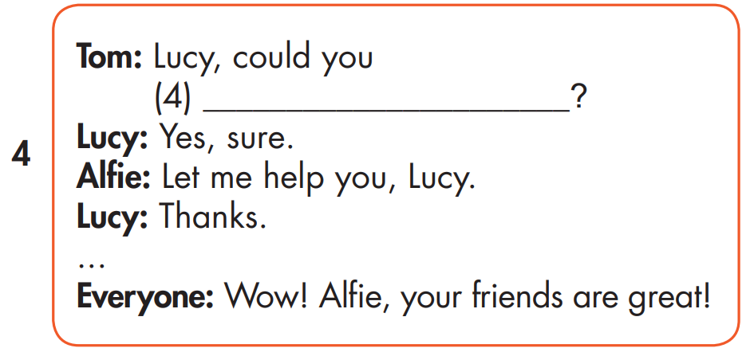
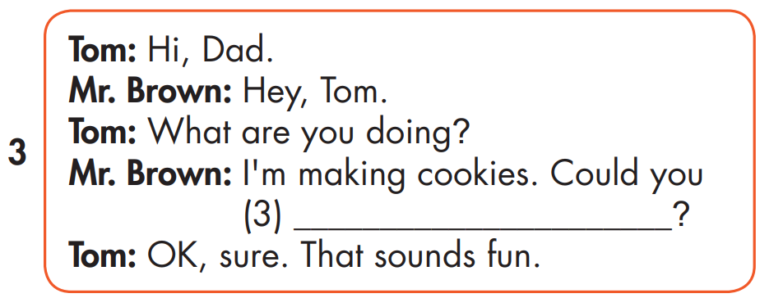
MAKE YOUR OWN STORY
blow up the balloons
put up colored paper
make a cake

Slide 8
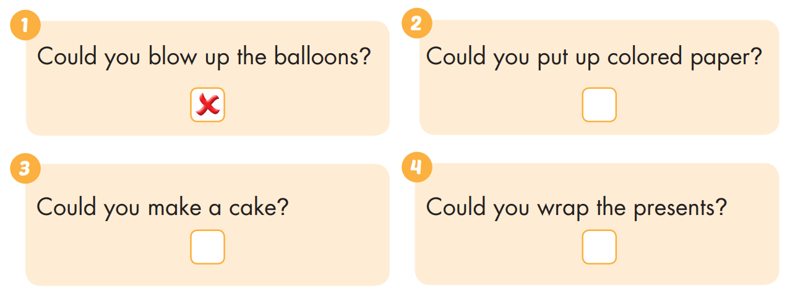


Extra Practice
WB, page 16

Slide 9

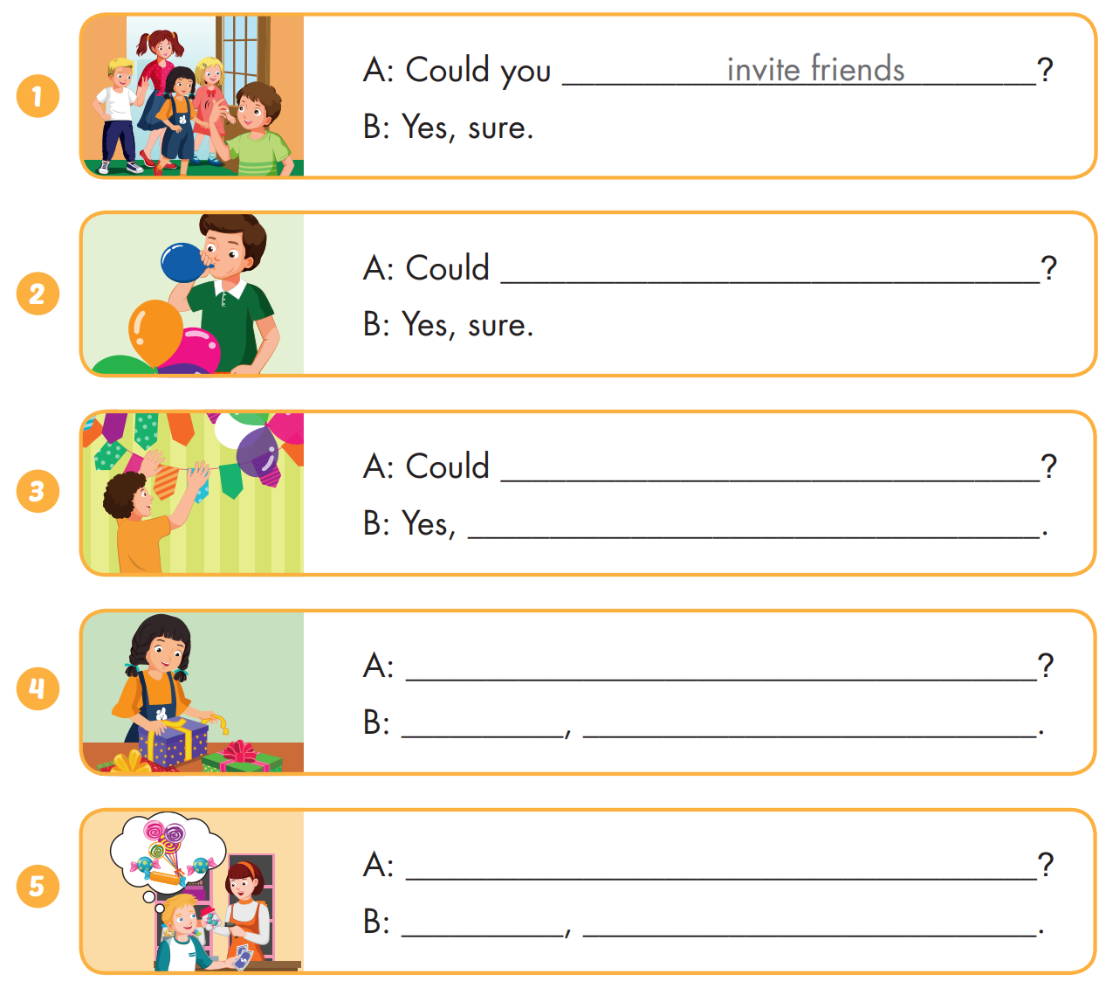
Extra Practice
WB, page 16

Slide 10
Today’s lesson
Structures/ Sentence patterns
Could you blow up the balloons? - Yes, sure.
Sound change
Could you...?

Slide 11

Enjoy your day!

