Slide 1
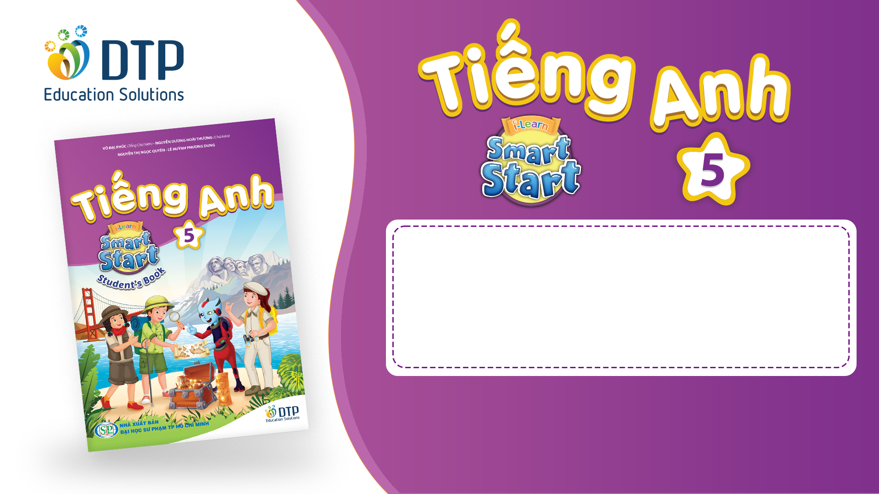
Unit 2: Holidays
Lesson 3.1
Page 26

Slide 2

Colored papers
YES
NO

Slide 3

balloons
YES
NO

Slide 4

papers
YES
NO

Slide 5

candy
YES
NO

Slide 6
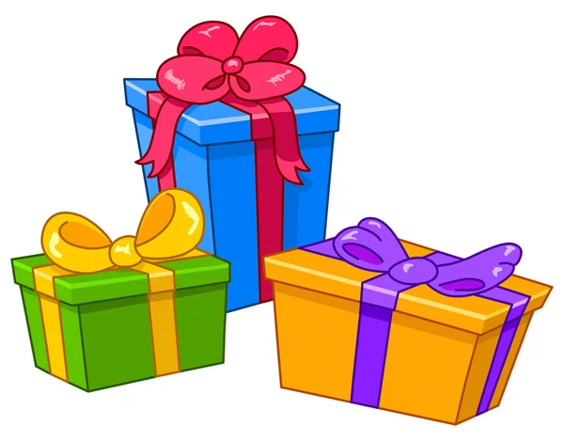
presents
YES
NO

Slide 7
balloons
YES
NO

Slide 8

cake
YES
NO

Slide 9

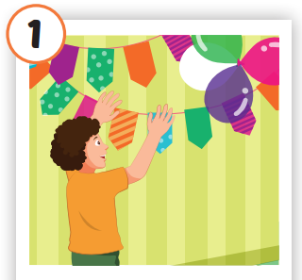
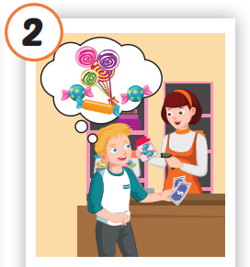
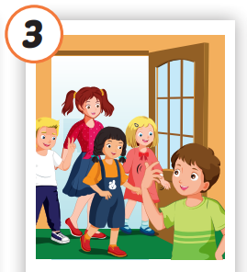
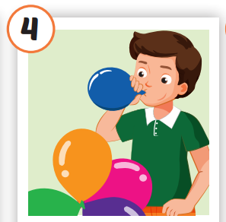
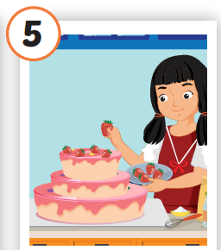
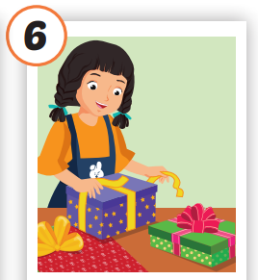






Presentation
/pʊt ʌp
ˈkʌlərd ˈpeɪpər/
treo giấy màu
/baɪ ˈkændi/
mua kẹo
/ɪnˈvaɪt
frendz/
mời bạn bè
/bloʊ ʌp ðə bəˈluːnz/
thổi bóng bay
/meɪk ə keɪk/
làm bánh
/ræp ðə ˈprezənts/
gói quà
Notes:
Click vào hình A. 1. Listen and point. Repeat để cho cả audio full chạy

Slide 10
Practice
CHECK YOUR MEMORY

Slide 11
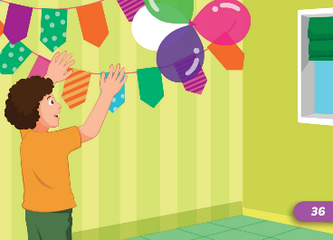
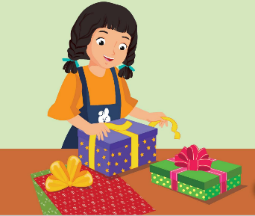
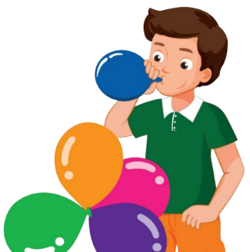
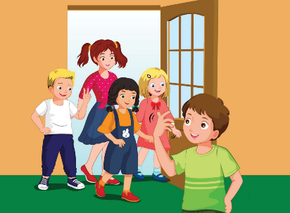
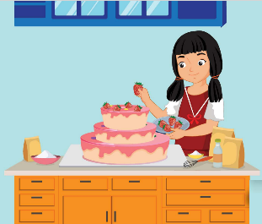

FLASH NOTE
Look and choose

Slide 12
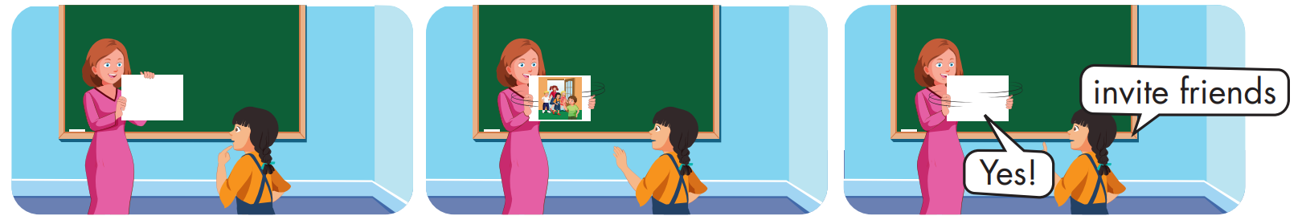

Slide 13

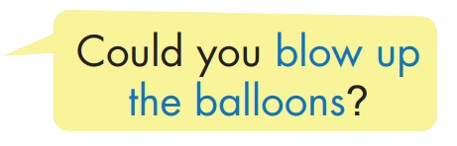


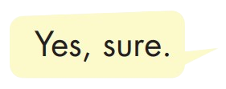
Practice

Slide 14
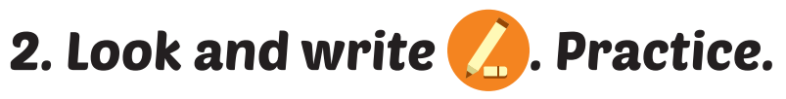
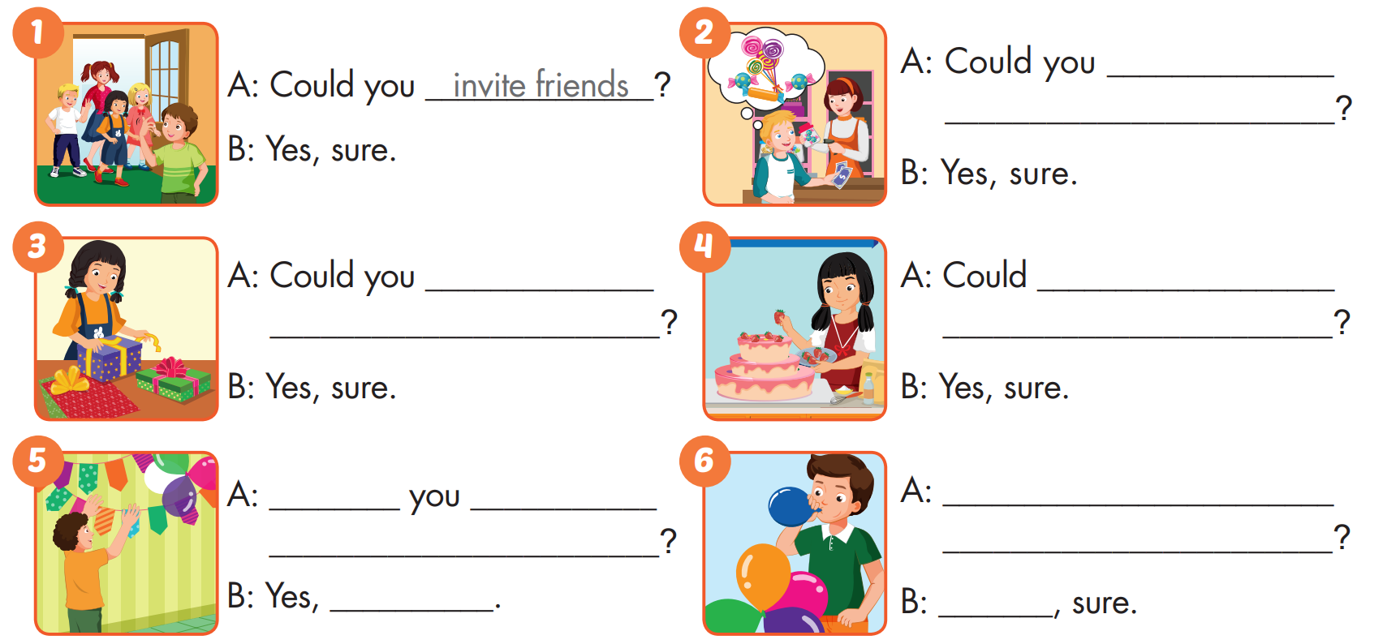
buy
candy
wrap
the presents
you make
a cake
Could
put up
Could you blow up
colored paper
the balloons
sure
Yes

Slide 15

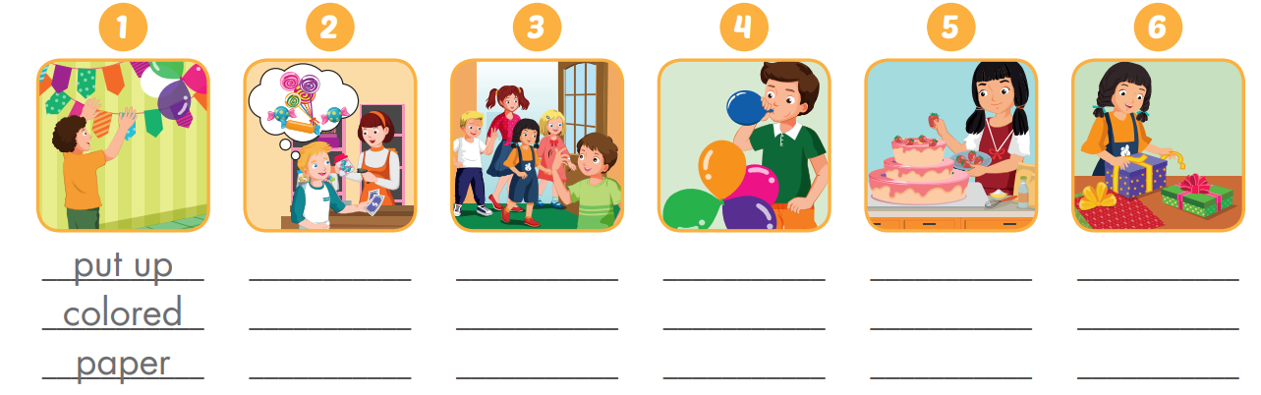
Extra Practice
WB, page 16
buy candy
invite
friends
blow up the balloons
make a cake
wrap the presents

Slide 16
Today’s lesson
Vocabularies
put up colored paper, buy candy, invite friends, blow up the balloons, make a cake, wrap the presents.
Structures/ Sentence patterns
Could you blow up the balloons? - Yes, sure.

Slide 17
Homework
Practice the vocabularies and structure, and make sentences using them.
Do the exercises in Tiếng Anh 5 i-Learn Smart Start WB (page 16)
Do the exercises in Tiếng Anh 5 i-Learn Smart Start Notebook (page12)
Prepare the next lesson (page 27 SB)
Play the consolidation games in Tiếng Anh 5 i-Learn Smart Start DHA App on www.eduhome.com.vn

Slide 18

Enjoy your day!

