Slide 1

Unit 4: Travel
Lesson 4.2
Page 58

Slide 2
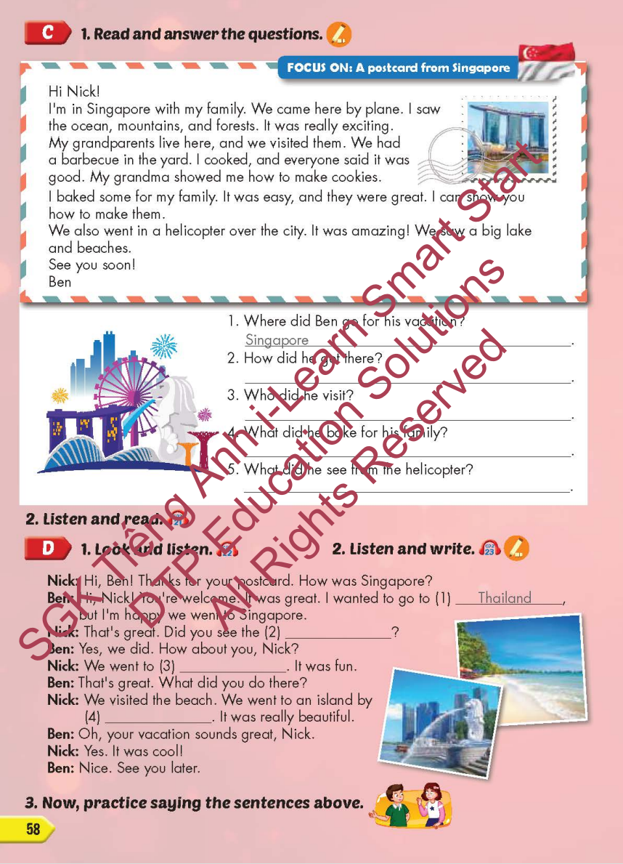
Lesson Outline
Warm-up
Reading
Listening
Consolidation
Wrap-up

Slide 3
Objectives
By the end of this lesson, students will be able to…
Skill: Read the text, listen to a conversation and practice saying the sentences.
Structure: I went to Laos last month.
- What did you do there?
- I watched a soccer game.

Slide 4

WARM-UP

Slide 5




Look at the the line and say what’s disappeared with the wind within the time limit (5 seconds)

Slide 6





Which country is disappered?
TIME’S UP
Laos

Slide 7





Which country is disappered?
TIME’S UP
Indonesia

Slide 8




Which country is disappered?
China
TIME’S UP

Slide 9

Which country is disappered?
TIME’S UP
Cambodia

Slide 10

Which country is disappered?
TIME’S UP
Singapore

Slide 11



Which country is disappered?
Thailand
TIME’S UP

Slide 12

It’s time to learn …

Slide 13

Reading

Slide 14
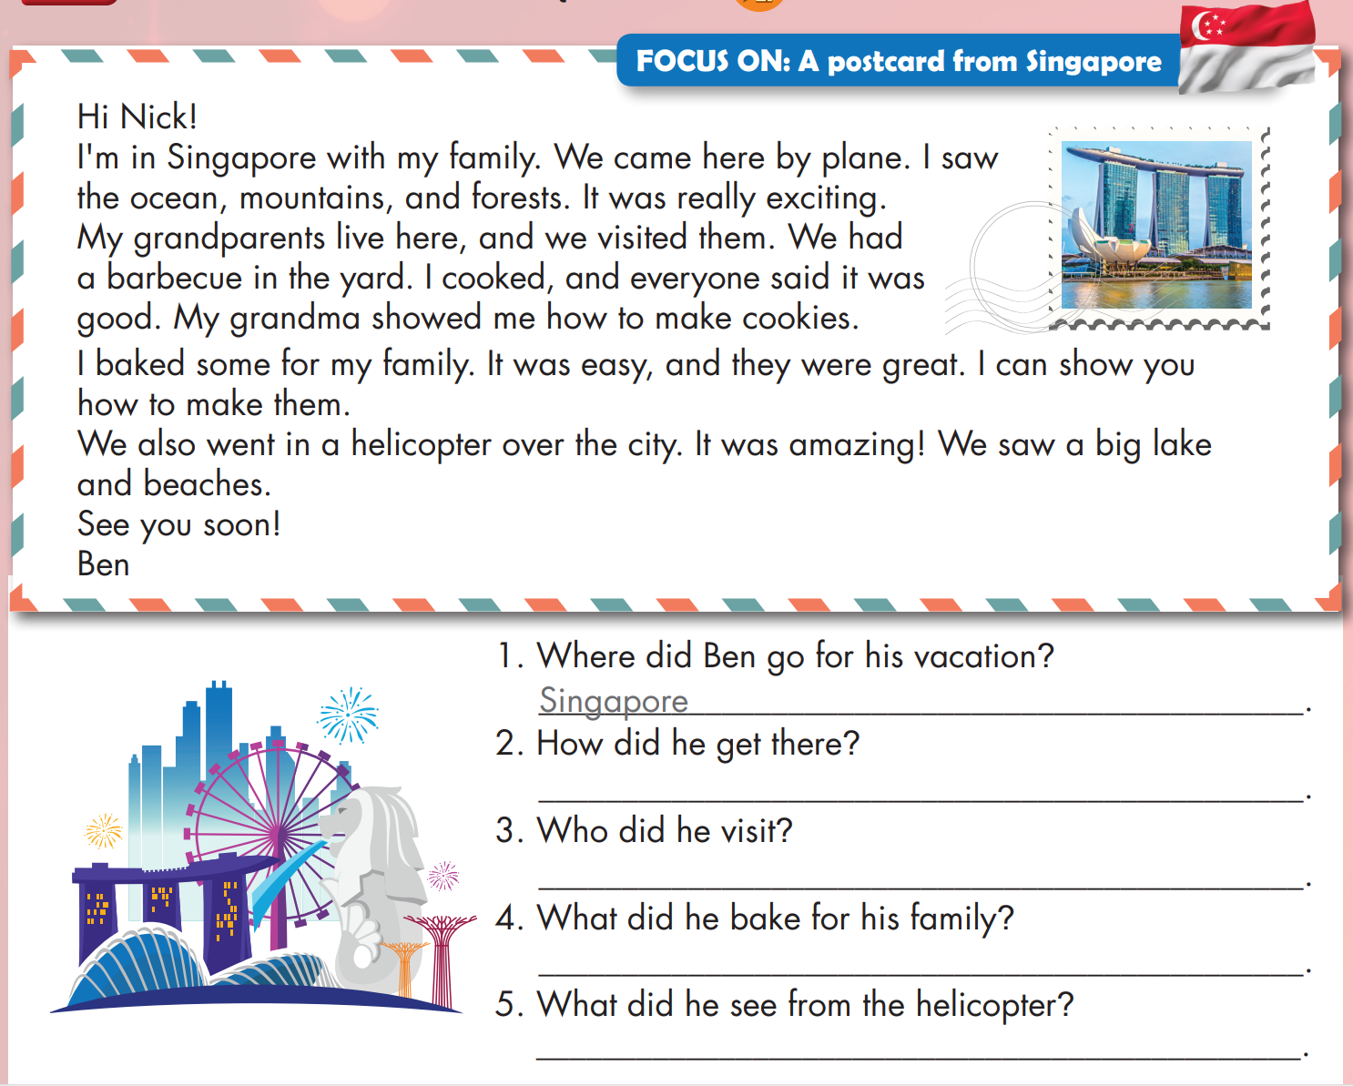

Slide 15
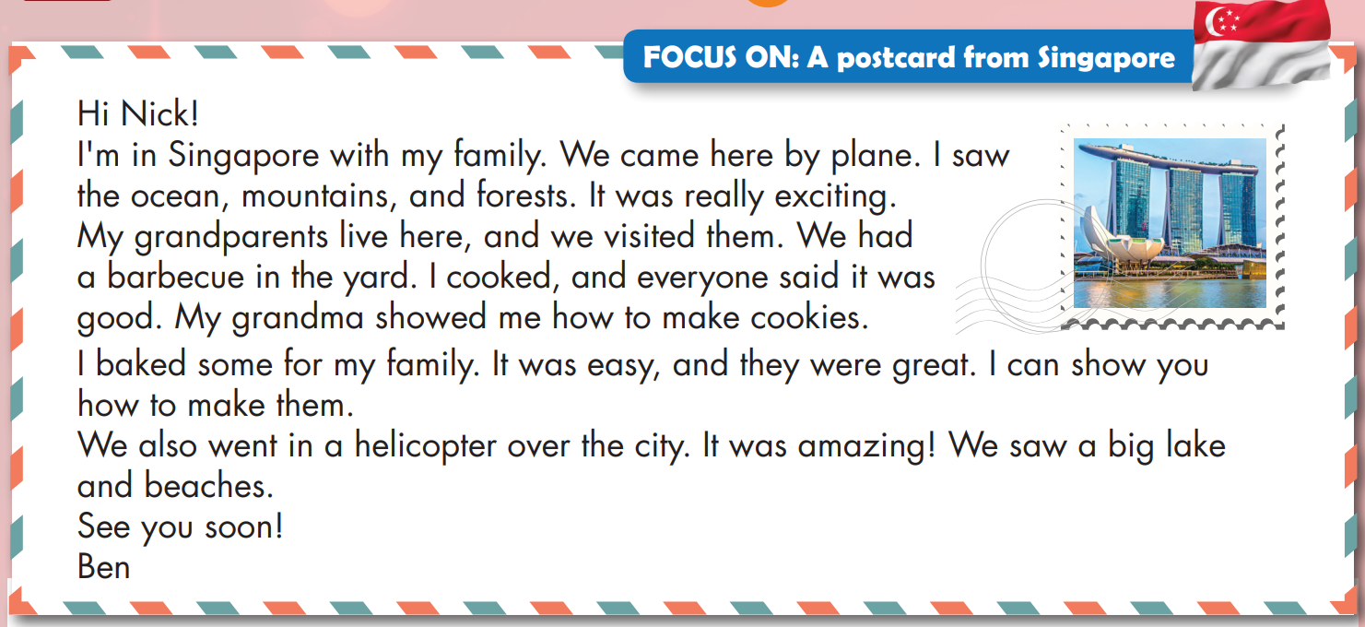

Slide 16
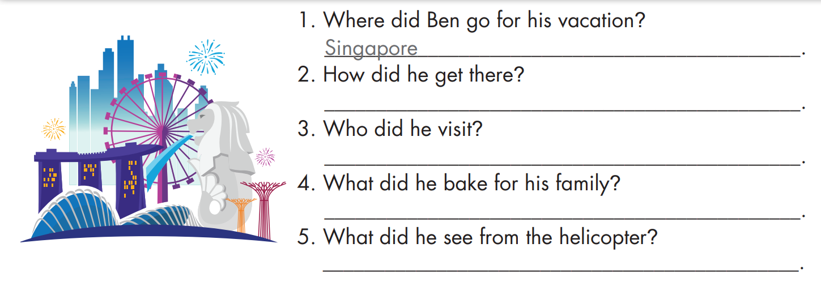
by plane
his grandparents
cookies
a big lake and beaches

Slide 17
Listening

Slide 18



Slide 19

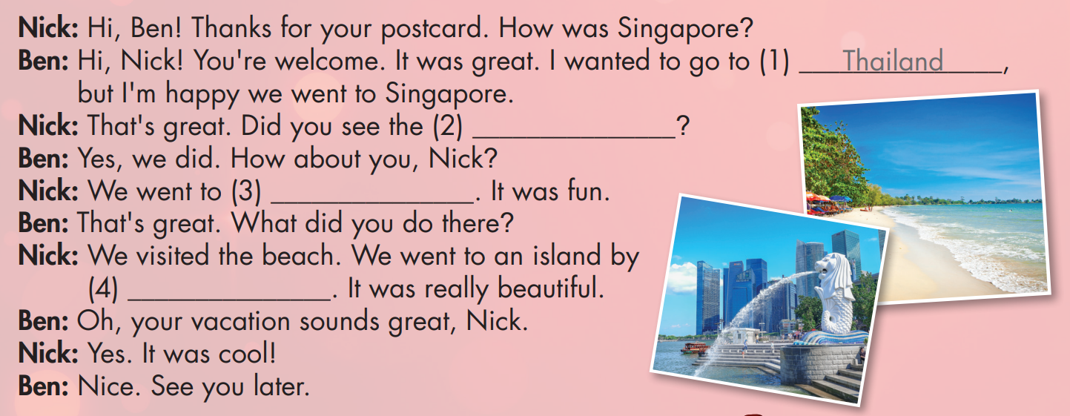

Slide 20

lake
Cambodia
speedboat

Slide 21
Practice

Slide 22

lake
Cambodia
speedboat

Slide 23

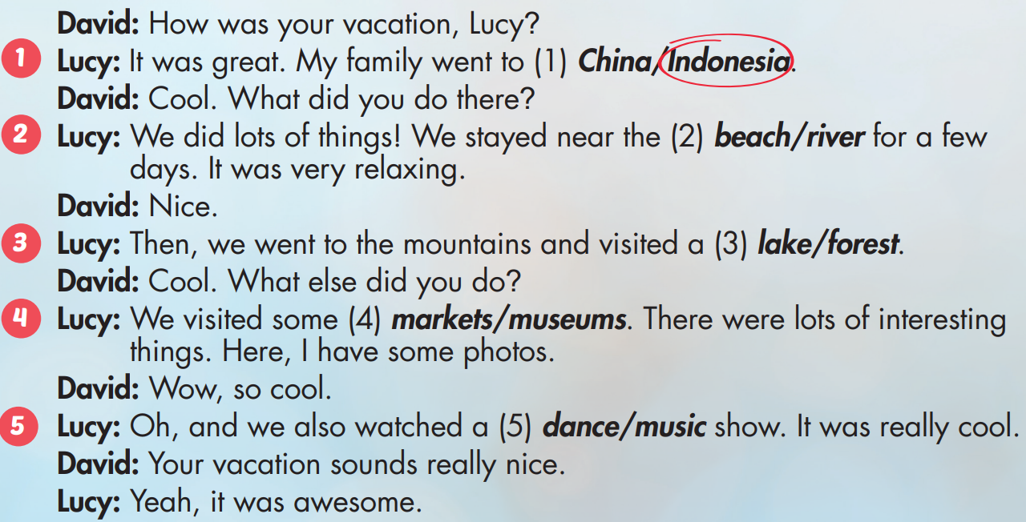

Extra Practice
WB, page 39

Slide 24

CONSOLIDATION

Slide 25

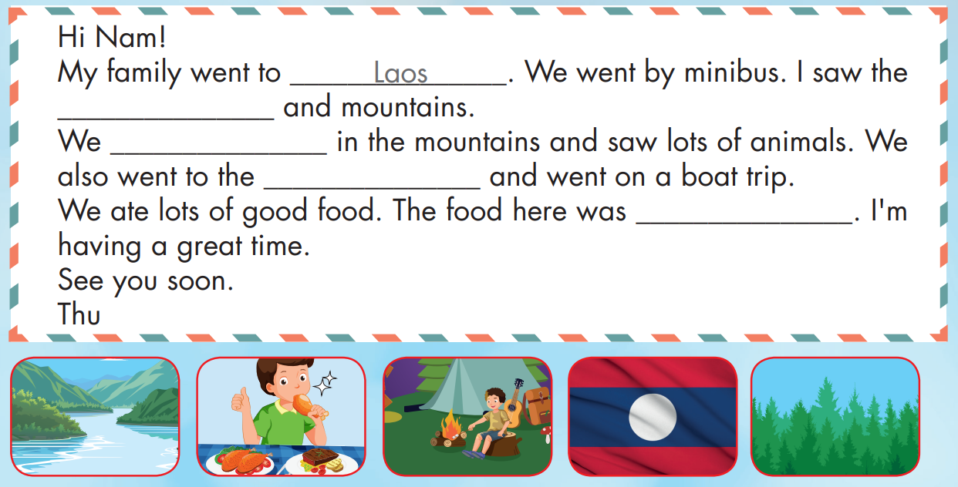
Extra Practice
WB, page 39
forest
went camping
river
delicious

Slide 26

WRAP-UP

Slide 27
Today’s lesson
Skill:
Read the text, listen to a conversation and practice saying the sentences.
Structures/ Sentence patterns
I went to Laos last month.
- What did you do there?
- I watched a soccer game.

Slide 28
Homework
Practice the vocabularies and structure, and make sentences using them.
Do the exercises in Tiếng Anh 5 i-Learn Smart Start WB (page 39)
Do the exercises in Tiếng Anh 5 i-Learn Smart Start Notebook (page 25)
Prepare the next lesson (page 59 SB)
Play the consolidation games in Tiếng Anh 5 i-Learn Smart Start DHA App on www.eduhome.com.vn

Slide 29

Enjoy your day!

Slide 30

Lesson 3
Stay positive and have a nice day!

