Slide 1
















Slide 2

01
Warm up
Game “Memory”

Slide 3
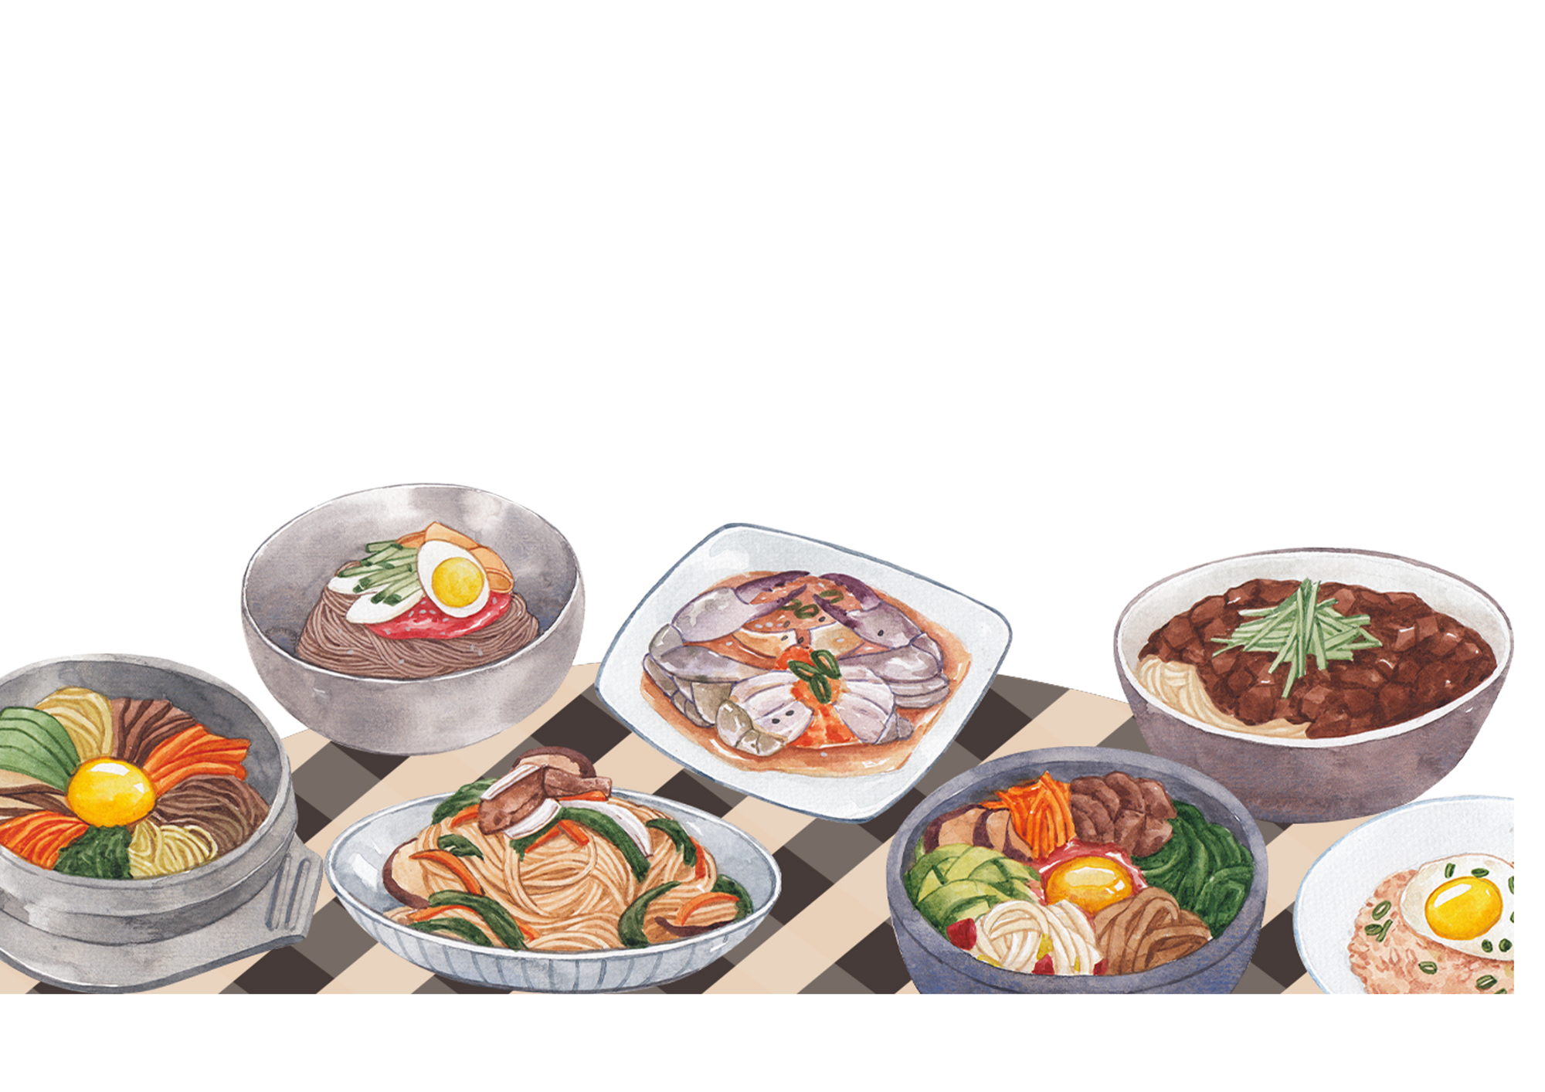
Unit 6: FOOD
Lesson 1 – Task 4, 5, 6

Slide 4

02
PRESENTATION

Slide 5
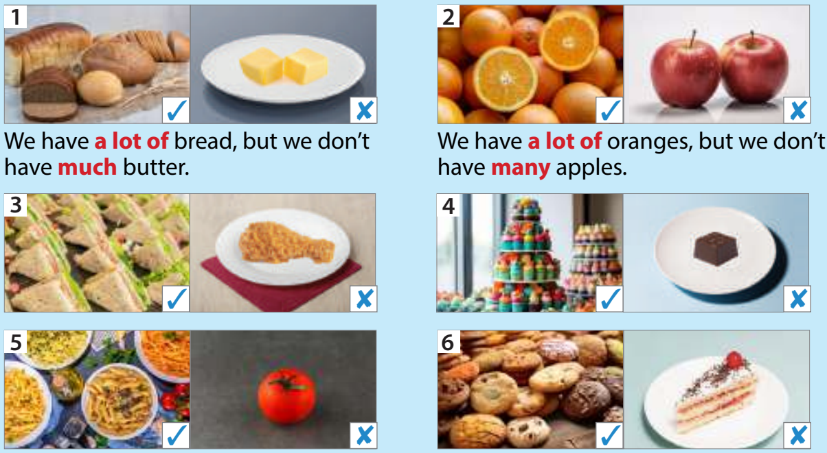
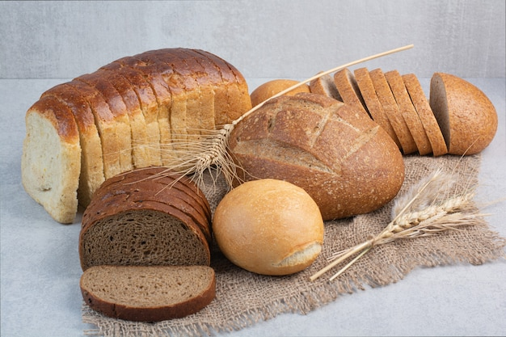
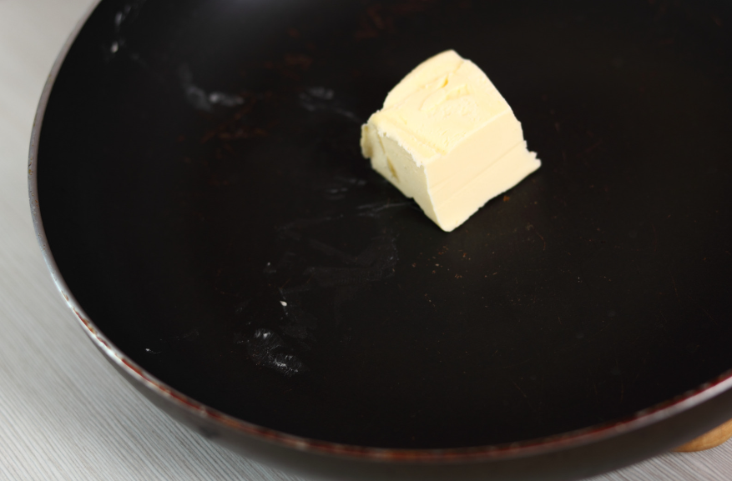
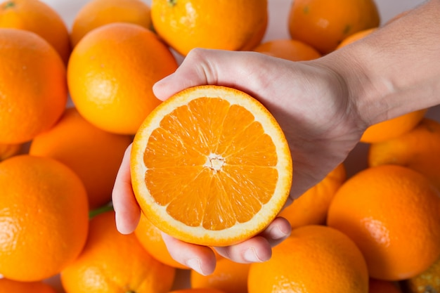
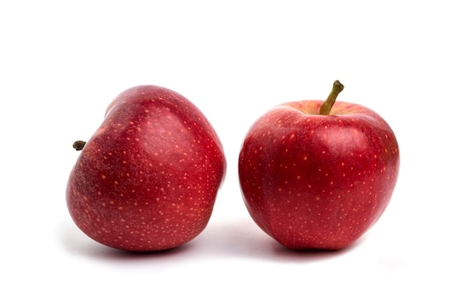


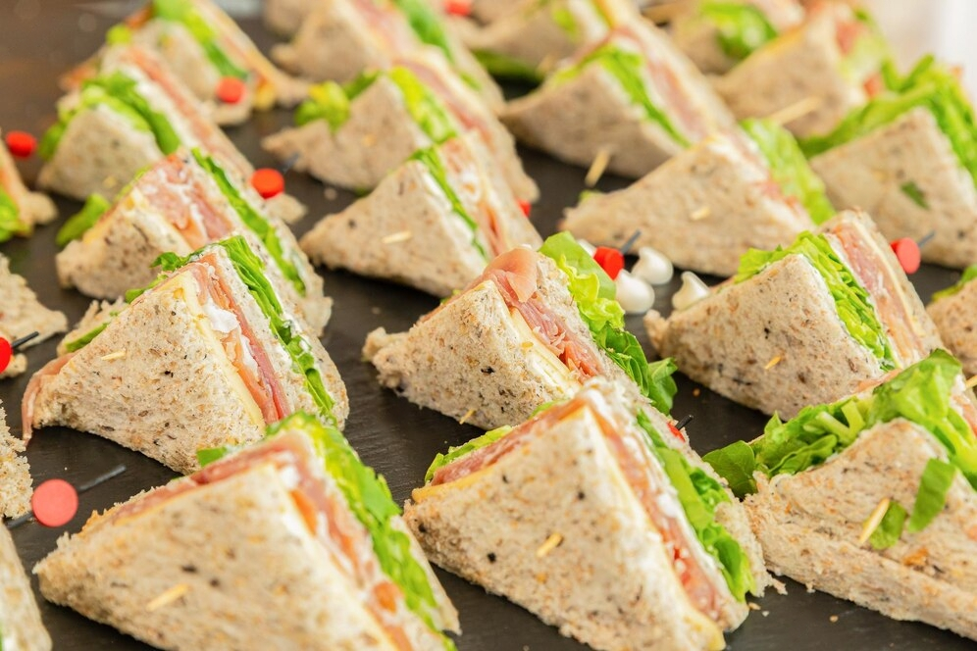
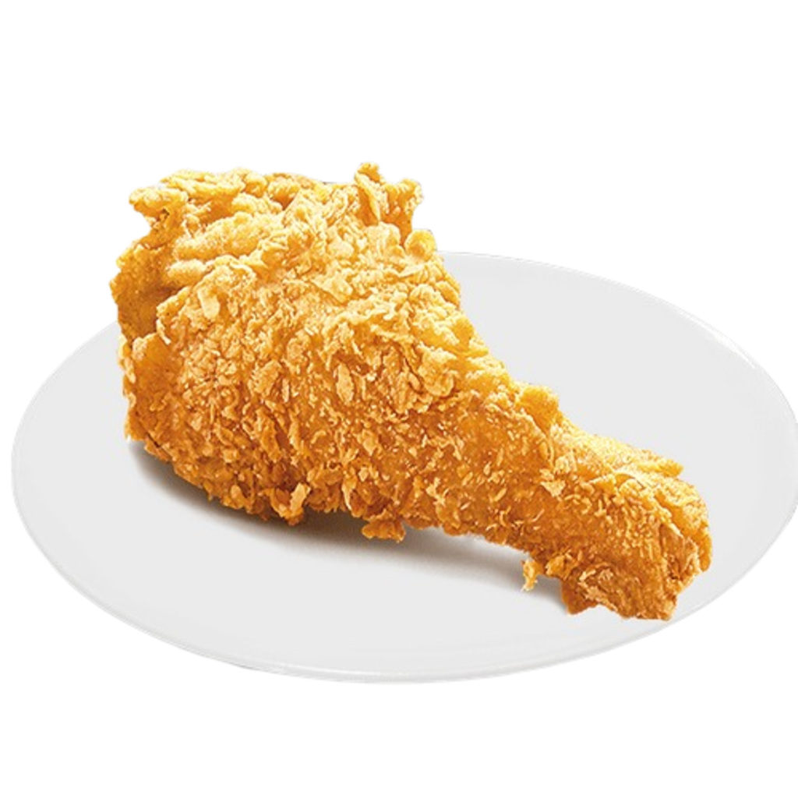
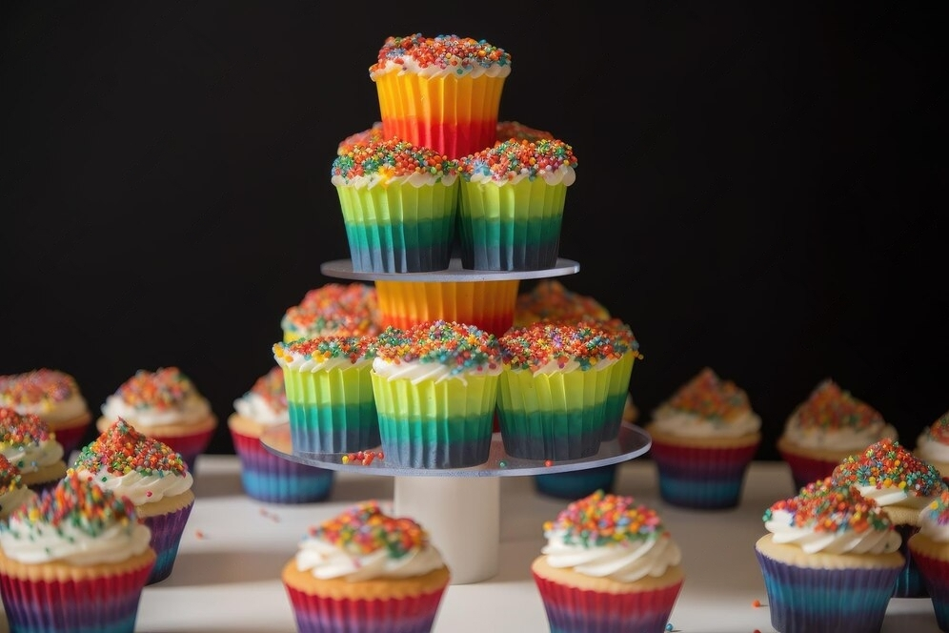
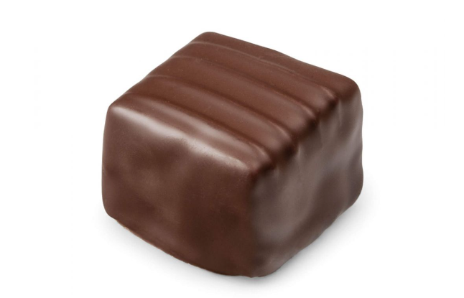

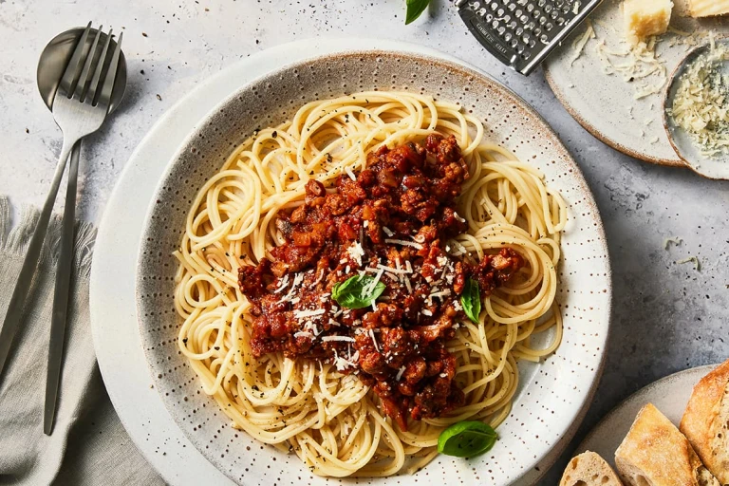
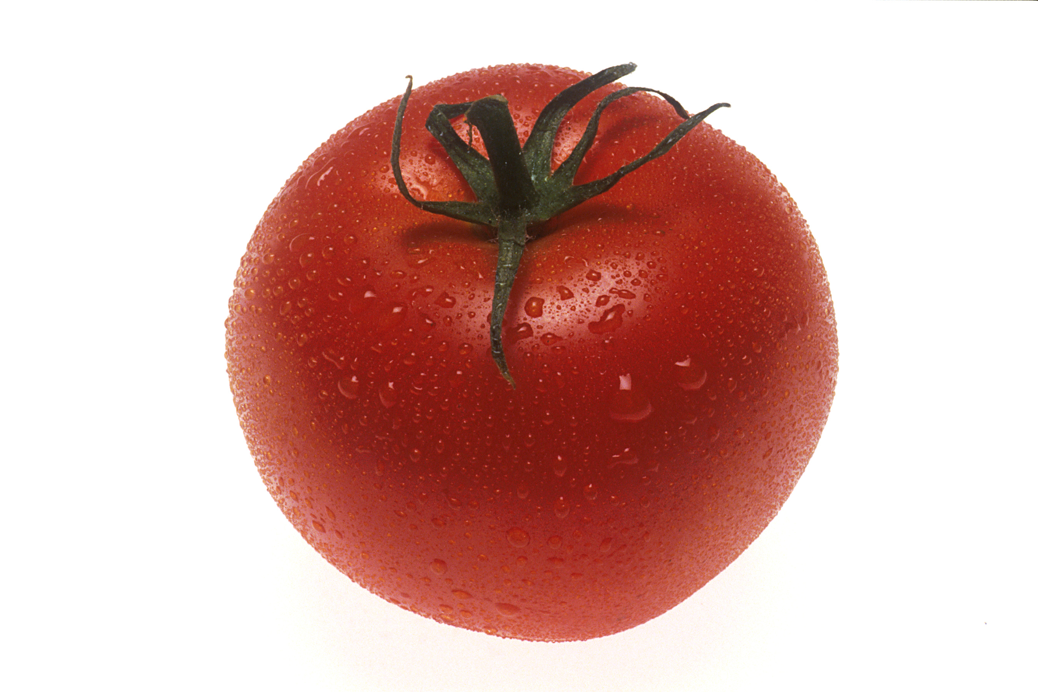
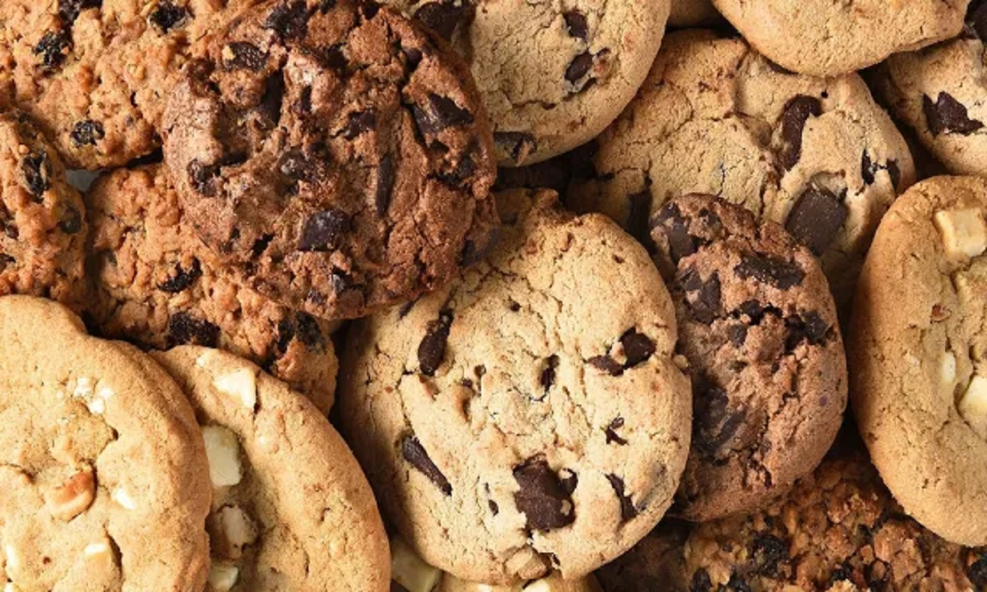
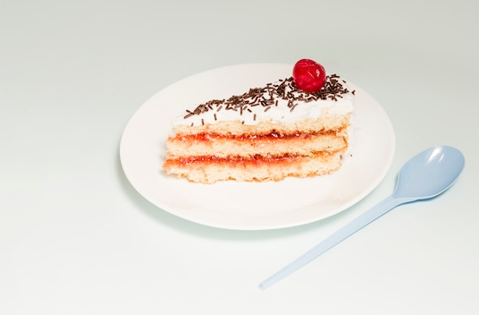
4 Listen and read. Then point and say.
1
2
✓

✓

3
4
✓

✓

5
6
✓

✓

Notes:
Answer:
a We have a lot of sandwiches but we don’t have much chicken.
b We have a lot of cupcakes but we don’t have much chocolate.
c We have a lot of spaghetti but we don’t have many tomatoes.
d We have a lot of cookies but we don’t have many cakes.

Slide 6

GRAMMAR: MANY, MUCH, A LOT OF
 | Uncountable nouns | Countable nouns
many
much
a lot of
Notes:
Answer:
a We have a lot of sandwiches but we don’t have much chicken.
b We have a lot of cupcakes but we don’t have much chocolate.
c We have a lot of spaghetti but we don’t have many tomatoes.
d We have a lot of cookies but we don’t have many cakes.

Slide 7
GRAMMAR: MANY, MUCH, A LOT OF
 | Affirmative (+) | Negative (-) | Question (?)
many
much | ít dùng
a lot of
Notes:
Answer:
a We have a lot of sandwiches but we don’t have much chicken.
b We have a lot of cupcakes but we don’t have much chocolate.
c We have a lot of spaghetti but we don’t have many tomatoes.
d We have a lot of cookies but we don’t have many cakes.

Slide 8
4 Listen and read. Then point and say.
1
2
✓

✓

3
4
✓

✓

5
6
✓

✓

Notes:
Answer:
a We have a lot of sandwiches but we don’t have much chicken.
b We have a lot of cupcakes but we don’t have much chocolate.
c We have a lot of spaghetti but we don’t have many tomatoes.
d We have a lot of cookies but we don’t have many cakes.

Slide 9
04
PRODUCTION
6 Let’s play

Slide 10
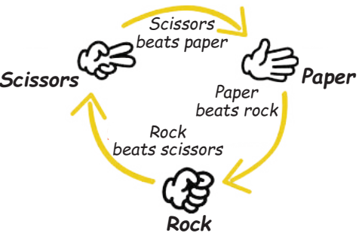



GAME RULES
Make a sentence with much / many
Make a sentence with a lot of
Make a question with How much / How many
Notes:
- Click số để quay về trang đầu.

Slide 11
05
WRAP-UP & ASSESSMENT

