Slide 1


















Unit 4
My house
Lesson 3 – Task 1,2,3
Notes:
Để nguyên trang bìa như này, chỉ thay đổi tên bài trong quá trình làm. Logo của sách Wonderful World

Slide 2



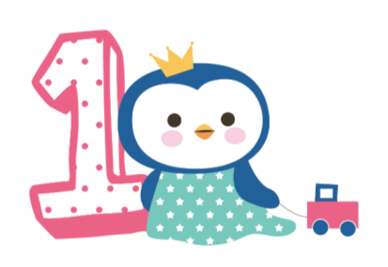



Warm up
Sing a song + Guessing game

Slide 3

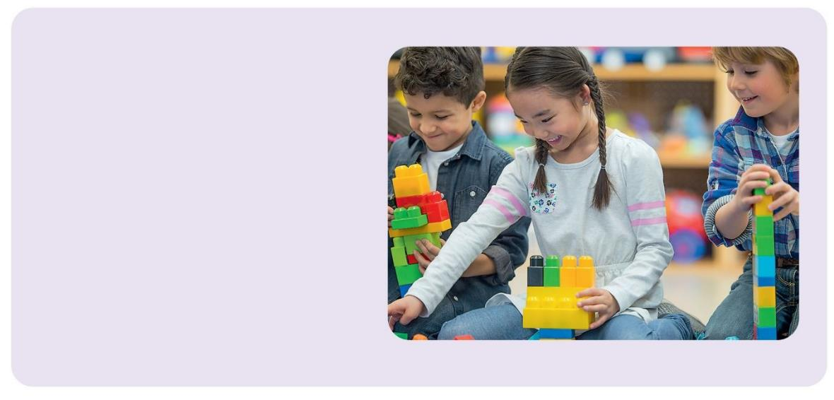
There are toys for you.
There are toys for you.
Are there toys for me?
There’s a book for you.
There’s a book for you.
Is there a book for me?
Yes, there are toys!
Yes, there’s a book!
Hooray! Hooray!
Let’s go home and play!

Slide 4
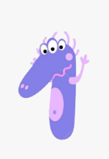



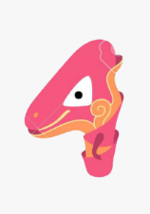
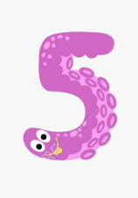
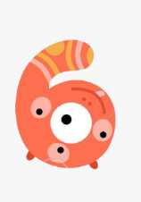
GUESSING GAME
Click on the number to go to the corresponding page and continue the lesson
Next

Slide 5


What is it?
bedroom

Slide 6
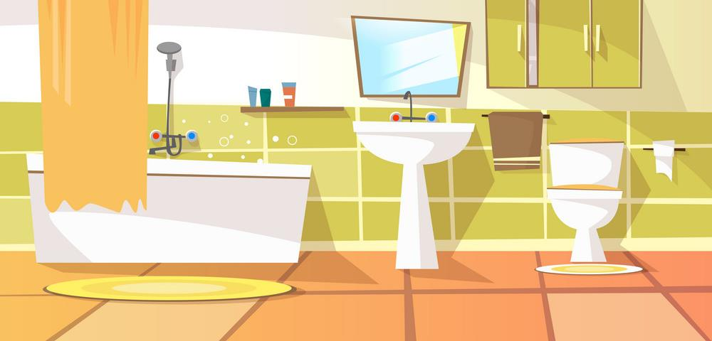
What is it?
bathroom

Slide 7

What is it?
TV

Slide 8
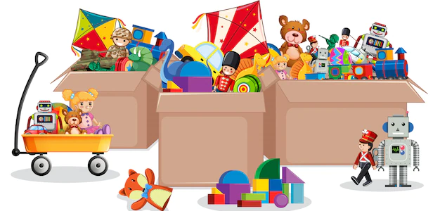
What is it?
toys

Slide 9

What is it?
computer

Slide 10

What is it?
lamp

Slide 11


Presentation
Task 1: Listen and point. Repeat

Slide 12


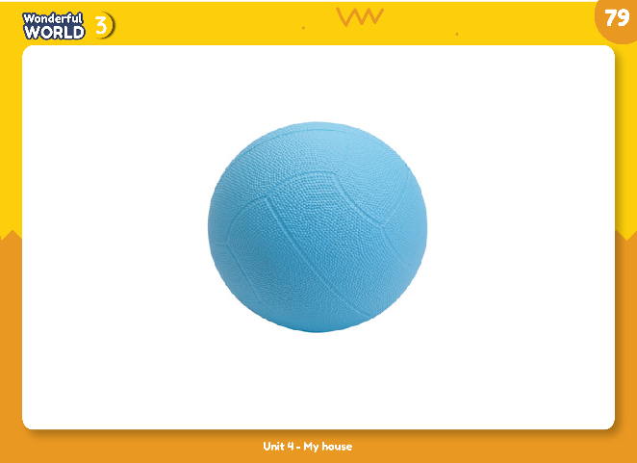
1
Listen and point. Repeat.
ball

Slide 13
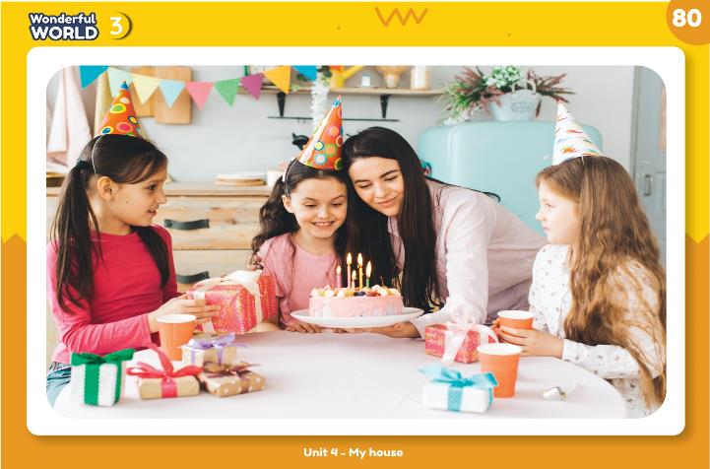
birthday

Slide 14
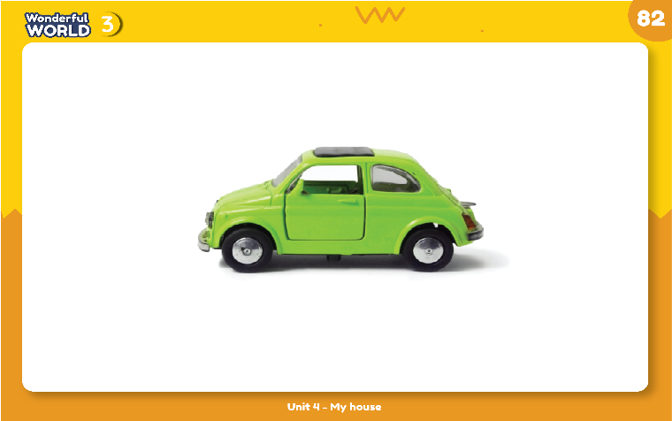
car

Slide 15
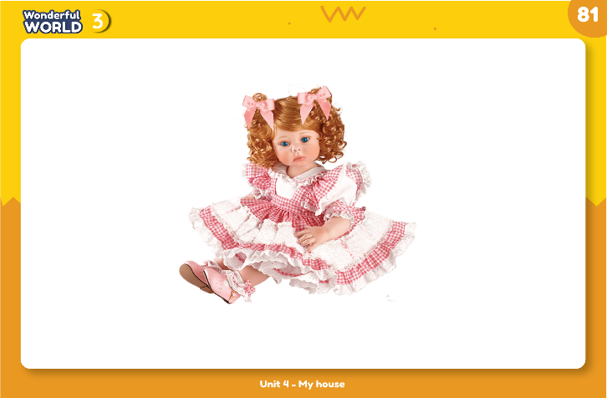
doll

Slide 16
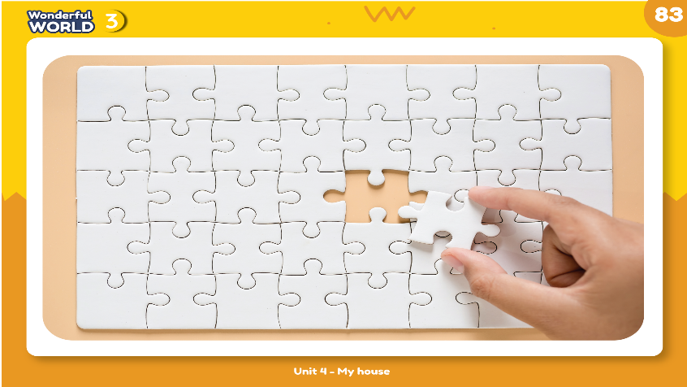
game

Slide 17
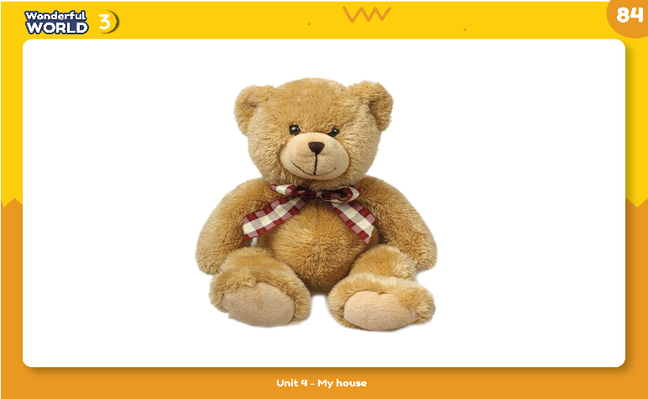
teddy bear

Slide 18
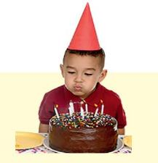
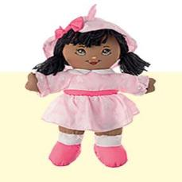
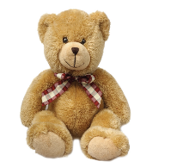
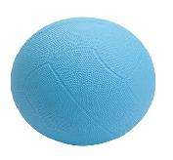
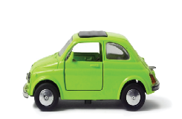
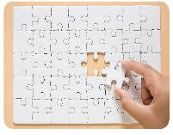
ball
birthday
car
doll
game
teddy bear

Slide 19






Find me
1
2
3
4
5
6
Notes:
Bấm vào audio nghe từ
Bấm vào số hiển thị ra hình ảnh & đáp án

Slide 20
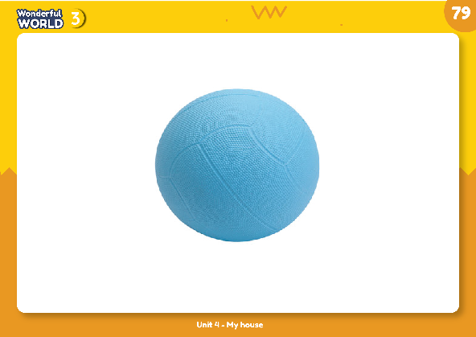
ball

Slide 21

car

Slide 22

doll

Slide 23
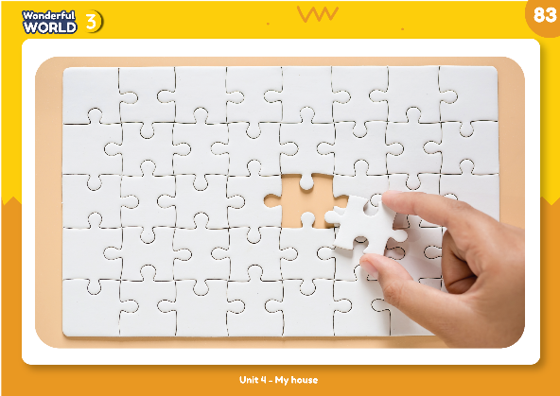
game

Slide 24

teddy bear

Slide 25
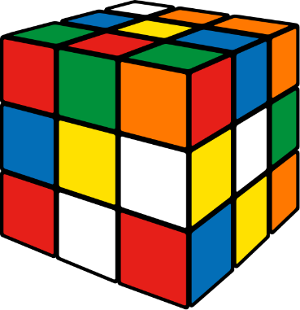
toy

Slide 26


Practice
Task 2: Listen and tick

Slide 27

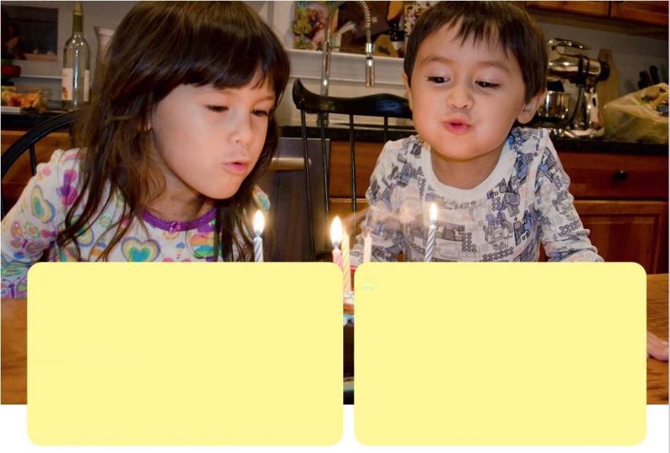
Lisa: Happy birthday Mary!
Mary: Yes, there are. They are in the kitchen.
Mary: Thank you, Lisa.
Lisa: Is that your brother?
Lisa: Are there toys?
Mary: Yes, there are. There’s a nice doll and there’s a cool game, too.
Mary: Yes, it is. His name is Tom.
He’s five years old today, too.
Lisa: Are there friends in the house?
Lisa: It’s a great birthday!

Slide 28

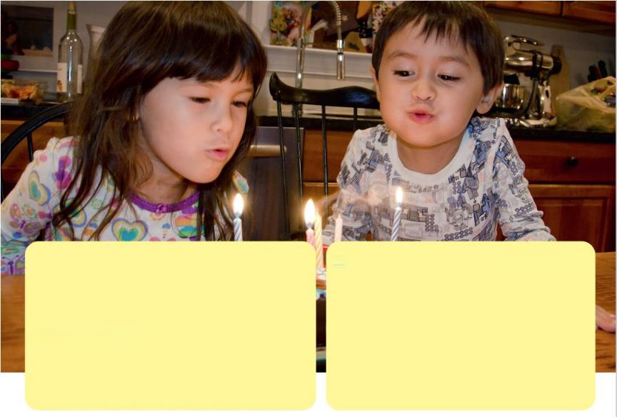
2
Listen and tick
Are there toys?
✓
No
Yes
✓
Is there a doll?
Yes
No
Is it a great party?
✓
Yes
No

Slide 29
Task 3:
Ask and answer about 2

Slide 30

3
Ask and answer about 2.
Lisa: Happy birthday Mary!
Mary: Yes, there are. They are in the kitchen.
Mary: Thank you, Lisa.
Lisa: Is that your brother?
Lisa: Are there toys?
Mary: Yes, it is. His name is Tom.
He’s five years old today, too.
Mary: Yes, there are. There’s a nice doll and there’s a cool game, too.
Lisa: Are there friends in the house?
Lisa: It’s a great birthday!

Slide 31



3
Ask and answer about 2.
Is there a ball?
1. ball
No, there isn’t.

Slide 32
3
Ask and answer about 2.
2. doll
Is there a doll?
Yes, there is.

Slide 33
3
Ask and answer about 2.
3. game
Is there a game?
Yes, there is.

Slide 34

3
Ask and answer about 2.
It there a teddy bear?
4.teddy bear
No, there isn’t.

Slide 35
3
Ask and answer about 2.
5. car
Is there a car?
No, there isn’t.

Slide 36

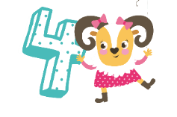
Production
Guessing game

Slide 37

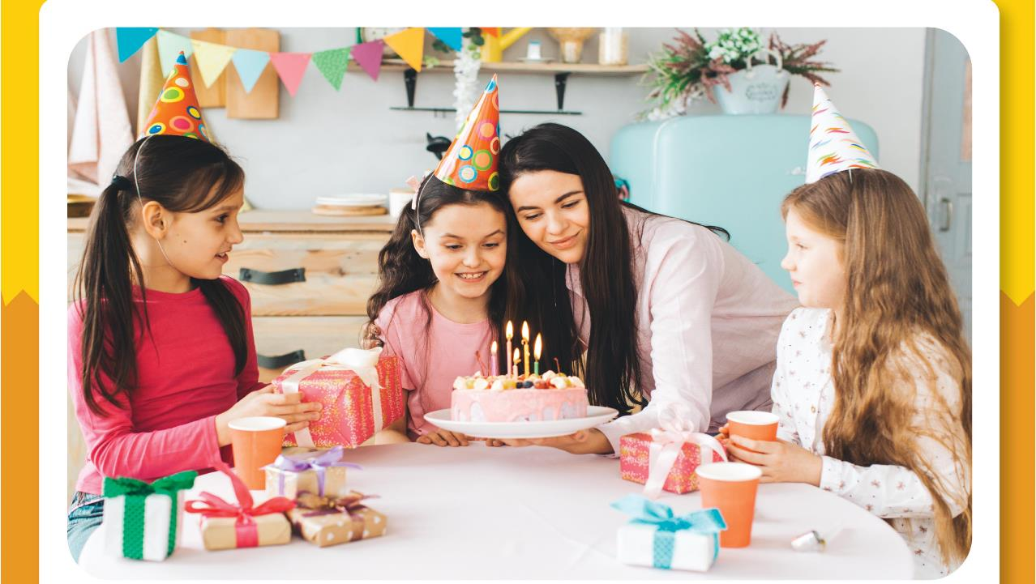
Notes:
Game: Guessing game
- Divide class in to 2 teams
- Put some toys in a bag.
- Have a ss from team A choose an object and ask
Is there a …?
- Ss from team B must feel the object (without looking) and respond either:
Yes, there is. / No, there isn’t
each team score one point for a correct question or answer.
- Continue until all ss have had a chance to participate.

Slide 38

Assessment

Slide 39


Notes:
HOẠT ĐỘNG TƯƠNG TÁC TỪ SLIDE 41 ĐẾN 47

Slide 40


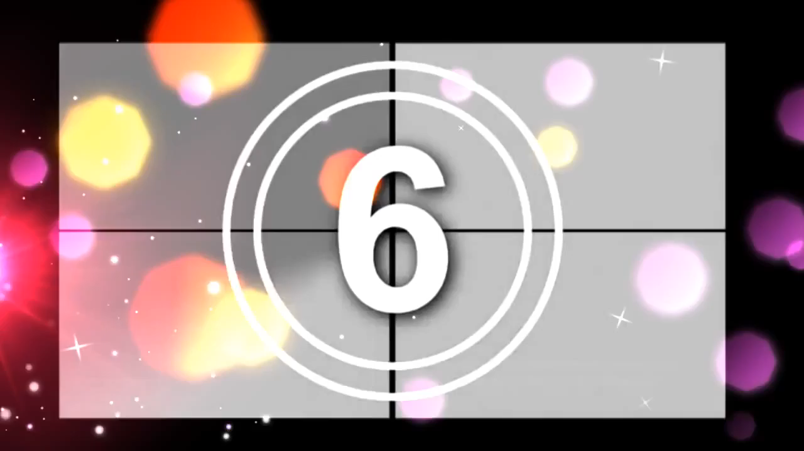
Choose the correct answer.
1. There is a………………..
a
ball
b
a car
c
toys

Slide 41
Choose the correct answer.
2. There isn’t a………. in my bedroom.
a
birthday
b
games
c
doll

Slide 42

Write
3. I have got a t_ddy b_ _r. They are on the desk.
e
e
a

Slide 43






Look and write.
Ex:
1.
B
A
L
L
2.
I
C
A
R
T
5.
H
3.
D
0
L
L
G
A
M
E
4.
T
E
D
D
Y
B
E
A
R

