Slide 1



















Notes:
Để nguyên trang bìa như này, chỉ thay đổi tên bài trong quá trình làm. Logo của sách Wonderful World

Slide 2







Unit 5: Leisure time
Lesson 3: Task 4 5 6

Slide 3

1
Warm up
Matching
Notes:
Warm-up: Play a small game “ Matching”
T divides the class into 2 teams.
T introduces the rule of game:
(Game: Matching
- T calls SS to choose 2 numbers to match the word and picture together.Who gets correct answers gets a point. Which team has more points will be a winner.)
T asks Ss to repeat after checking.

Slide 4

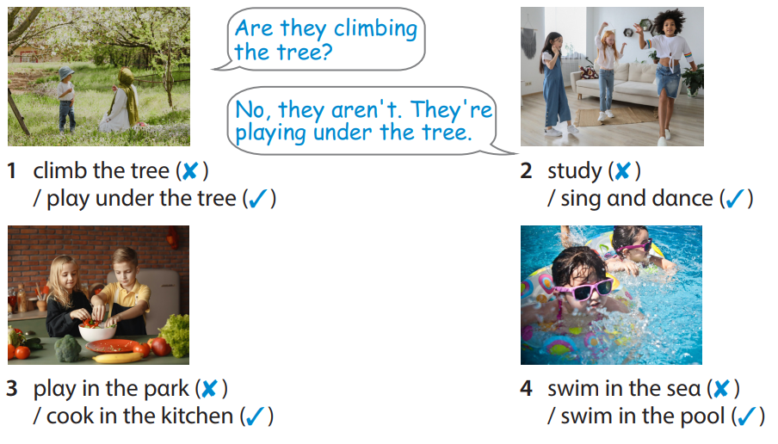
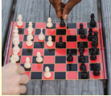



1
2
3
play video games
4
5
6
swim in the pool
7
8
9
read a comic book
play under the tree
10
11
12
play board games
watch a film
Notes:
Click the numbers to show, click the red circle signs to hide the pictures and sentences.
(GV gọi học sinh chọn 2 số để ghép tranh với cụm từ. Khi học sinh trả lời không chính xác giáo viên bấm vào hình tròn màu đỏ để đóng các ô lại.)

Slide 5
2
Presentation

Slide 6



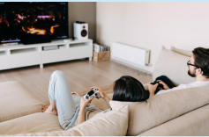
Structure
are
they
Where
playing video games?
is
she
In the living room.
Notes:
Task 4: Listen and repeat. Track 5.11.
- T asks SS to look at board and guide SS to use different subject pronouns: “they”- plural subjects uses “are” and “she”- singular subjects uses “is” .
- T shows a picture “playing video games” and asks Ss to identify name of this picture.
- T makes the full structure and asks SS to repeat. Then T guides SS to answer this structure.
- T calls SS to repeat in the chorus.

Slide 7


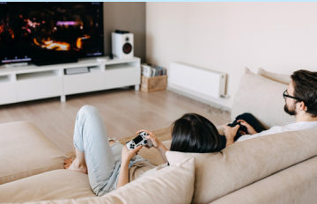
4 Listen and repeat. TR: 5.11.
Where αre they plαying video gαmes?
- In the living room.
Notes:
- T plays audio and asks SS to repeat in the chorus.
- T calls some pairs to present in front of the class.

Slide 8
3
Practice

Slide 9
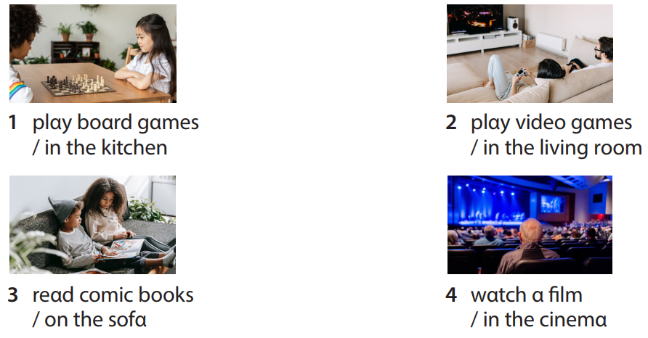
5 Look and say.
Notes:
Task 5: Look and say.
- Ask SS to look at the picture and identify what activity they can see in each picture and place where they are.
-Ask SS to look at the example and work in pairs to make the sentences in 3 min.
- T asks SS to play a game: “Tic-tac-toe”.
- T introduces the rule of the game:
(T divides the class into 2 teams. 2 Ss choose a number and make a sentence as the example. If they answer correctly, they can tick X or O for the number which they chose. Which team has 3 X or 3 O in a line will be a winner. A number can exist more than once.)
- Give their feedback.

Slide 10
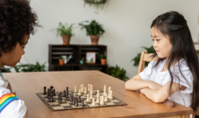
Example
Where αre they plαying board gαmes?
- In the kitchen.
plαy boαrd gαmes / in the kitchen

Slide 11



TIC – TAC - TOE
1
2
3
O
X
O
X
X
O
4
5
6
X
X
X
O
O
O
Team X
Team O
X1
X2
X3
O1
O2
O3
7
8
9
X
O
O
X
X4
X5
X6
O
X
O5
O6
O4
X7
X8
X9
O7
O8
O9

Slide 12


3. reαd comic books / on the sofα
Where are they reading comic books?
On the sofa.

Slide 13

4. wαtch α film/ in the cinemα
Where are they watching a film?
In the cinema.

Slide 14
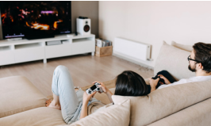
2. plαy video gαmes / in the living room
Where are they playing video games?
In the living room.

Slide 15
1. plαy boαrd gαmes / in the kitchen
Where are they playing board games?
In the kitchen.

Slide 16
4
Production

Slide 17
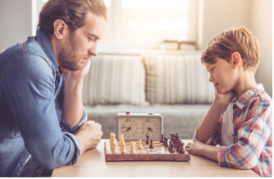


6. Let’s talk.
What are they doing?
They’re playing board games.
Where are they playing board games?
In the living room.
Notes:
Let’s talk
- Ask each SS to draw a small picture which describes an action and a place where someone is in 3 min.
- Ask SS to work in groups of 4 and make the questions as the example on the slide in 2 min.
- Call some groups to present in front of the class.
- Check and give feedback.

Slide 18
5
Assessment

Slide 19
Read and write.
Where
reading comic books
are
is
kitchen
What ____________ Mr. Dan doing? – He’s cooking.
What ___________ your parents doing?
– They’re watching a film.
3. __________ are they swimming? – In the pool.
4. Where are you? – In the _____________.
5. Where is Mary ____________________ ?
– In her bedroom.

Slide 20
UNIT 5: LEISURE TIME
LESSON 3 – PERIOD 2
What we learnt today
Review vocabulary
play board games
play video games
read a comic book
watch a film
- Where are they playing video games?
- In the living room.
Structures

