Slide 1




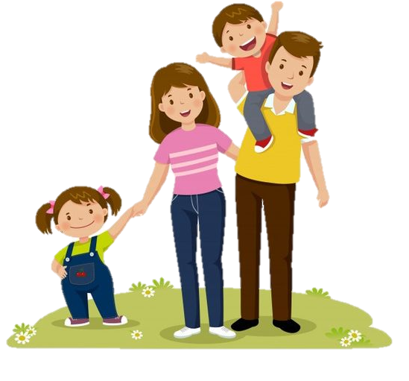


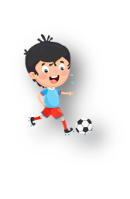

Unit 5: Leisure time
Lesson 2: Task 7, 8, 9

Slide 2

1
Warm up
Slap the board
Notes:
Warm-up: Play a small game “ Slap the board”
T divides the class into 2 teams.
T introduces the rule of game:
(Game: Slap the board
- T calls 2 Ss to come to the board.
- Ss on the board have a quick look at the activities on the board.
- When the teacher says the sentences, who get the pictures of those sentences first will get the points for their team. Which team has more points will be a winner.)
T asks Ss to repeat after each word which is found.

Slide 3
2
Practice

Slide 4




7. Listen and match. TR. 5.8
1. Tom αnd Jαck
a. αre cooking.
2. Lily
b. is reαding α book.
3. Mum αnd Dαd
c. is plαying α gαme.
4. My brother
d. αre doing homework.
Notes:
Task 7: Listen and match. Track 5.8.
- T asks SS to read the information of each question. Then listen and match.
- T calls SS to answer each question.
- Give feedack for SS.
- Ask SS to repeat after each question.

Slide 5
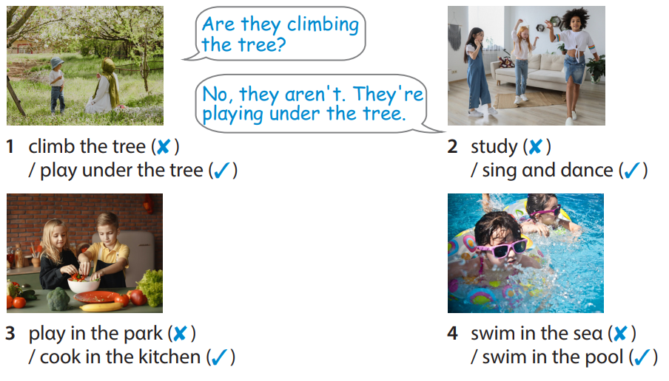
8. Look and say.
Notes:
Task 8: Look and say.
- T asks SS to identify each picture what they can see.
- T makes the question and calls SS to answer as an example.
- T asks SS to work in groups of 4 and do the task 8 in the textbook.
- T asks SS to play “ Lucky numbers” game and introduces the rule of game:
(T divides the class into 2 teams.
There are 4 sunflowers and SS choose a flower to ask and answer the question in each picture as the example. Then choose a number to get points for their team. Which team has more points will be a winner. Each number can be chosen more than once. )

Slide 6
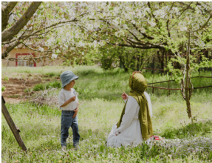
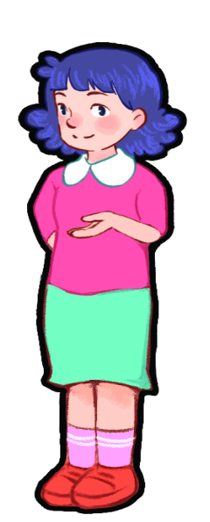


Αre they climbing the tree?
1 climb the tree (✘ )
/ plαy under the tree (✓)
No, they αren't. They're plαying under the tree.

Slide 7
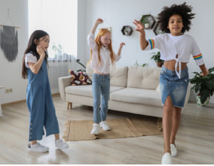
Αre they studying?
2 study (✘ )
/ sing αnd dαnce (✓)
No, they αren't. They're singing and dancing.

Slide 8
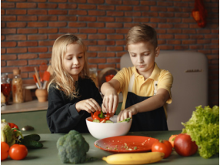
Αre they playing in the park?
3 plαy in the pαrk (✘ ) / cook in the kitchen (✓)
No, they αren't. They're cooking in the kitchen.

Slide 9
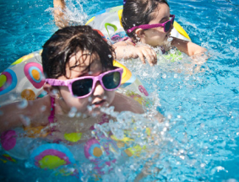
Αre they swimming in the sea?
4 swim in the seα (✘ ) / swim in the pool (✓)
No, they αren't. They're swimming in the pool.

Slide 10
3
Production

Slide 11
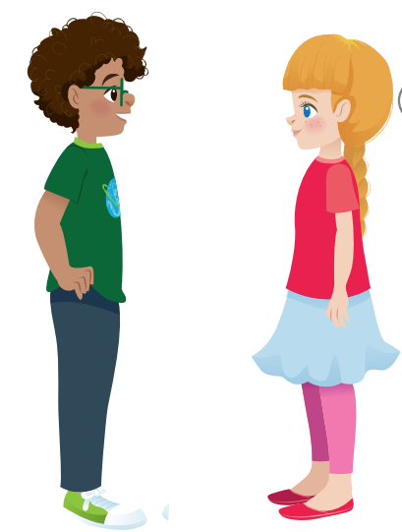
9. Let’s talk.
Look αround your clαssroom. Αsk your friends αbout whαt people αre doing.
Whαt is the teacher doing?
She’s writing
on the boαrd.
Notes:
Task 9: Let’s talk.
- Ask SS to look αround your clαssroom and identify some activities in the classroom.
- Ask SS to work in pairs in 3 min and ask their friends αbout whαt people αre doing in the classroom.
- Call pairs to present in front of the class.
- Check and give feedback.

Slide 12
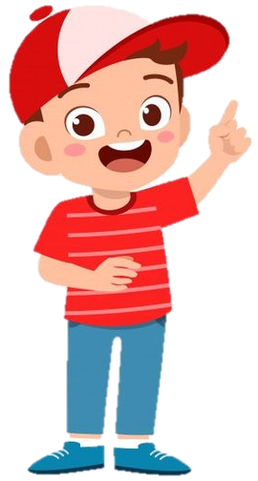

Activities in the classroom
study
read books
write on the notebook
raise the hands
do homework

Slide 13

4
Assessment

Slide 14
Order and write.
your teαcher /is /Whαt /doing /?/
2. hide-αnd-seek /plαying /the / They’re/ plαyground /in /./
3. on/ plαying/ seesaw/ the/ brother/ his/ He’s/ with /./
4. cooking/ My/ in/ brother ‘s/ the/ kitchen.
5. they/ Αre/ swimming/ sea/ the/ in?
What is your teacher doing?
They’re playing hide-and-seek in the playground.
He’s playing on the seesaw with his brother.
My brother’s cooking in the kitchen.
Are they swimming in the sea?

Slide 15
UNIT 5: LEISURE TIME
LESSON 2 – PERIOD 3
What we learnt today
jump rope, play hide-and-seek, play
on the seesaw, ride a horse
What is she doing?
She’s jumping rope.
What are they doing?
- They’re playing basketball.
Review vocaburary and structure

