Slide 1





















Unit 0
Greetings
Notes:
Để nguyên trang bìa như này, chỉ thay đổi tên bài trong quá trình làm. Logo của sách Wonderful World

Slide 2






Warm up!

Slide 3




Movement Game: Hip hip hooray
Hands up!
Hands down!
Hip hip hooray
Go to Wonderful World!
Notes:
+ Hands up: raise 2 hands up
+ Hands down: Put to hands down
+ Hip hip hooray (2 times): smack 2 hands on hips then put hands to mouth when saying hooray (2 times)
+ Go to Wonderful World: join 2 hands and make waves then raise both hands up and wave.
Hướng dẫn:
+ Hands up: giơ 2 tay lên
+ Hands down: hạ 2 tay xuống
+ Hip hip hooray (2 lần): vỗ 2 tay vào hông rồi đưa tay lên miệng khi nói hooray (2 lần)
+ Go to Wonderful World: chắp 2 tay tạo sóng rồi giơ cả 2 tay lên vẫy.

Slide 4
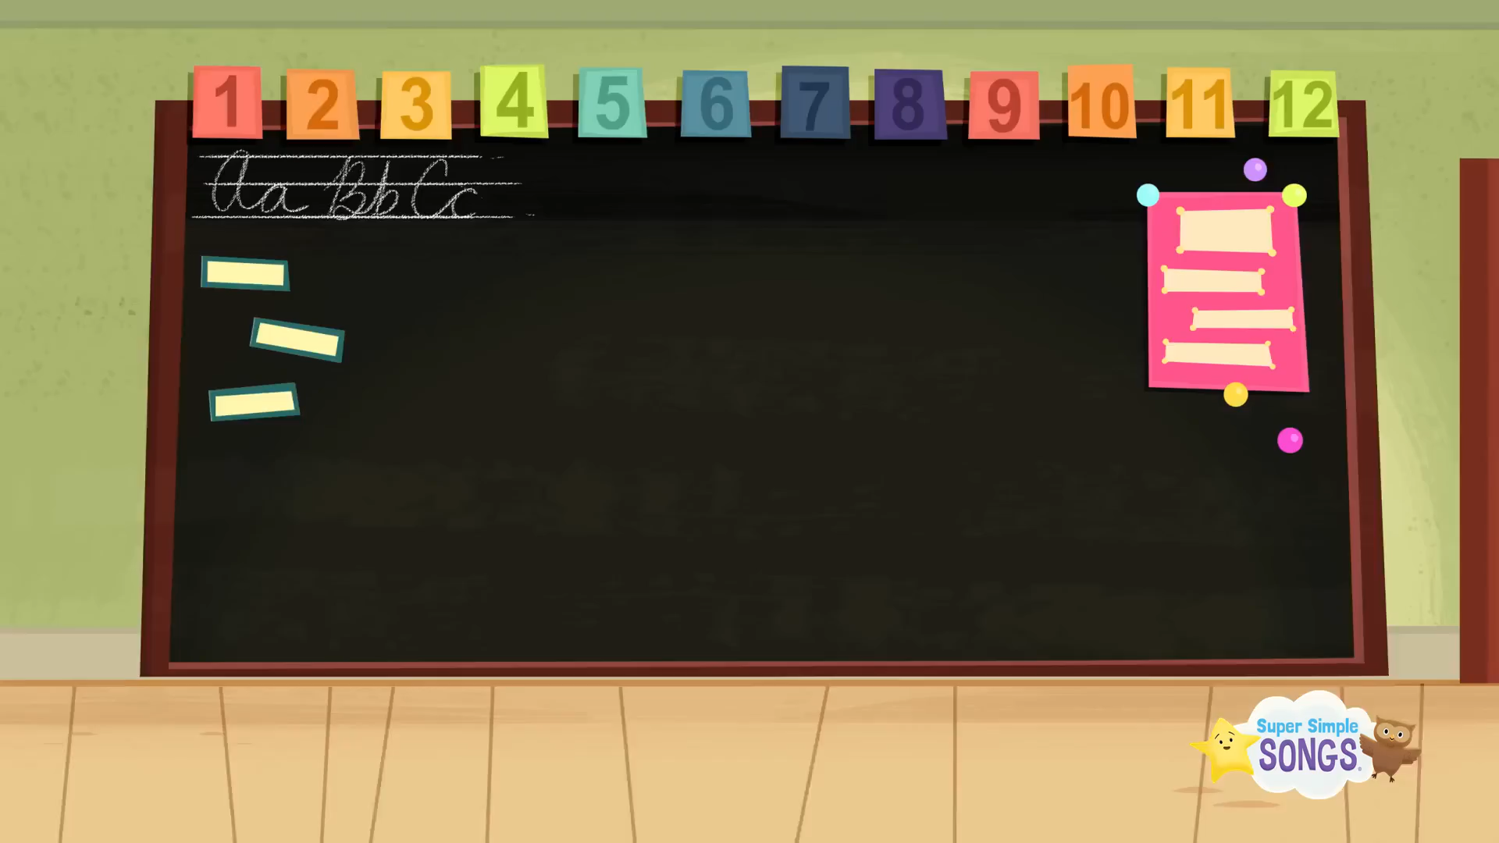
Notes:
+ Hands up: raise 2 hands up
+ Hands down: Put to hands down
+ Hip hip hooray (2 times): smack 2 hands on hips then put hands to mouth when saying hooray (2 times)
+ Go to Wonderful World: join 2 hands and make waves then raise both hands up and wave.
Hướng dẫn:
+ Hands up: giơ 2 tay lên
+ Hands down: hạ 2 tay xuống
+ Hip hip hooray (2 lần): vỗ 2 tay vào hông rồi đưa tay lên miệng khi nói hooray (2 lần)
+ Go to Wonderful World: chắp 2 tay tạo sóng rồi giơ cả 2 tay lên vẫy.

Slide 5
Review:
Let’s chant!
Notes:
Review: Let’s chant!
- Say the chant and do the action.
Hi, I’m Ana. (wave hand, put hand in front of chess)
Hello, I’m Tom. (wave hand, put hand in front of chess)
Nice to meet you. (Shake hands)
Nice to meet you, too. (Shake hands back)

Slide 6
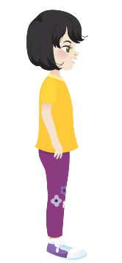

Hi, I’m Ana.
Hello, I’m Tomas.
Nice to meet you.
Nice to meet you, too.
Notes:
Review: Let’s chant!
- Say the chant and do the action.
Hi, I’m Ana. (wave hand, put hand in front of chess)
Hello, I’m Tom. (wave hand, put hand in front of chess)
Nice to meet you. (Shake hands)
Nice to meet you, too. (Shake hands back)
Say the chant individually.
A pair come to the board and do the action.
Lead in:
Ask 2 sts come to the board and say the chant. Then lead to the lesson with sentences:
Hi, ______ How are you?
I’m ______, thank you.

Slide 7

Presentation
Task 4 and task 5.

Slide 8
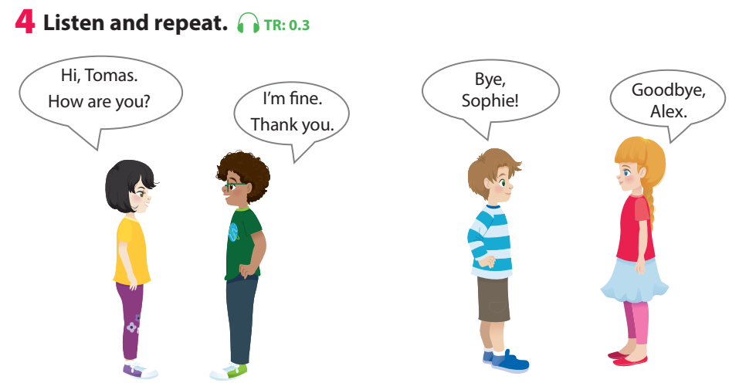

Notes:
Play the track 0.3, ask students to listen and repeat in chorus, group.

Slide 9
Notes:
Use flashcards to introduce the vocabulary and structure of lesson.
Say the words/sentences for sts to repeat in chorus.
Put the flashcards in different places around the room.
Say a word/sentence for sts to repeat then point.

Slide 10
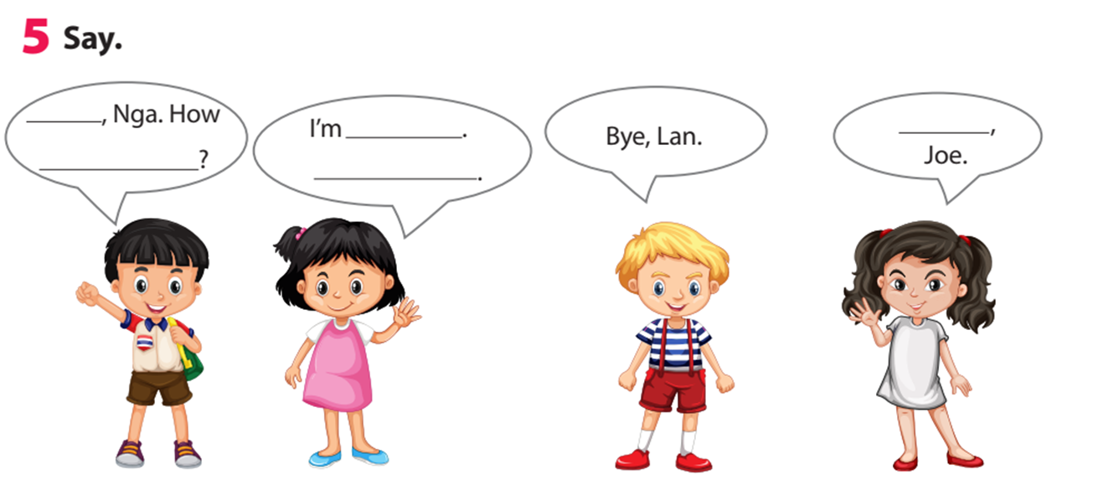
Thank you
Hi
are you
fine
Goodbye
Notes:
Task 5: Say
- Ask sts how many friends can they see and their names.
- Have sts look at the bubbles and ask them to complete (spoken).

Slide 11
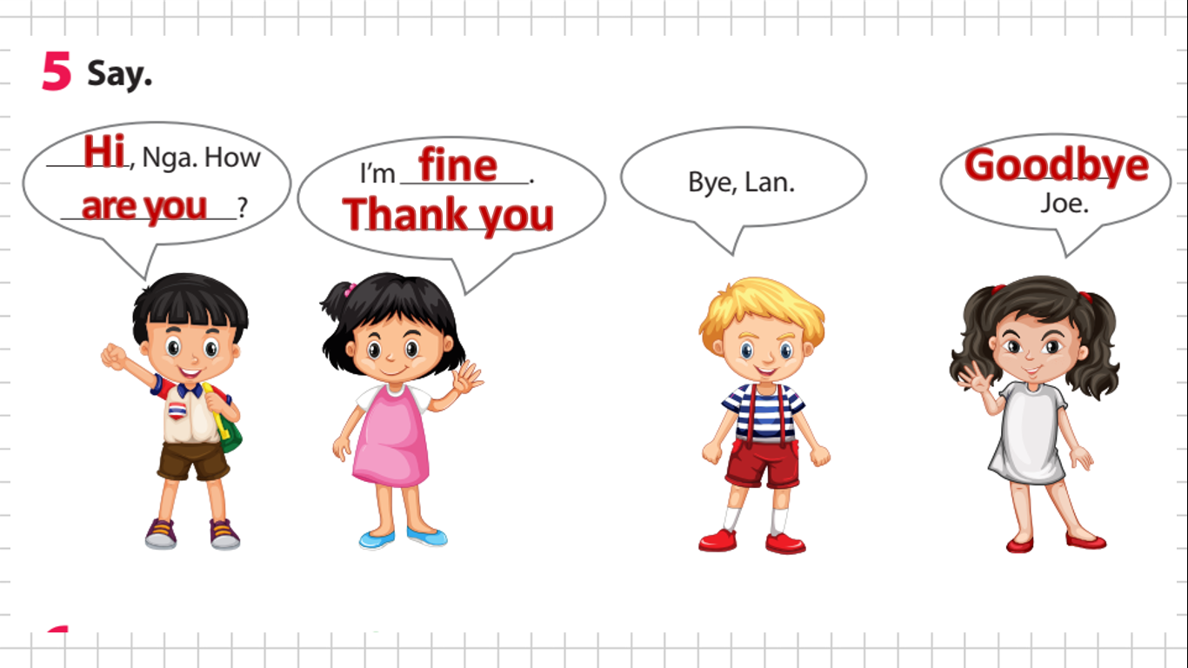
Notes:
- Have sts practice the dialogues in chorus, group, pairs.
- Go over the activity. Ask children to say sentences about different pictures in their classroom, pointing to them.

Slide 12

Notes:
- Have sts practice the dialogues in chorus, group, pairs.
- Go over the activity. Ask children to say sentences about different pictures in their classroom, pointing to them.

Slide 13


Game: whispering
Good morning. How are you?
Notes:
Game: Chinese whisper!
Let sts stand in lines of 5-6. Say a sentence for them to whisper one by one, from the top the back. The last one will say out loud the sentence.
Hướng dẫn: - Cho HS đứng thành hàng 5-6 em. Đọc một câu cho các em thì thầm từng em một, từ trên xuống dưới. HS cuối cùng sẽ đọc to câu đó.

Slide 14
Game: whispering
I’m good. Thank you.
Notes:
Game: Chinese whisper!
- Let sts stand in lines of 5-6. Say a sentence for them to whisper one by one, from the top the back. The last one will say out loud the sentence.
Hướng dẫn: - Cho HS đứng thành hàng 5-6 em. Đọc một câu cho các em thì thầm từng em một, từ trên xuống dưới. HS cuối cùng sẽ đọc to câu đó.

Slide 15
Game: whispering
Bye, see you tomorrow.
Notes:
Game: Chinese whisper!
- Let sts stand in lines of 5-6. Say a sentence for them to whisper one by one, from the top the back. The last one will say out loud the sentence.
Hướng dẫn: - Cho HS đứng thành hàng 5-6 em. Đọc một câu cho các em thì thầm từng em một, từ trên xuống dưới. HS cuối cùng sẽ đọc to câu đó.

Slide 16
Game: whispering
Goodbye. See you later.
Notes:
Game: Chinese whisper!
- Let sts stand in lines of 5-6. Say a sentence for them to whisper one by one, from the top the back. The last one will say out loud the sentence.
Hướng dẫn: - Cho HS đứng thành hàng 5-6 em. Đọc một câu cho các em thì thầm từng em một, từ trên xuống dưới. HS cuối cùng sẽ đọc to câu đó.

Slide 17

Practice
Task 6: Listen and sing.
Notes:
Task 6: Listen and sing.
-Ask children to look at the picture. Point to the book and ask What’s this? Ask children to predict what the song is about (Good bye friends).
-Play the song all the way through once for children to listen; then play it again as they follow the words in their books.
-Play it again, stopping after each line for children to repeat.
-Play the recording for children to sing along.

Slide 18

Goodbye, Alex. Bye!
Goodbye, Sophie. Bye!
Goodbye! Goodbye!
Bye! Bye!
Notes:
Task 6: Listen and sing.
-Ask children to look at the picture. Point to the book and ask What’s this? Ask children to predict what the song is about (Good bye friends).
-Play the song all the way through once for children to listen; then play it again as they follow the words in their books.
-Play it again, stopping after each line for children to repeat.
-Play the recording for children to sing along.

Slide 19

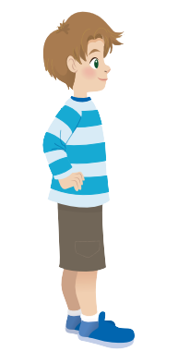

Notes:
Game: Sing, stand up, sit down!
-Give 2 students word cards for 2 children Alex, Sophia.
- Play the song. Each time children hear their word, they quickly stand up and sit down.

Slide 20

Production
Role play
Notes:
Game: Role play
Situation 1:
A new member of an English club come to the club. Practice the greeting and goodbye.

Slide 21

English club
Hi, I’m Anna. Nice to meet you.
Hi, I’m Sophia. Nice to meet you.
Notes:
Game: Role play
Situation 1:
A new member of an English club come to the club. Practice the greeting and goodbye.
Hướng dẫn:
Game: Role play
Tình huống 1:
Một thành viên mới của câu lạc bộ tiếng Anh đến câu lạc bộ. Thực hành chào hỏi và tạm biệt.

Slide 22
English club
Notes:
Practice the greeting and goodbye.
Ask some sts to come to the front to role play and use their names.
Hướng dẫn: Thực hành chào hỏi và tạm biệt.
Yêu cầu một số em lên phía trước để role-play và sử dụng tên của mình.

Slide 23



Hi, I’m Tomas. Nice to meet you, too.
Hi, I’m Alex. Nice to meet you.
Notes:
Situation 2:
2 new classmates meet at the school the first time. Practice the greeting and goodbye.
Ask some sts to come to the front to role play for the class.
Hướng dẫn:
Tình huống 2:
2 bạn học mới gặp nhau lần đầu tiên tại trường. Thực hành chào hỏi và tạm biệt.
Yêu cầu một số học sinh lên phía trước để đóng vai cho lớp.

Slide 24
Bye, Alex
Goodbye, Tomas
Notes:
Situation 2:
2 new classmates meet at the school the first time. Practice the greeting and goodbye.
Ask some sts to come to the front to role play for the class.
Hướng dẫn:
Tình huống 2:
2 bạn học mới gặp nhau lần đầu tiên tại trường. Thực hành chào hỏi và tạm biệt.
Yêu cầu một số học sinh lên phía trước để đóng vai cho lớp.

Slide 25

Assessment
Say and respond!
Notes:
THIẾT KẾ HOẠT ĐỘNG TƯƠNG TÁC CHO 3 CÂU HỎI Ở SLIDE 32 (ĐÁP ÁN Ở SLIDE 33)

Slide 26
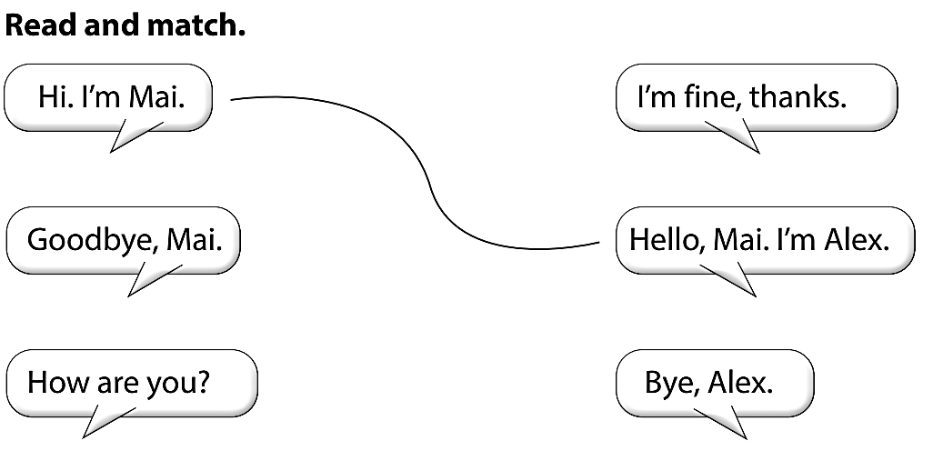

Slide 27


Let’s check!

Slide 28
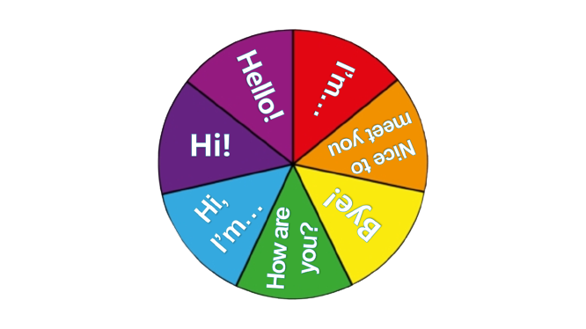
Spin, say
and do action!
spin
Notes:
Bấm vào Spin để xoay và bấm vào spin để dừng lại. Muốn sang slide khác thì click ra ngoài ảnh

Slide 29
Spin, say
and do action!
spin

Slide 30
Spin, say
and do action!
spin

Slide 31
Spin, say
and do action!
spin

Slide 32




Good bye.
See you again!

