Slide 1





















Unit 0
Greetings
Notes:
Để nguyên trang bìa như này, chỉ thay đổi tên bài trong quá trình làm. Logo của sách Wonderful World

Slide 2






Warm up!

Slide 3




Movement Game: Hip hip hooray
Hands up!
Hands down!
Hip hip hooray
Go to Wonderful World!
Notes:
+ Hands up: raise 2 hands up
+ Hands down: Put to hands down
+ Hip hip hooray (2 times): smack 2 hands on hips then put hands to mouth when saying hooray (2 times)
+ Go to Wonderful World: join 2 hands and make waves then raise both hands up and wave.
Hướng dẫn:
+ Hands up: giơ 2 tay lên
+ Hands down: hạ 2 tay xuống
+ Hip hip hooray (2 lần): vỗ 2 tay vào hông rồi đưa tay lên miệng khi nói hooray (2 lần)
+ Go to Wonderful World: chắp 2 tay tạo sóng rồi giơ cả 2 tay lên vẫy.

Slide 4
Memorization
game

Slide 5

E L O L H
HELLO
Notes:
- Show flashcard of letters E L O L H to sts in 5 seconds.
- Ask sts to read the letters they have seen
- Ask if sts know what word in English built from 5 letter.
- Write on the board Hello and introduce the greeting lesson.
Hướng dẫn:
- Cho HS xem thẻ chữ cái E L O L H trong 5 giây.
- Yêu cầu HS đọc các chữ cái đã nhìn thấy
- Hỏi xem HS có biết từ tiếng Anh nào được tạo thành từ 5 chữ cái không.
- Viết lên bảng HELLO và giới thiệu greeting lesson.

Slide 6

Presentation
Task 1: Listen and repeat

Slide 7

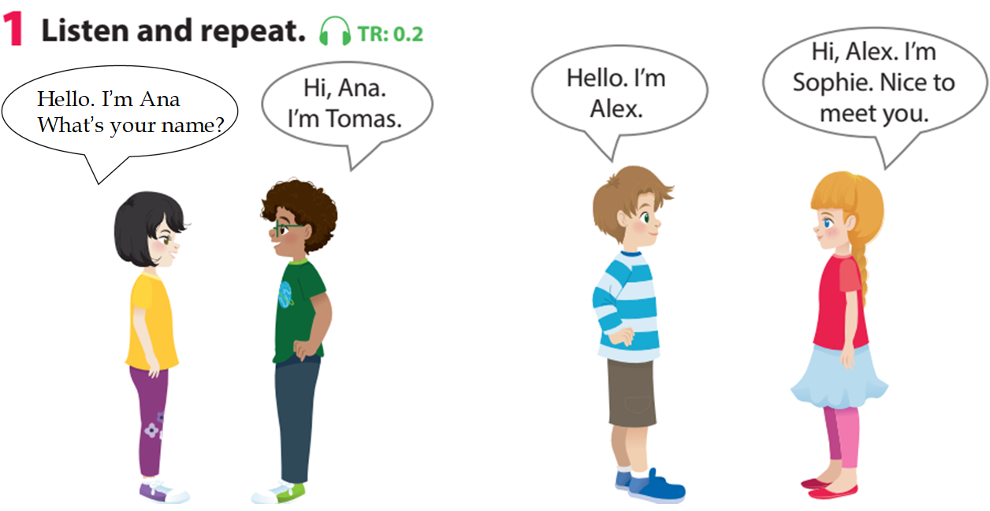

Notes:
Gv bấm audio trước sau đó nghe tới đâu bấm chuột tới đấy
Use flashcards to introduce the vocabulary and structure of lesson.
Say the words/sentences for sts to repeat in chorus.
Put the flashcards in different places around the room.
Say a word/sentence for sts to repeat then point.
Play the track 0.2, ask students to listen and repeat in chorus, group.

Slide 9





Anna
Tomas
Alex
Sophie
Notes:
Do as a model
Say a word/sentence for sts to repeat then point.

Slide 10

Practice
Task 2: Say

Slide 11
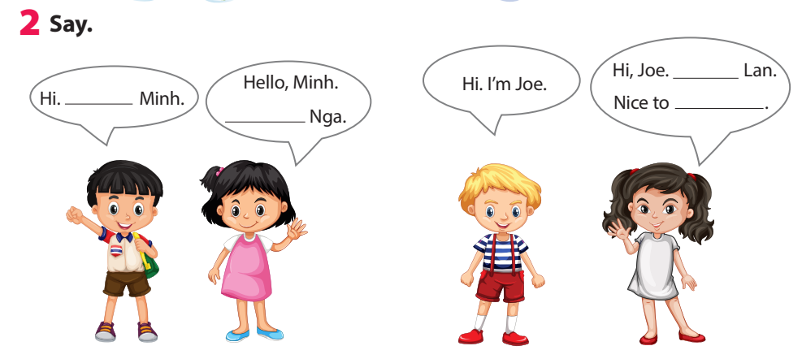
I’m
meet you
I’m
I’m
Notes:
Task 2: Say
- Ask sts how many friends can they see and their names.
- Have sts look at the bubbles and ask them to complete (spoken).
- Have sts practice the dialogues in chorus, group, pairs.

Slide 12
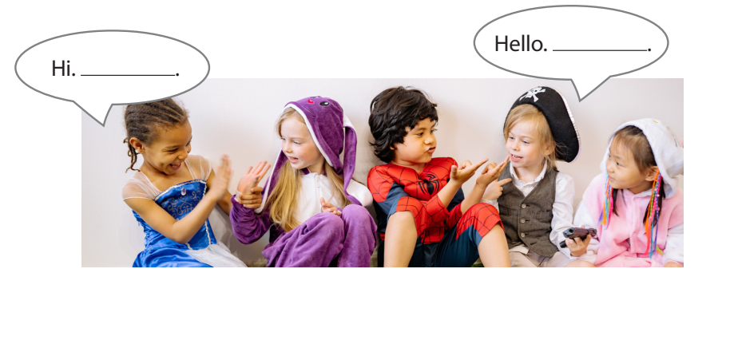
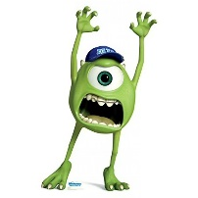
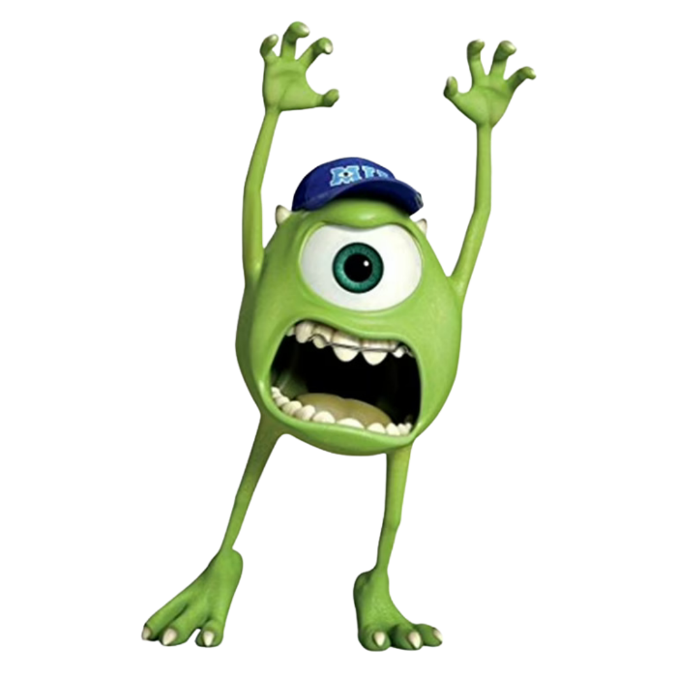
Task 3: Let’s talk
Game: Pass the
Notes:
Play some music.
Ask sts to pass the ball to the next person.
When the music stops the student with the ball stands up and say: “Hi/Hello, I’m…”
Hướng dẫn:
- Phát một số bản nhạc.
- Yêu cầu các em chuyền bóng cho người tiếp theo.
- Khi nhạc dừng lại, học sinh cầm bóng đứng lên và nói: “Hi/Hello, I’m…”

Slide 13

Production
Make a name tag

Slide 14
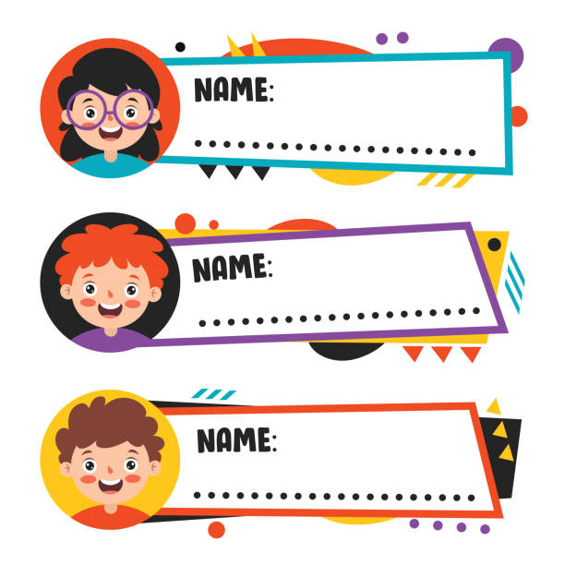
Linh – Cinderella
Long – superman
Nam – iron man
Notes:
- Ask Sts to choose a name that they like then make a name tag and decorate it, stick on chest.
- Have Sts to stand in 2 lines facing together.
- Ask sts of 2 lines shake hand and introduce their name, using
Hello/Hi. I’m…
Hello/Hi. I’m… Nice to meet you.
- When hearing hand clapping, sts in line 1 make a step to the left. They meet a new friend and practice the conversation again.

Slide 15

Hello/Hi. I’m…
Nice to meet you.
I’m Linh
Cinderella
Hello/Hi.
I’m Long - super man.
Notes:
- Ask Sts to choose a name that they like then make a name tag and decorate it, stick on chest.
- Have Sts to stand in 2 lines facing together.
- Ask sts of 2 lines shake hand and introduce their name, using
Hello/Hi. I’m…
Hello/Hi. I’m… Nice to meet you.
- When hearing hand clapping, sts in line 1 make a step to the left. They meet a new friend and practice the conversation again.

Slide 16

Assessment
Choose the correct answer!
Notes:
Thiết kế hoạt động tương tác ở phần Assessment (nội dung câu hỏi ở slide 17, 18.)

Slide 17

Choose the correct answer!
  1. ……, I’m Nhung.
Hello B. I’m Tuan
2. Hi, ……….
A. Hello B. I’m Ana
3. I’m Thanh. …….
A. Hello, Thanh B. Nice to meet you
Notes:
Choose the correct answer
……, I’m Nhung.
A. Hello B. I’m Tuan
2. Hi, ……….
A. Hello B. I’m Ana
3. I’m Thanh. …….
A. Hello, Thanh B. Nice to meet you
- Check in pair then whole class.
- Say goodbye

Slide 18
Let’s check!
  1. ……, I’m Nhung.
Hello B. I’m Tuan
2. Hi, ……….
A. Hello B. I’m Ana
3. I’m Thanh. …….
A. Hello, Thanh B. Nice to meet you
Notes:
Choose the correct answer
……, I’m Nhung.
A. Hello B. I’m Tuan
2. Hi, ……….
A. Hello B. I’m Ana
3. I’m Thanh. …….
A. Hello, Thanh B. Nice to meet you
- Check in pair then whole class.
- Say goodbye

Slide 19



Good bye.
See you again!

