Slide 1

Unit 7: JOBS
Culture – Lesson 1
Page 101

Slide 2




Slide 3
1. Tom _____ sports. I think he’ll be a soccer player.
likes
like
liked
A
B
C
NEXT

Slide 4
2.Davis likes helping people. I think He’ll be a ________________.
cashier
farmer
police officer
A
B
C
NEXT

Slide 5
3.You like _______. I think you’ll be a singer.
drawing
singing
cooking
A
B
C
NEXT

Slide 6
4.Will you be a ______ in the future?
Yes, I will. I love baking.
writer
chef
baker
A
B
C
NEXT

Slide 7
5.What would you like to be when you _____?
stand up
grow up
get up
A
B
C
NEXT

Slide 8

It’s time to learn …

Slide 9

Presentation

Slide 10

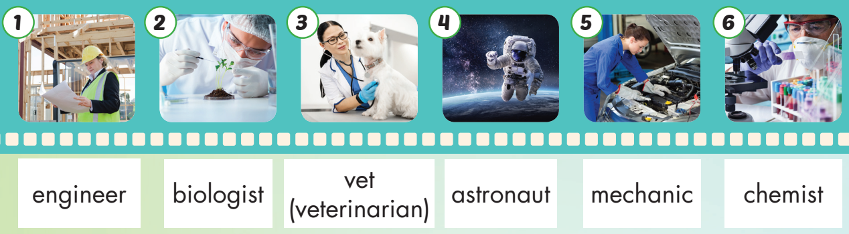
← Click on the title to hear the sound.
/ˌendʒɪˈnɪr/ kỹ sư
/ˌvetərɪˈneriən/ bác sĩ thú y
/məˈkænɪk/ thợ máy, thợ cơ khí
/baɪˈɑːlədʒɪst/ nhà sinh vật học
/ˈæstrənɑːt/ phi hành gia
/ˈkemɪst/ nhà hóa học
Notes:
Click vào hình A. 1. Listen and point. Repeat để cho cả audio full chạy

Slide 11

Click on the picture below to hear the sound.
engineer
/ˌendʒɪˈnɪr/ kỹ sư

Slide 12

Click on the picture below to hear the sound.
biologist
/baɪˈɑːlədʒɪst/ nhà sinh vật học

Slide 13

Click on the picture below to hear the sound.
vet
(veterinarian)
/ˌvetərɪˈneriən/ bác sĩ thú y

Slide 14

Click on the picture below to hear the sound.
astronaut
/ˈæstrənɑːt/ phi hành gia

Slide 15
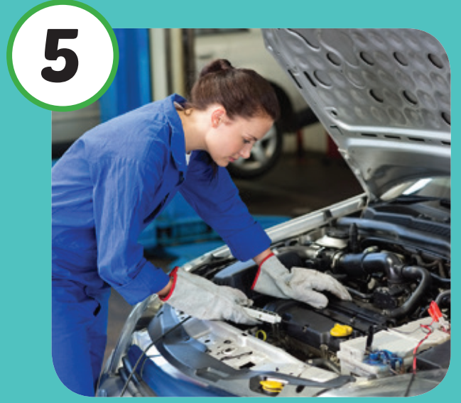
Click on the picture below to hear the sound.
mechanic
/məˈkænɪk/ thợ máy, thợ cơ khí

Slide 16

Click on the picture below to hear the sound.
chemist
/ˈkemɪst/ nhà hóa học

Slide 17
Practice

Slide 18
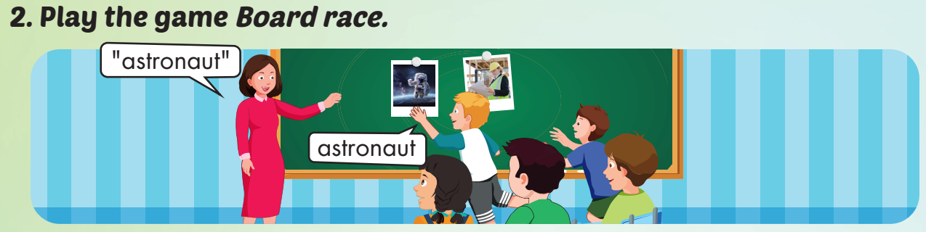

Slide 19

Structure
What jobs will people do in the future?
- I think many people will be engineers.

Slide 20
Presentation

Slide 21


Structure
Click on the picture below to hear the sound.

Slide 22

Click on each picture to hear the sound.

Slide 23

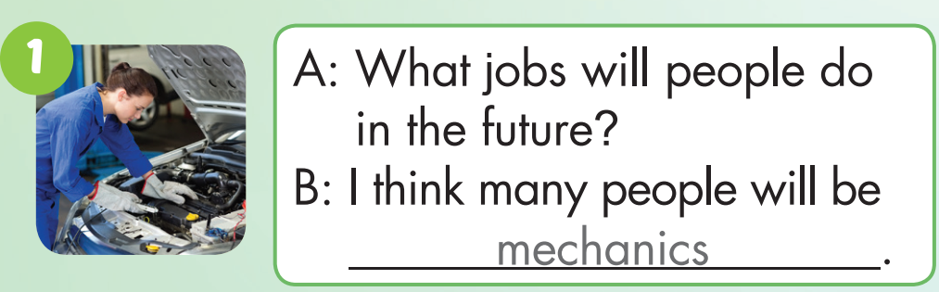
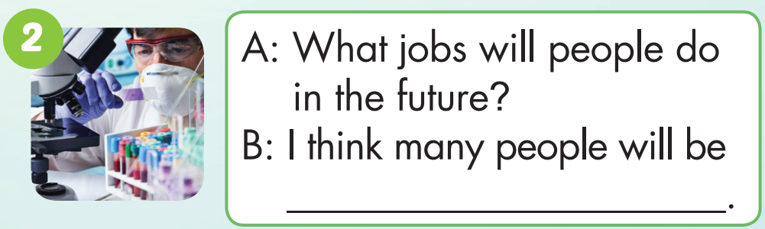
chemists

Slide 24


will be engineers
will people do
many people
will be biologists

Slide 25


What jobs
do in the future
many people
will be vets/ veterinarians
jobs will people
do in the future
I think many people
will be astronauts

Slide 26











What jobs will people do in the future?
I think many people will be __________.

Slide 27

CONSOLIDATION

Slide 28
Today’s lesson
Vocabularies
engineer,
biologist,
vet (veterinarian),
astronaut,
mechanic,
chemist
Structures/ Sentence patterns
A- What jobs will people do in the future?
B- I think many people will be engineers.

Slide 29
Homelink
Practice the vocabularies and structure, and make sentences using them.
Do the exercises in Tiếng Anh 5 i-Learn Smart Start WB (page 68).
Do the exercises in Tiếng Anh 5 i-Learn Smart Start Notebook. Do the Unit 7 Test in yourhomework.net
Prepare the next lesson (page 102 SB).
Play the consolidation games in Tiếng Anh 5 i-Learn Smart Start DHA App on www.eduhome.com.vn

Slide 30

Enjoy your day!

