Slide 1

Unit 6: Clothes
Lesson 1.1
Page 82

Slide 2
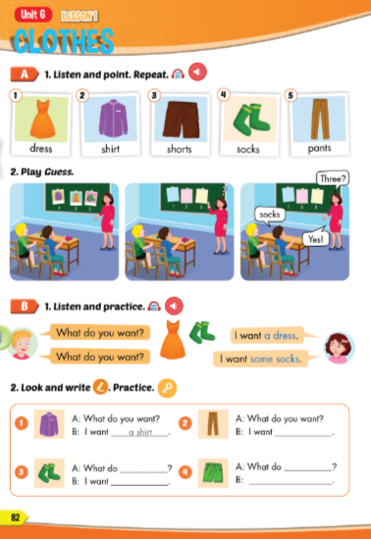
Lesson Outline
Warm-up
Vocabulary
Structure
Consolidation
Wrap-up

Slide 3

WARM-UP

Slide 4


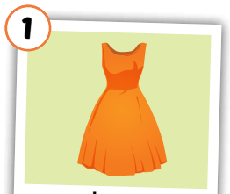
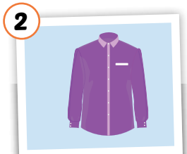
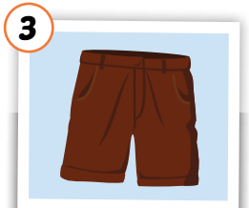
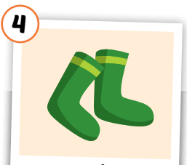
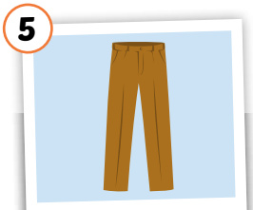
Click each word to hear the sound.
dress
shirt
shorts
socks
pants
/dres/
đầm, áo đầm
/ʃɜːrt/ áo sơ mi
/ʃɔːrts/
quần soóc, quần cộc
/sɑːks/ đôi tất
/pænts/
quần tây, quần dài

Slide 5
Put the pictures in the right group.
◆
❖
a
some

Slide 6

Structures
What do you want?
I want a dress.
What do you want?
I want some socks.

Slide 7

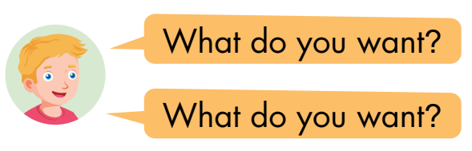
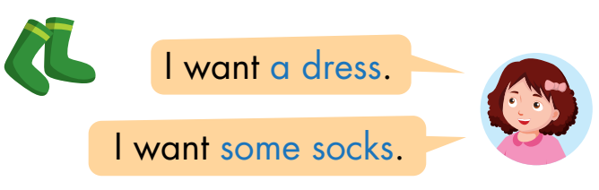

Click on the number to hear the sound.
◆
❖
⬥


Slide 8

Practice

Slide 9

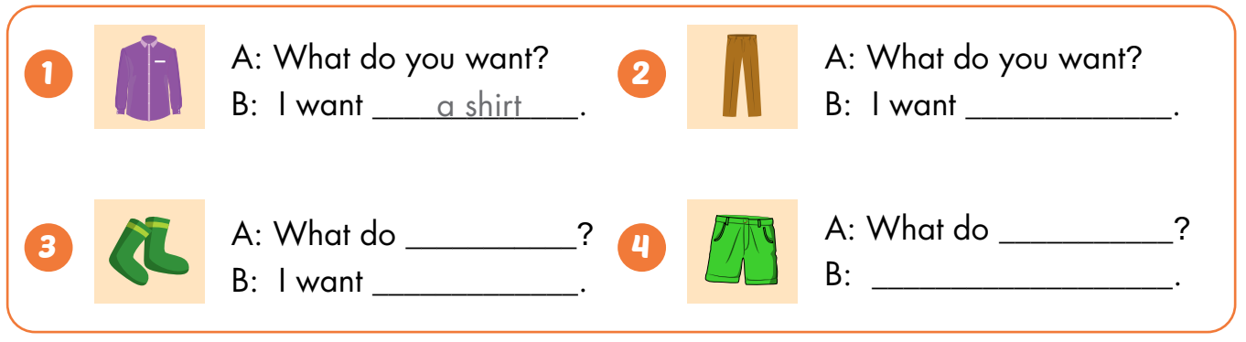
some pants
you want
you want
some socks
I want some shorts

Slide 10
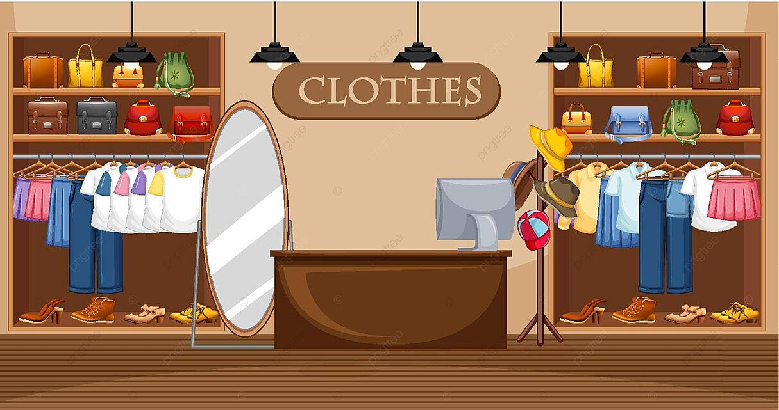

CONSOLIDATION

Slide 11

WRAP-UP

Slide 12
Friday February 21st 2025
Unit 6 – Clothes – Lesson 1.1 –P. 82
1. Vocabularies:
dress
shirt
shorts
socks
pants
2. Structures:
What do you want?
- I want a dress.
What do you want?
- I want some shorts.

Slide 13

Enjoy your day!

Slide 14
Homework
Practice the vocabularies and structure, and make sentences using them.
Do the exercises in Tiếng Anh 3 i-Learn Smart Start Workbook (page 58).
Prepare the next lesson (page 83 SB).
Play the consolidation games in Tiếng Anh 3 i-Learn Smart Start DHA App on www.eduhome.com.vn
Do the exercise in Tiếng Anh 3 i-Learn Smart Start Notebook (page 40).

