Slide 1

Ngoc Lam
Primary School
Unit 5: Getting Around
Review and Practice 1
Page 76

Slide 2
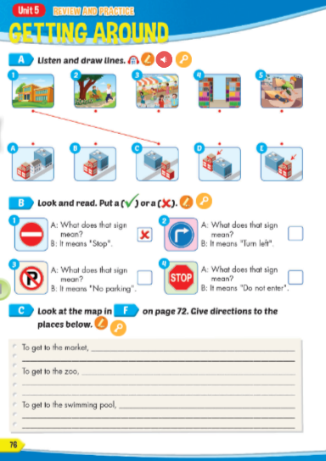
Lesson Outline
Warm-up
Reading
Listening
Consolidation
Wrap-up

Slide 3
Objectives
By the end of this lesson, students will be able to…
Vocabulary: Review: "stop, do not enter, turn left, turn right, no parking, near, behind, next to, opposite, in front of, go straight, go over, traffic lights, corner, bridge, on the left, on the right."
Structure: Review: "What does that sign mean? It means "Stop". Where's the park? It's next to the library. How do I get to the swimming pool? Go straight. Then, turn left. It's on the right."

Slide 4

WARM UP

Slide 5






VOCAB QUIZ

Slide 6






stop
A
B

Slide 7


turn right
A
B

Slide 8

turn left
A
B

Slide 9

no parking
A
B

Slide 10
do not enter
A
B

Slide 11


near
A
B

Slide 12
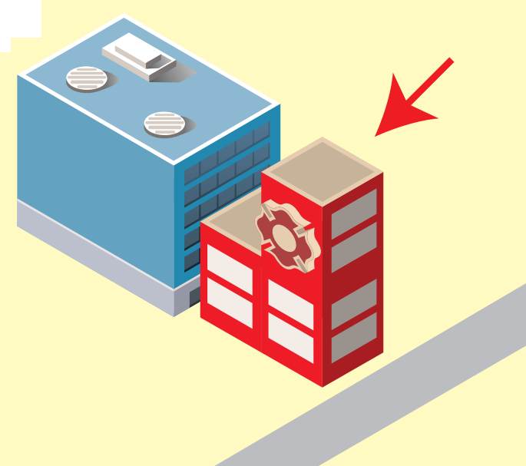
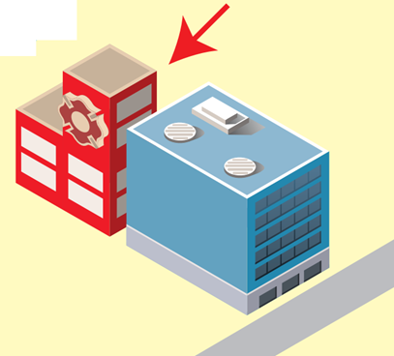
behind
A
B

Slide 13

It’s time to learn …

Slide 14

Listening

Slide 15


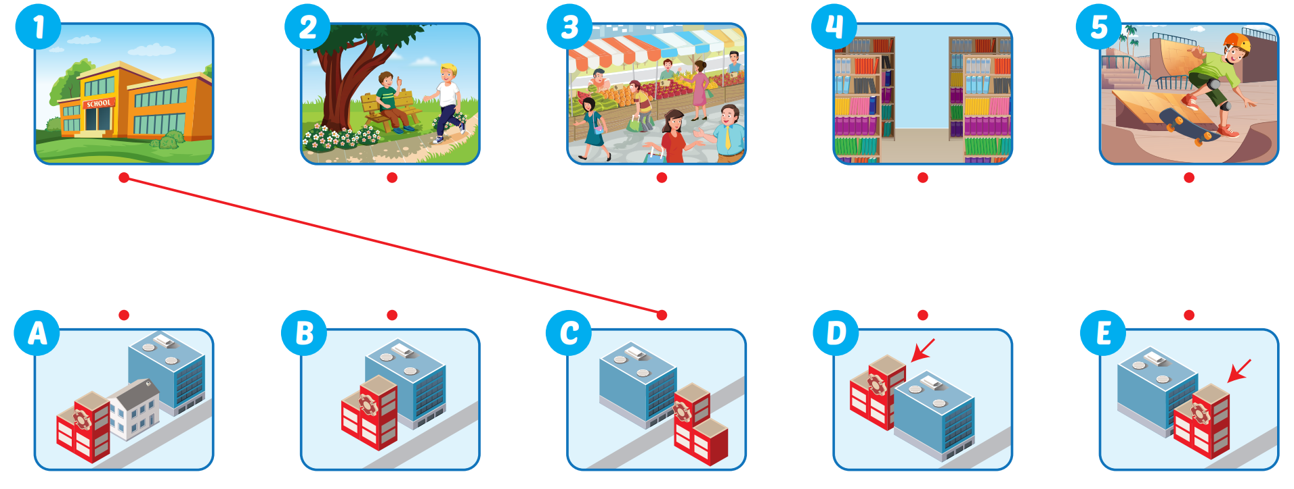

Slide 16

Reading

Slide 17
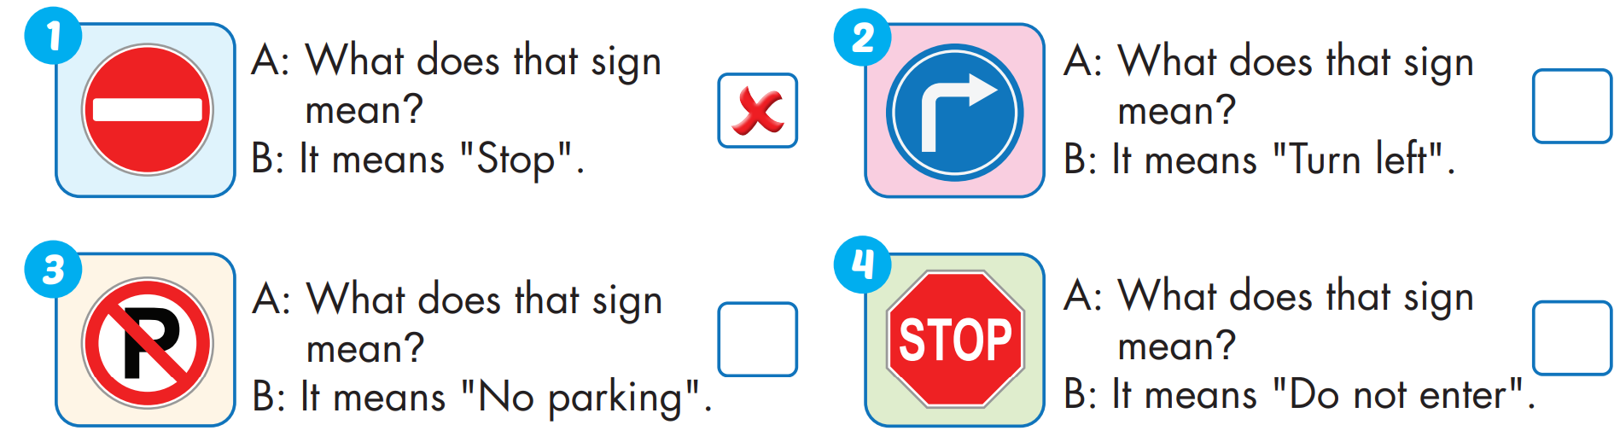



Slide 18

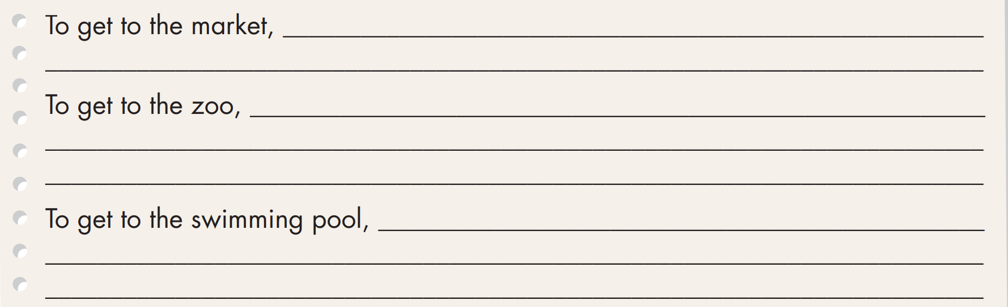

Slide 19

Practice

Slide 20

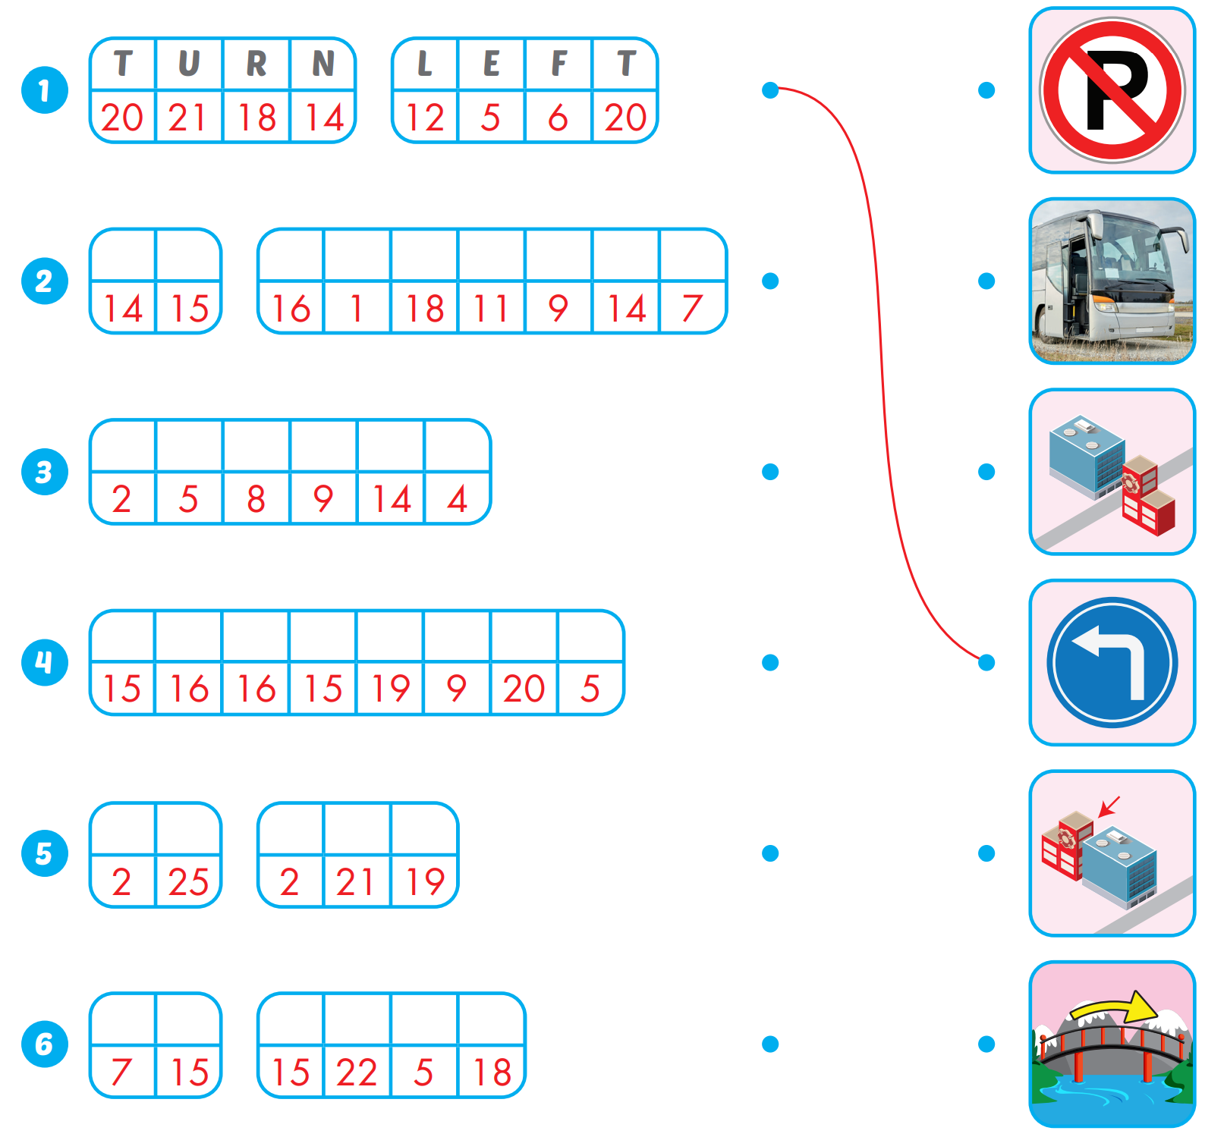
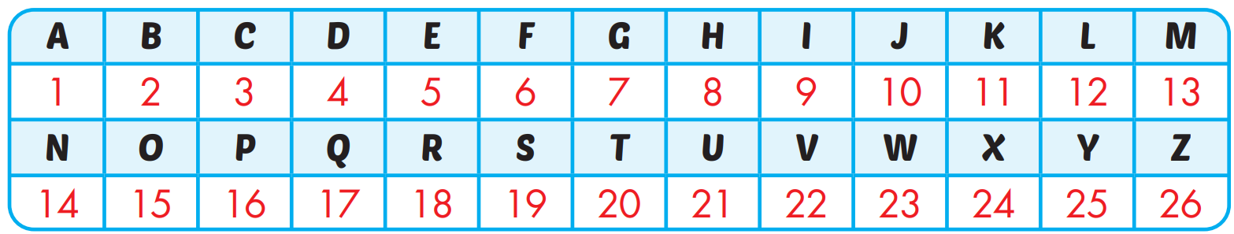
Extra Practice
WB, page 50
N O
P A R K I N G
B E H I N D
O P P O S I T E
B Y
B U S
G O
O V E R

Slide 21

Production

Slide 22

WRAP-UP

Slide 23
Today’s lesson
Vocabularies
Vocabulary: Review: " stop, do not enter, turn left, turn right, no parking, near, behind, next to, opposite, in front of, go straight, go over, traffic lights, corner, bridge, on the left, on the right."
Structures/ Sentence patterns
Review: "What does that sign mean?
It means "Stop".
Where's the park?
It's next to the library.
How do I get to the swimming pool?
Go straight. Then, turn left. It's on the right."

Slide 24
Homework
Practice the vocabularies and structure; and make sentences using them.
Do the exercises in Tiếng Anh 4 i-Learn Smart Start WB (page 50).
Do the exercises in Tiếng Anh 4 i-Learn Smart Start Notebook (page 32).
Prepare the next lesson (page 77 SB).
Play the consolidation games in Tiếng Anh 4 i-Learn Smart Start DHA App on www.eduhome.com.vn

Slide 25

Enjoy your day!

