Slide 1

Ngoc Lam
Primary School
Unit 6: FOOD AND DRINKS
Review 2
Page 91

Slide 2
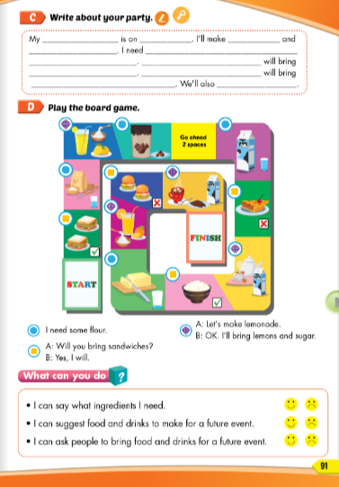
Lesson Outline
Warm-up
Writing
Speaking
Wrap-up

Slide 3
Objectives
By the end of this lesson, students will be able to review and practice the target language and skills in unit 6.
Vocabulary: unit 6
Structure: unit 6

Slide 4

WARM-UP

Slide 5
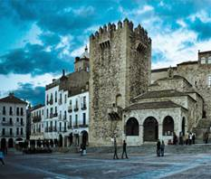
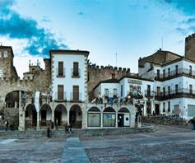
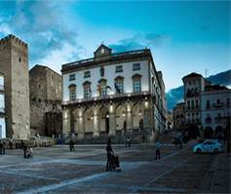

WHAT IS IT?
PHOTO PUZZLE

Slide 6

WHAT IS IT?
Turn around as many colored boxes as you can within the time limit (5 seconds) and say what it is in the picture.

Slide 7
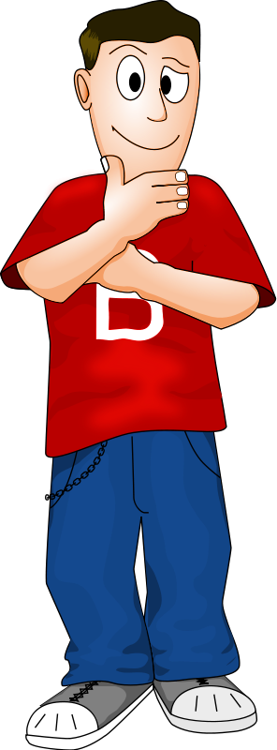
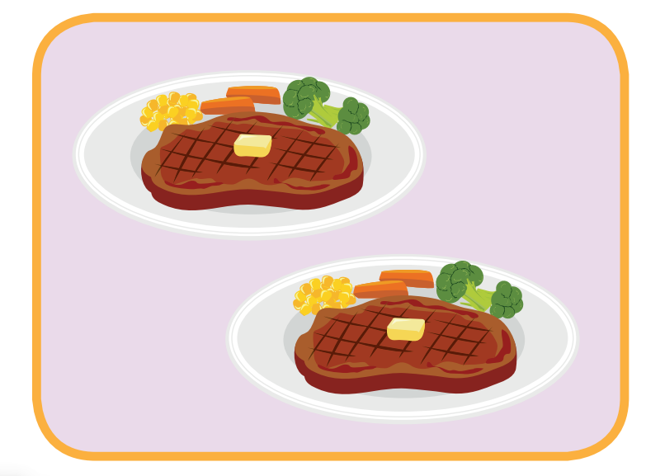
I will bring steak.
T
I
M
E
I
S
U
P
CHECK
NEXT
Click on the colored boxes to turn them around

Slide 8
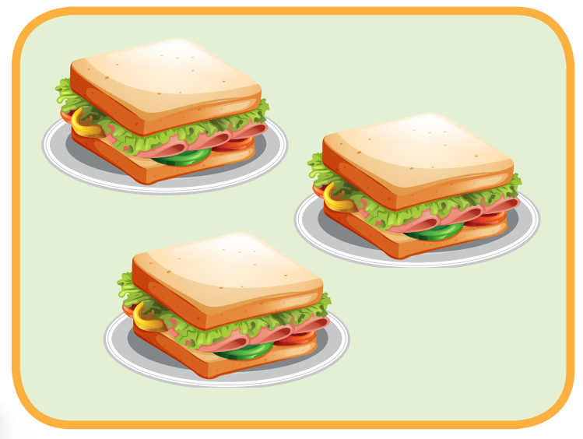
I will bring sandwiches.
T
I
M
E
I
S
U
P
CHECK
NEXT
Click on the coloured boxes to turn them around

Slide 9
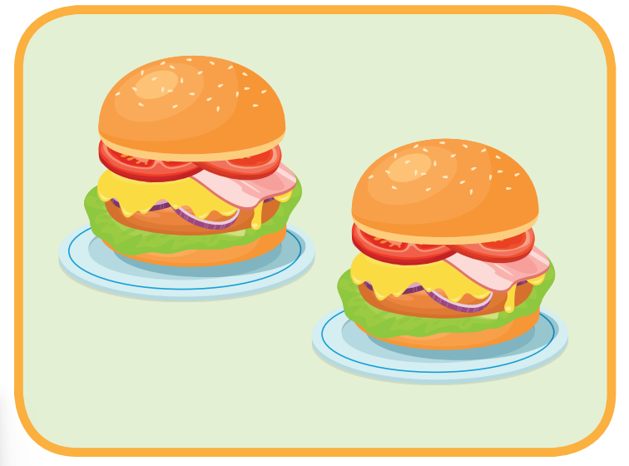
I will bring hamburgers.
T
I
M
E
I
S
U
P
CHECK
NEXT
Click on the colored boxes to turn them around

Slide 10
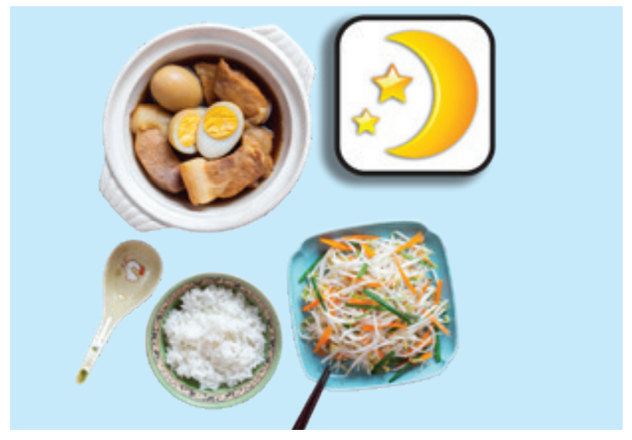
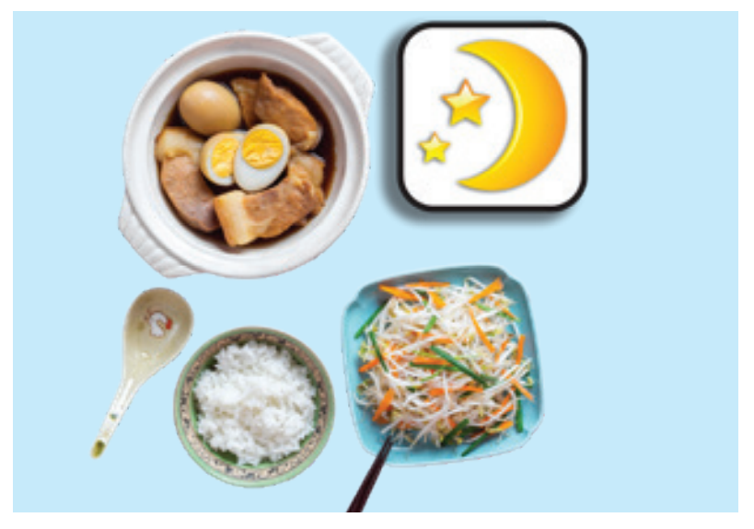
lunch
What is it?
T
I
M
E
I
S
U
P
CHECK
NEXT
Click on the colored boxes to turn them around

Slide 11
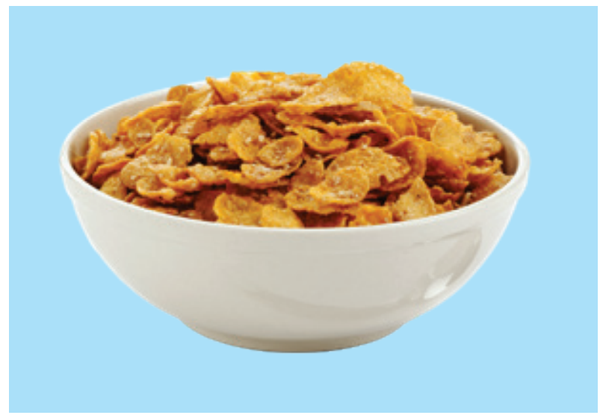
cereal
T
I
M
E
I
S
U
P
CHECK
NEXT
Click on the colored boxes to turn them around

Slide 12
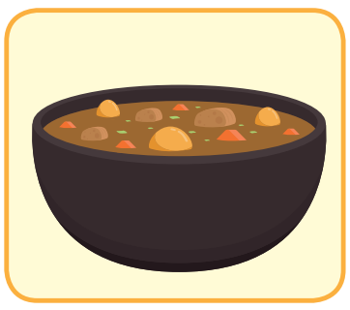
curry
T
I
M
E
I
S
U
P
CHECK
END
Click on the colored boxes to turn them around

Slide 13

hot chocolate
T
I
M
E
I
S
U
P
CHECK
END
Click on the colored boxes to turn them around

Slide 14

It’s time to learn …

Slide 15

Writing

Slide 16
Look and answer these questions.
When is your party?
What food will you make?
What food do you need?
What will your friends bring?
What games do you play?

Slide 17

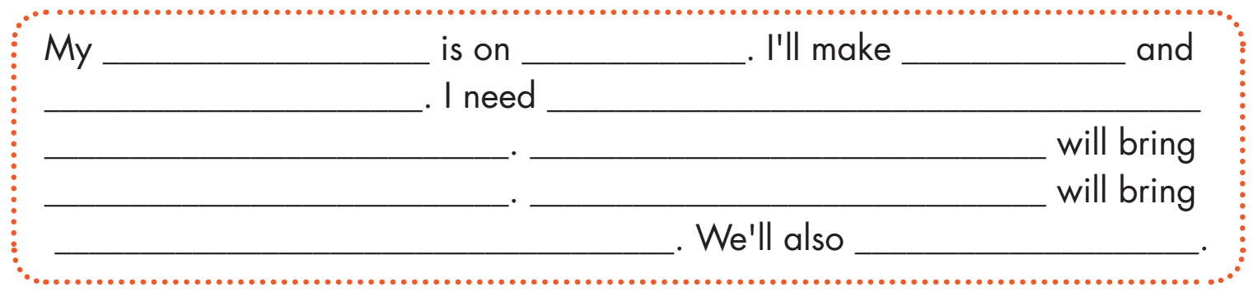
Examples:
party
Saturday
a cake
some sandwiches
some bread, a lot of flour
some butter and a little oil
Emma
some rice and curry
Peter
some soda
play a lot of games

Slide 18
Speaking

Slide 19

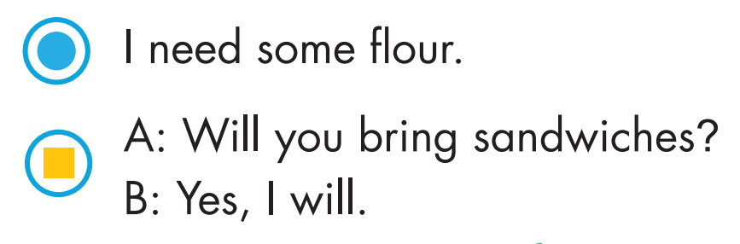

Work in pairs and play the game.

Slide 20
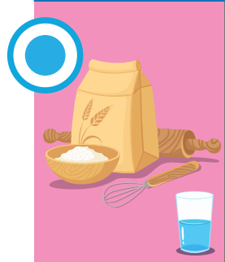
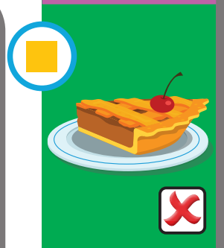


Slide 21
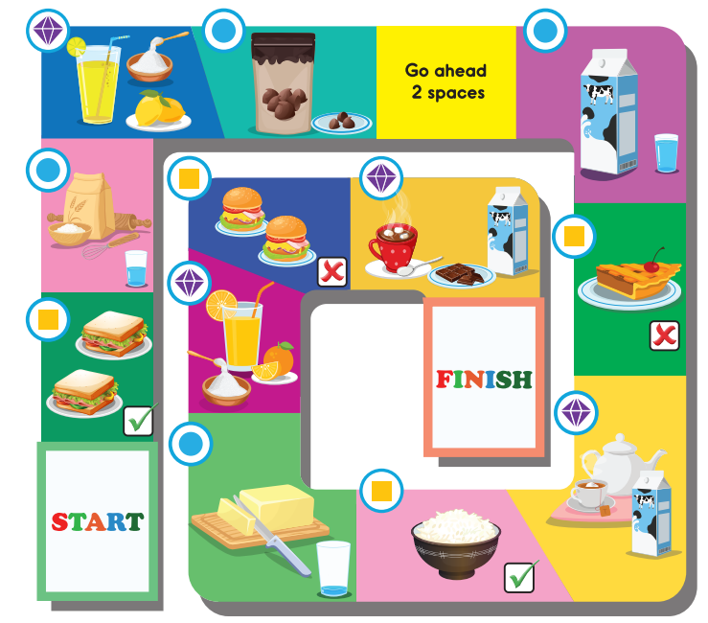

Slide 22

Self- Evaluation

Slide 23
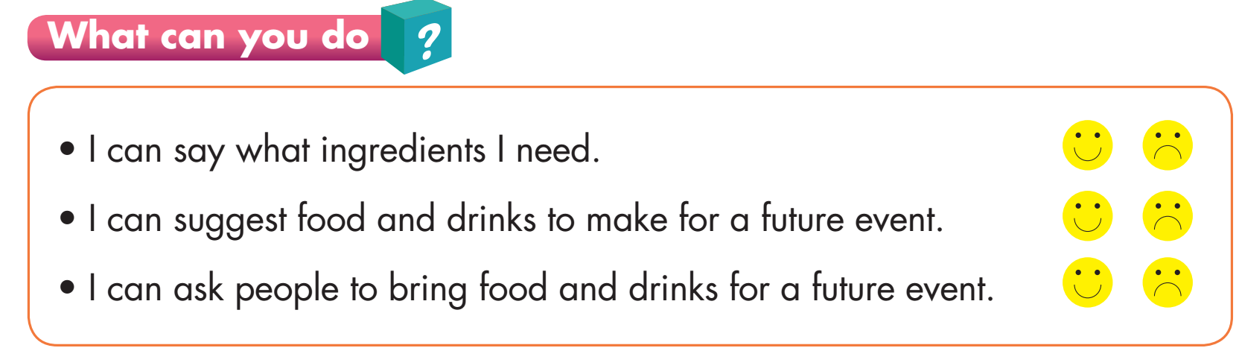

Slide 24

Extra
Writing

Slide 25

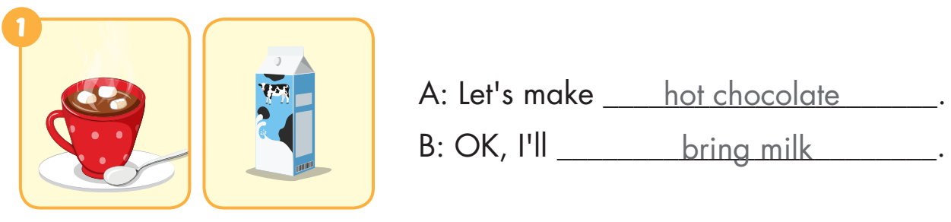
Extra Practice
WB, page 51

Slide 26
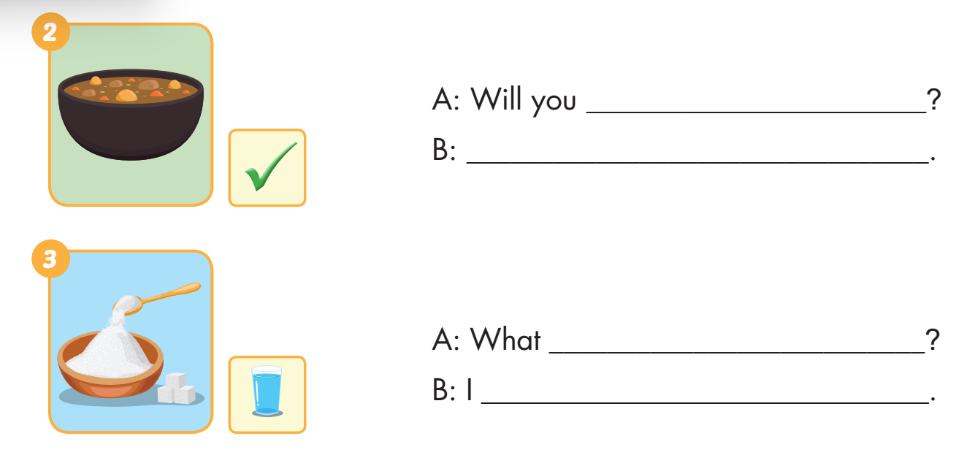
Extra Practice
WB, page 51
bring curry
Yes. I will
do you need
need a lot of sugar

Slide 27
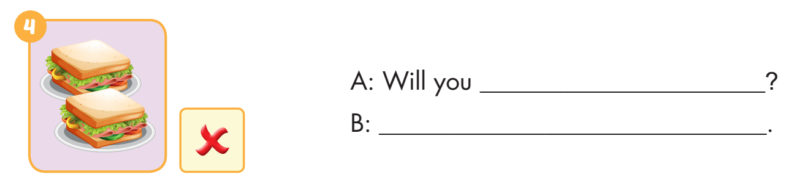
Extra Practice
WB, page 51
bring sandwiches
No. I won’t

Slide 28

CONSOLIDATION

Slide 29

READ AND CHOOSE

Slide 30
I want to make a cake.
Ok. What do you need?
I need a lot of sugar.
I will bring curry.
I usually eat bread for breakfast.

Slide 31
What do you usually eat for dinner?
I will bring milk.
I need a little butter.
I usually eat rice for dinner.

Slide 32
Will you bring sandwiches, Nick?
I need a few apples.
Yes. I will.
She eats sandwiches for lunch.

Slide 33
Let’s make hot chocolate!
I usually eat cakes after dinner.
Ok. I will bring chocolate chips
Ok. I will bring bananas.

Slide 34
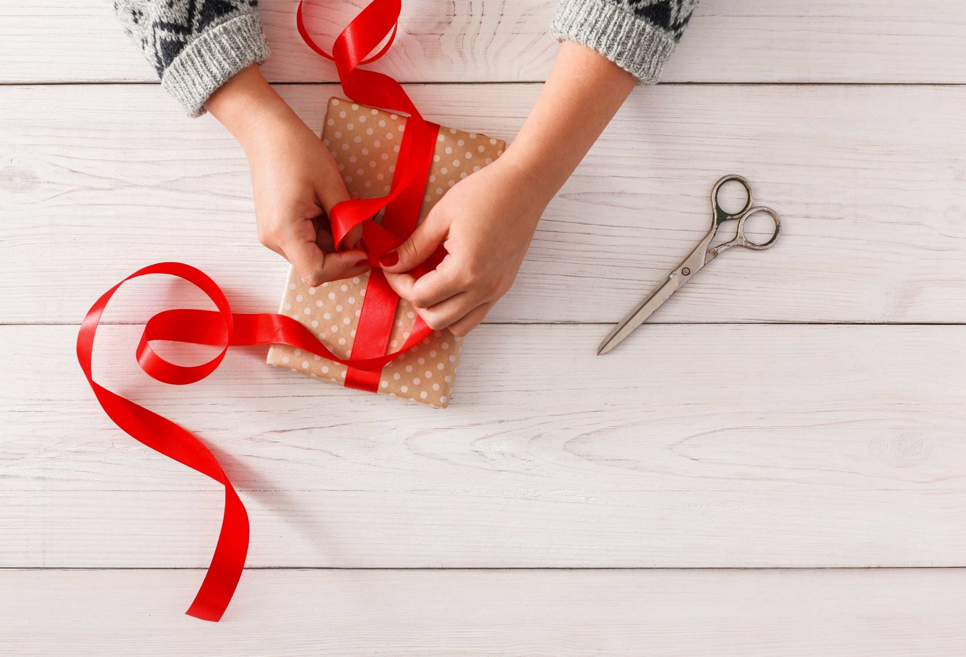
WRAP-UP

Slide 35
Today’s lesson
Vocabularies
Unit 6
Structures/ Sentence patterns
Unit 6

Slide 36
Homework
Practice the vocabularies and structure, and make sentences using them.
Do the exercises in Tiếng Anh 5 i-Learn Smart Start WB (page 61).
Do the exercises in Tiếng Anh 5 i-Learn Smart Start Notebook.
Prepare the next lesson (page 92 SB).
Play the consolidation games in Tiếng Anh 5 i-Learn Smart Start DHA App on www.eduhome.com.vn

Slide 37

Enjoy your day!

Slide 38

Lesson 3
Stay positive and have a nice day!

