Slide 1

Ngoc Lam
Primary School
Unit 6: FOOD AND DRINKS
Lesson 3.1
Page 84

Slide 2
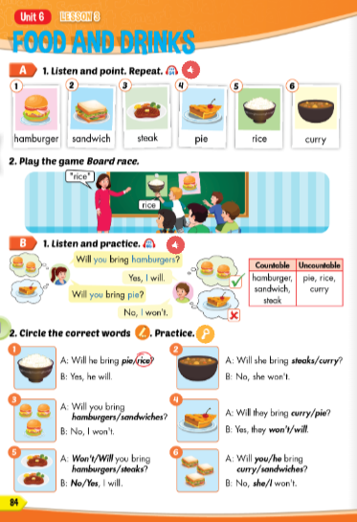
Lesson Outline
Warm-up
Vocabulary
Structure
Consolidation
Wrap-up

Slide 3
Objectives
By the end of this lesson, students will be able to ask and answer about what food people will bring.
Vocabulary: hamburger, sandwich, steak, pie, rice, curry.
Structure: Will you bring hamburgers?
Yes, I will.
Will you bring pie?
No, I won't.

Slide 4

WARM-UP

Slide 5













Countable and Uncountable Nouns
Countable Noun | Uncountable Noun
a cake | rice
a burger | bread
an onion | ice cream
a sandwich | butter
a sausage | cheese
an egg | milk
Countable Noun | Uncountable Noun

Slide 6

It’s time to learn …

Slide 7

New words
hamburger, sandwich, steak, pie, rice, curry.

Slide 8

Presentation

Slide 9

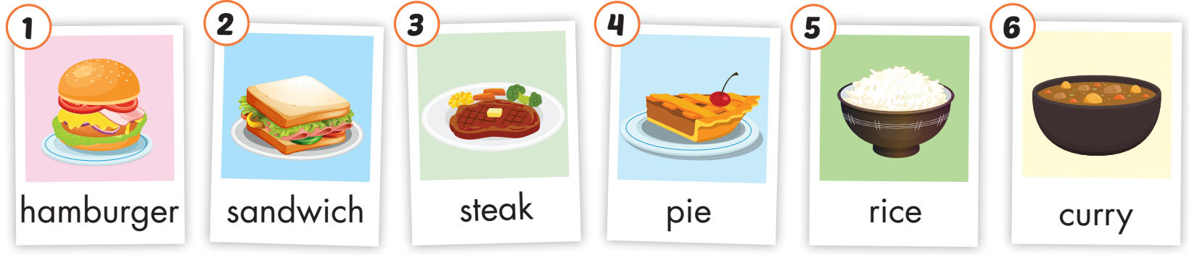
Click on the picture to hear the sound.
/ˈhæmˌbɜːrɡər/
bánh hamburger
/ˈsænwɪtʃ/
bánh mì sandwich
/steɪk/
bít tết
/paɪ/
bánh nướng
/raɪs/
cơm
/ˈkɜːri/
cà ri
Notes:
Click vào hình A. 1. Listen and point. Repeat để cho cả audio full chạy

Slide 10
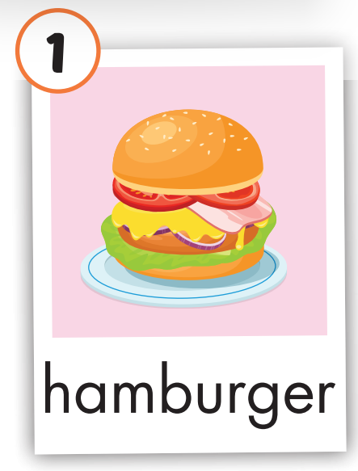

Click on the picture to hear the sound.
hamburger
/ˈhæmˌbɜːrɡər/
bánh hamburger

Slide 11
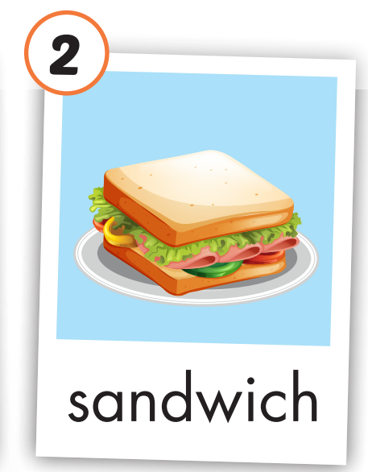
Click on the picture to hear the sound.
sandwich
/ˈsænwɪtʃ/
bánh mì sandwich

Slide 12
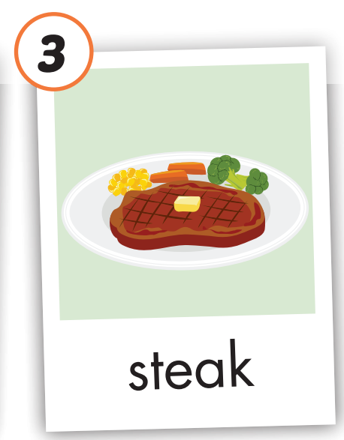

Click on the picture to hear the sound.
steak
/steɪk/
bít tết

Slide 13
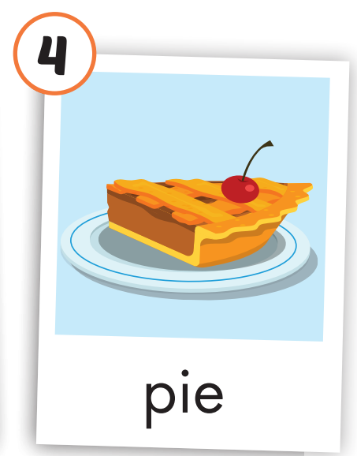

Click on the picture to hear the sound.
pie
/paɪ/
bánh nướng

Slide 14
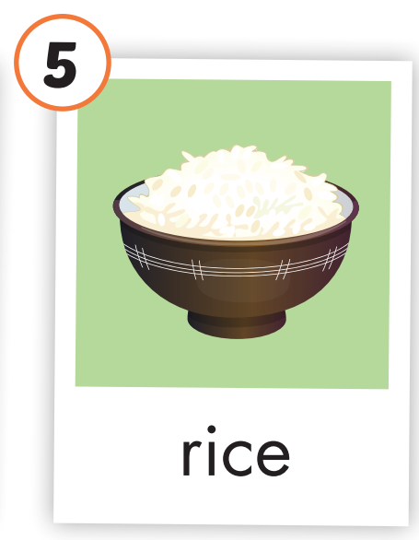

Click on the picture to hear the sound.
rice
/raɪs/
cơm

Slide 15
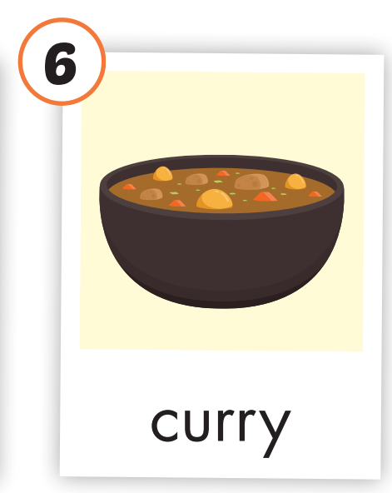

Click on the picture to hear the sound.
curry
/ˈkɜːri/
cà ri

Slide 16
Practice

Slide 17
Look, read and choose

Slide 18



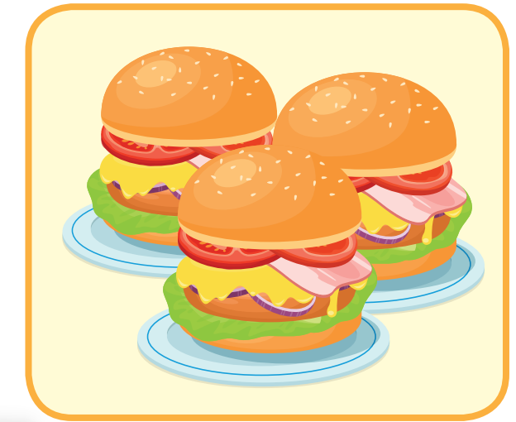
Look, read and choose
a hamburger
A
B
C

Slide 19
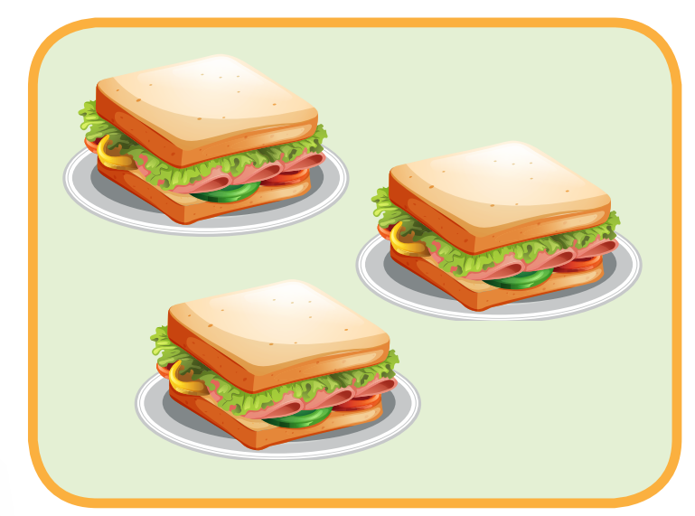

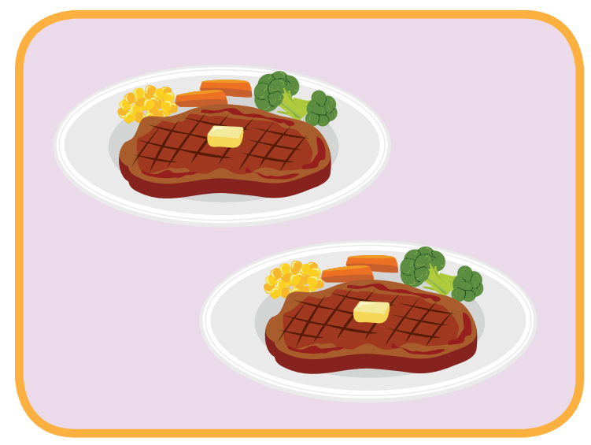
Look, read and choose
steak
A
B
C

Slide 20
Look, read and choose
a sandwich
A
B
C

Slide 21
Look, read and choose
curry
A
B
C

Slide 22
Look, read and choose
pie
A
B
C

Slide 23



Slide 24
Structure
Will you bring hamburgers?
Yes, I will.
Will you bring pie?
No, I won't.

Slide 25
Presentation

Slide 26
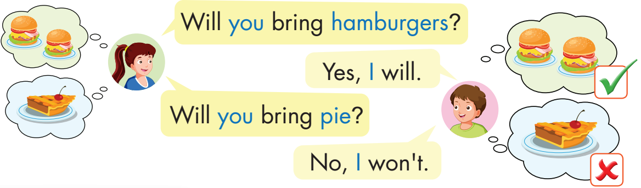
Structure

Slide 27

Practice

Slide 28

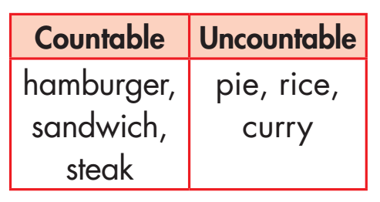


Click on B to hear the sound.

Slide 29
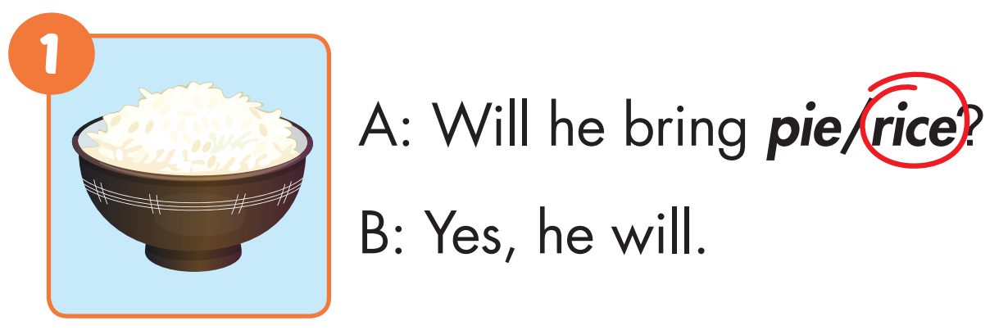

Slide 30
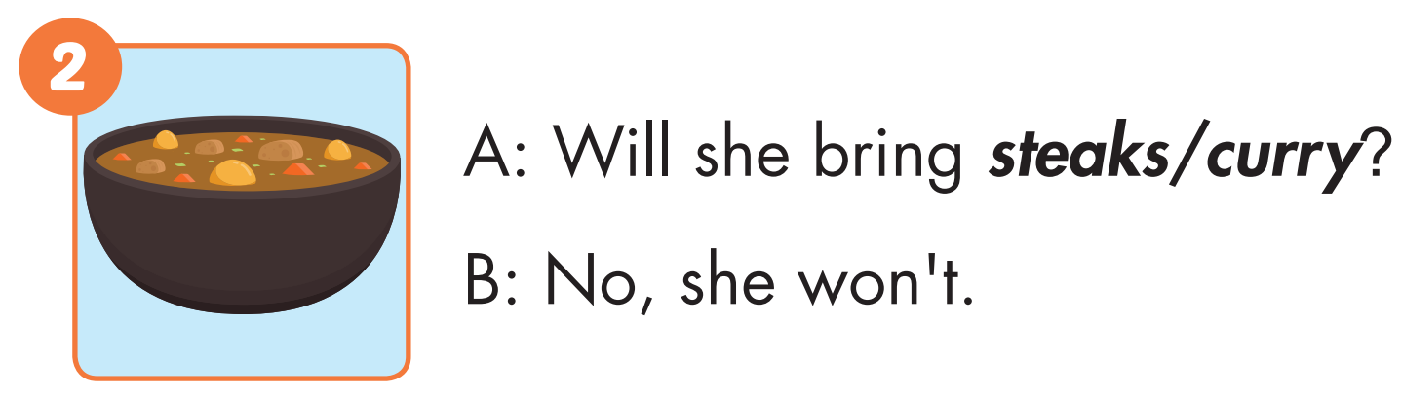

Slide 31
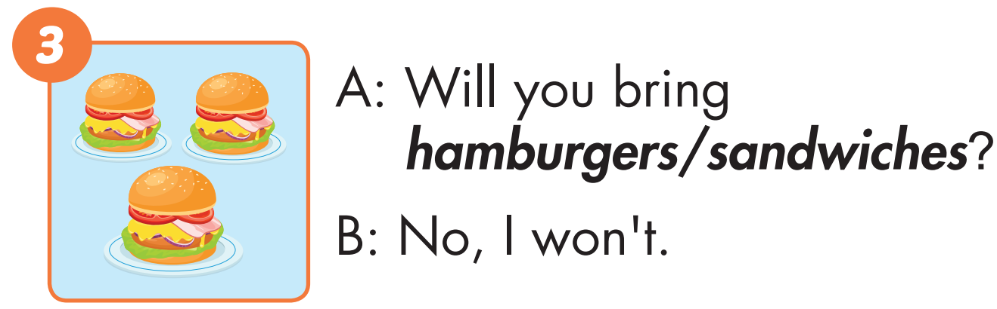

Slide 32
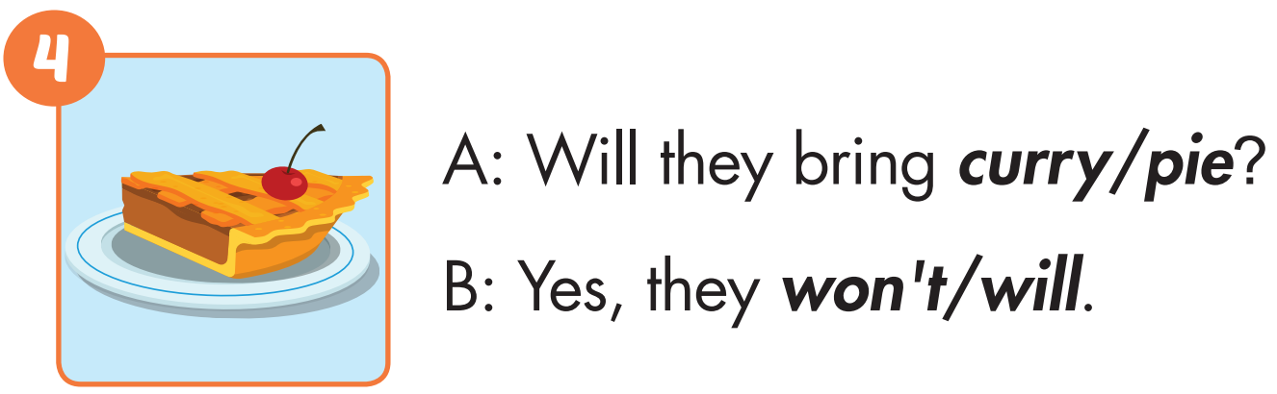

Slide 33
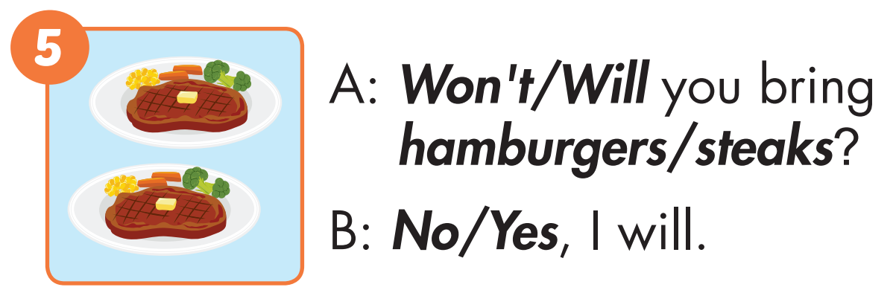

Slide 34
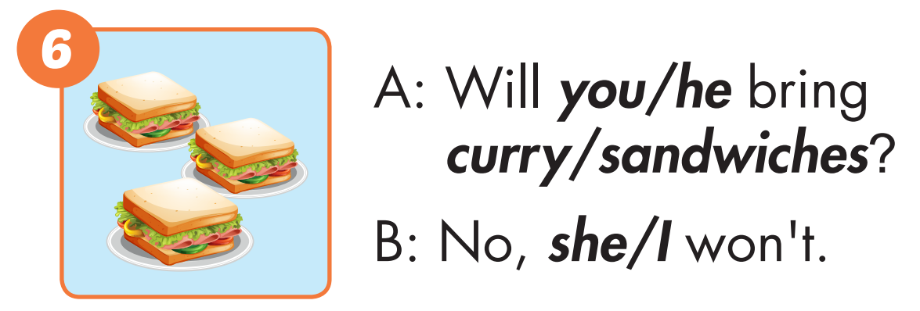

Slide 35

Production

Slide 36
WHAT’S MISSING?
1
2
3
?
?
?
4
5
6
?
?
?

Slide 37

CONSOLIDATION

Slide 38
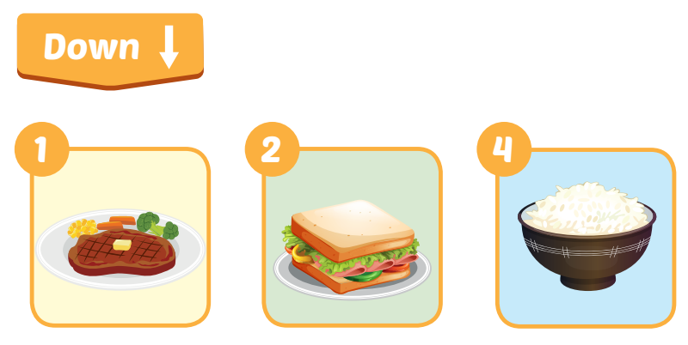
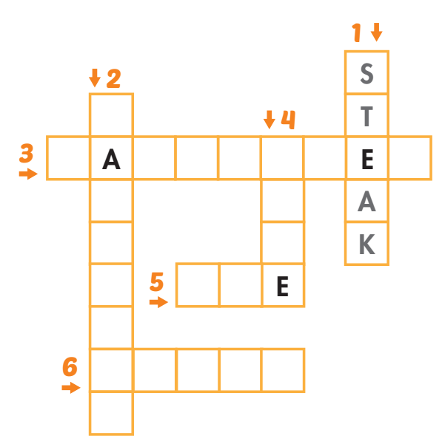

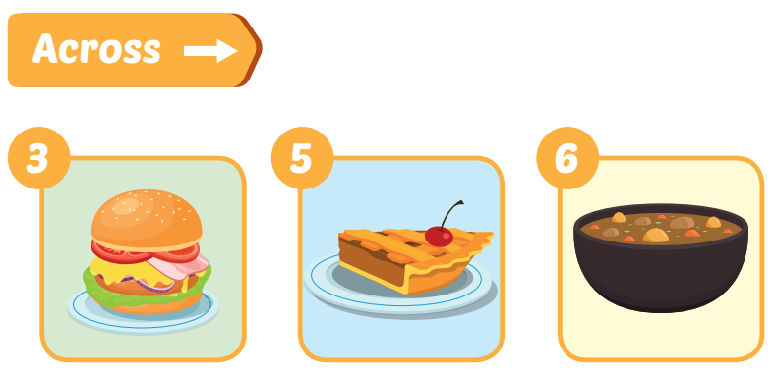
Extra Practice
WB, page 57
S
N
D
W
I
C
H
R
I
C
H M B U G R
P I
U R R Y

Slide 39

WRAP-UP

Slide 40
Today’s lesson
Vocabularies
hamburger, sandwich, steak, pie, rice, curry.
Structures/ Sentence patterns
Will you bring hamburgers?
Yes, I will.
Will you bring pie?
No, I won't.

Slide 41
Homework
Practice the vocabularies and structure, and make sentences using them.
Do the exercises in Tiếng Anh 5 i-Learn Smart Start WB (page 57).
Do the exercises in Tiếng Anh 5 i-Learn Smart Start Notebook.
Prepare the next lesson (page 85 SB).
Play the consolidation games in Tiếng Anh 5 i-Learn Smart Start DHA App on www.eduhome.com.vn

Slide 42

Enjoy your day!

Slide 43

Lesson 3
Stay positive and have a nice day!

