Slide 1

Ngoc Lam
Primary School
Review Units 1-4
Page 62

Slide 2
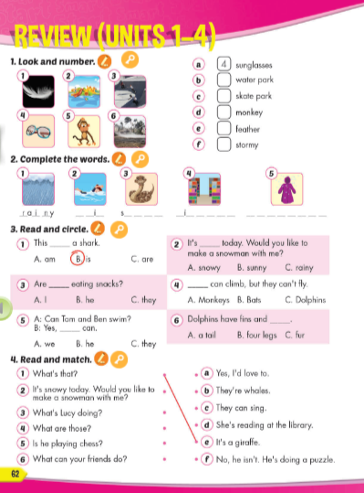
Lesson Outline
Warm-up
Reading
Listening
Consolidation
Wrap-up

Slide 3
Objectives
By the end of this lesson, students will be able to…
Vocabulary: Review: "sunglasses, water park, skate park, monkey, feather, stormy, rainy, swim, snake, library, raincoat."
Structure: Review: "This is a monkey. These are monkeys. Bring your sunglasses because it's sunny today. OK, thank you. That's a snake. Those are snakes. What's the weather like today? It's sunny. What do you like doing when it's hot? I like swimming."

Slide 4

WARM UP

Slide 5

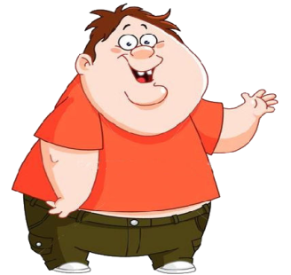
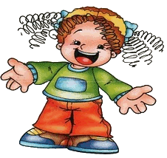
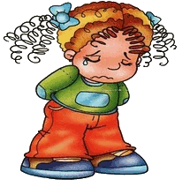


Slide 6
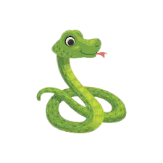

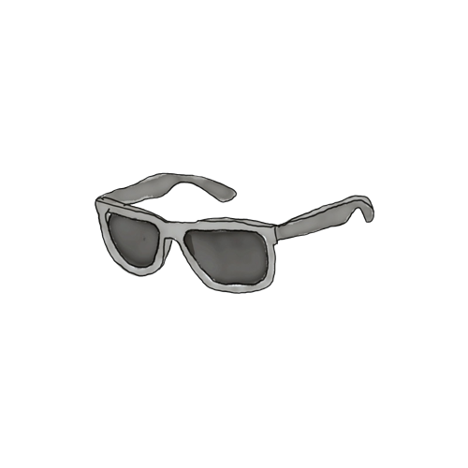

sunglasses

Slide 7
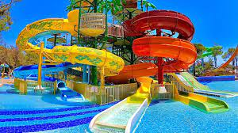
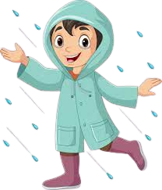
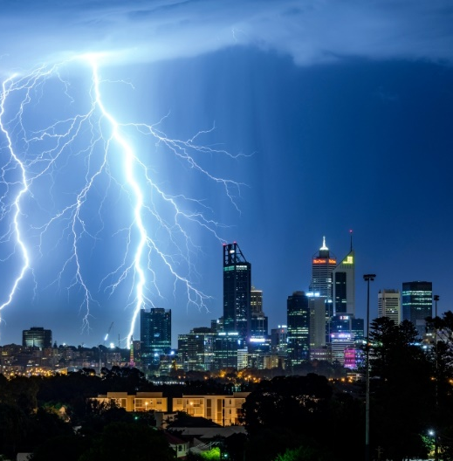
water park

Slide 8
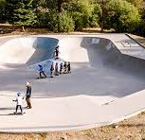


skate park

Slide 9
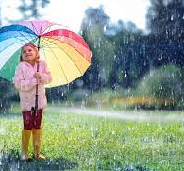
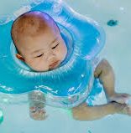
library

Slide 10
monkey

Slide 11
snake

Slide 12
library

Slide 13

It’s time to learn …

Slide 14

Reading

Slide 15

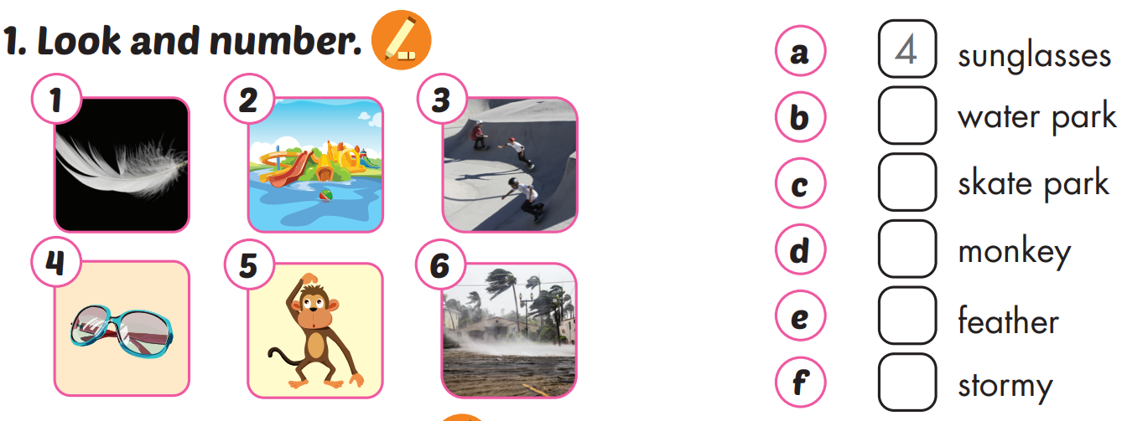
2
3
5
1
6

Slide 16

Reading

Slide 17

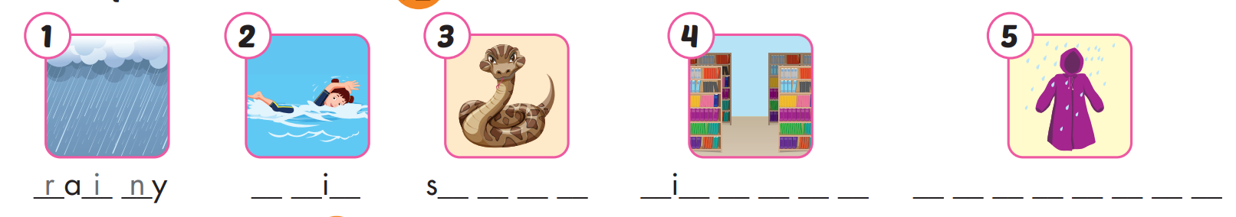
sw m
n a k e
l b r a r y
r a i n c o a t

Slide 18

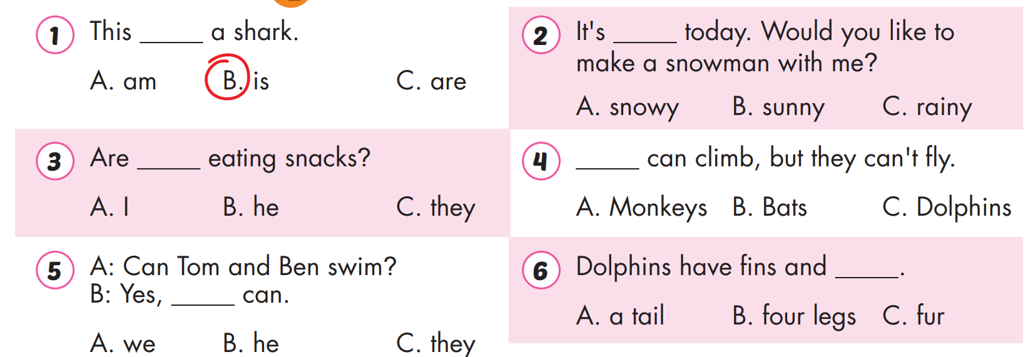


Slide 19

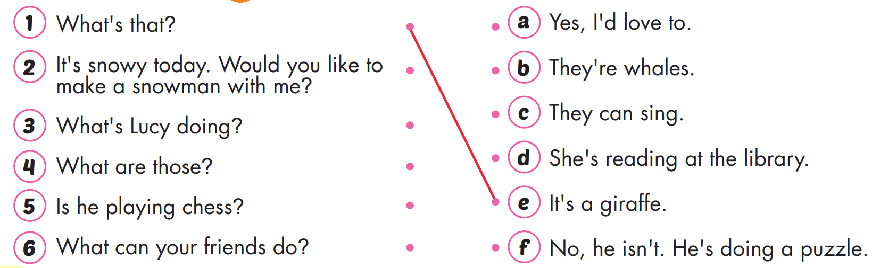

Slide 20

WRAP-UP

Slide 21
Today’s lesson
Vocabularies
Vocabulary: Review: " sunglasses, water park, skate park, monkey, feather, stormy, rainy, swim, snake, library, raincoat."
Structures/ Sentence patterns
Review: "This is a monkey. These are monkeys. Bring your sunglasses because it's sunny today. OK, thank you. That's a snake. Those are snakes. What's the weather like today? It's sunny. What do you like doing when it's hot? I like swimming."

Slide 22
Homework
Practice the vocabularies and structure; and make sentences using them.
Prepare the next lesson (page 63 SB)
Play the consolidation games in Tiếng Anh 4 i-Learn Smart Start DHA App on www.eduhome.com.vn

Slide 23

Enjoy your day!

