Slide 1

Ngoc Lam
Primary School
Review Units 1-4
Part 2
Page 63

Slide 2
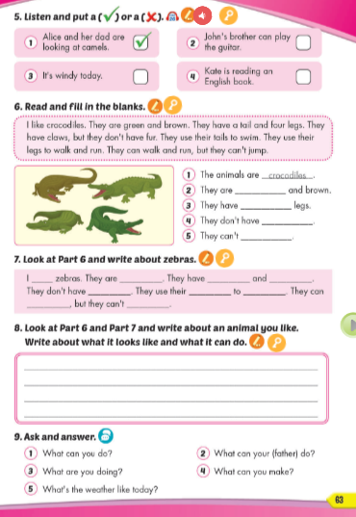
Lesson Outline
Warm-up
Writing
Speaking
Wrap-up

Slide 3
Objectives
By the end of this lesson, students will be able to…
Vocabulary: Review: ferry, well, go bowling, buy candy, stay at home, fast, third, science, thirsty, noisy, helicopter
Structure: Review: Ella's favorite subject is math; Matt likes using computers; The computer club was at 4 p.m; Matt was at the movie theater with his sister and mom; The computer club was noisy yesterday.

Slide 4

WARM-UP

Slide 5

FLASH NOTE
Look and choose

Slide 6


Click on the correct option.
well
ferry
stay at home
buy candy

Slide 7
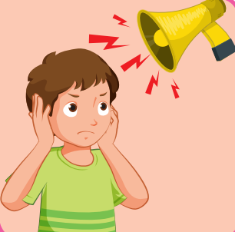
Click on the correct option.
well
go bowling
ferry
noisy

Slide 8

Click on the correct option.
helicopter
buy candy
fast
well

Slide 9
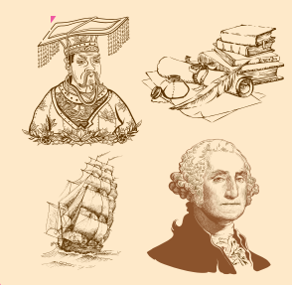
Click on the correct option.
noisy
well
history
science

Slide 10
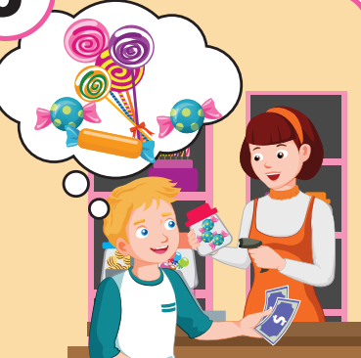
Click on the correct option.
fast
history
buy candy
science

Slide 11
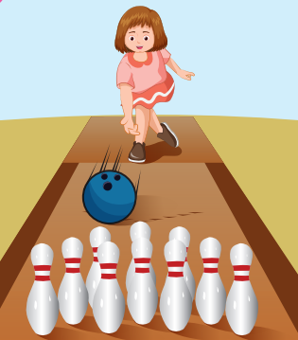
Click on the correct option.
go bowling
history
third
noisy

Slide 12

It’s time to learn …

Slide 13

Writing

Slide 14



PRE-WRTING
What else do you and your friends like doing on the weekends?
What do you and your friends like doing on the weekends?
What’s your name?
What do you and your friend like doing?
What do you and your friends not like doing?
...

Slide 15
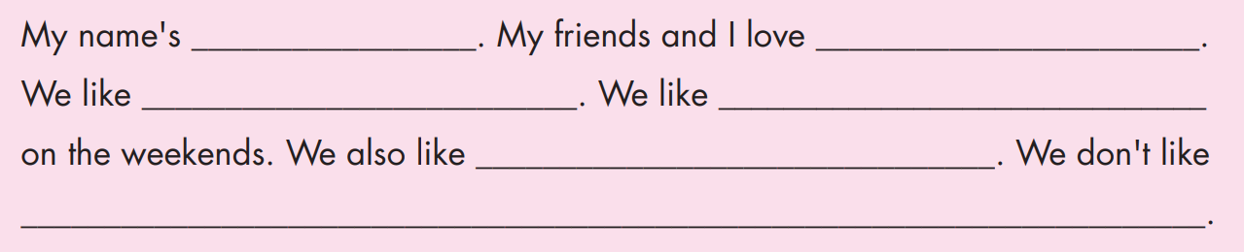
Notes:
Click vào hình A. 1. Listen and point. Repeat để cho cả audio full chạy

Slide 16
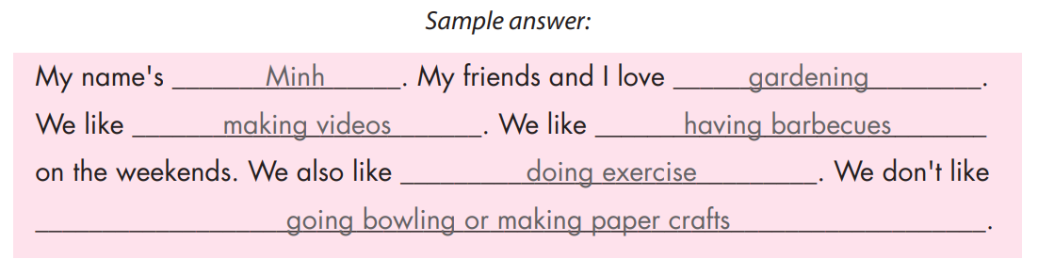
Notes:
Click vào hình A. 1. Listen and point. Repeat để cho cả audio full chạy

Slide 17
Reading & Writing

Slide 18
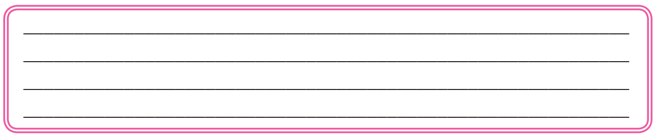

Slide 19
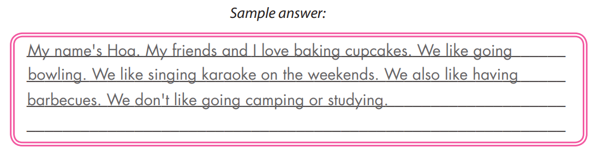

Slide 20

Extra Practice
Present your work to the class.
Suggested Answers
Good morning, everyone. My name is ……………. Today, I’m going to tell you about what I and my friends like doing and what we don’t like doing. We like ……..

Slide 21

Speaking

Slide 22

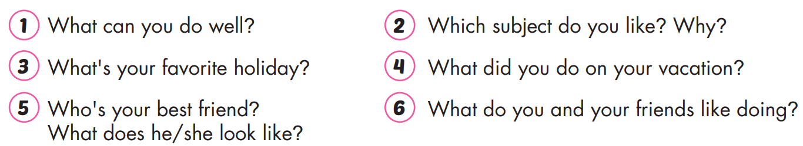

Slide 23
Use the same questions to ask another partner. Record his/ her answers.
Extra Practice

Slide 24
Report what your partner told you to the class.
Extra Practice
For Fast Finshers

Slide 25

WRAP-UP

Slide 26
Today’s lesson
Structures/ Sentence patterns
Review: Ella's favorite subject is math; Matt likes using computers; The computer club was at 4 p.m; Matt was at the movie theater with his sister and mom; The computer club was noisy yesterday.
Vocabularies
Review: ferry, well, go bowling, buy candy, stay at home, fast, third, science, thirsty, noisy, helicopter

Slide 27
Homework
Review the vocabularies and structure, and make sentences using them.
Prepare the next lesson (page 64 SB)
Play the consolidation games in Tiếng Anh 5 i-Learn Smart Start DHA App on www.eduhome.com.vn

Slide 28

Enjoy your day!

Slide 29

Lesson 3
Stay positive and have a nice day!

