Slide 1

Ngoc Lam
Primary School
Review Units 1-4
Part 1
Page 62

Slide 2
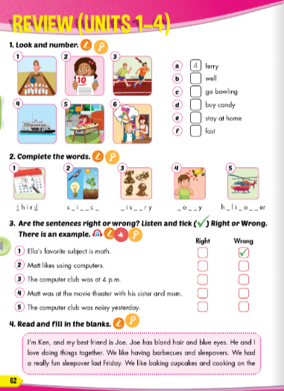
Lesson Outline
Warm-up
Vocabulary
Reading
Listening
Wrap-up

Slide 3
Objectives
By the end of this lesson, students will be able to…
Vocabulary: Review: ferry, well, go bowling, buy candy, stay at home, fast, third, science, thirsty, noisy, helicopter
Structure: Review: Ella's favorite subject is math; Matt likes using computers; The computer club was at 4 p.m.; Matt was at the movie theater with his sister and mom; The computer club was noisy yesterday.

Slide 4

WARM-UP

Slide 5
CHECK YOUR MEMORY

Slide 6
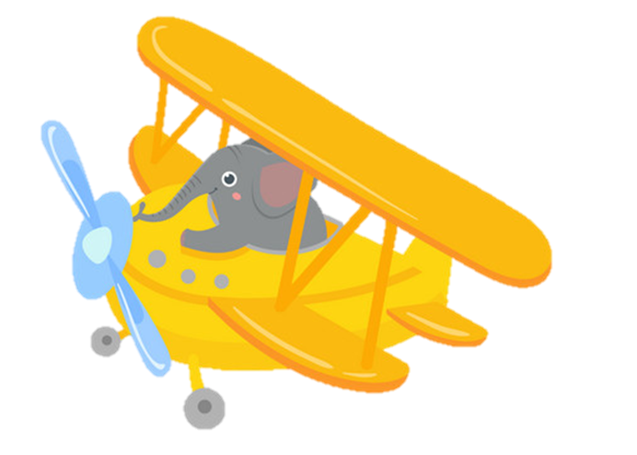


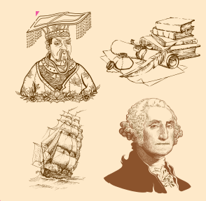
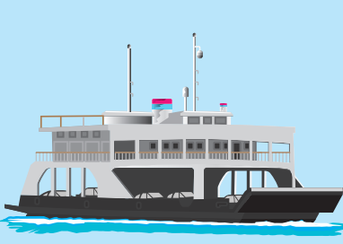
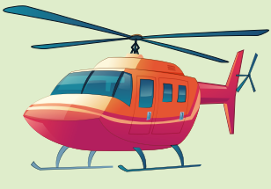
ferry
A.
B.
C.

Slide 7
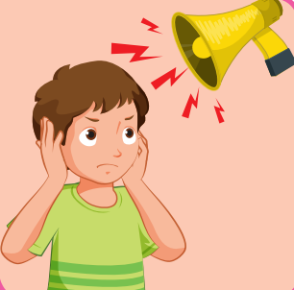

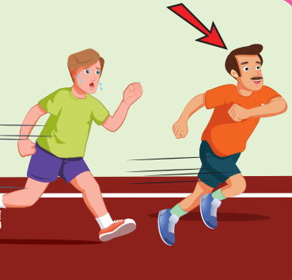
noisy
A.
B.
C.

Slide 8
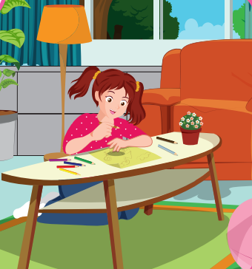
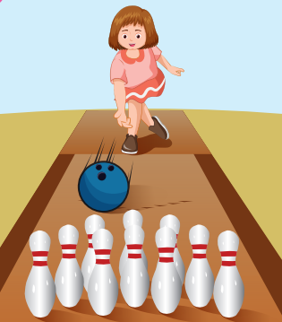
well
A.
B.
C.

Slide 9
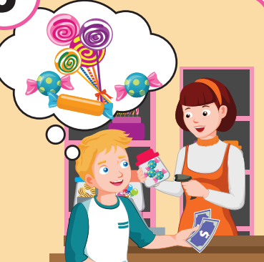
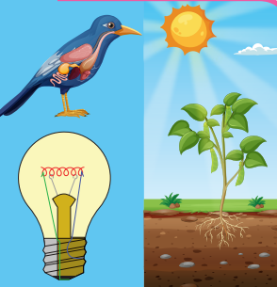
history
A.
B.
C.

Slide 10

third
A.
B.
C.

Slide 11
science
A.
B.
C.

Slide 12
buy candy
A.
B.
C.

Slide 13
fast
A.
B.
C.

Slide 14
stay at home
A.
B.
C.

Slide 15
go bowling
A.
B.
C.

Slide 16

It’s time to learn …

Slide 17
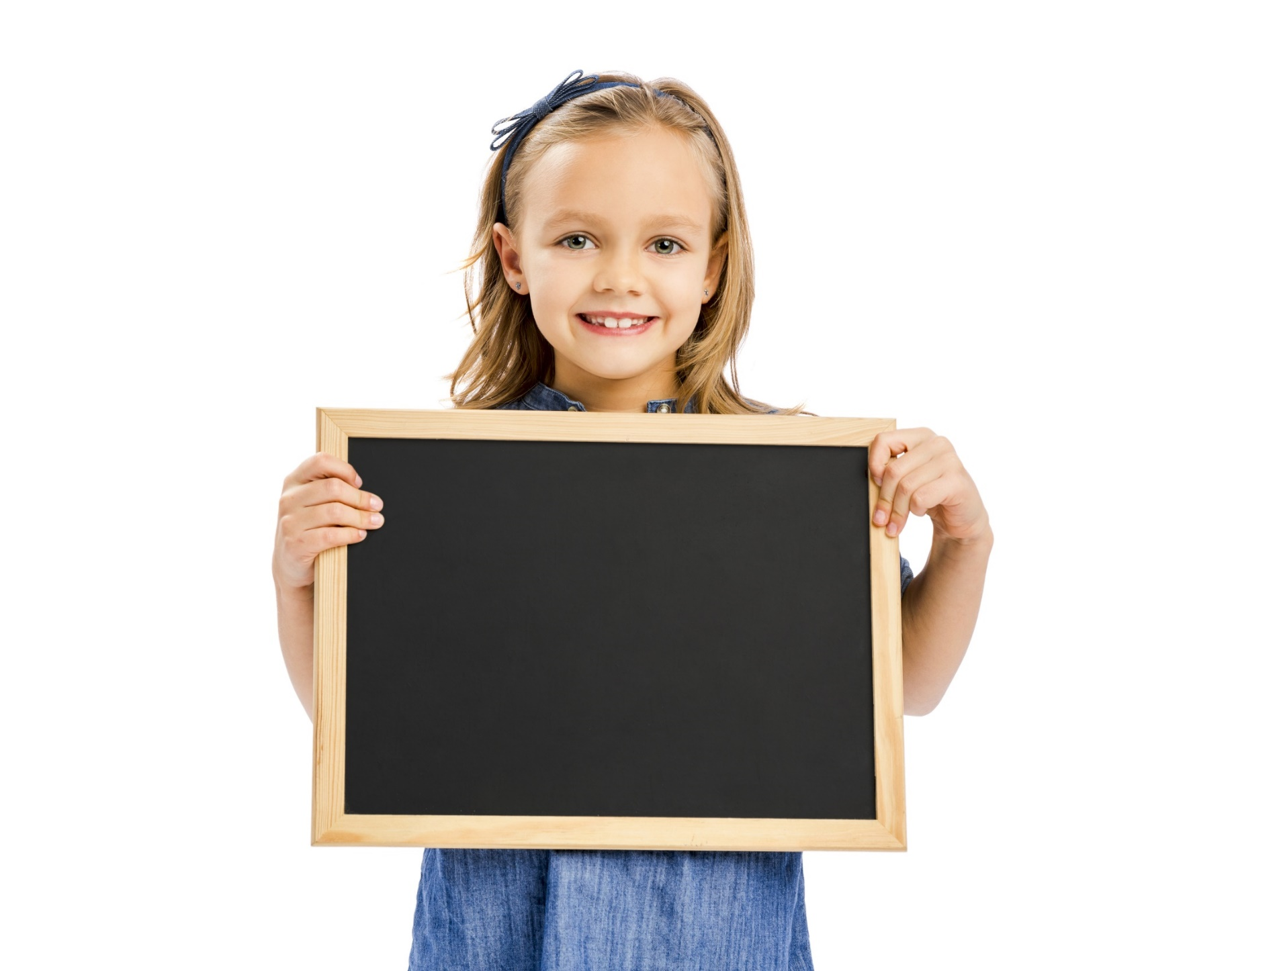
Vocabulary

Slide 18

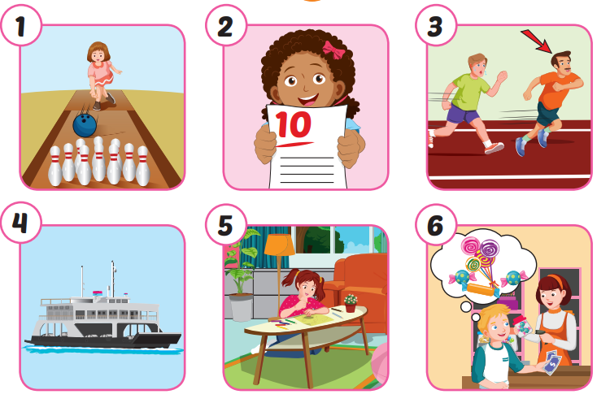
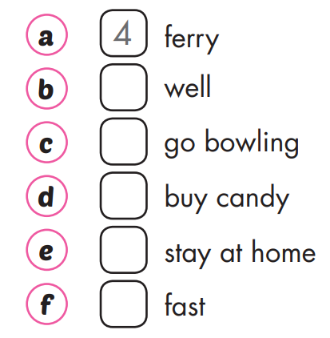
2
1
6
5
3
Notes:
Click vào hình A. 1. Listen and point. Repeat để cho cả audio full chạy

Slide 19

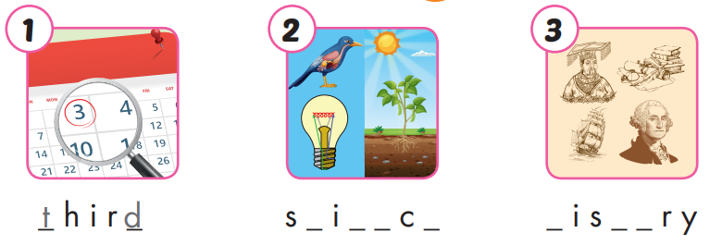
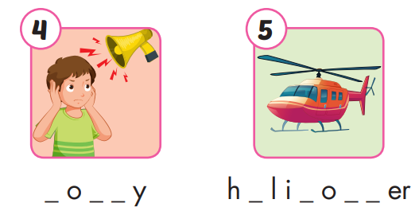
c e n e
h t o
n i s
e c p t

Slide 20
Listening

Slide 21

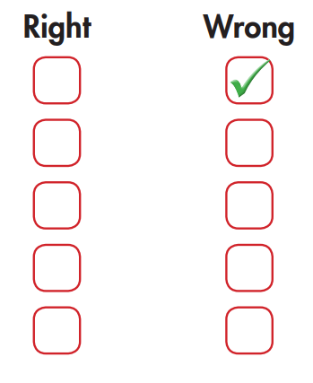
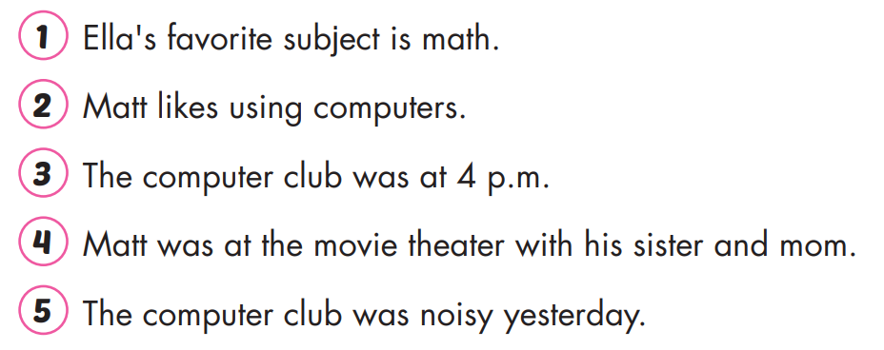


Slide 22


Extra Practice
Listen and fill in the blanks.
subject
B: What's your favorite (1) ___________, Ella?
G: It's science because I like doing experiments.
G: How about you, Matt? I know you like (2) _________. Do you like I.T.?
B: Yes, I do. I like it because I like using computers.
G: Cool. Where were you yesterday? We had computer club at (3) ____________o'clock.
B: I was at the movie theater with my sister and dad.
G: Oh, that's nice. How was the movie?
B: It was OK. It was really (4) ________.
G: That sounds fun. I like scary movies.
B: I don't like them. I like funny movies. How was computer club?
G: It was fun, but it was also really (5) ___________. Nancy had a fun new game, and we all played it. Everyone loved it
computers
four
scary
noisy

Slide 23
Reading

Slide 24

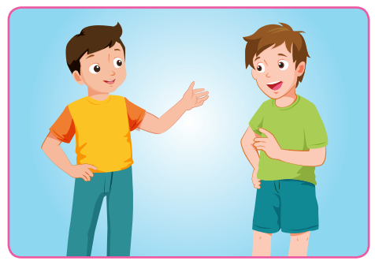
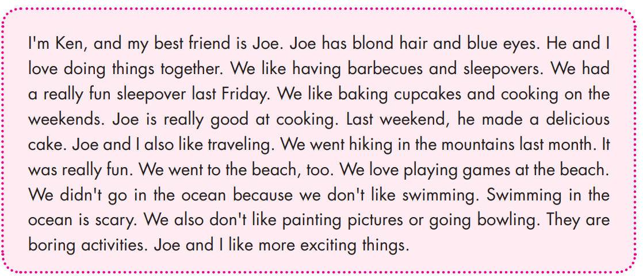

Slide 25
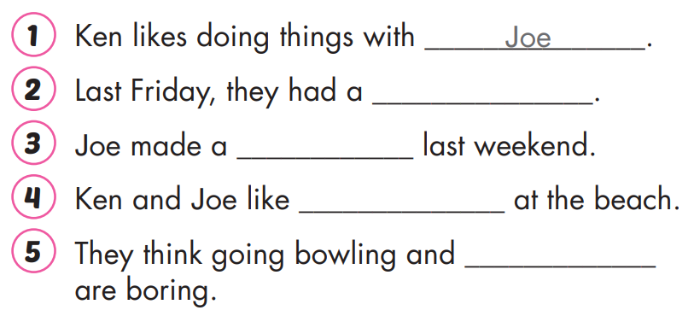
(fun) sleepover
(delicous) cake
playing games
painting pictures.

Slide 26
Extra Practice
Read and write T (True) or F (False).
I'm Ken, and my best friend is Joe. Joe has blond hair and blue eyes. He and I love doing things together. We like having barbecues and sleepovers. We had a really fun sleepover last Friday. We like baking cupcakes and cooking on the weekends. Joe is really good at cooking. Last weekend, he made a delicious cake. Joe and I also like traveling. We went hiking in the mountains last month. It was really fun. We went to the beach, too. We love playing games at the beach. We didn't go in the ocean because we don't like swimming. Swimming in the ocean is scary. We also don't like painting pictures or going bowling. They are boring activities. Joe and I like more exciting things.
F
1. Joe isn't Ken's best friend. ________
T
2. They like having barbecues and sleepovers. ________
F
3. They like baking cupcakes and cooking on the beach. ________
4. They went hiking in the mountains last year. ________
F
T
5. Swimming in the ocean is scary. ________

Slide 27

WRAP-UP

Slide 28
Today’s lesson
Structures/ Sentence patterns
Review: Ella's favorite subject is math; Matt likes using computers; The computer club was at 4 p.m; Matt was at the movie theater with his sister and mom; The computer club was noisy yesterday.
Vocabularies
Review: ferry, well, go bowling, buy candy, stay at home, fast, third, science, thirsty, noisy, helicopter

Slide 29
Homework
Review the vocabularies and structure; and make sentences using them.
Prepare the next lesson (page 63 SB)
Play the consolidation games in Tiếng Anh 5 i-Learn Smart Start DHA App on www.eduhome.com.vn

Slide 30

Enjoy your day!

Slide 31
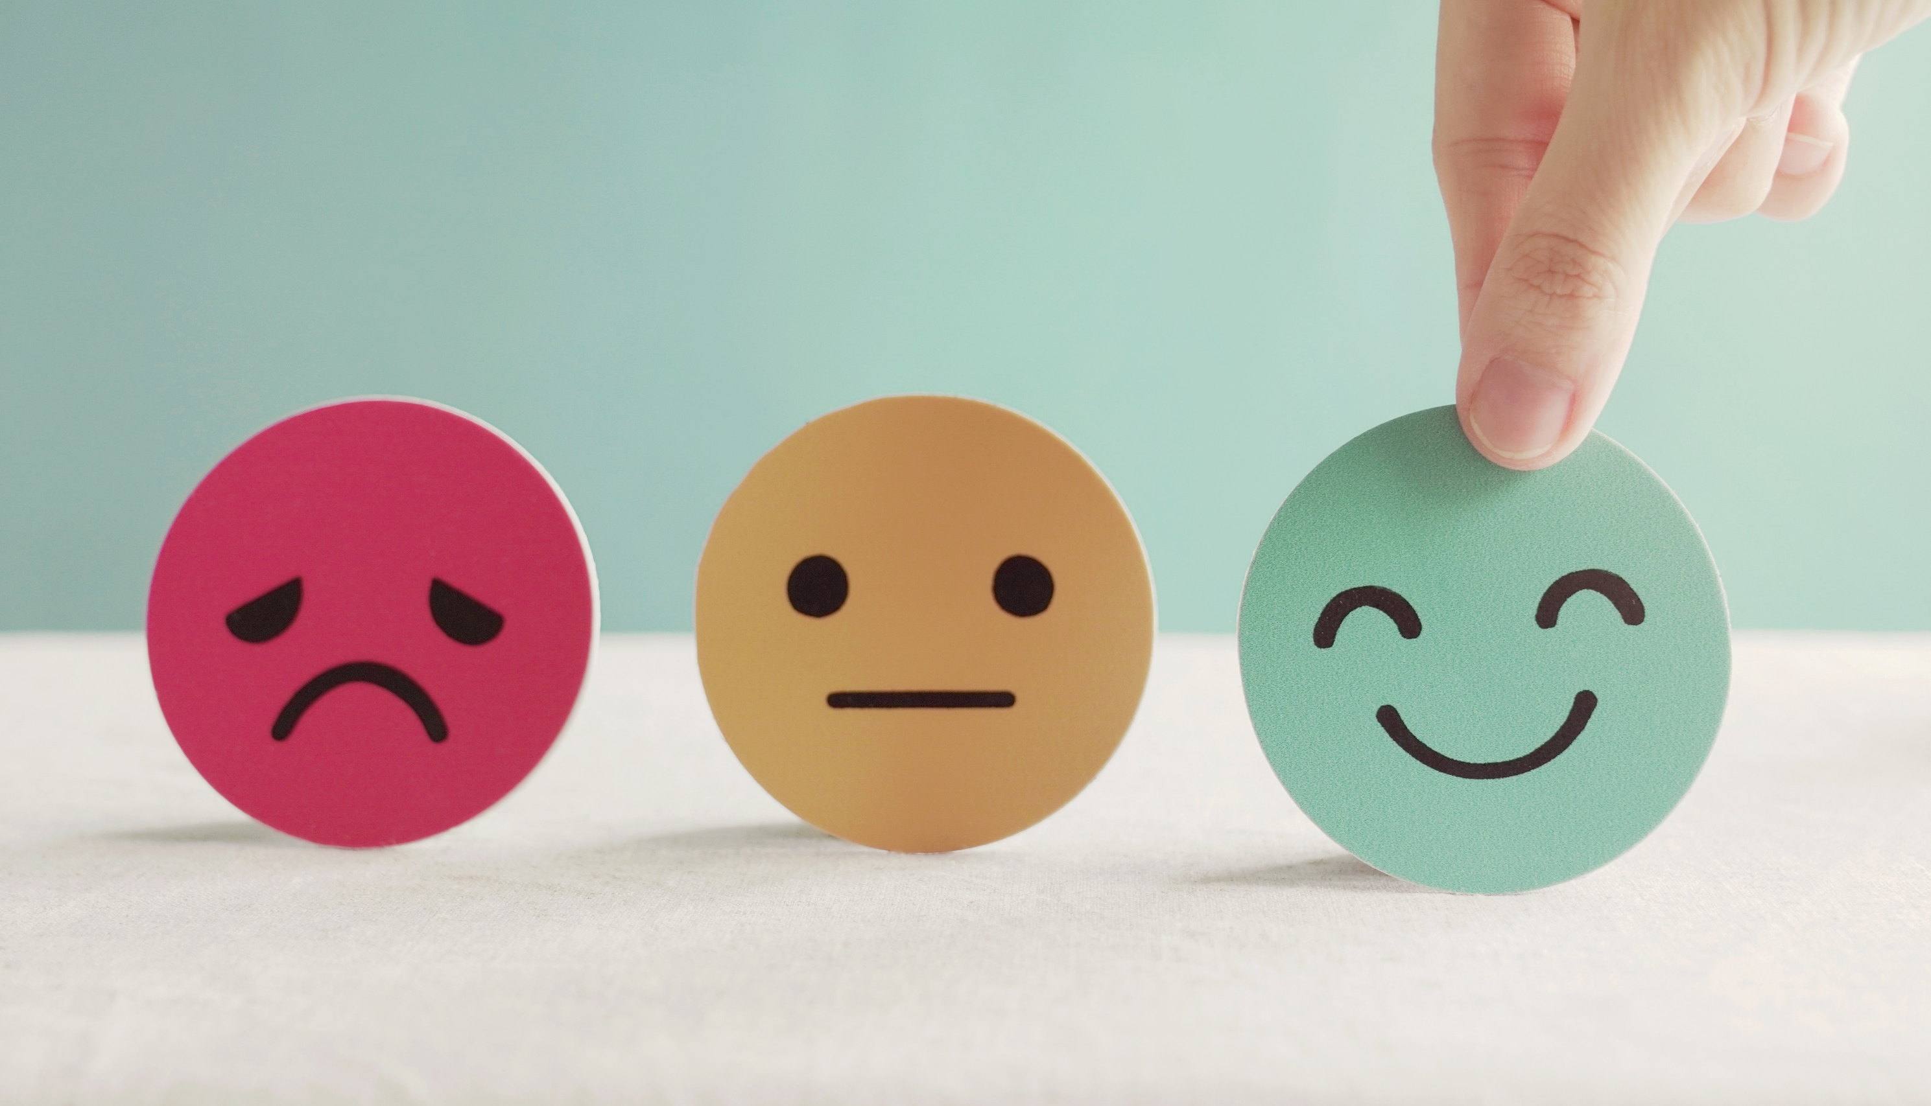
Lesson 3
Stay positive and have a nice day!

