Slide 1














REVIEW 6: PART 4

Slide 2




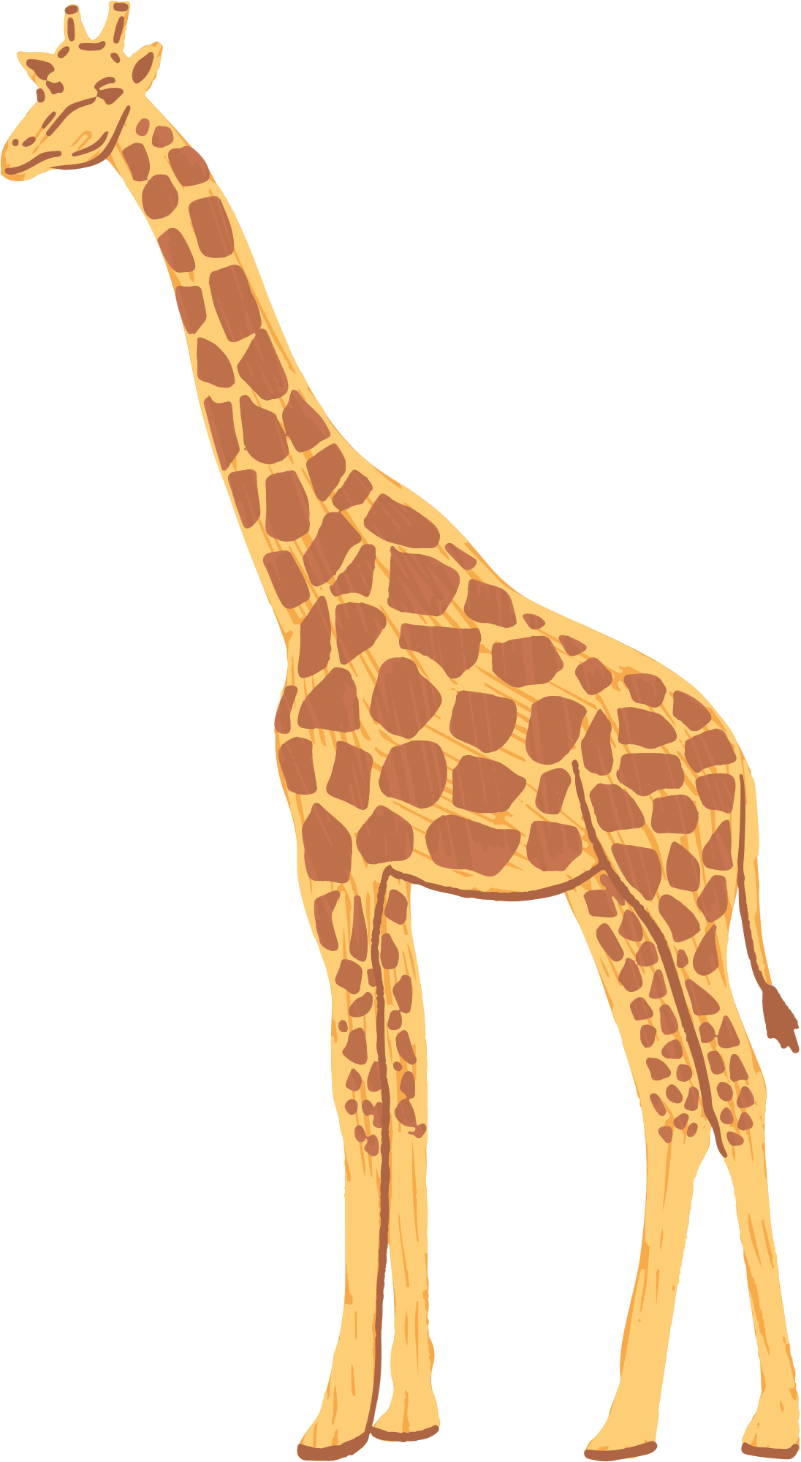



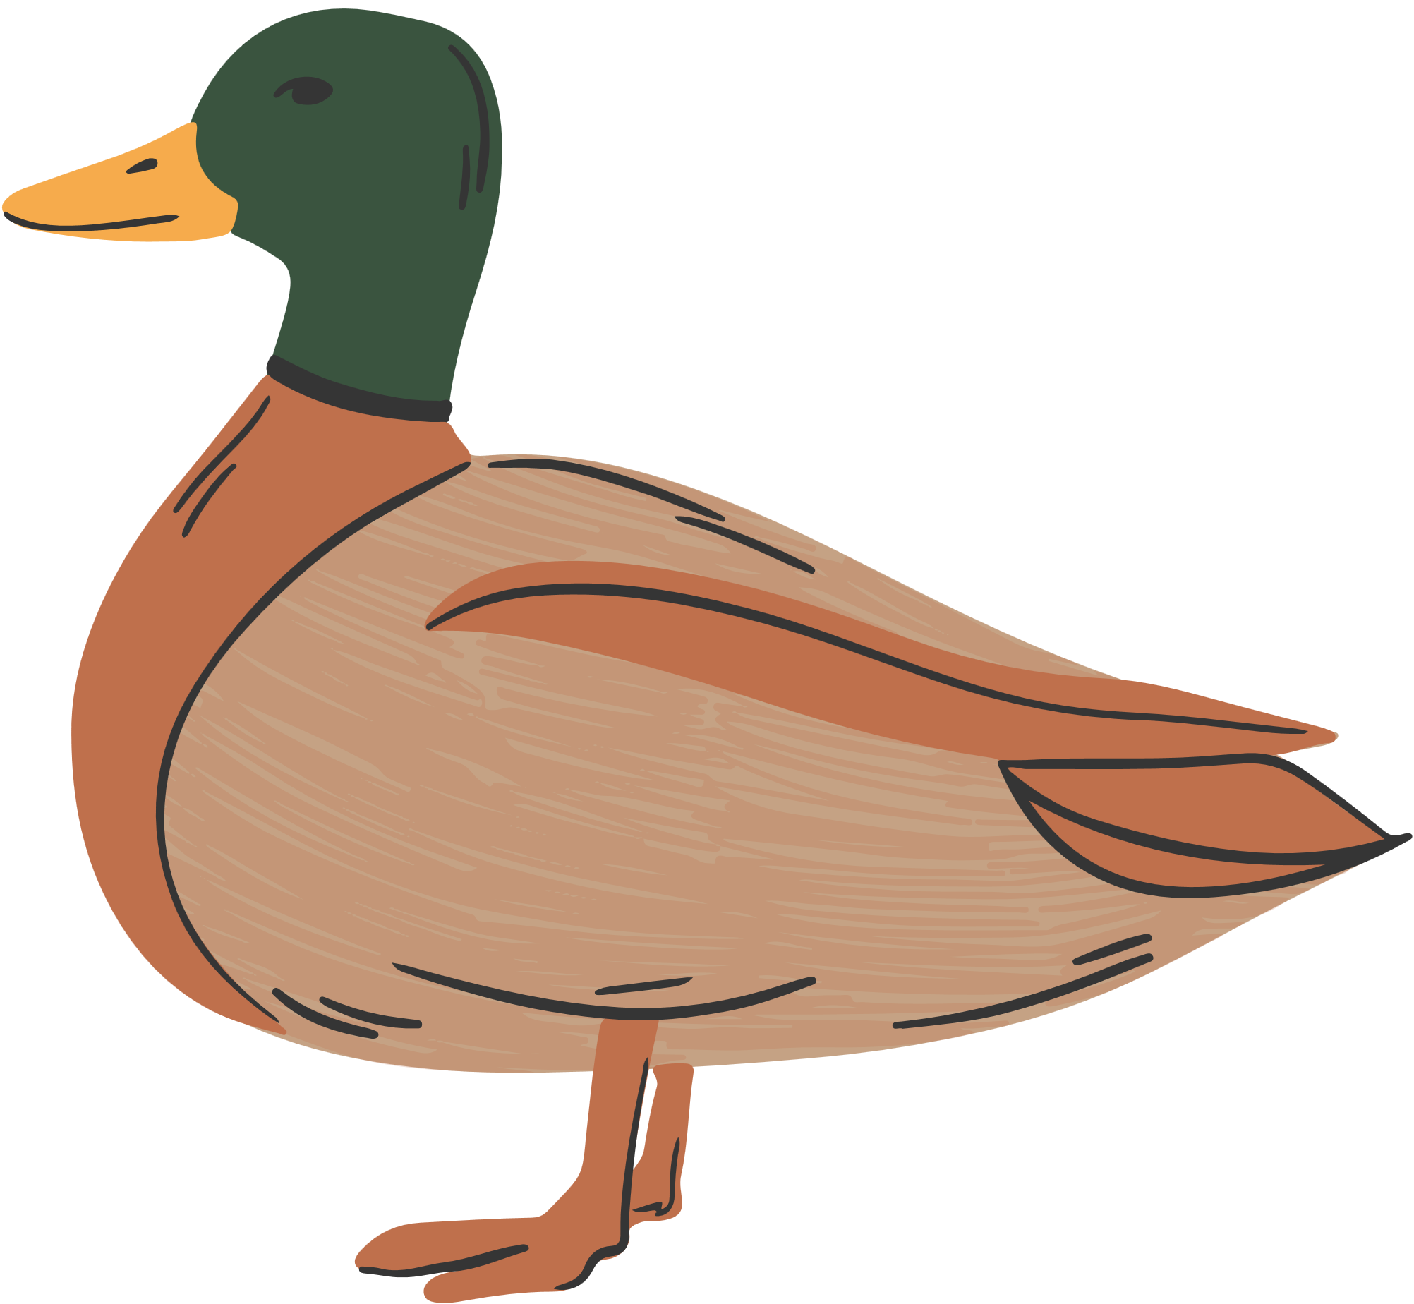
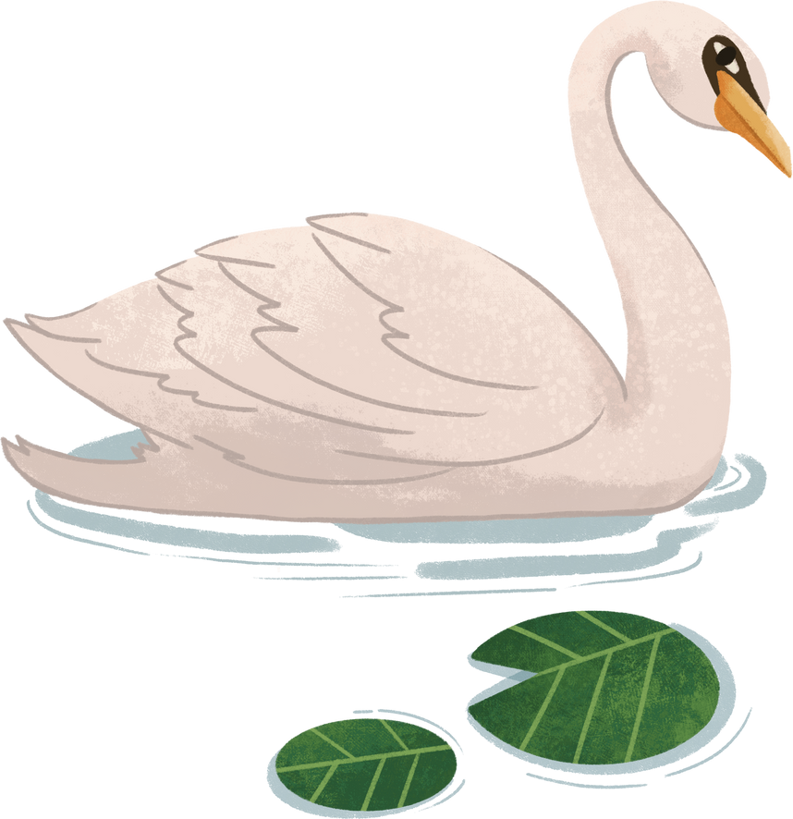


SPEAKING
Work in pairs. Discuss these questions below:
1. What is your favorite animal, and why do you like it?
2. Name five animals that live in the ocean.
3. What is an animal you would like to have as a pet, and why?
4. What is the fastest land animal, and how fast can it run?
5. Can you think of an animal that can fly, swim, and walk?

