Slide 1



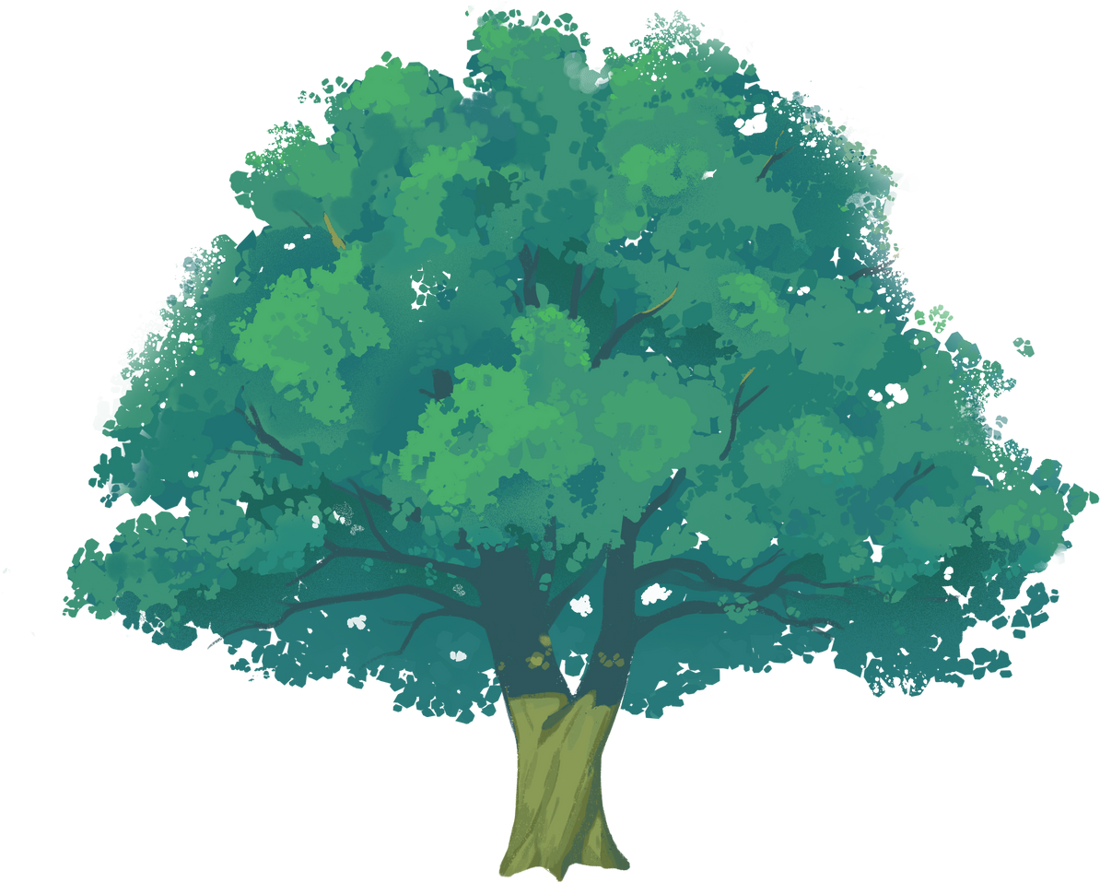
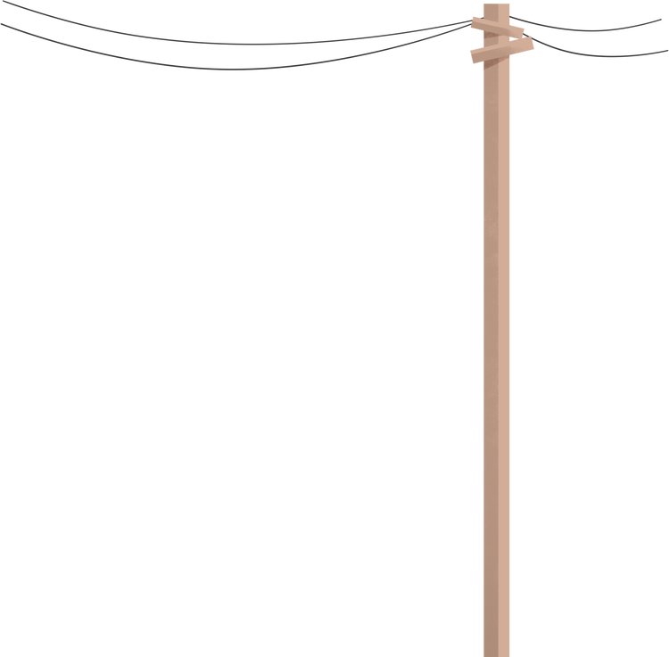
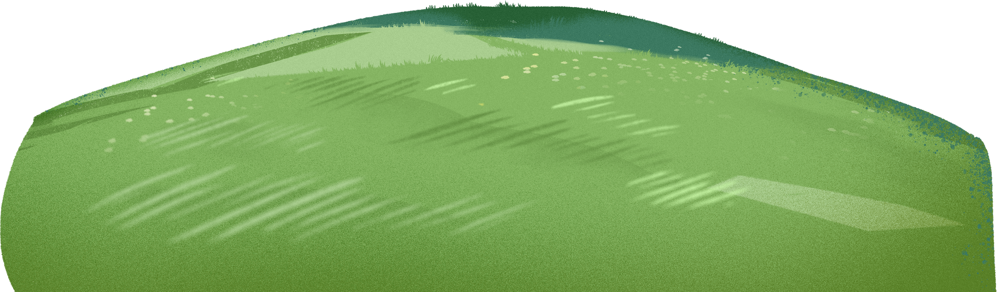
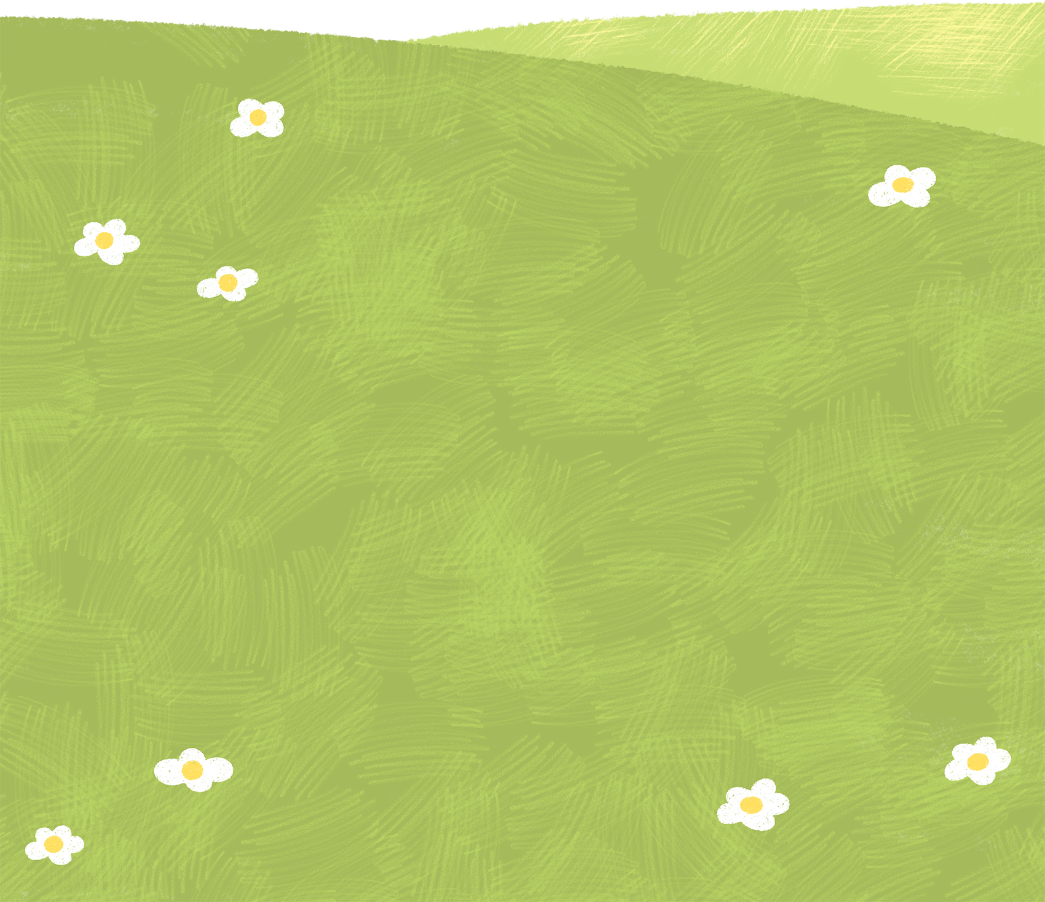

1 Complete the dialogue with the correct form of “be going to” and the verbs in the box.
Vicky: (1) ___________________ on holiday?
Mark: No, I am not. I (2) _______________ at home.
Vicky: What (3) _____ you _____________?
Mark: I (4) _______________ a tree house!
Vicky: On your own?
Mark: No, my dad (5) _______________ us.
Then we (6) _______________ all our friends there. You can come too.
Are you going to travel
travel
am going to stay
make
are
going to do
do
am going to make
stay
help
is going to help
are going to invite
invite

Slide 2
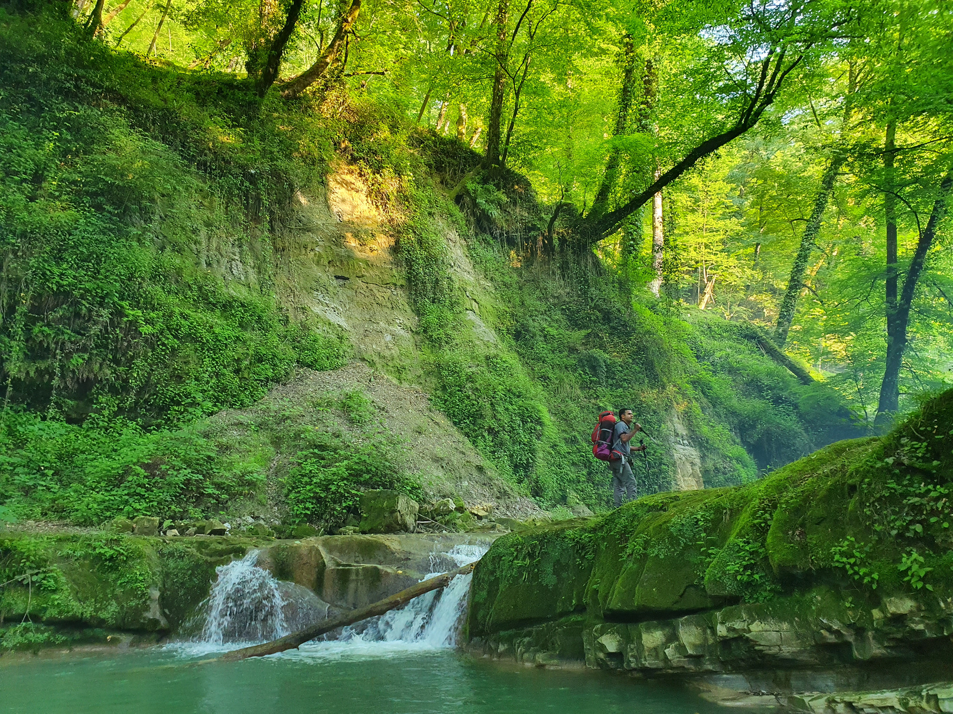


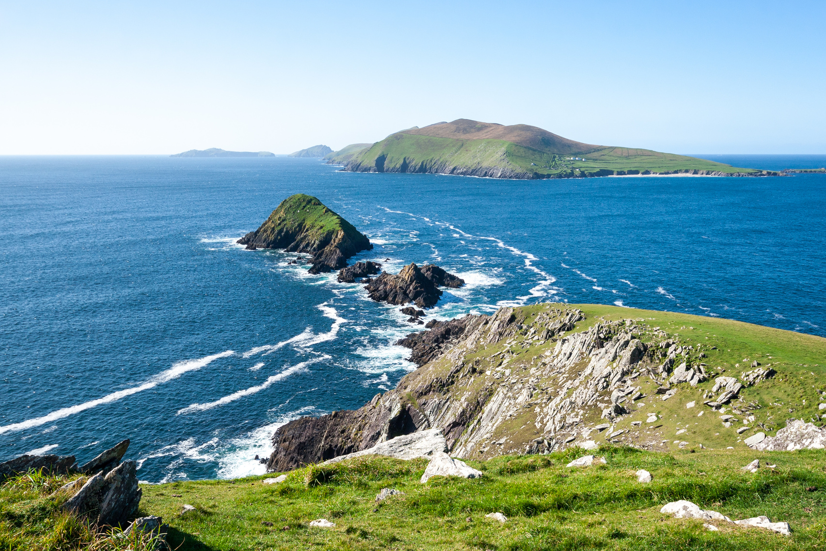

2 Choose the correct answer.
1. We are ____________ to see a water fall tomorrow.
a. go
b. going
2. ____________ the forest be here in 50 years?
a. Will
b. Going
3. Are we going ____________ lizards at the zoo?
a. to see
b. seeing

