Slide 1



REVIEW 4 : PART 2
Units 7 & 8

Slide 2



2 Complete sentences with and, so, but or because.
1 My friend plays tennis _____ football.
and
2 They were hungry, ____ they made some sandwiches.
so
3 He went to the shops, _____ he didn’t buy anything.
but
4 Nam walked slowly _________ he was tired.
because
so
5 The bike was expensive, ___ she didn’t buy it.

Slide 3
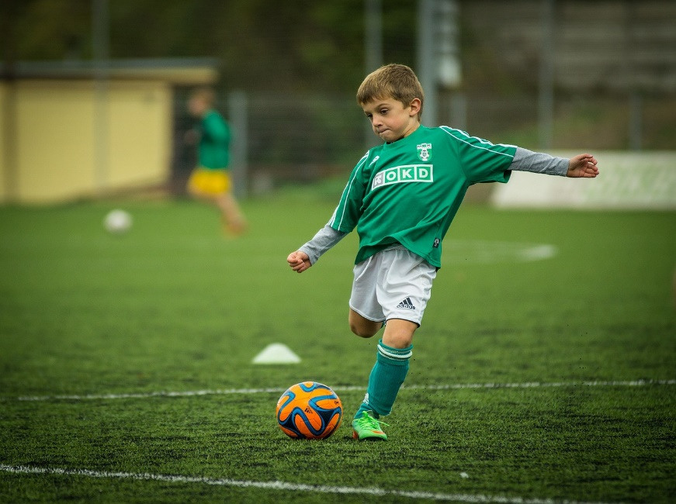
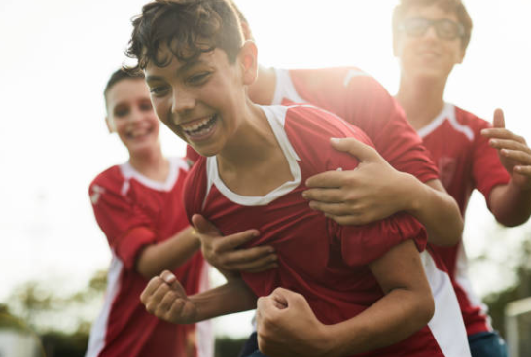
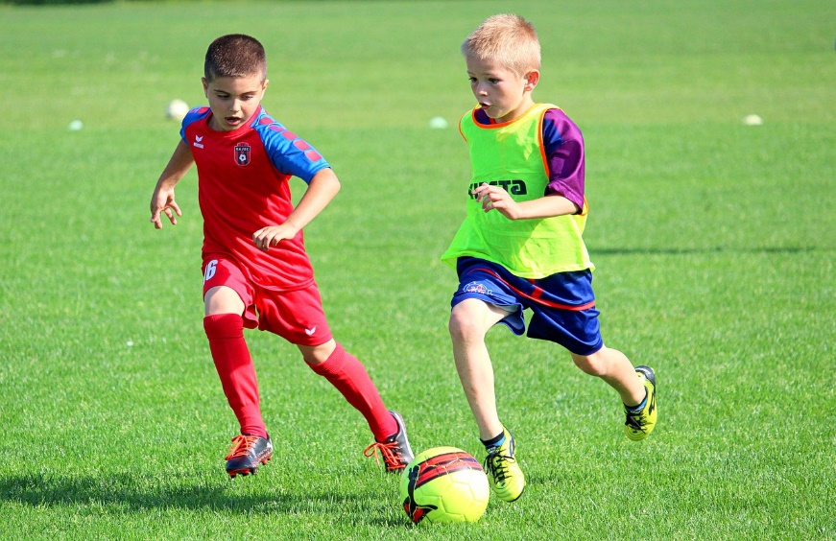
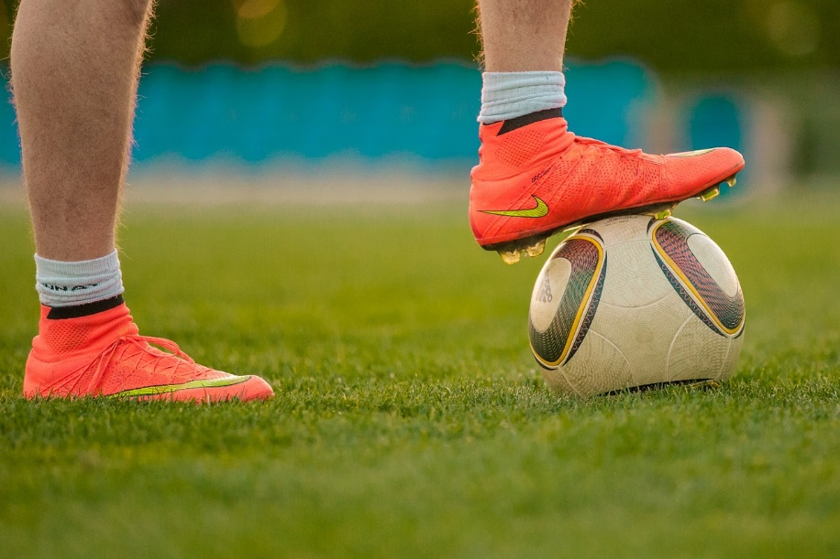
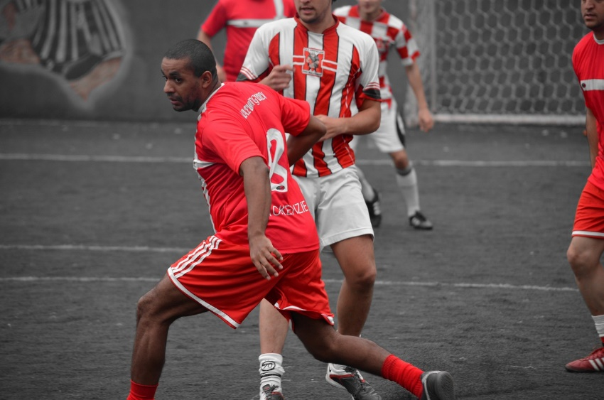
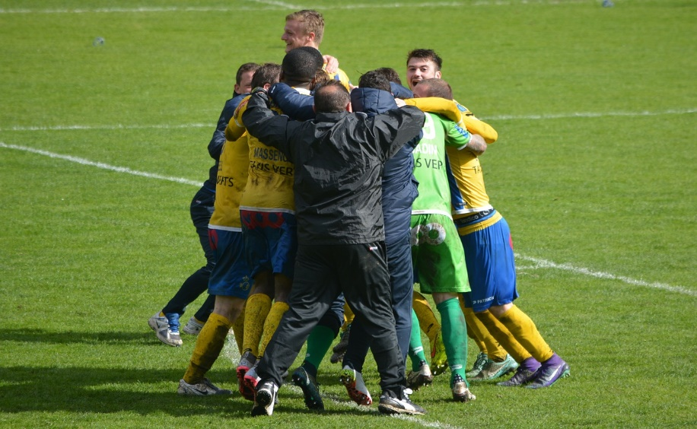
Look and match
playing
exciting
1
4
pass
push
2
team
5
shoes
3
6

Slide 4

3 Read the text. Choose the correct word next to numbers 1-7
playing
exciting
pass
push
team
shoes
ball
playing
exciting
I like ______ football. Football is fun and ________. You should always wear the right _______. You mustn’t use your hands to touch the ______, as only the goalkeeper can do it.
You should try to _____ the ball to your teammates and work together as a ______. You must always follow the rules of game. You shouldn’t play too rough and mustn’t ______ other players. Football is a great way to stay active and make new friends.
shoes
ball
pass
team
push

Slide 5




Odd one out.
1 a, exciting
b, happy
c, ball
2 a, climbing
b, dancing
c, jump
3 a, but
b, why
c, so
4 a, was
b, are
c, is

