Slide 1




Unit 8 - Lesson 2 – Period 2

Slide 2



4
Listen and repeat.
2. Teacher, can we surf the Internet?
- No, you can’t.
✔
1. Teacher, can we use the tablet?
❌
- Yes, you can.

Slide 3



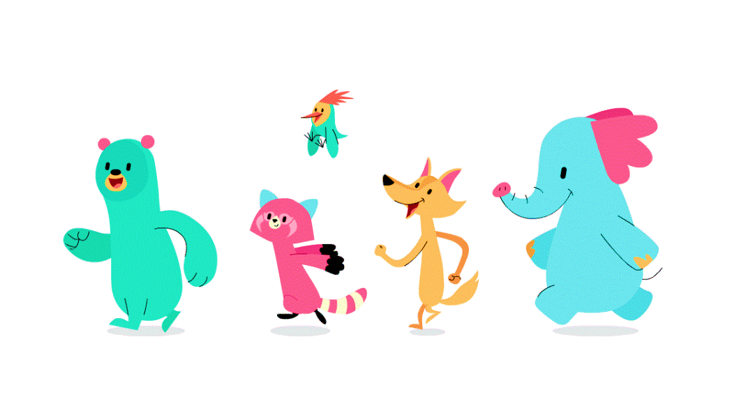


Practice
5
Look. Ask and answer.

Slide 4


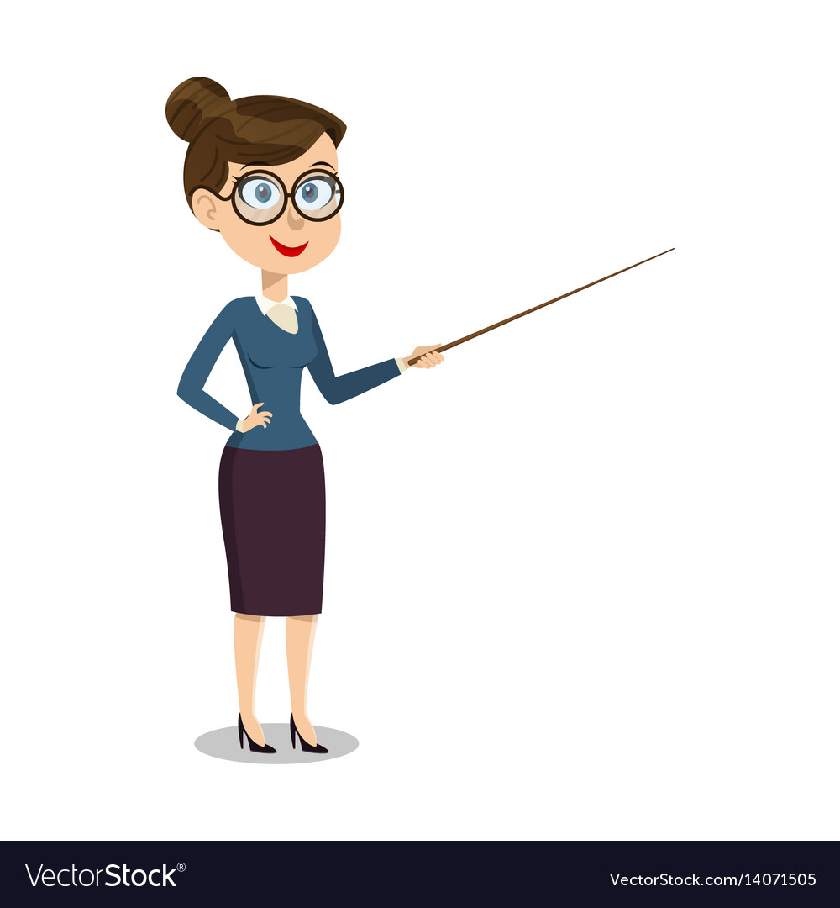


5
Look. Ask and answer.
Work in groups
✔
Teacher, can we work in groups?
Yes, you can.

Slide 5



Work in pairs
✔
Teacher, can we work in pairs?
Yes, you can.

Slide 6

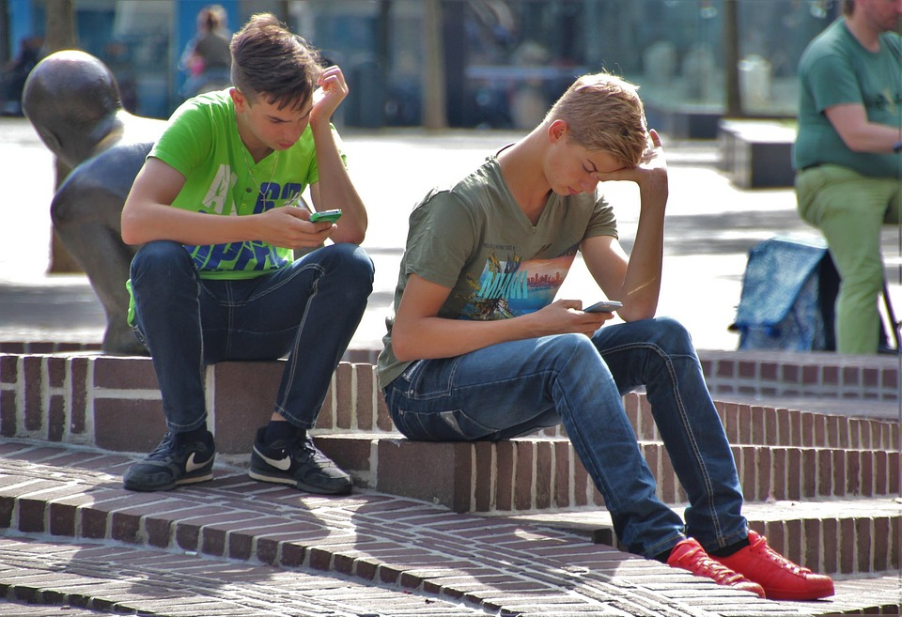
Use our smartphones
❌
Teacher, can we use our smartphones?
No, you can’t.

Slide 7


❌
Surf the Internet
Teacher, can we surf the Internet?
No, you can’t.

Slide 8
Use the tablet
❌
Teacher, can we use the tablet?
No, you can’t.

Slide 9

Production
6
Listen and chant.

