Slide 1



Unit 7: Jobs
Lesson 3
Task 4, 5, 6

Slide 2
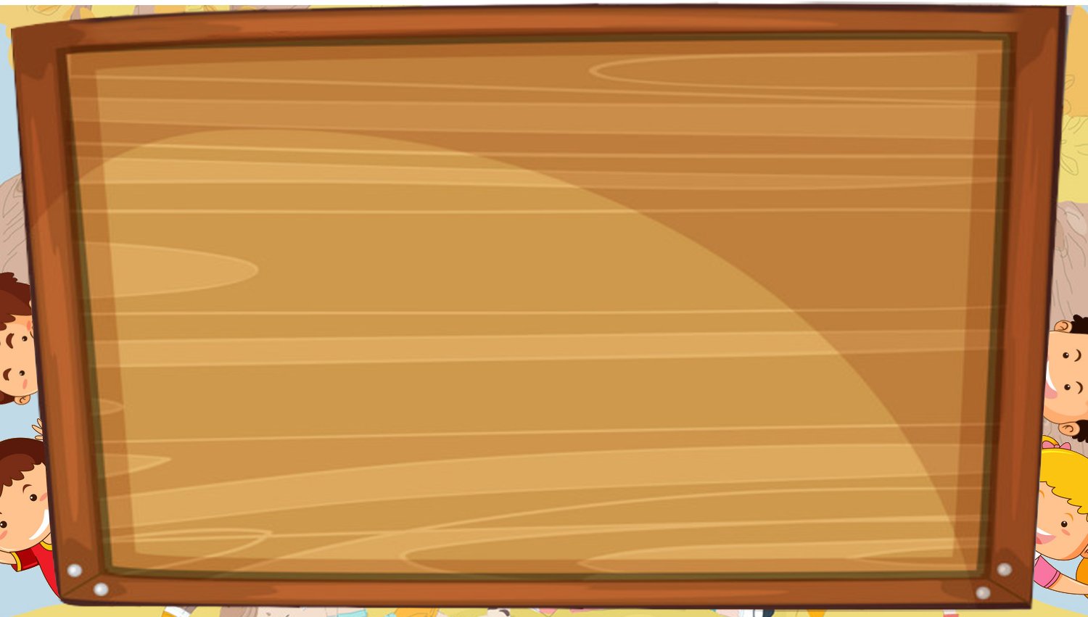
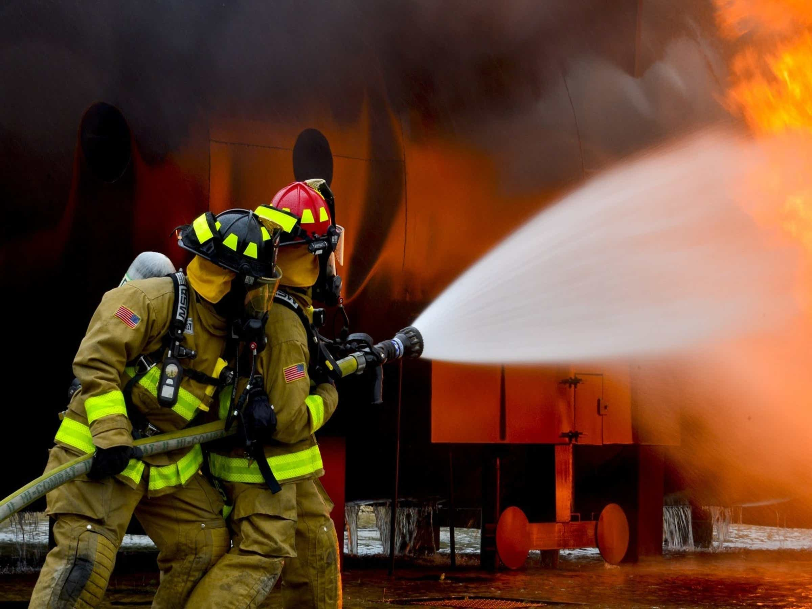
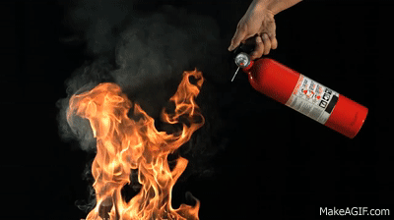
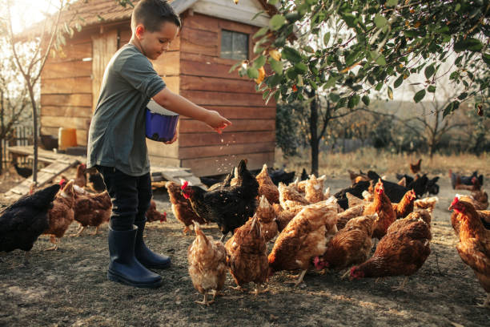
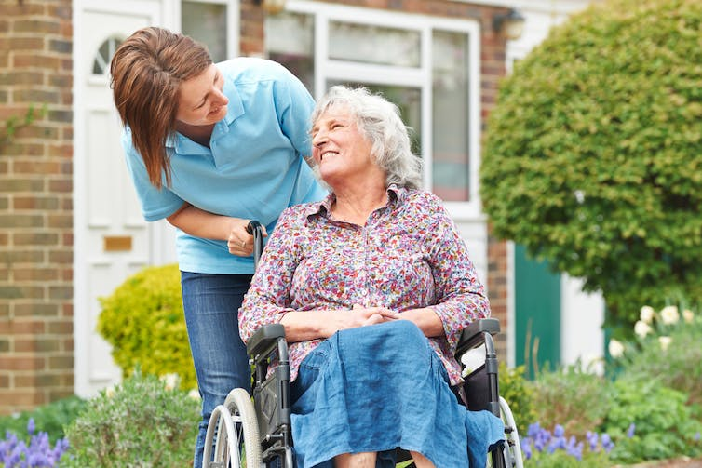
Listen and point. Repeat.
firefighter
put out fires
feed animals
take care of people

Slide 3
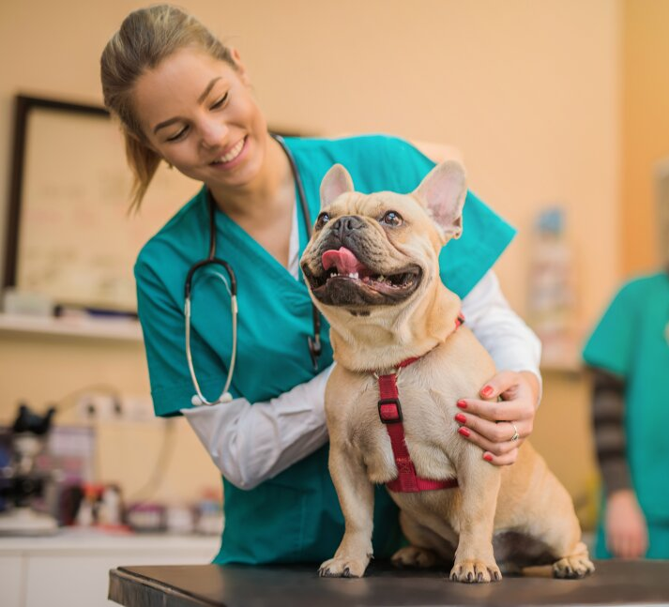

4. Listen and repeat.
What does a vet do?
A vet takes care of animals.

Slide 4
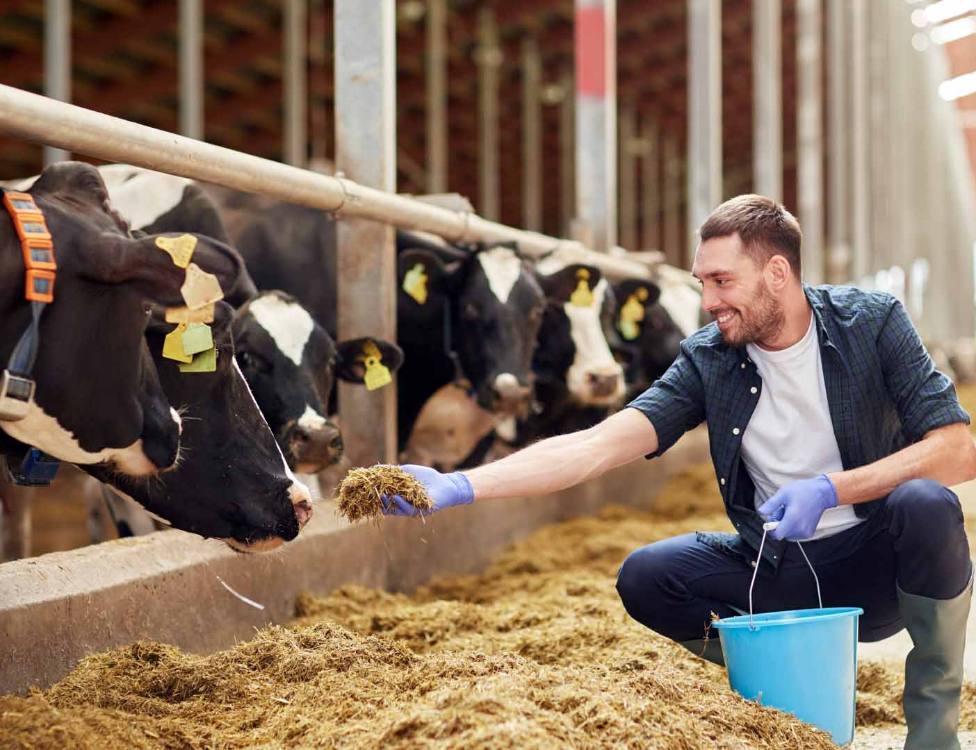
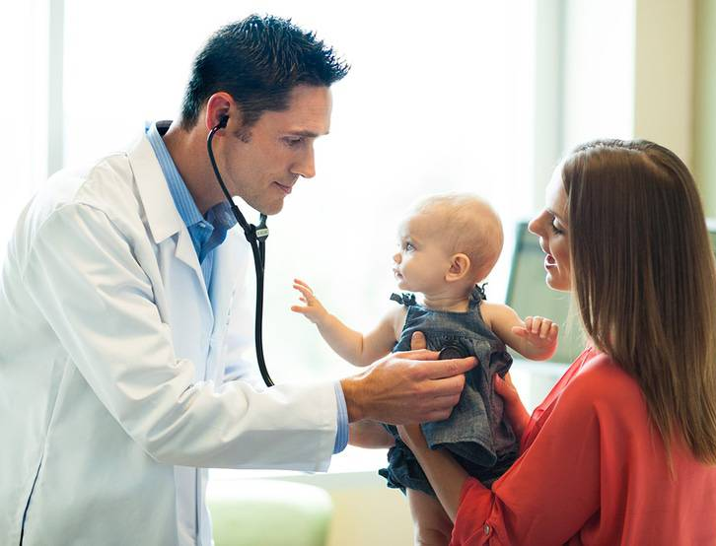
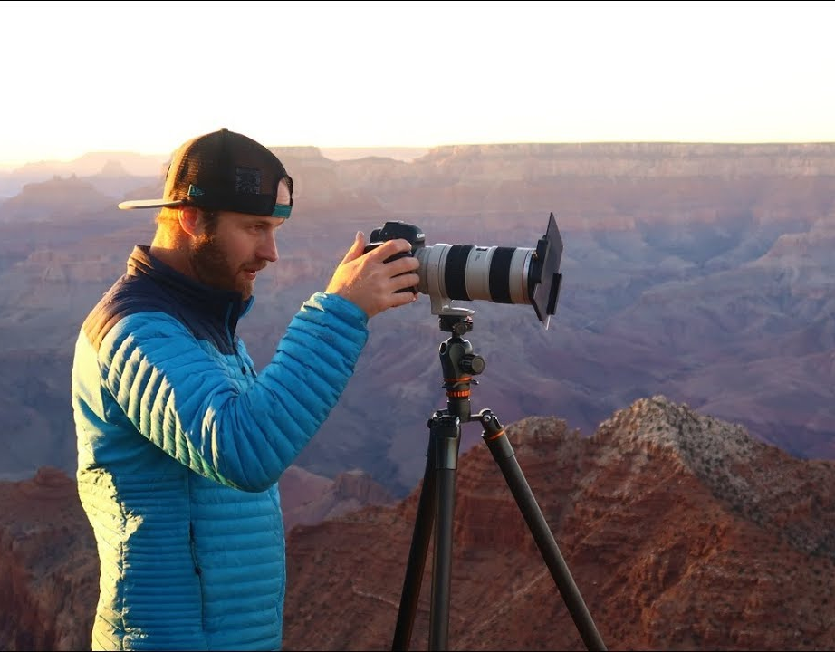
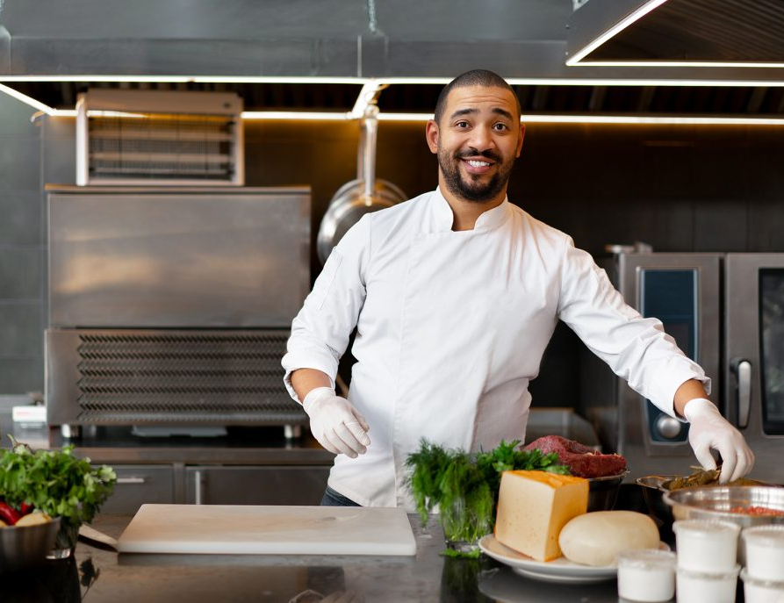
5. Look. Ask and answer.
What does a farmer do?
A farmer feeds animals.

Slide 5
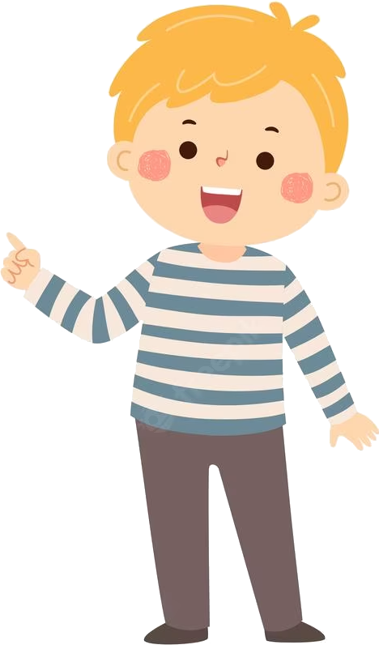
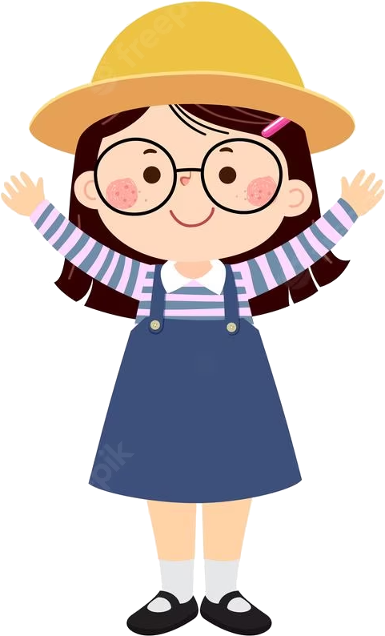
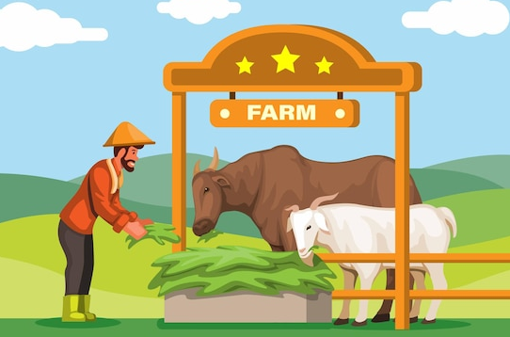
6. Role-play
What does he do?
He’s a farmer.
He works on a farm.
Where does he work?
What does he do everyday?
He feeds animals on the farm.

Slide 6
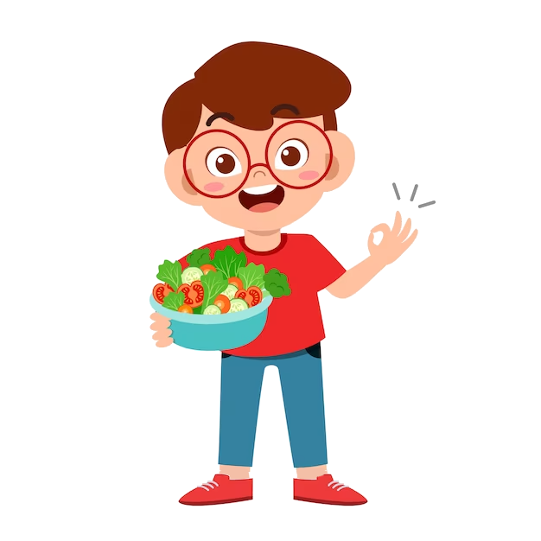
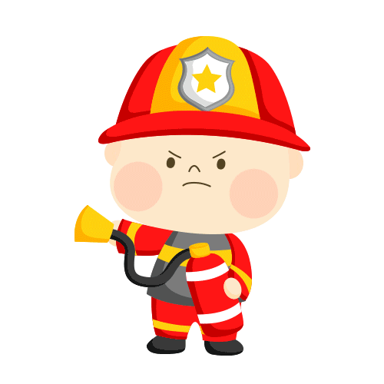
UNIT 7: JOBS
LESSON 3: PERIOD 2
What we learnt today:
1. Review vocabulary:
- firefighter, feed animals, put out fires, take care of
2. Structure:
What does a vet do?
A vet takes care of animals.

