Slide 1


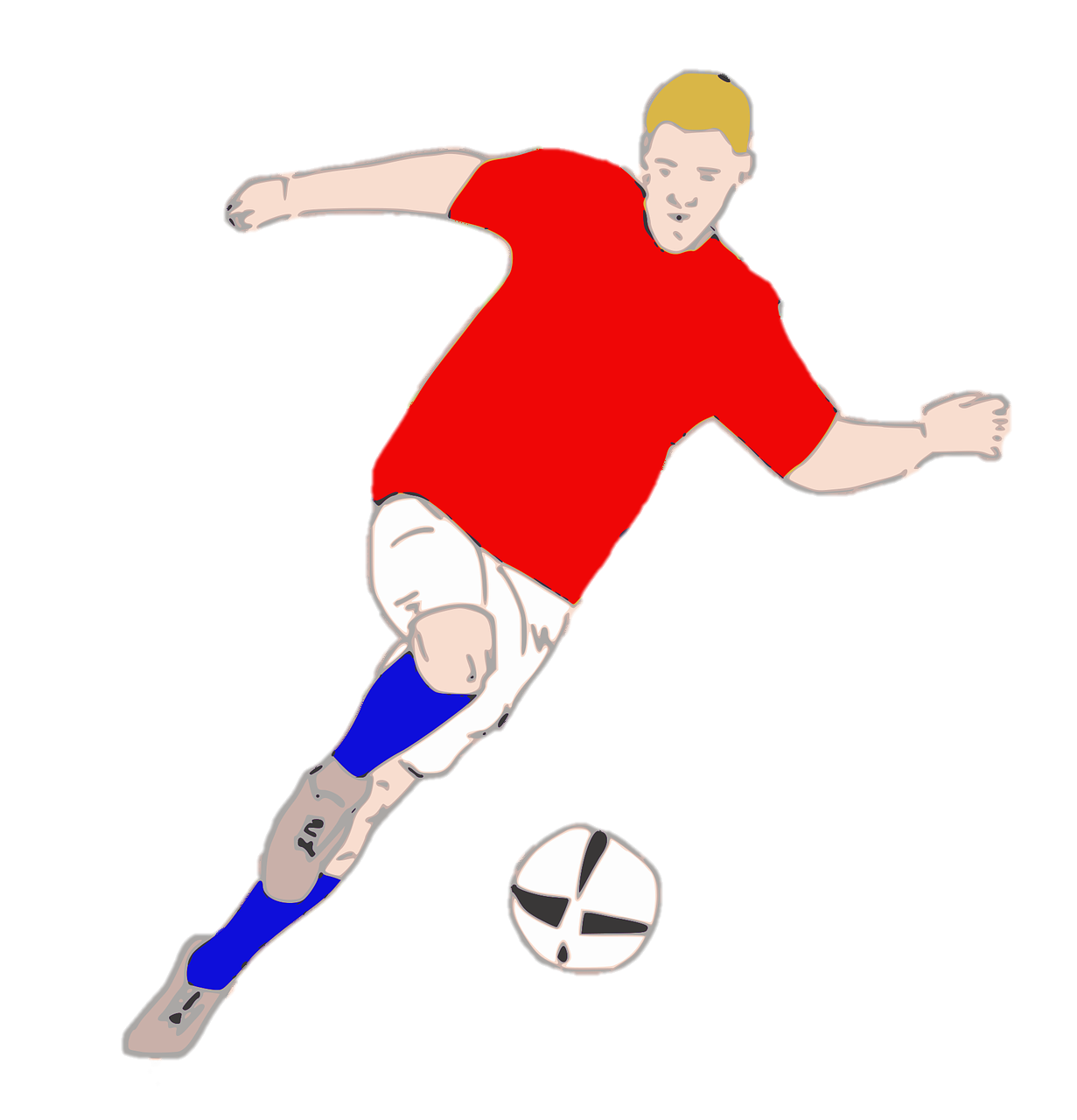
Unit 7:
SPORTS
Lesson 2 – Part 1, 2, 3

Slide 2


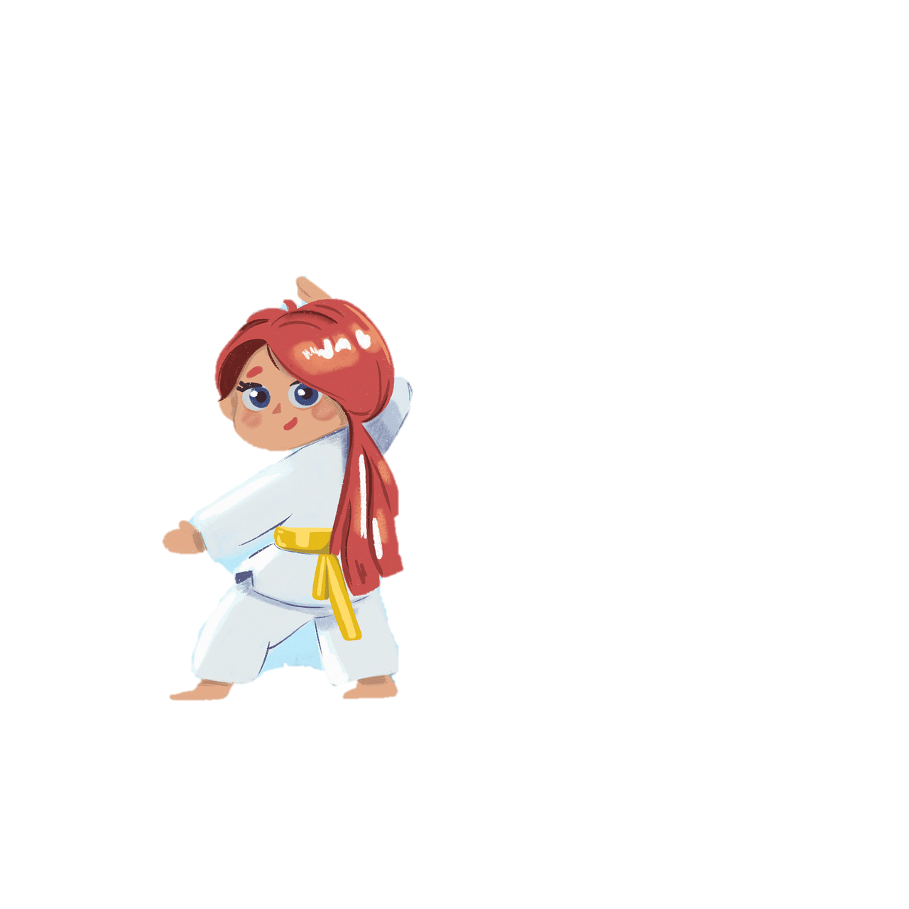

1
Warm-up

Slide 3

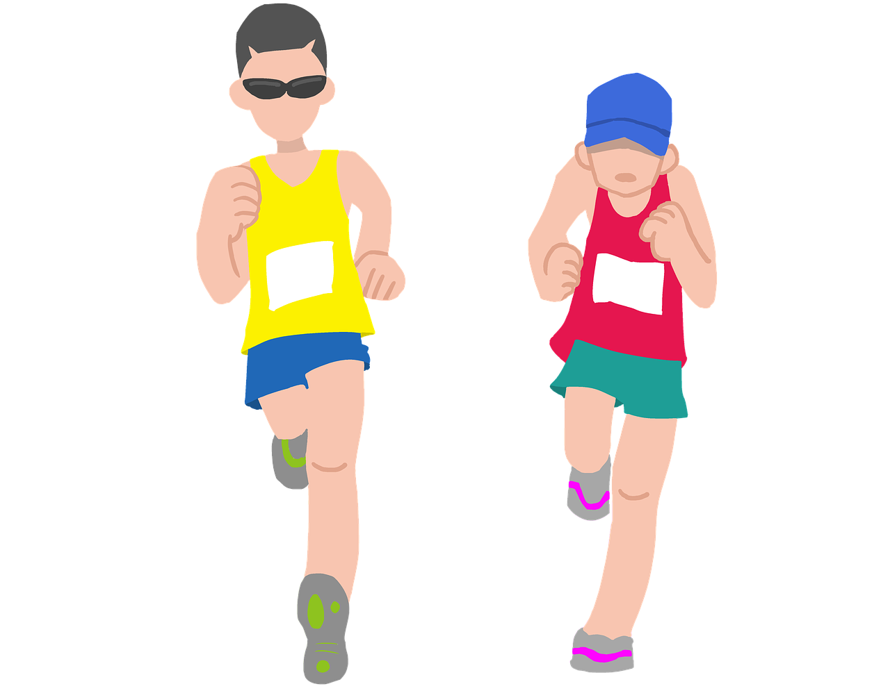
Reorder the words to make a meaningful sentence.
am/jogging/with/I/my/brother
=> I am jogging with my brother.

Slide 4

Reorder the words to make a meaningful sentence.
reading/at/is/the/moment/she/books
=> She is reading books at the moment.

Slide 5
2
Presentation

Slide 6
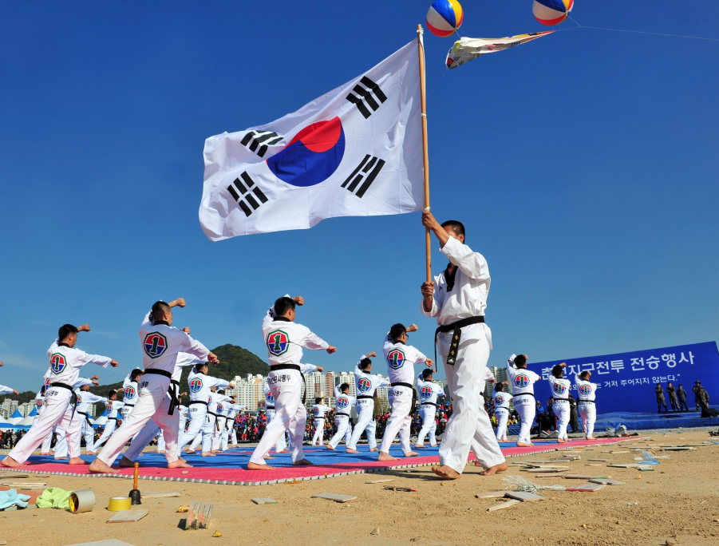

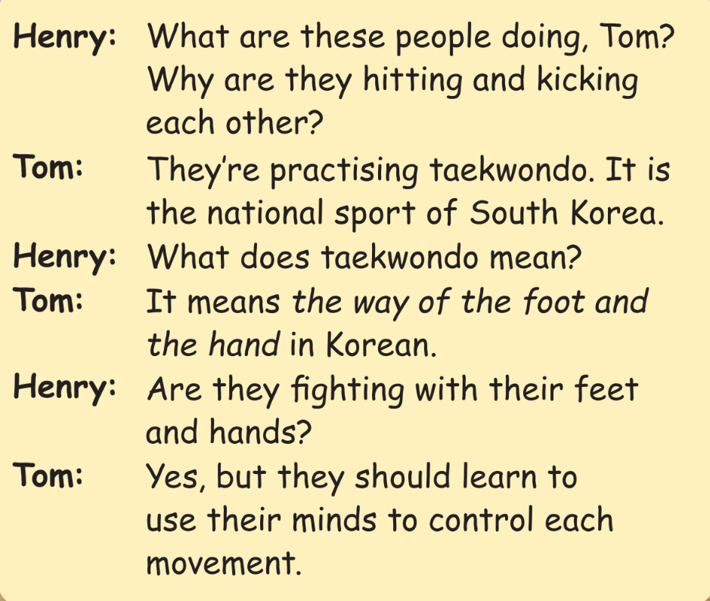

Slide 7
3
Practice

Slide 8

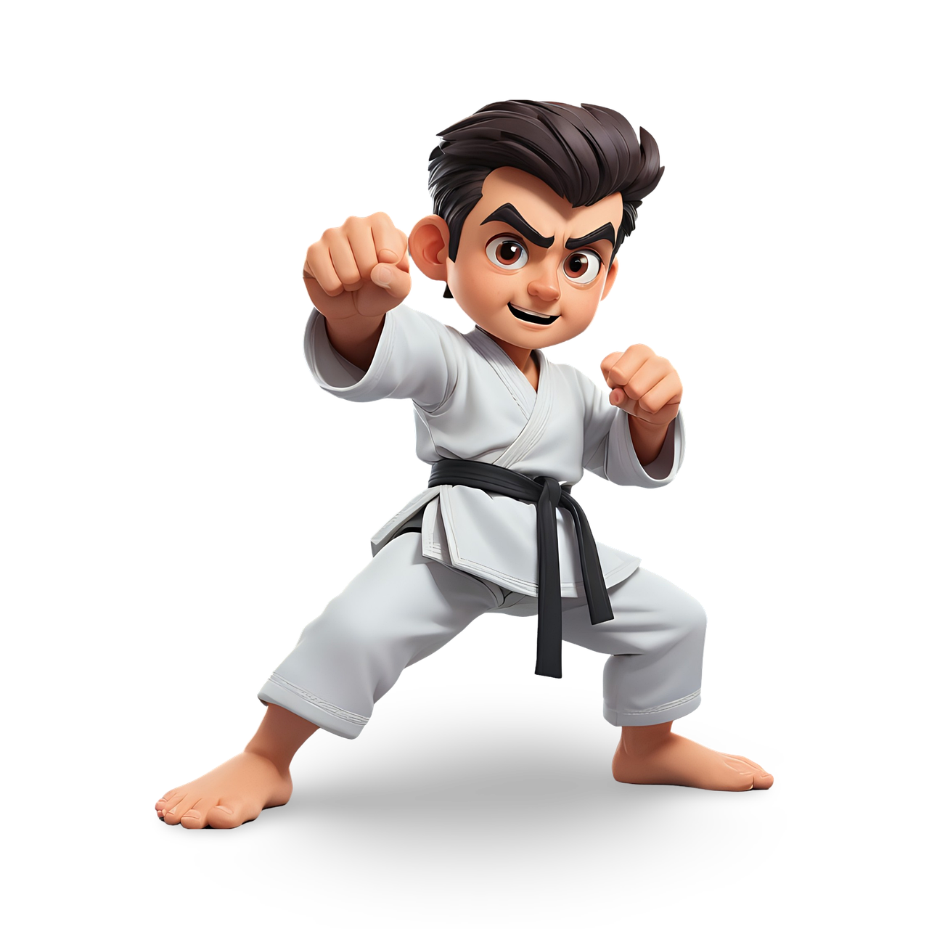
Quiz:
What do you know about Taekwondo?

Slide 9
4
Production

Slide 10


Let’s make a mind map about Taekwondo!

Slide 11

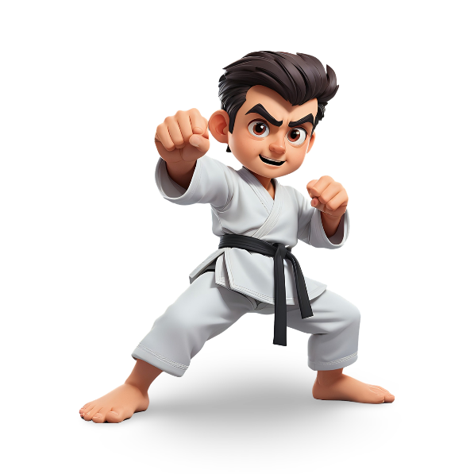


Comes from South Korean
National sport of South Korea
Good for health
Use the feet and the hands
Taekwondo
benefits
white
Use mind to control body’s movement
yellow
6 basic belt colours
Protect ourselves & others
green
blue
black
(strongest)
red

Slide 12
5
Wrap-up &
Assessment

Slide 13

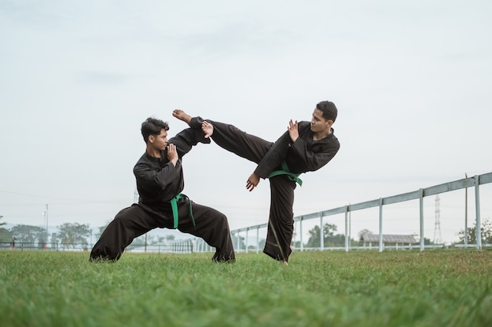
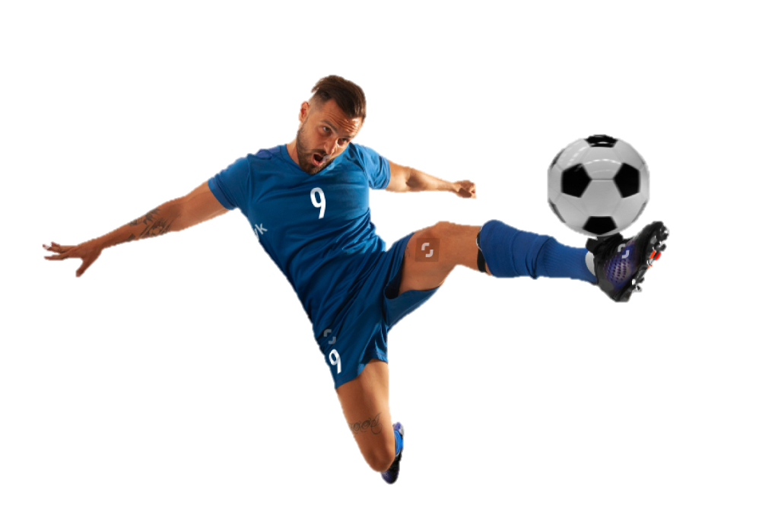
Look and circle the words.
dradcontrolahdwllz
lkwasrufightas
askickawrdfg

Slide 14

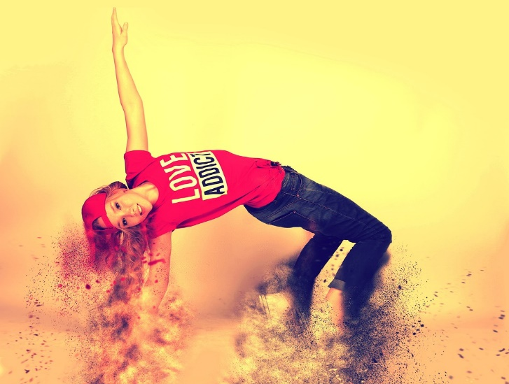
Look and circle the words.
swminmindahdwllz
ovemtenmovementmov

Slide 15


Wrap-up
Unit 7: Sports
Lesson 2 – Part 1,2,3
What have we learnt today?
Vocabulary: control, mind, movement, kick, fight

