Slide 1

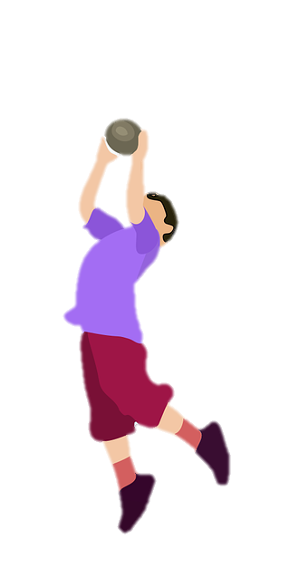
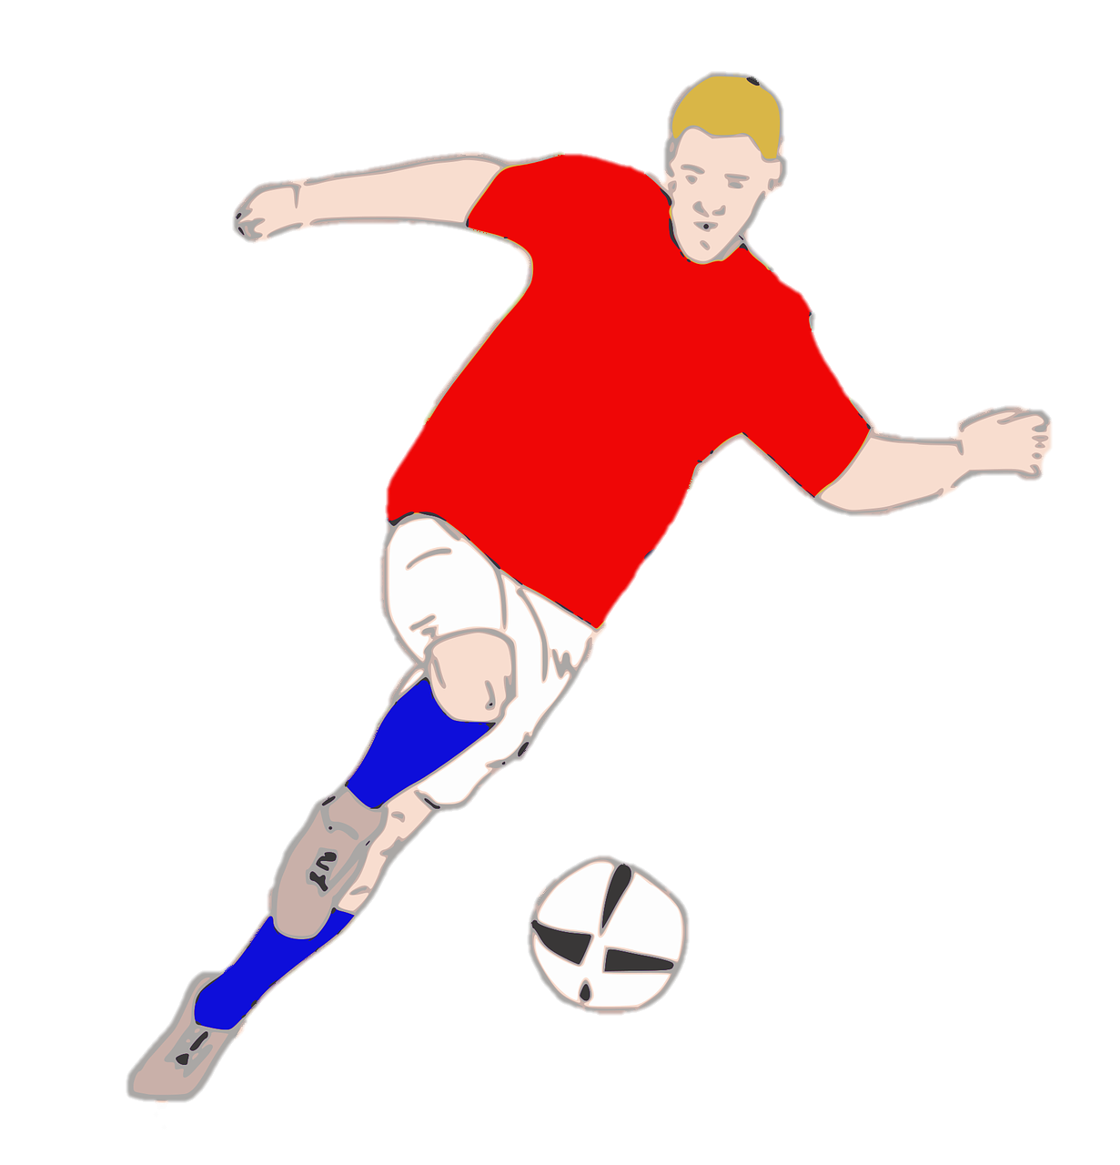
Unit 7:
SPORTS
Lesson 2 – Part 4,5,6

Slide 2


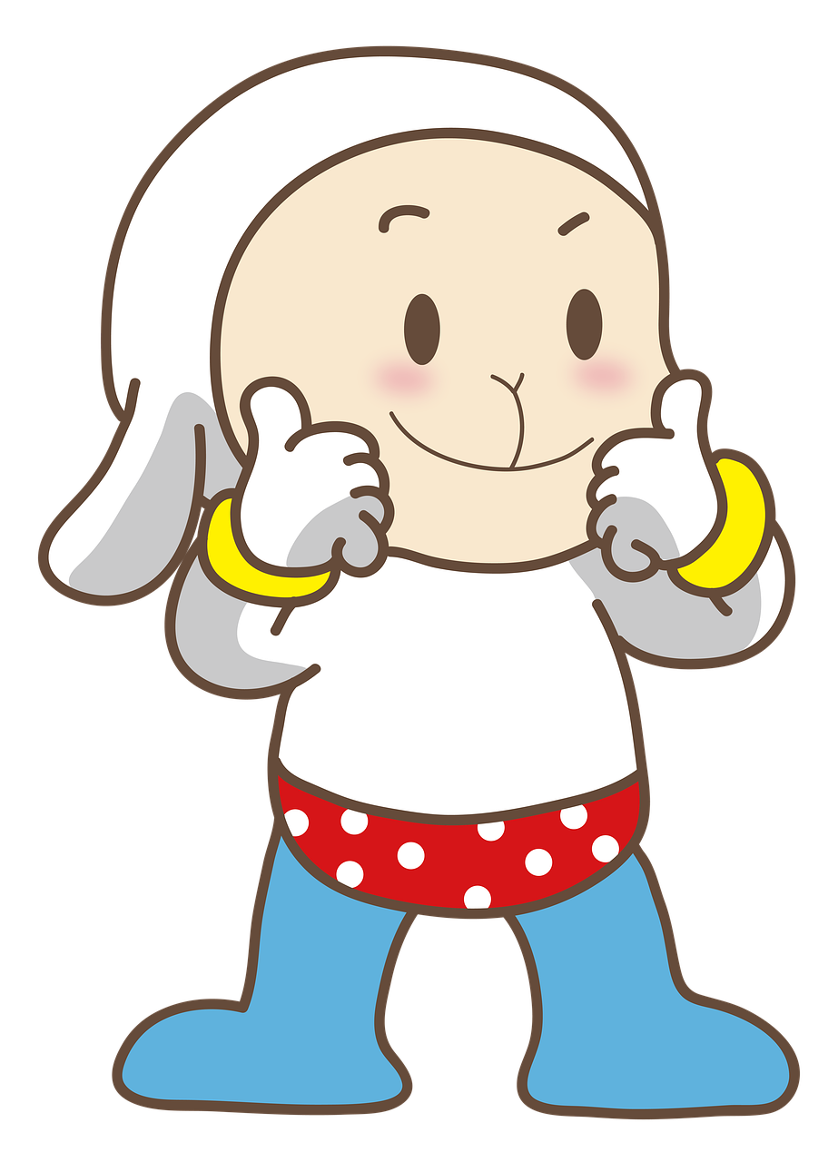
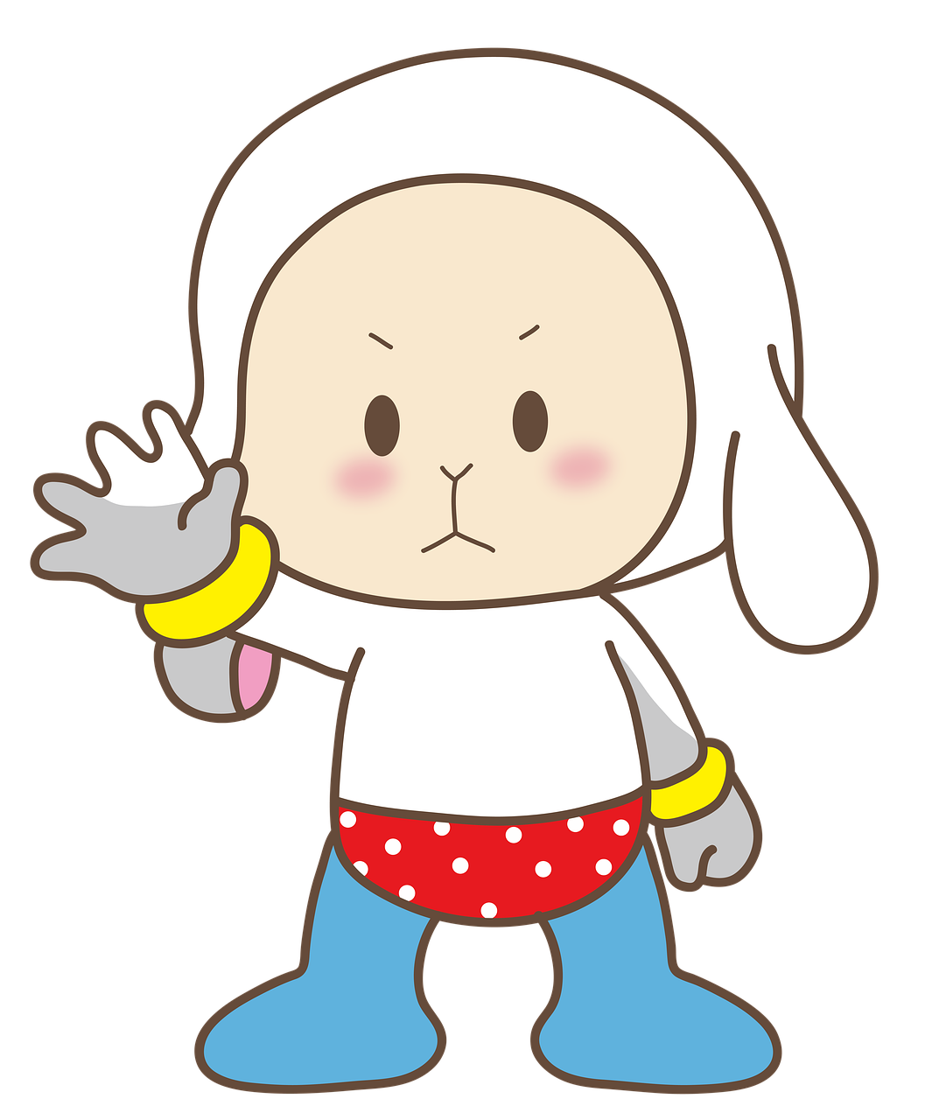
1
Warm-up

Slide 3

2
c
o
n
t
r
o
l
5
f
i
g
h
t
1
4
n
i
m | i | n | d
n
i
k | i | c | k
3
o
o
t
m |  | v | e | m | e | n | t
t
Next
Notes:
T clicks the number to show the question (image clue), clicks the puzzle to show the answer (the word).

Slide 4
2
Presentation

Slide 5


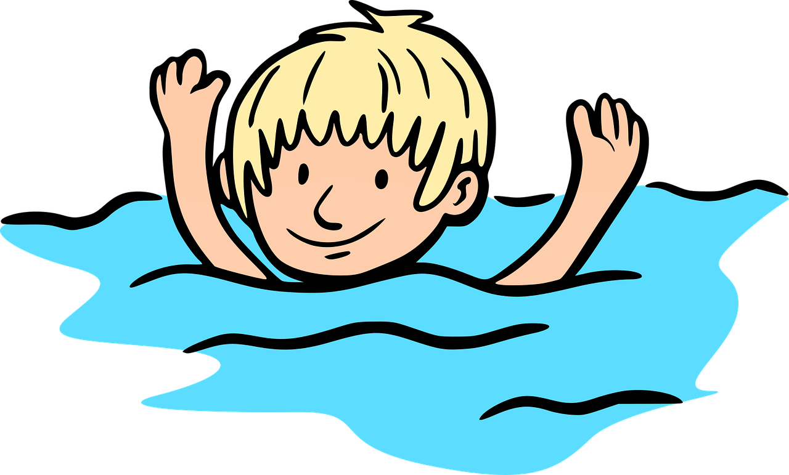

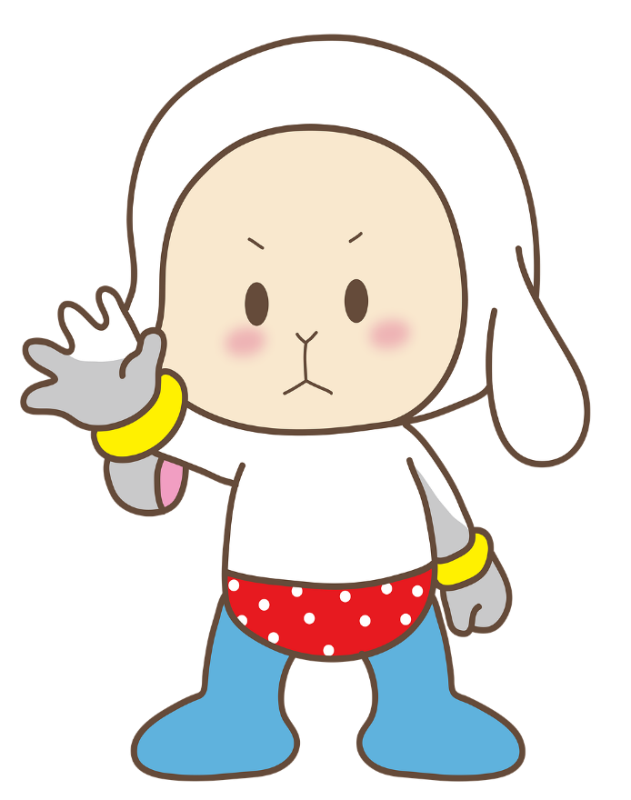
‘should’ or ‘shouldn’t’?
shouldn’t
You _______ swim alone in the river.

Slide 6



‘should’ or ‘shouldn’t’?
should
You ______ do your homework.

Slide 7
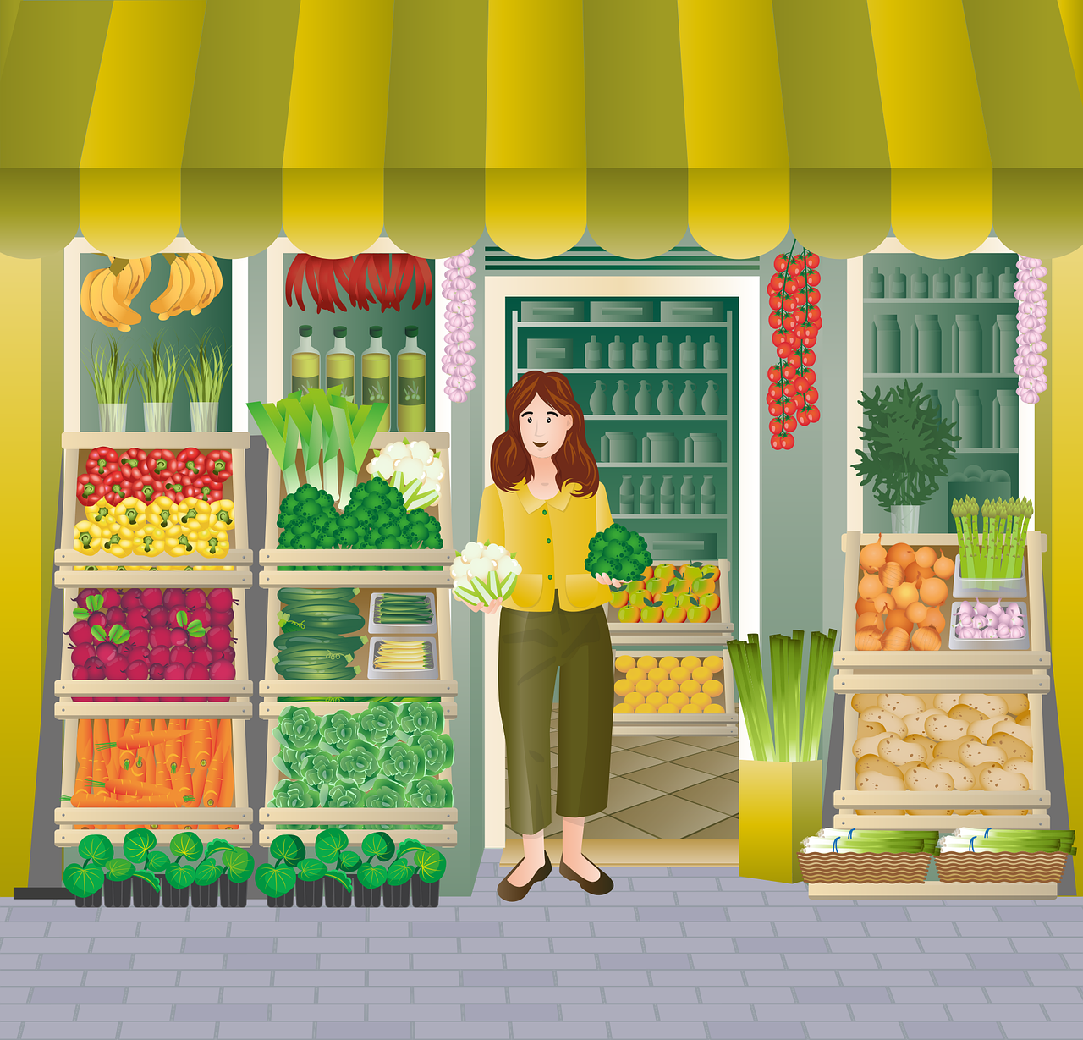
‘should’ or ‘shouldn’t’?
We _____ eat a lot of vegetables.
should

Slide 8
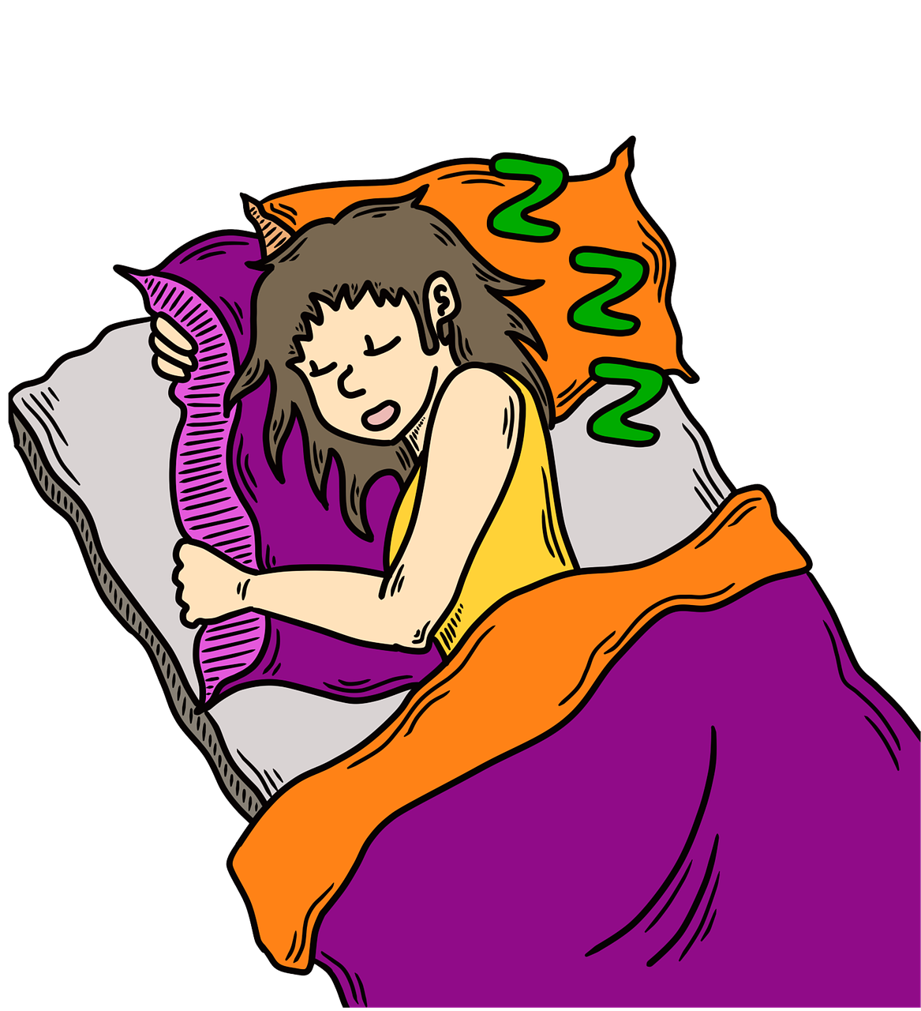
‘should’ or ‘shouldn’t’?
You ________ go to bed late.
shouldn’t

Slide 9
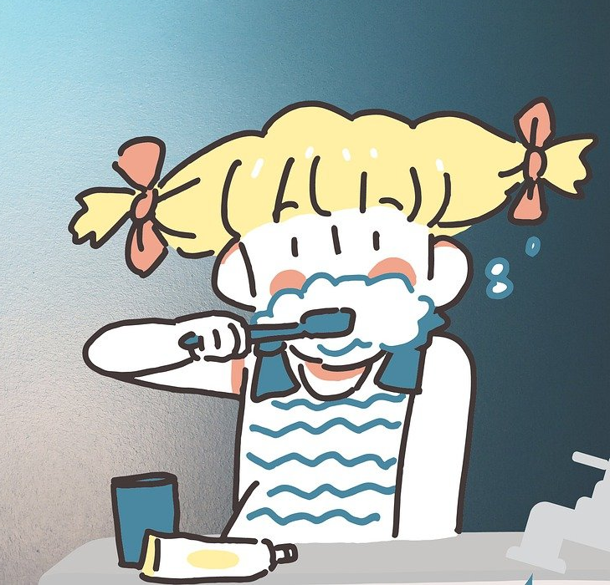
‘should’ or ‘shouldn’t’?
We _____ brush our teeth twice a day.
should

Slide 10
3
Practice

Slide 11
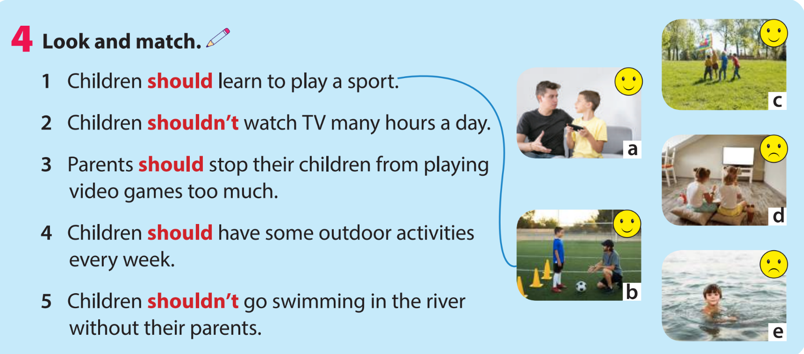

Slide 12

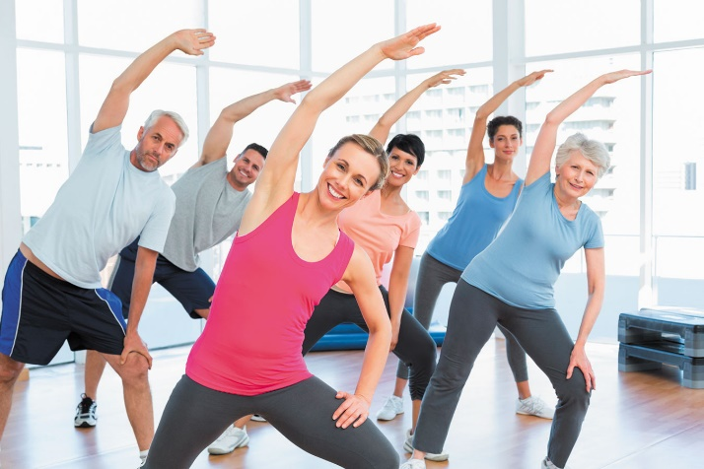
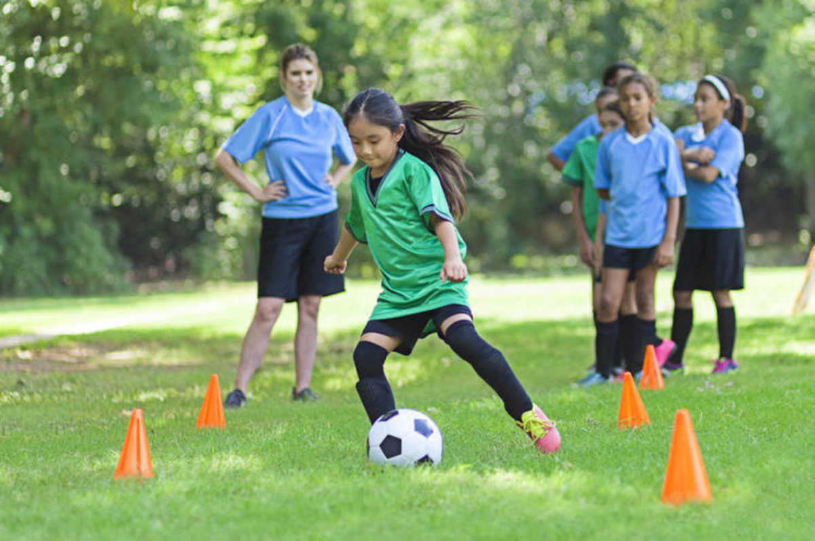
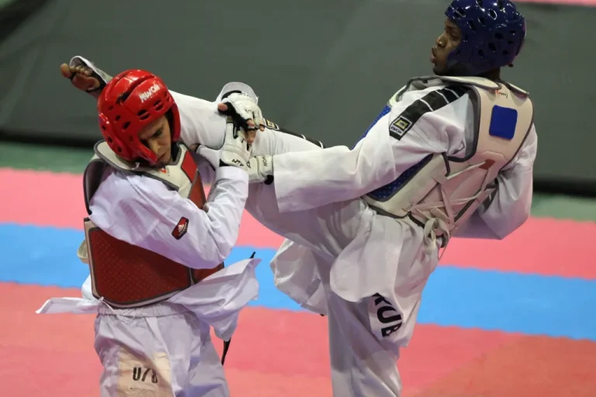
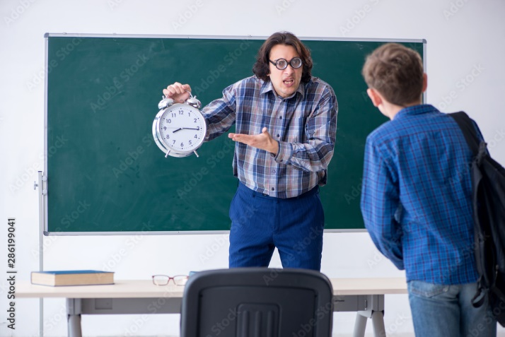
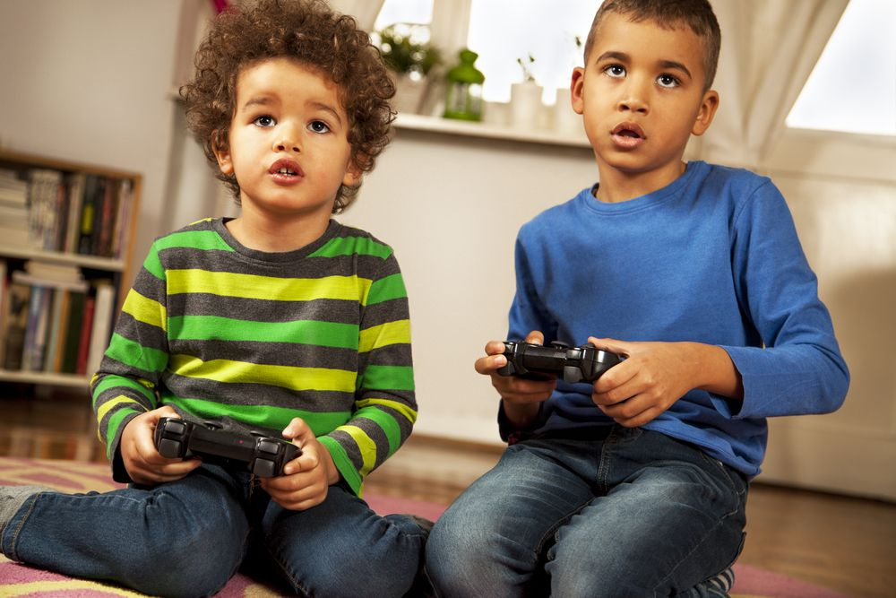
5 Make sentences using should or shouldn’t.
People should do exercise every day.
People / do exercise / every day.
______________________________________________
Children / learn / sports.
______________________________________________
In taekwondo / people / control / movements.
______________________________________________
Students / not / be late / school.
______________________________________________
Young people / not / play / video games / too much.
______________________________________________
Children should learn sports.
In taekwondo, people should control (their) movements.
Students should not be late for school.
Young people should not play video games too much.

Slide 13
4
Production

Slide 14

Ask your friend, tick (✓) or cross (×).
What should we do to stay healthy?
What shouldn’t we do to stay healthy?
We shouldn’t watch TV many hours.
We should do exercise everyday.
do exercise everyday | watch TV many hours
✓ | ×

Slide 15

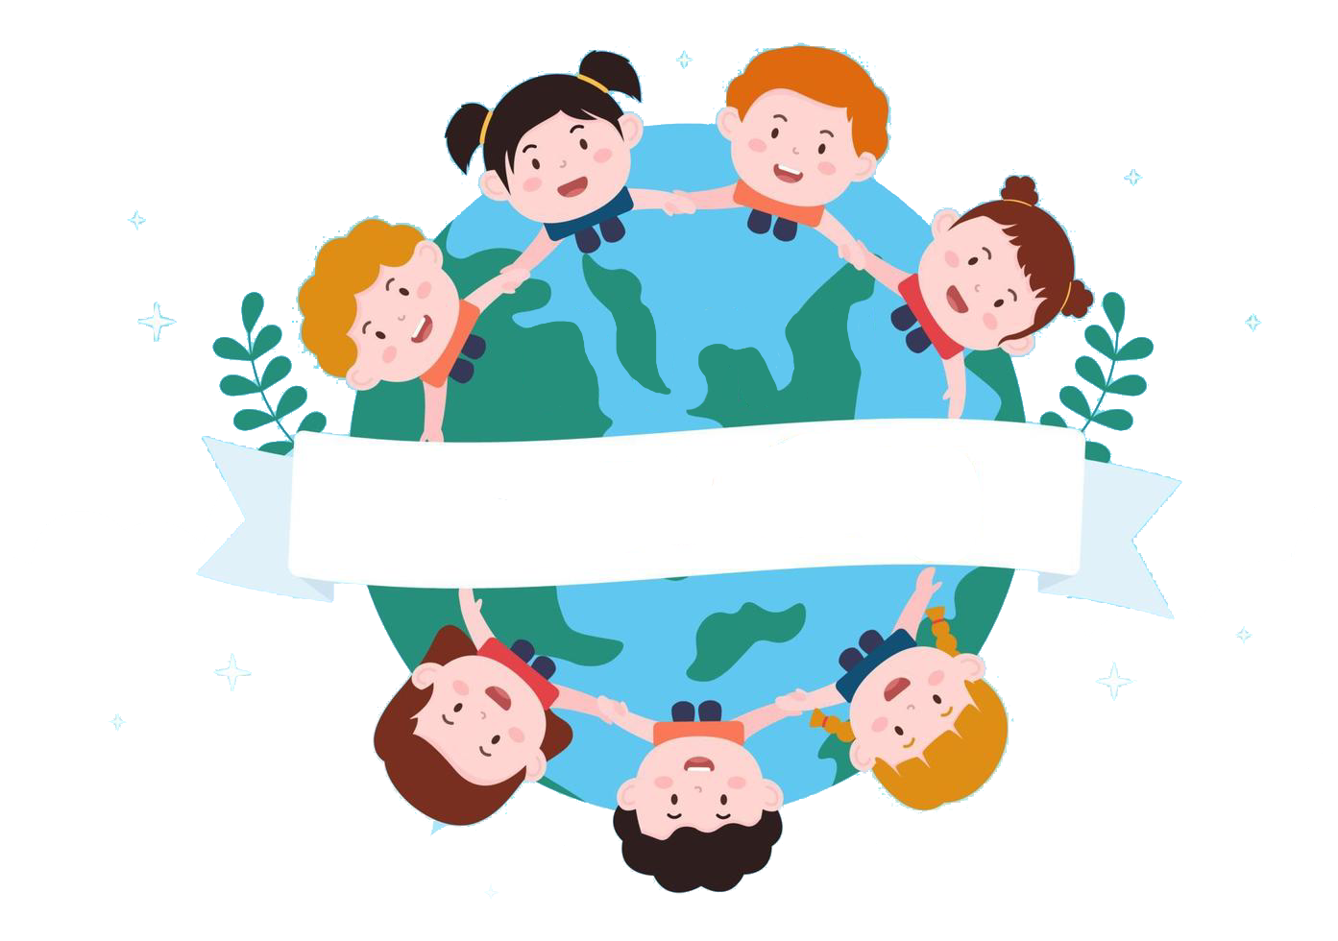

Thank you
& goodbye!

