Slide 1








Slide 2






8
6
10
3 + 5 =
4 + 2 =
8 + 2 =
?
?
?
8 – 3 =
6 – 4 =
10 – 2 =
8 – 5 =
6 – 2 =
10 – 8 =
?
?
?
7
8
5
4 + 3 =
7 + 1 =
5 + 0 =
?
?
?
3 + 4 =
1 + 7 =
5 – 0 =
7 – 4 =
5 – 5 =
?
8 – 1 =
?
?

Slide 3
8
6
10
3 + 5 =
4 + 2 =
8 + 2 =
5
2
?
?
?
8 – 3 =
6 – 4 =
8
10 – 2 =
3
4
8 – 5 =
6 – 2 =
10 – 8 =
?
?
?
2
7
8
5
4 + 3 =
7 + 1 =
5 + 0 =
?
5
7
?
?
3 + 4 =
8
5 – 0 =
1 + 7 =
3
7 – 4 =
5 – 5 =
?
8 – 1 =
?
7
?
0

Slide 4

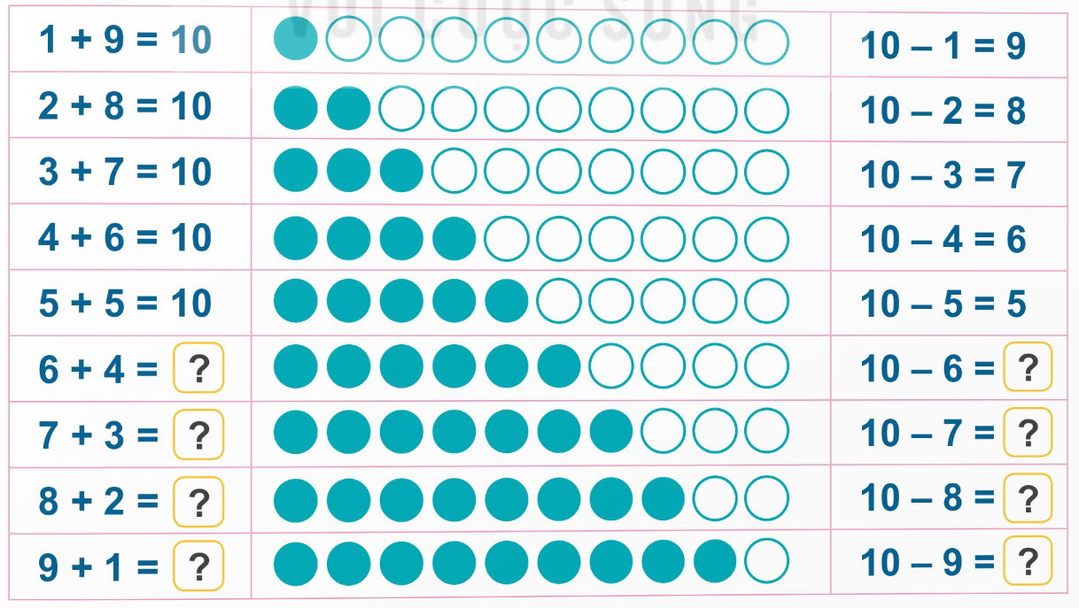


Slide 5
10
4
10
3
10
2
10
1

Slide 6


+ | 3 | 6 | 7 | 4 | 2 | 4 | 9
 | 4 | 2 | 1 | 3 | 8 | 6 | 0
 | 7 |  |  |  | 10

Slide 7
+ | 3 | 6 | 7 | 4 | 2 | 4 | 9
 | 4 | 2 | 1 | 3 | 8 | 6 | 0
 | 7 |  |  |  | 10
8
8
7
10
9

Slide 8

9
8
7
5
4
6
2
5
2
6
5
4
2
1
6
0
8
0

Slide 9
9
8
7
5
4
6
2
5
2
6
3
5
3
3
4
7
2
7
1
6
1
0
9
0
8
7
0

Slide 10


+ 4
- 6
+ 7
5

Slide 11
+ 4
- 6
+ 7
5
9
3
10

Slide 12

6
3
3
1
2
1
0

Slide 13
10
6
4
3
3
1
1
2
1
0

Slide 14



