Slide 1

Unit 9. Places in town
Lesson 3. Task 1, 2, 3

Slide 2

1
Warm Up

Slide 3
2
Presentation

Slide 4
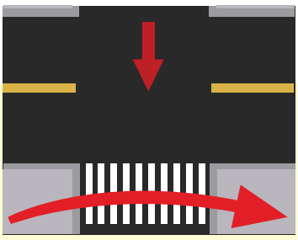



1 Listen and point. Repeat.
Cross the road
Go straight
Turn left
Turn right

Slide 5

3
Practice

Slide 6
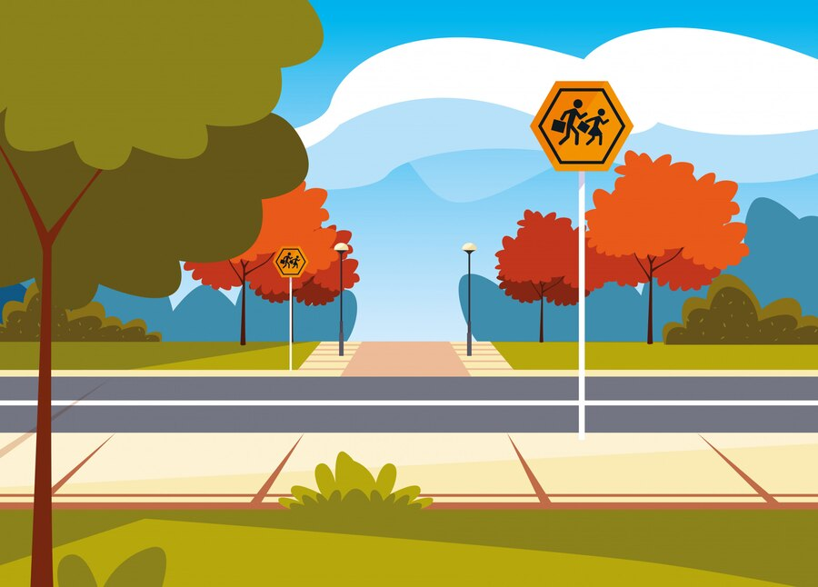

Let’s cross the road here. We go straight on high street and then turn right. The cinema is opposite the school.
Great !
How do we go to the cinema now , Anika ?

Slide 7

THANK YOU & GOODBYE!

