Slide 1




Unit 8 - Lesson 3 – Period 1

Slide 2
2 Presentation
Task 1 Listen and point.
Notes:
Dấu câu

Slide 3




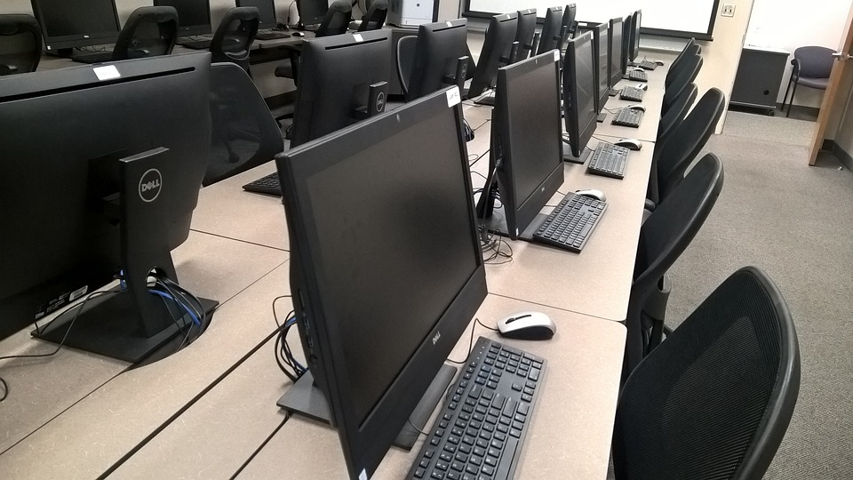
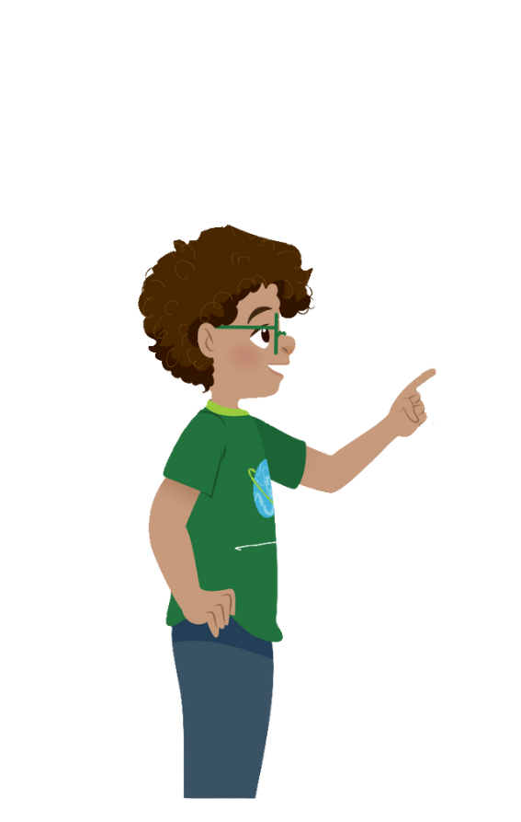

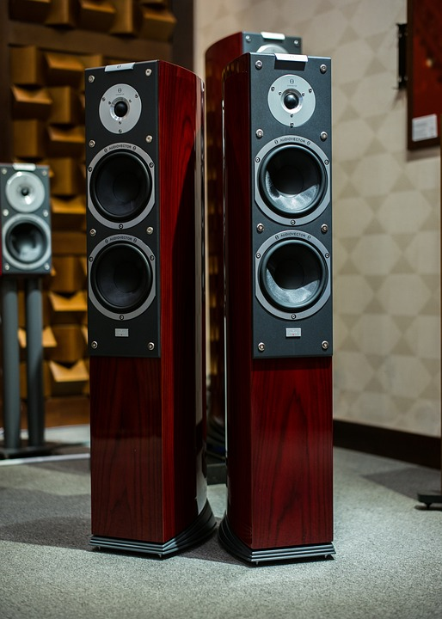
1 Listen and point. Repeat.
Change the password
Use the computer lab
Use the projector
Use the speaker

Slide 4
3 Practice
Task 2 Listen and write.
Notes:
Dấu câu

Slide 5



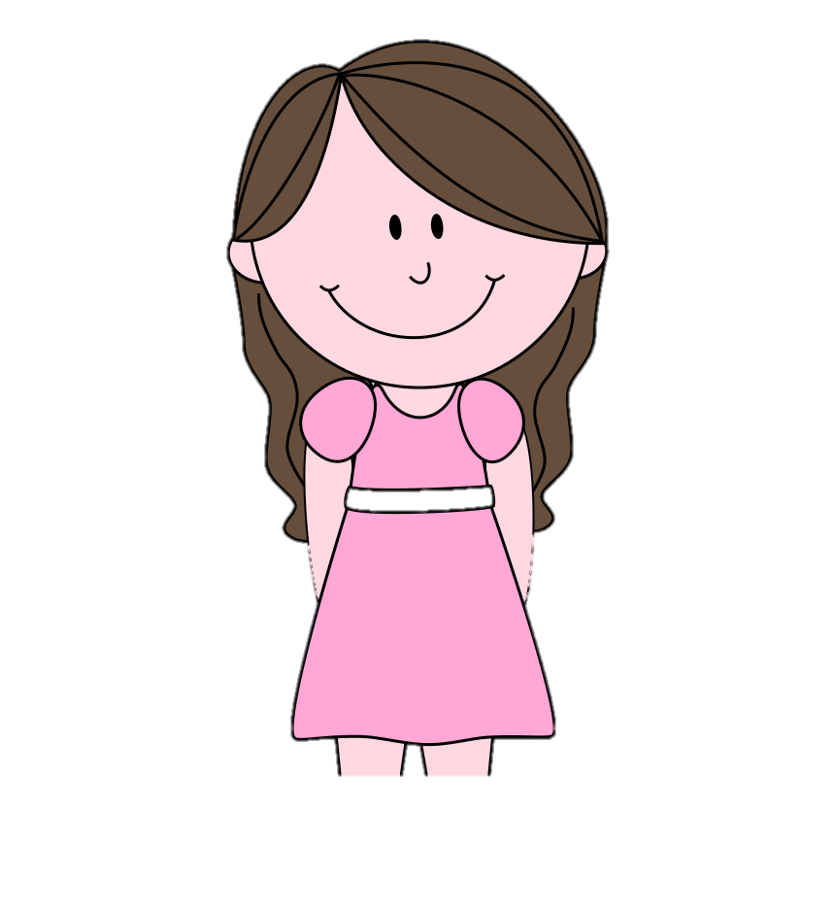

2
Listen and write.
All teachers and students can.
Teacher Sam, who can use the computer lab?
Can we use the projector there?
Yes, you can. And you can use the speaker, too.
That’s great!
Thank you.
Sam
Andy

Slide 6
3 Practice
Task 3 Look and say.
Notes:
Dấu câu

Slide 7

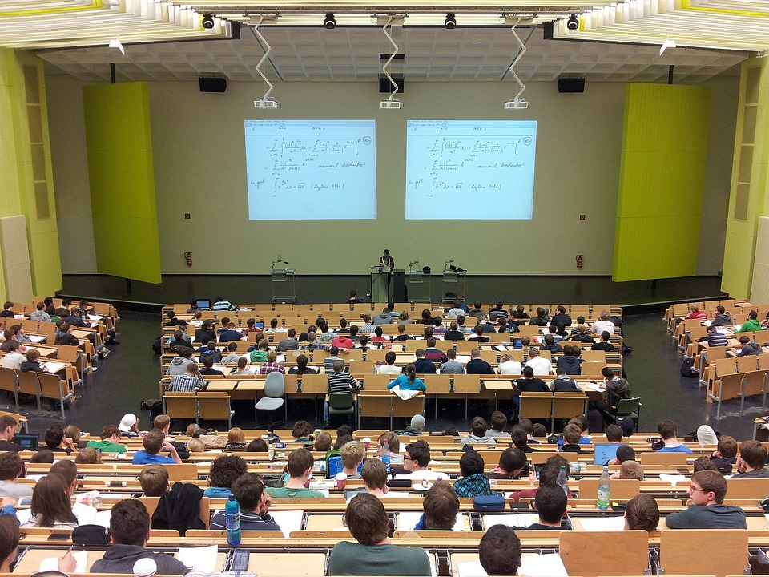
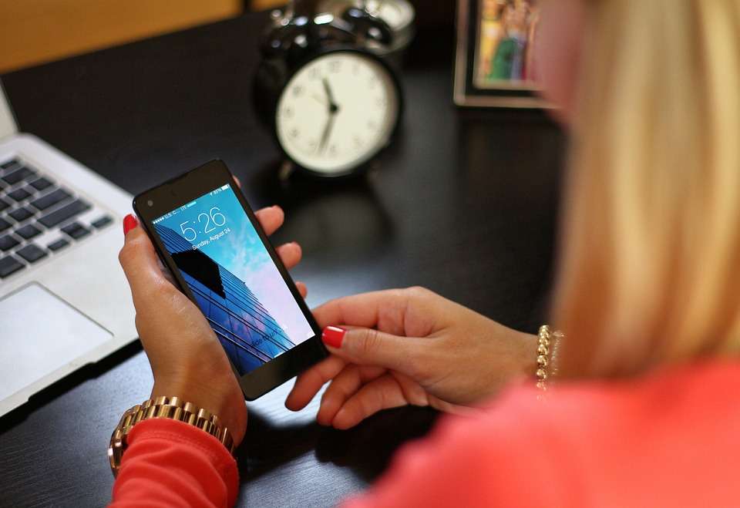
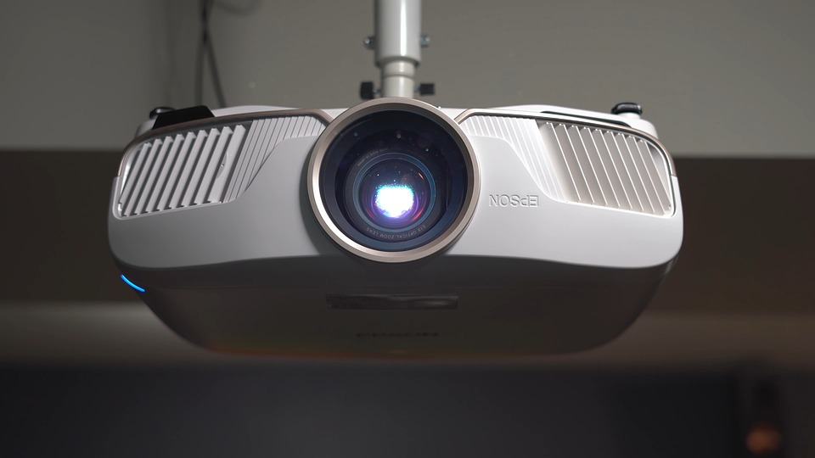

Click to the picture to get the dialogue
1
2
3
4

