Slide 1



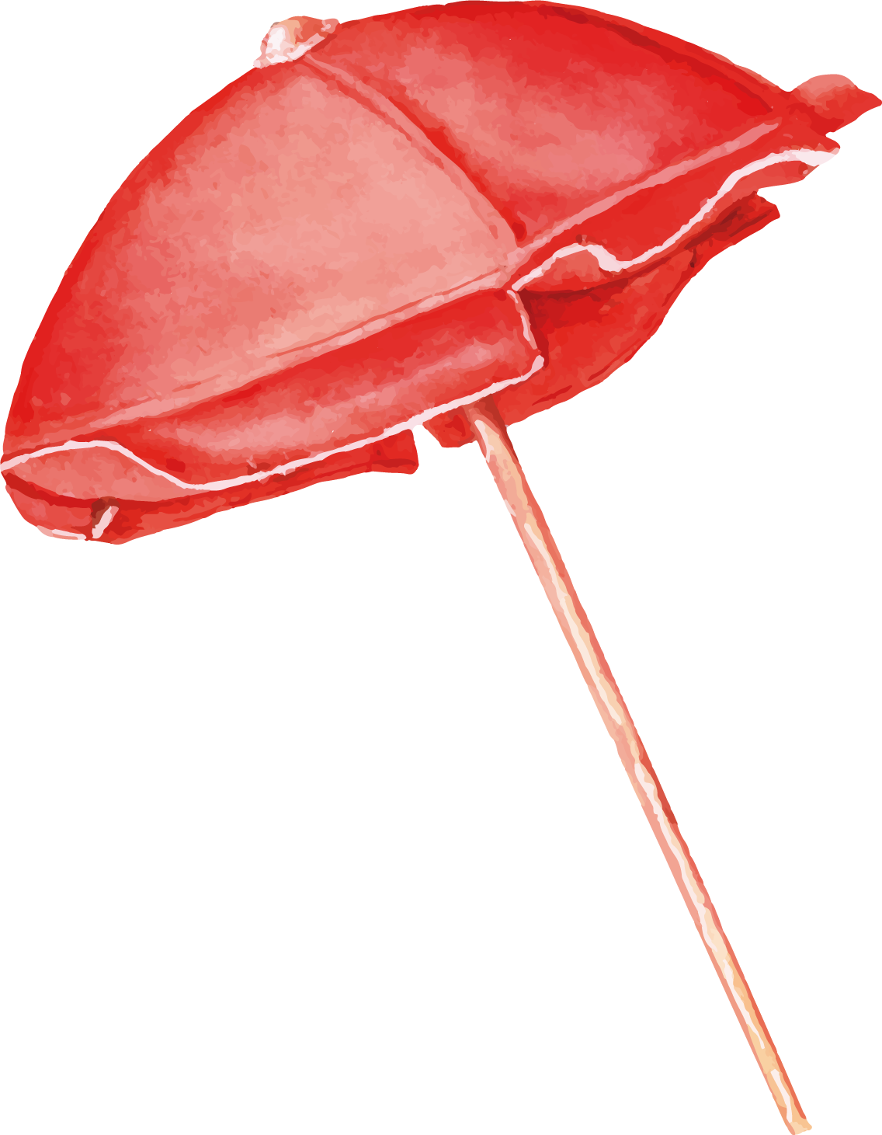
WELCOME TO OUR CLASS – 4A4
UNIT 10: ON HOLIDAY
Lesson 1: Task 4, 5,6
Teacher: Duong Thi Hong Van

Slide 2
REVIEW

Slide 3

bay

Slide 4

hill

Slide 5
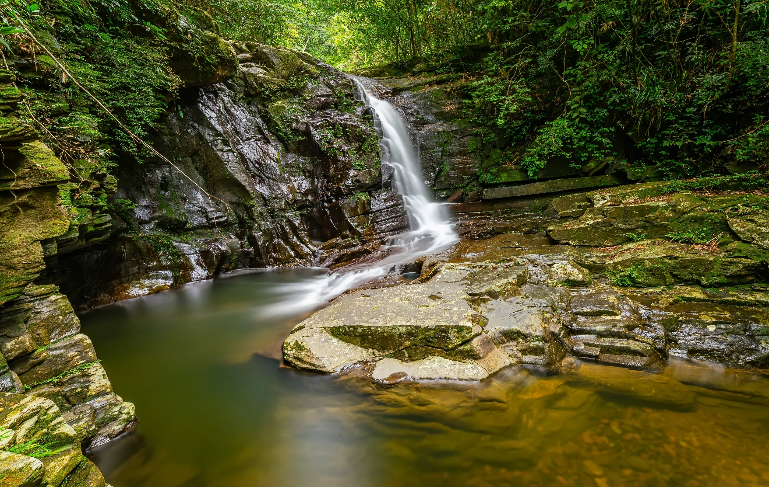
national park

Slide 6
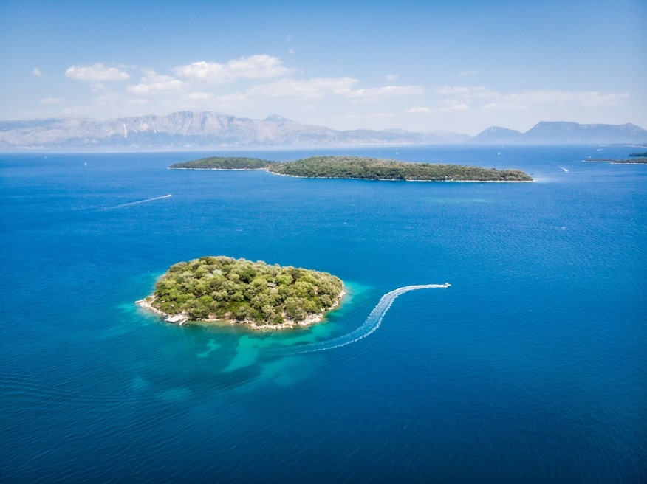
island

Slide 7
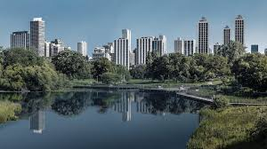
city

Slide 8


Slide 9
TODAY’S LESSON

Slide 10
THANK YOU VERY MUCH !

