Slide 1





REVIEW 6
PART 4

Slide 2

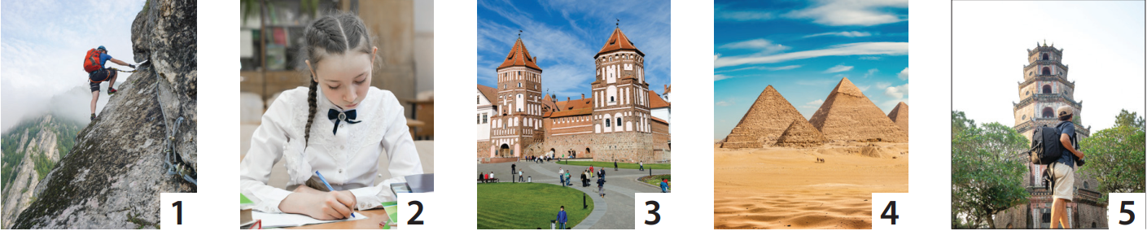
1. Look and circle.
Tom was on the mountain / at the tower yesterday.
Sara was in class / on a trip last week.
We were at the bridge / castle last month.
They were in Vietnam / Egypt last week.
We were at the temple / castle yesterday.

Slide 3
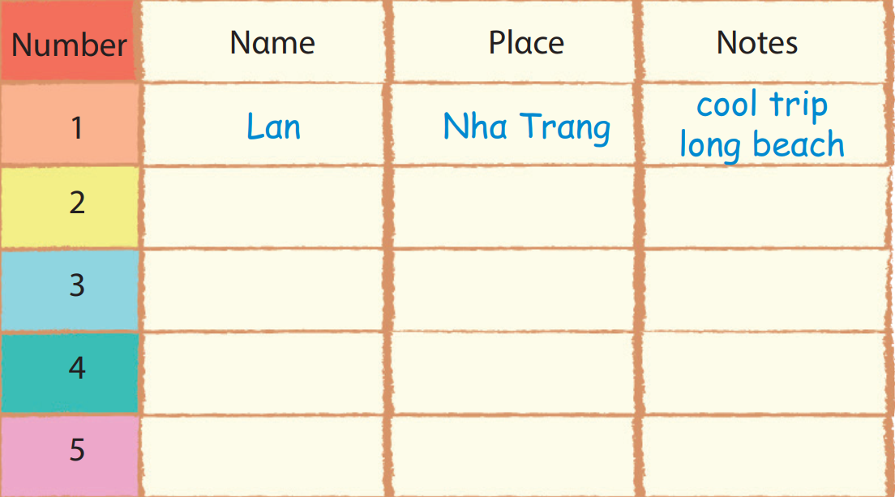


2. Write and say.
I was in Nha Trang. There was a long beach.
It was cool.
How was your trip?
Where were you last summer?

Slide 4
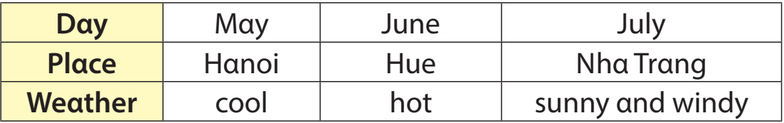

3. Look and write.
My trip to Vietnam was awesome. I was in Hanoi in May. The weather was cool. I was in …

Slide 5
REVIEW 6 – PART 4
What we learnt today:
Structure:
Where were you last summer?
I was in Egypt.
2. How were your trip?
- It was cool.

Slide 6




Thank you & goodbye!

