Slide 1









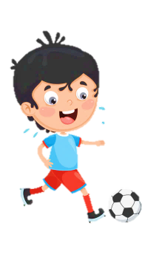













Slide 2
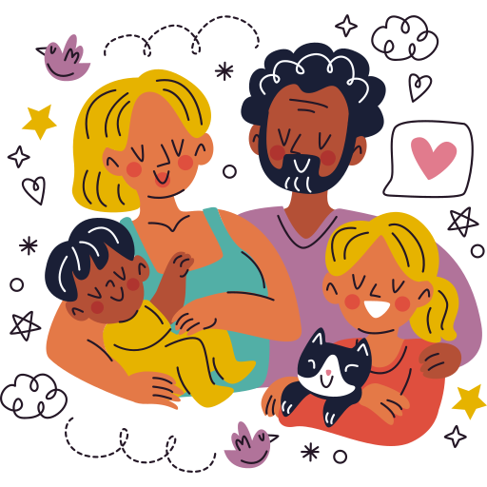
Unit 1:
FAMILY AND FRIENDS
Fun time & Project – Lesson 2

Slide 3




Table of contents
01
02
Warm - up
Review &
Practice
04
03
Wrap-up &
Assessment
Production

Slide 4
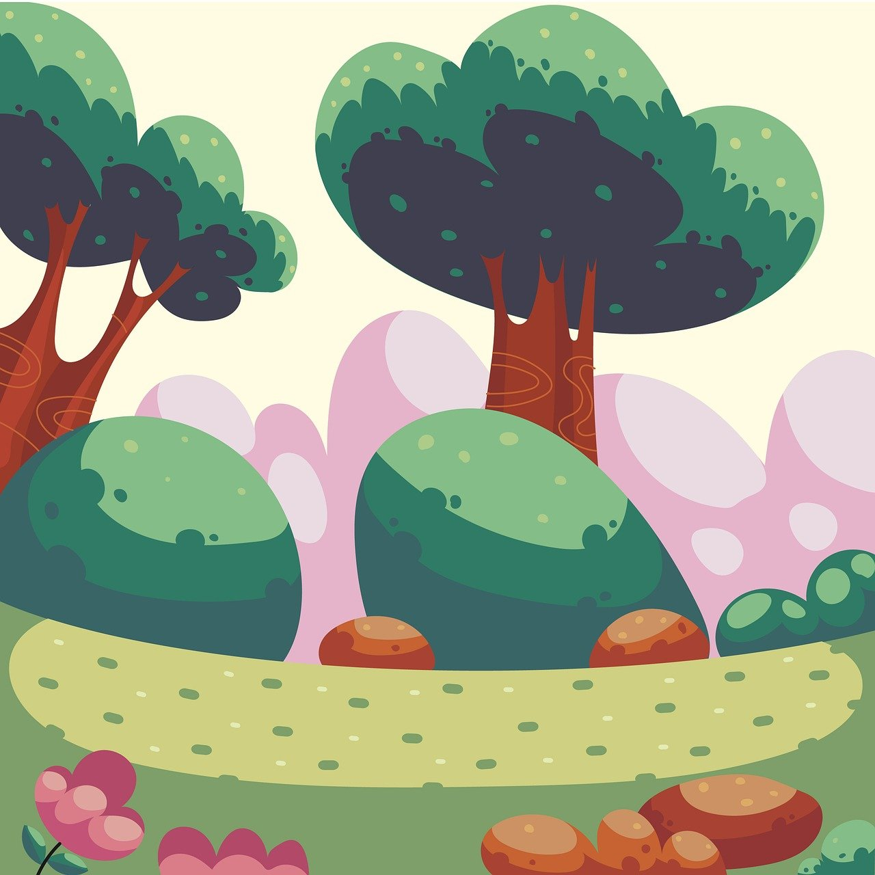

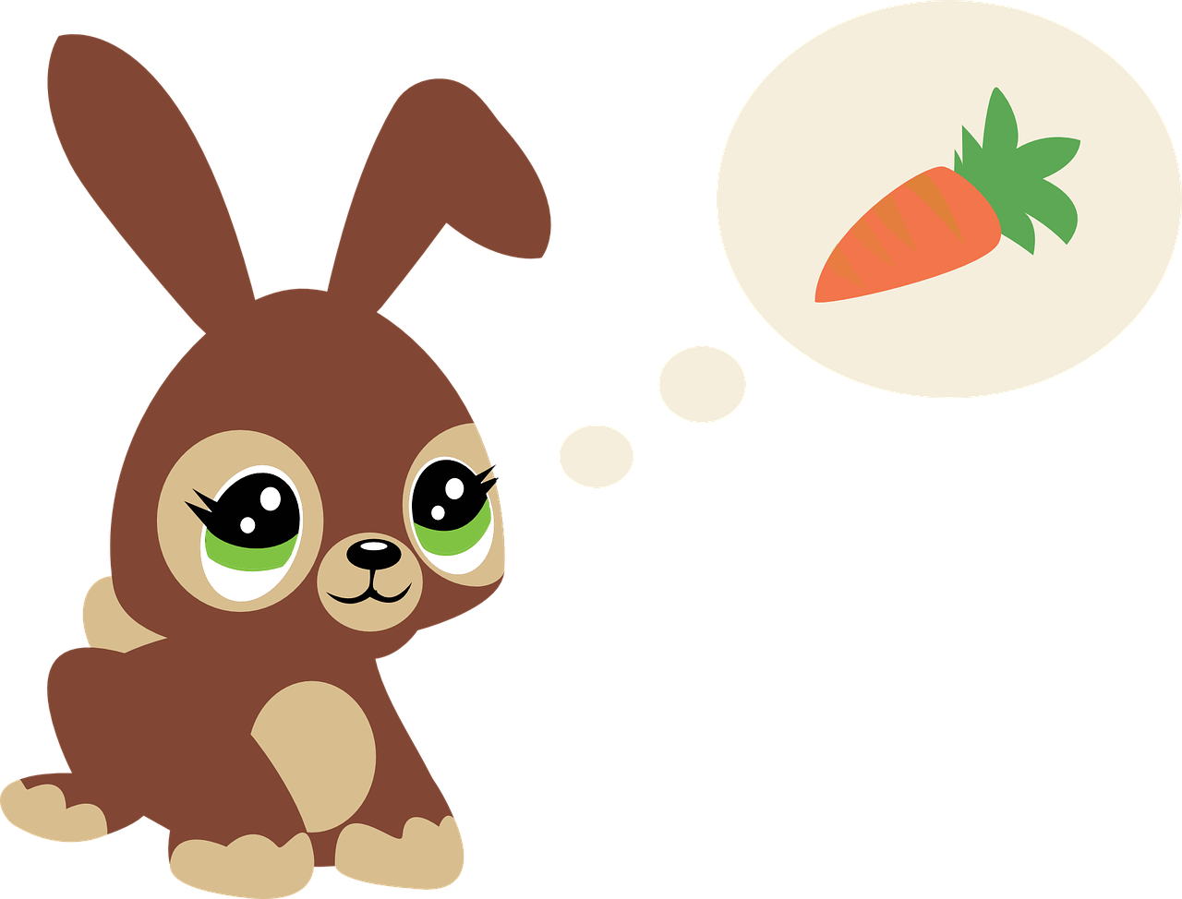
01
Warm up

Slide 5


Slide 6

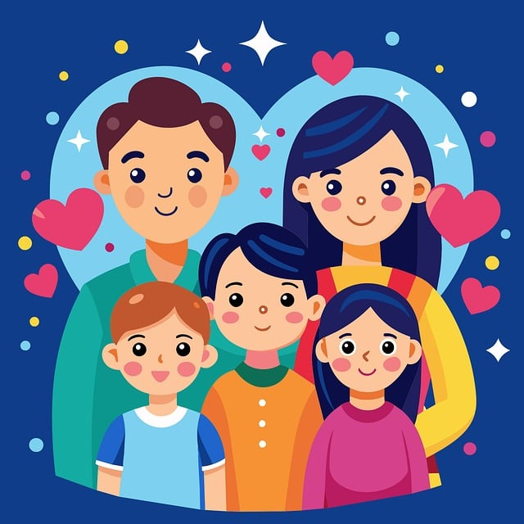

Do the puzzle
Show all
a | b | c
d | e | f
g | h | u
1
2
3
4
5
6
7
8
9
Notes:
T clicks numbers to match each piece of the puzzle, clicks ‘Show all’ to match all the pieces at the same time.

Slide 7
02
Review &
Practice

Slide 8
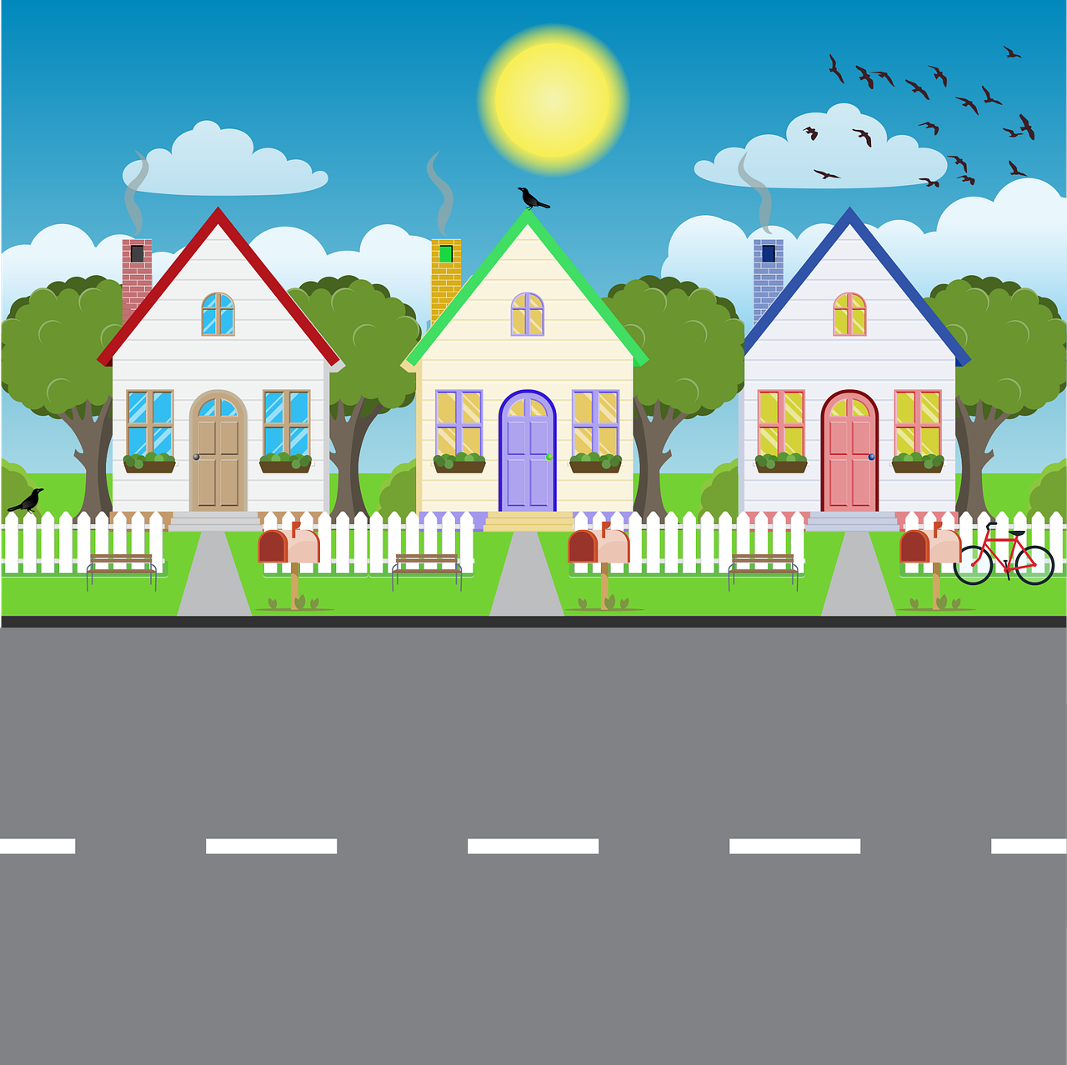

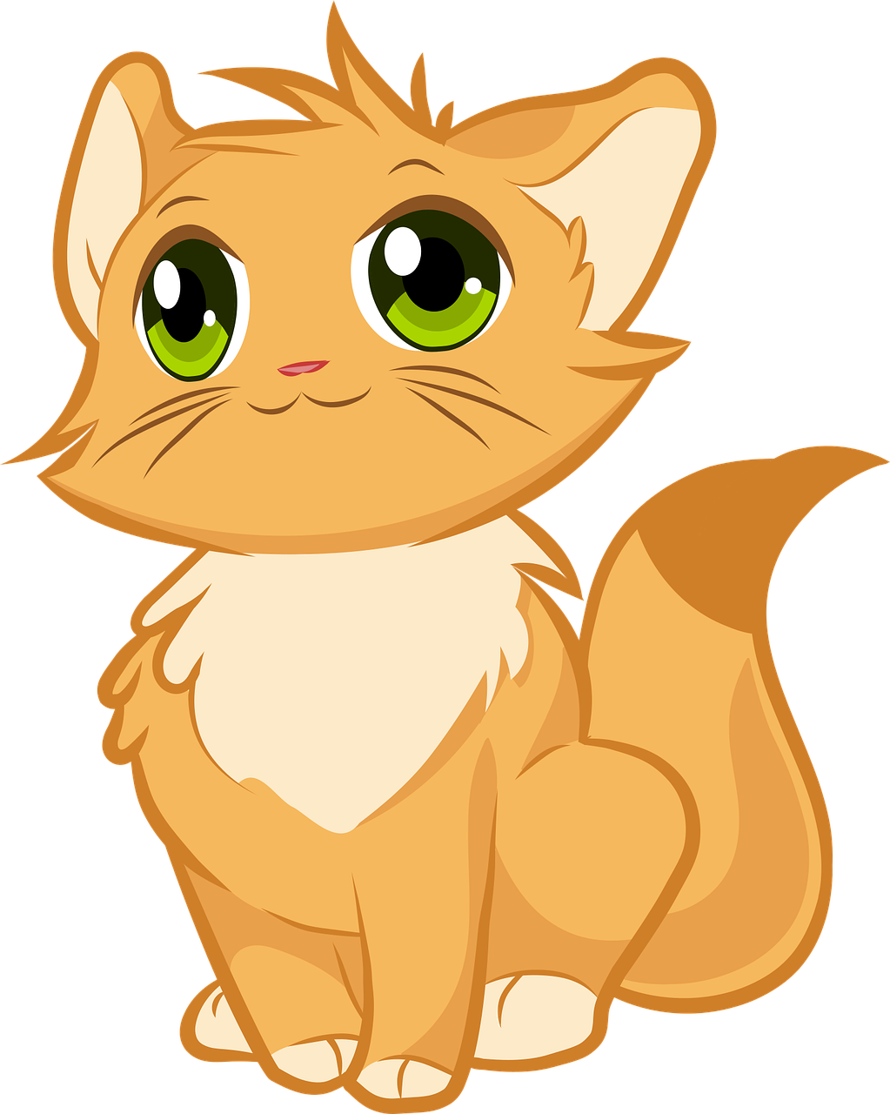
Who runs faster?

Slide 9

Next
1
2
3
4
5
6
Notes:
T clicks the cat and the rabbit to make they move forward.

Slide 10


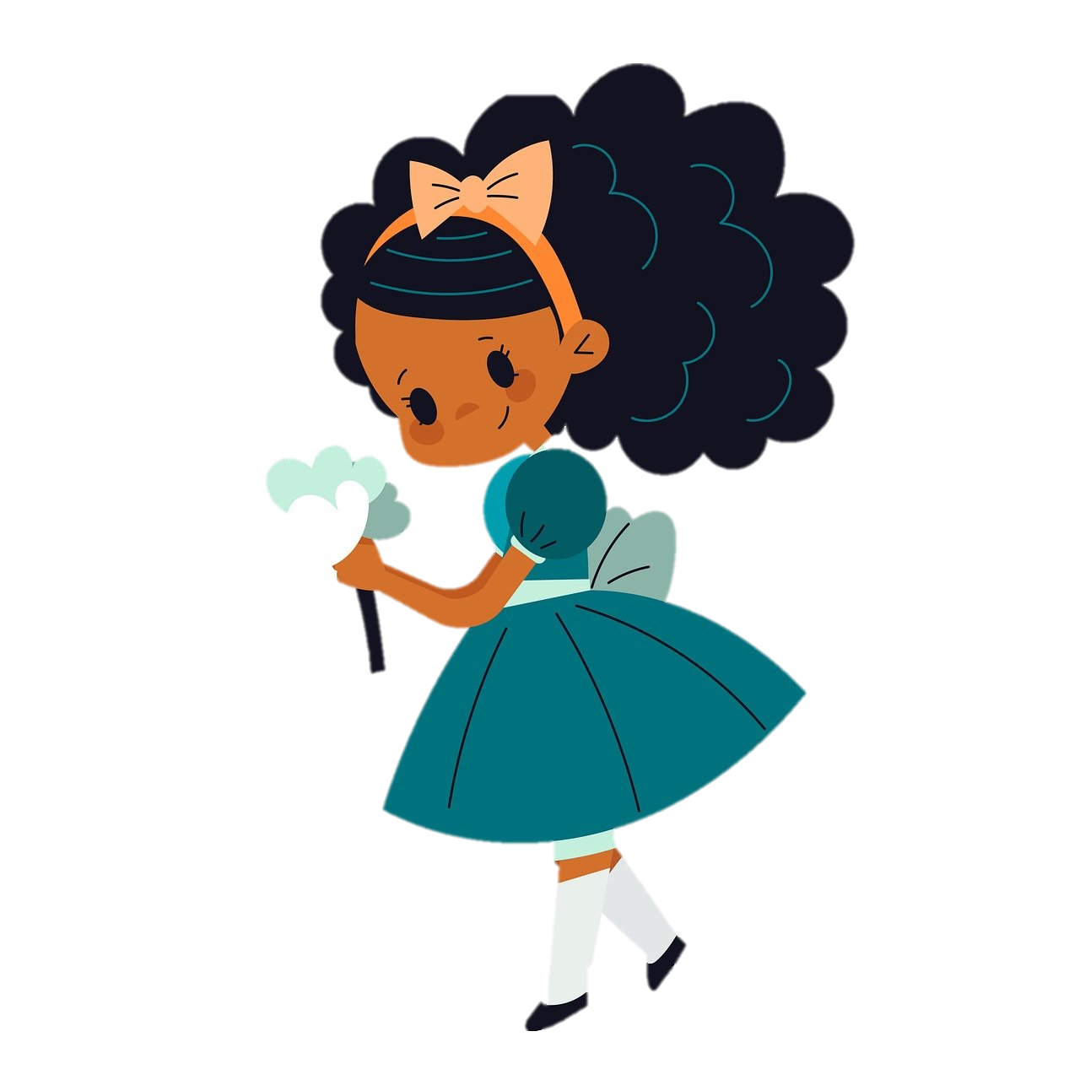
Back
Look and choose
Both he and she are quiet and loud.
Both he and she is quiet and loud.
c. He is quiet, but she is loud.
d. She is quiet, but he is loud.

Slide 11
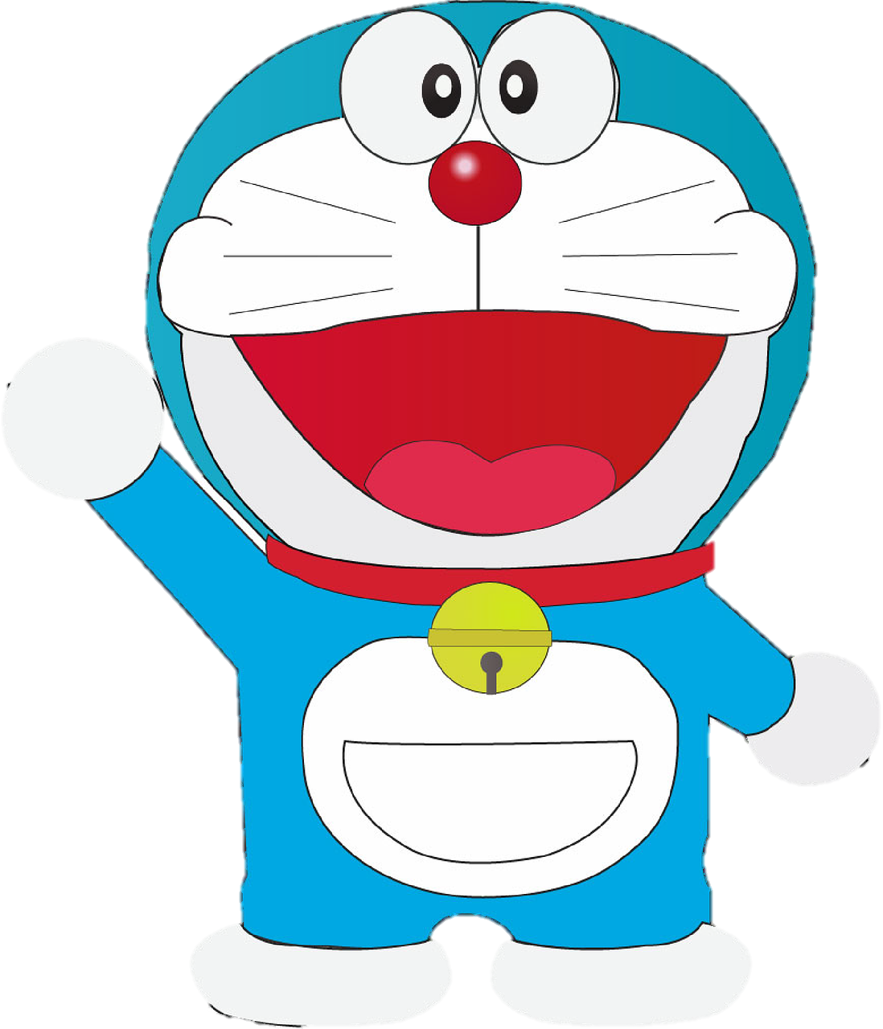
Back
Look and choose
John is crazy about comic books, but Anna doesn’t like them.
John is crazy about comic books, so Anna doesn’t like them.
John is crazy about comic books, and Anna doesn’t like them.
John is crazy about comic books, or Anna doesn’t like them.

Slide 12

Back
Choose the correct answer
Yesterday, we did our exam ________.
careful
carefully
care
careless

Slide 13

Back
Choose the correct answer
My sister is a _____ girl. She always smiles ____.
happy/happyly
happily/happy
happy/happilly
happy/happily

Slide 14
Back
Choose the correct answer
She goes to grandparents’ house in the summer.
b. She goes to grandparent’s house in the summer.
c. She goes to grandparents house in the summer.
d. She goes to grandparent’ house in the summer.

Slide 15
Back
Odd one out (word stress)
a. giraffe b. hippo
c. rabbit d. monkey
giraffe
lion
rabbit
monkey

Slide 16
03
Production

Slide 17

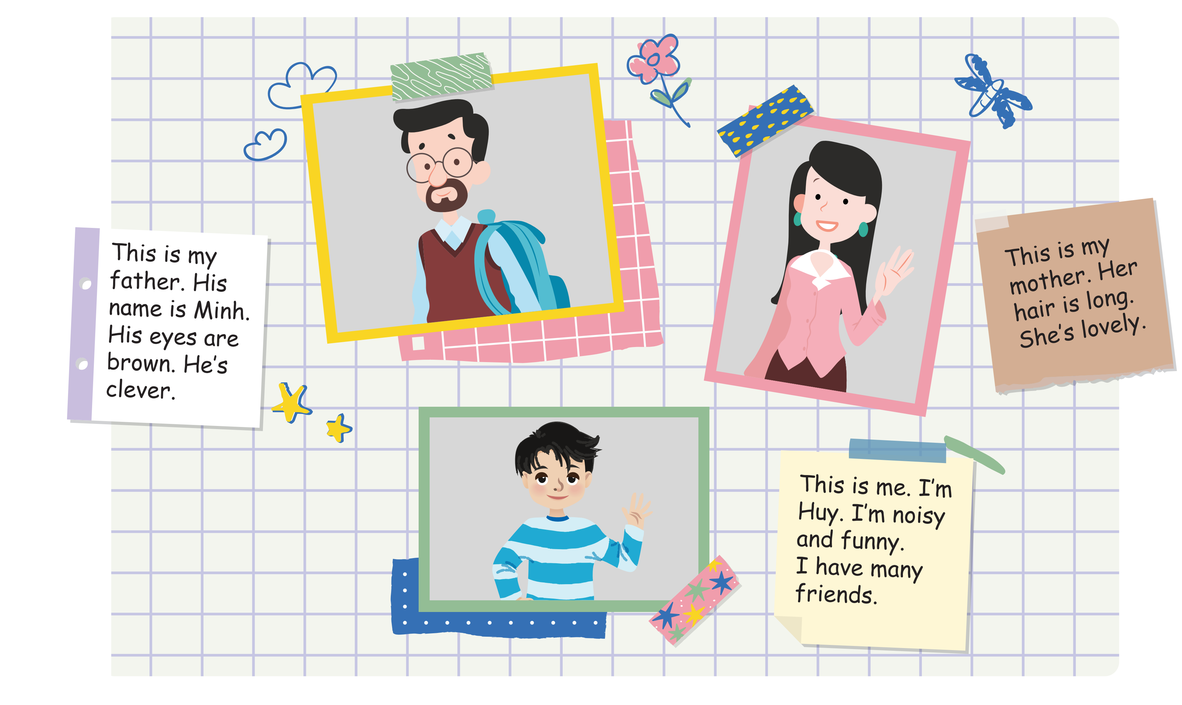

Slide 18
1 List the names of your family members.

Slide 19
2 Find their photos or draw their pictures

Slide 20
3 Write about them.

Slide 21

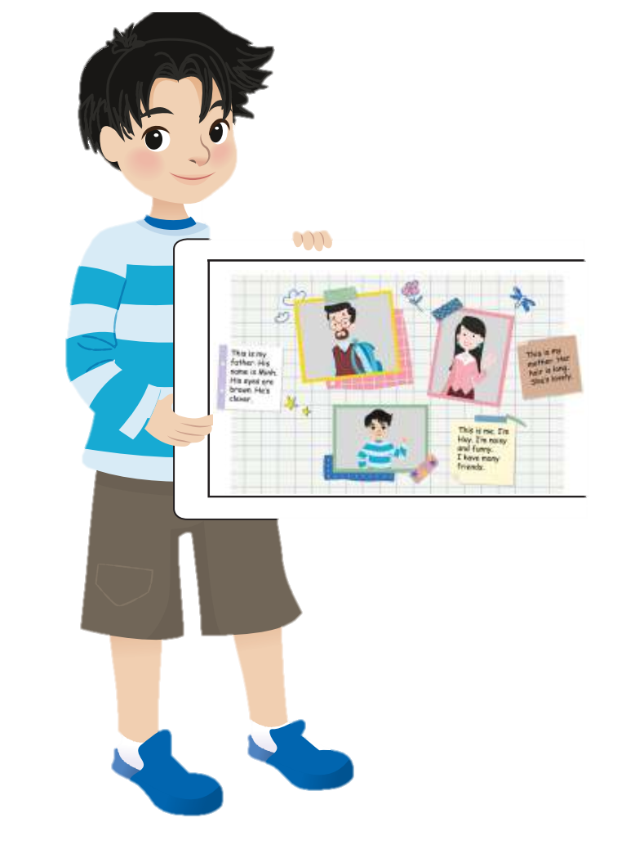
This is my father.
His name is Minh.
His eyes are brown.
He is clever.
Show your poster.
Tell the class about it.

Slide 22
04
Wrap-up &
Assessment

Slide 23
Read and write
Both
years
and
‘s
Her
but
pretty
This is my friend. (1) ____ name is Mai. She’s 12 (2) ____ old. She has brown eyes (3)____ dark hair. She has a (4) ______ smile. She’s quiet, (5) _____ she’s really clever. She loves her family. She often visits her grandpa(6)_____ house on the weekend. (7) _____ she and I love reading, so we often go to the library together.

Slide 24
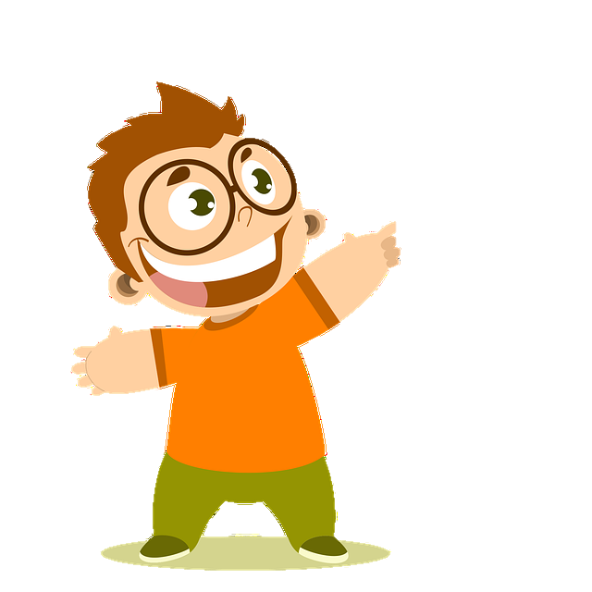
Wrap up
Unit 1: Family and friends
Fun time & Project – Lesson 2
What we learn today
Wrap up
Show & tell
Make a family poster, show and tell the class about it.

Slide 25

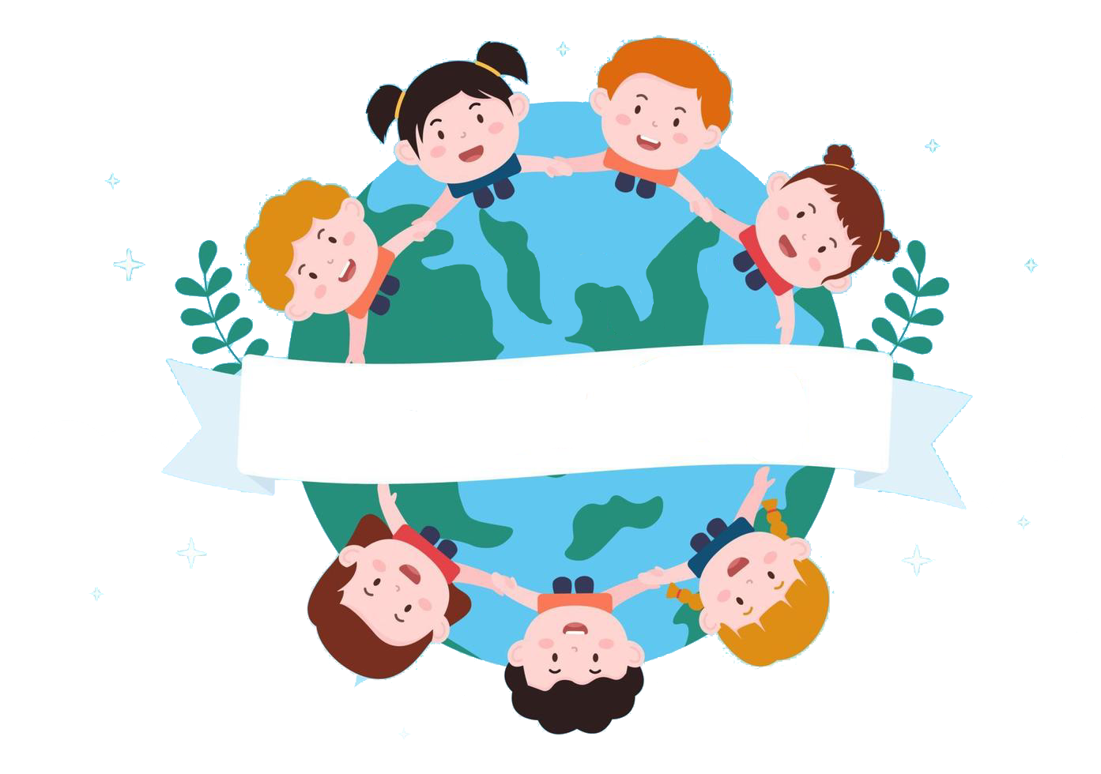
Thank you
& goodbye!

