Slide 1









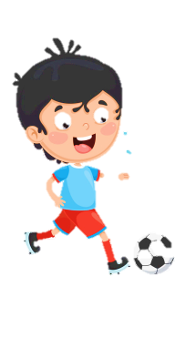


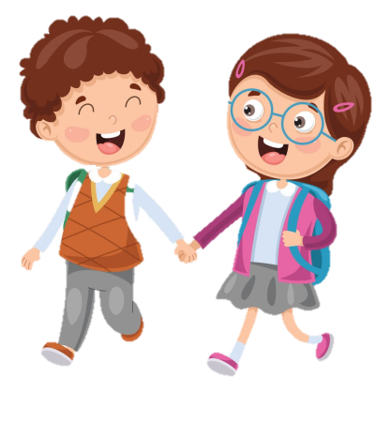



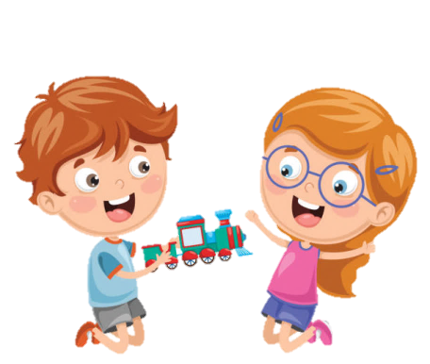






Slide 2





Table of contents
01
02
Warm - up
Presentation
05
04
Wrap-up &
Assessment
Production
03
Practice

Slide 3
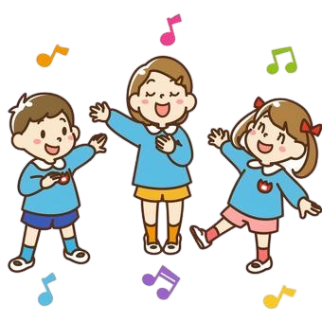
01
Warm up
Game “Stop the bus”

Slide 4
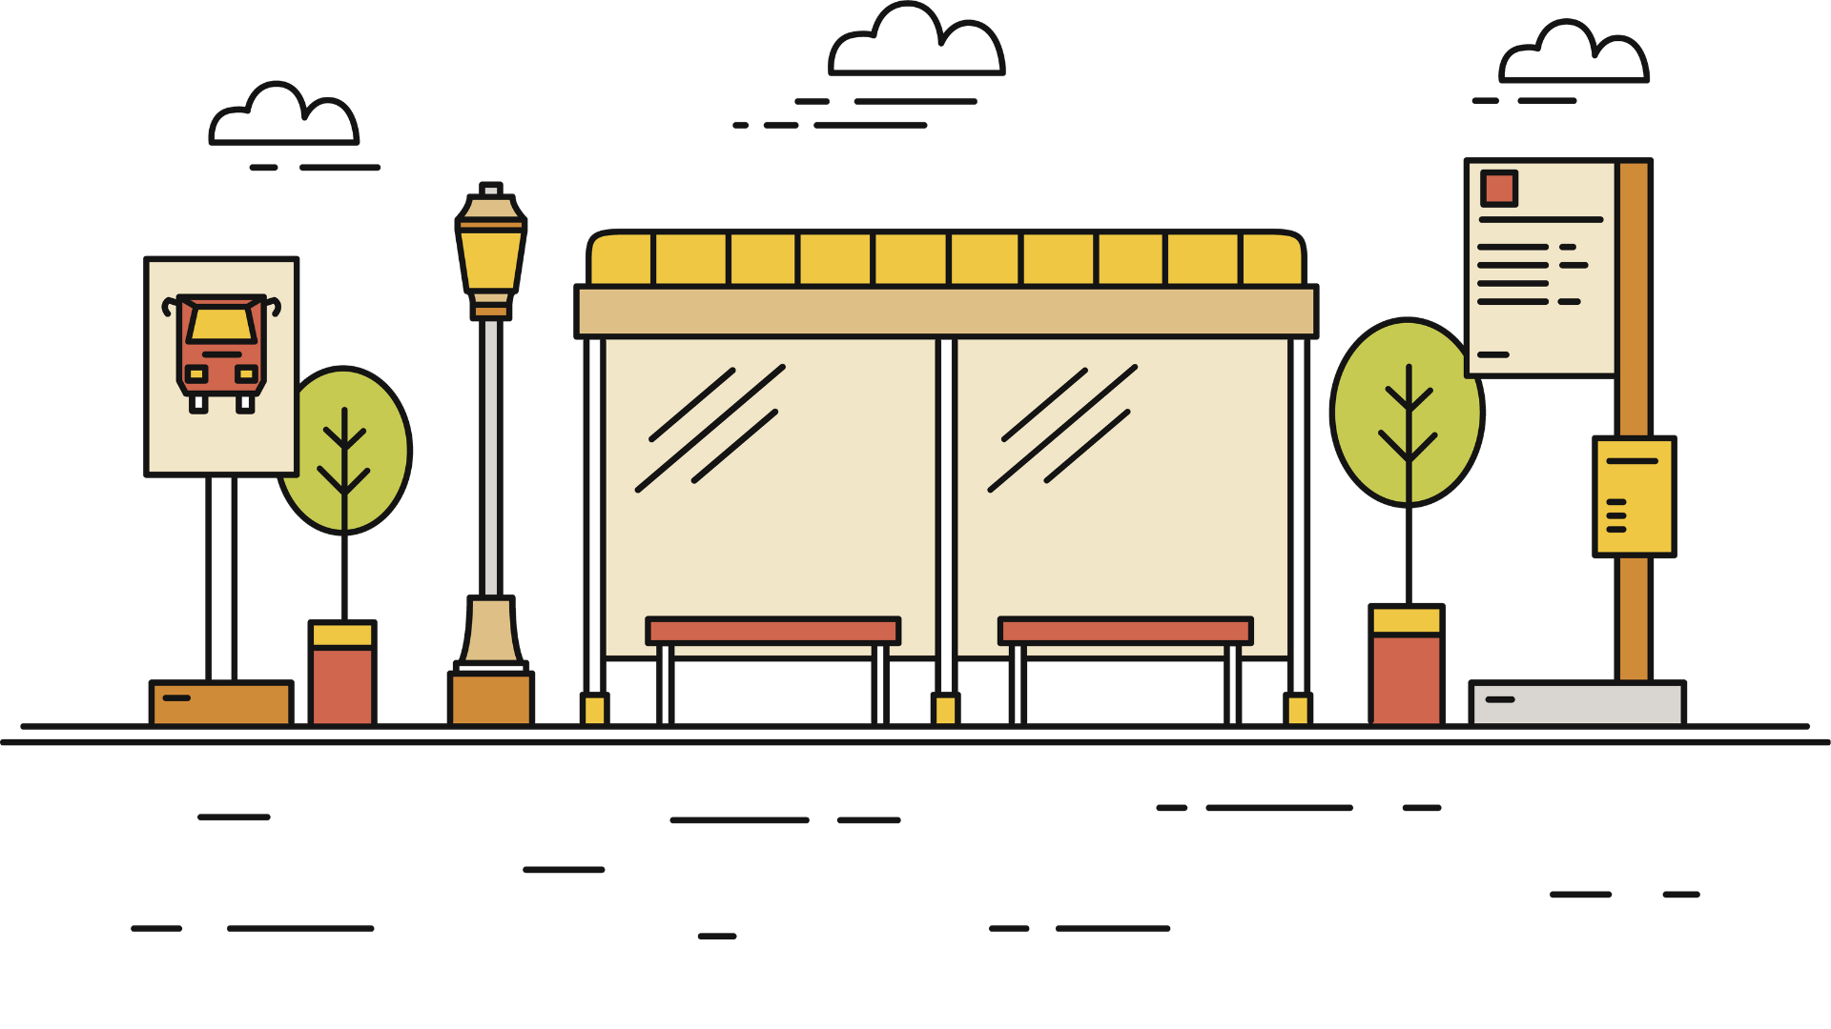
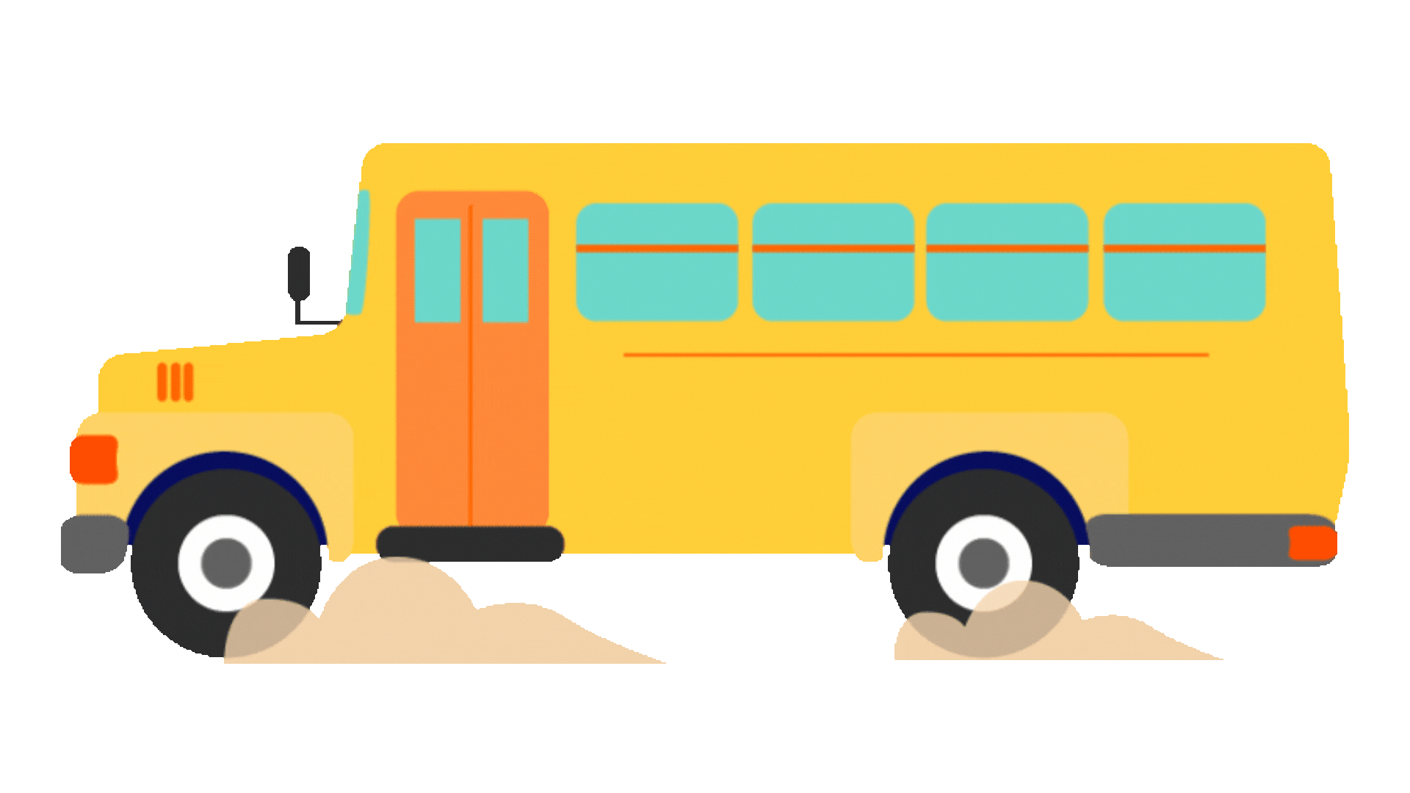
STOP THE BUS

Slide 5

do homework

Slide 6
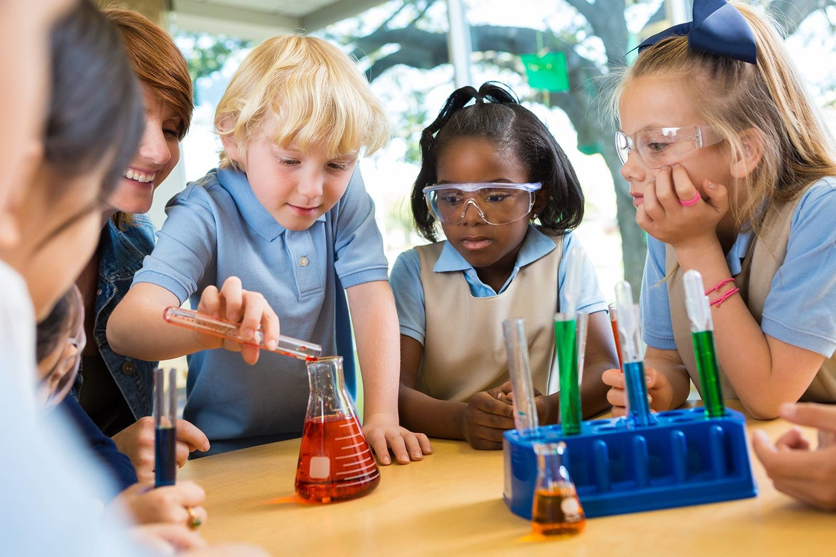
go to science clubs

Slide 7

have fun

Slide 8
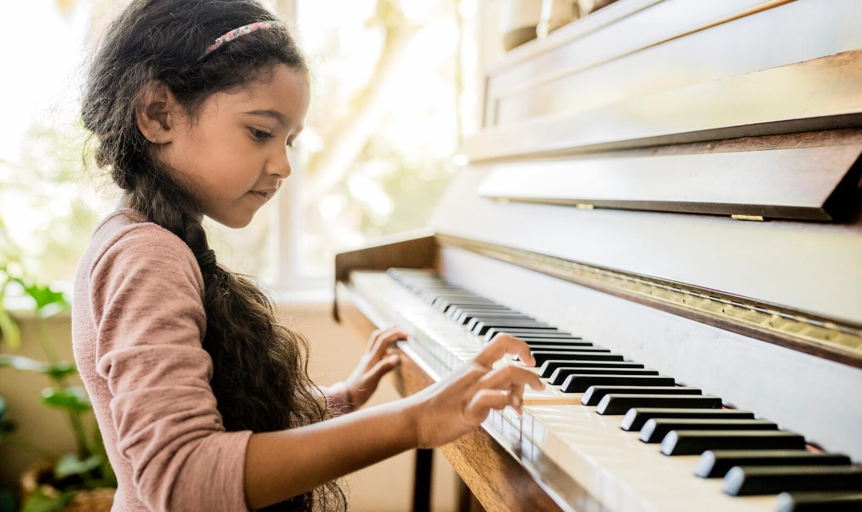
play a musical instrument

Slide 9
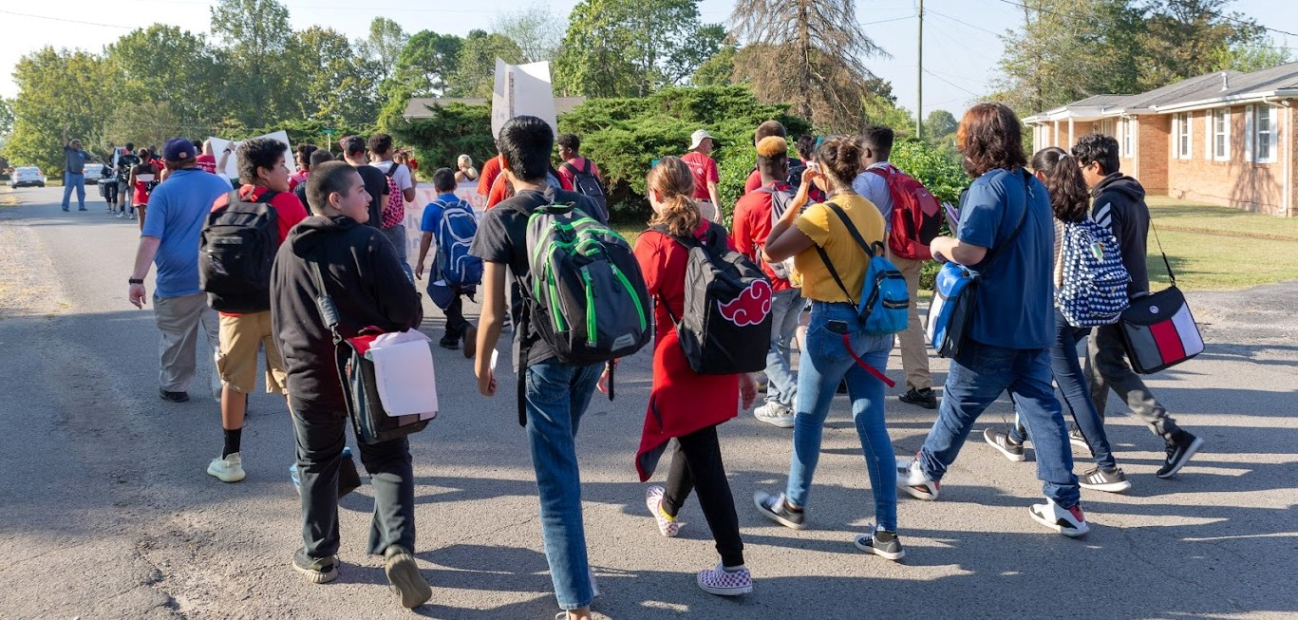
walk to school

Slide 10
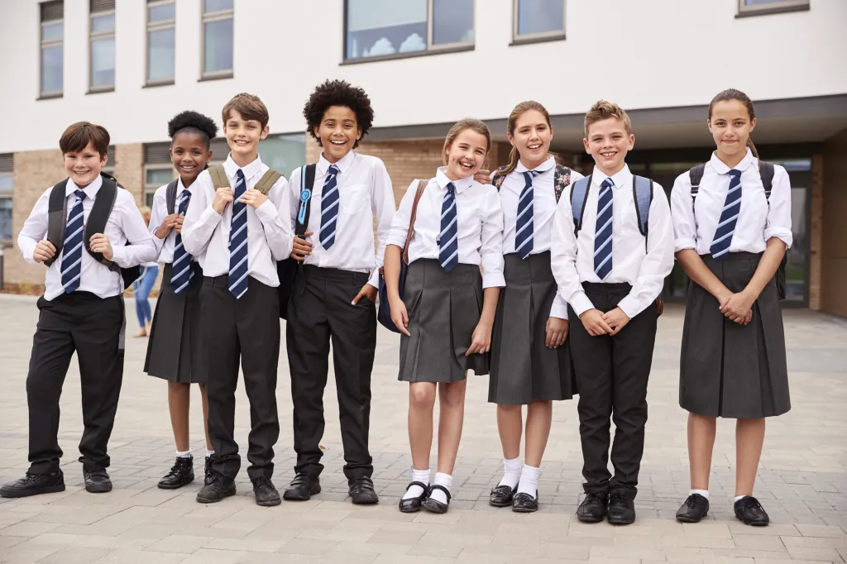
wear a uniform

Slide 11




Unit 3:
SCHOOL LIFE
Lesson 3 – Task 4, 5, 6

Slide 12
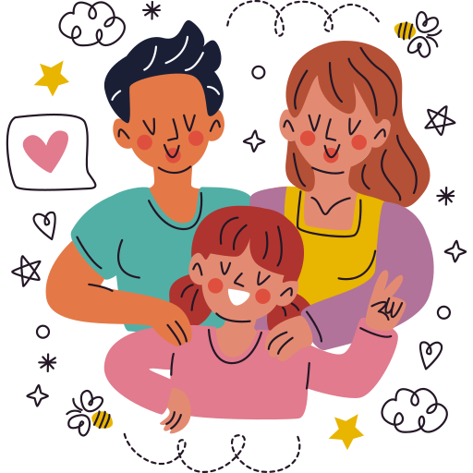
02
PRESENTATION

Slide 13

4 Listen and read.
2. My name is Doug. I usually walk to school. I haven’t got a bike. I never ride a bike to school. I don’t like science. I never go to any science clubs. I love sports. I usually practise sport with my best friend on Sundays.
1. My name is Ann. I often walk to school, but I sometimes ride my bike. I love science. I usually go to science clubs in the evening. I sometimes practise sport with my friends at the weekends.

Slide 14
4 Listen and read.
2. My name is Doug. I usually walk to school. I haven’t got a bike. I never ride a bike to school. I don’t like science. I never go to any science clubs. I love sports. I usually practise sport with my best friend on Sundays.
1. My name is Ann. I often walk to school, but I sometimes ride my bike. I love science. I usually go to science clubs in the evening. I sometimes practise sport with my friends at the weekends.
often
sometimes
never
usually

Slide 15
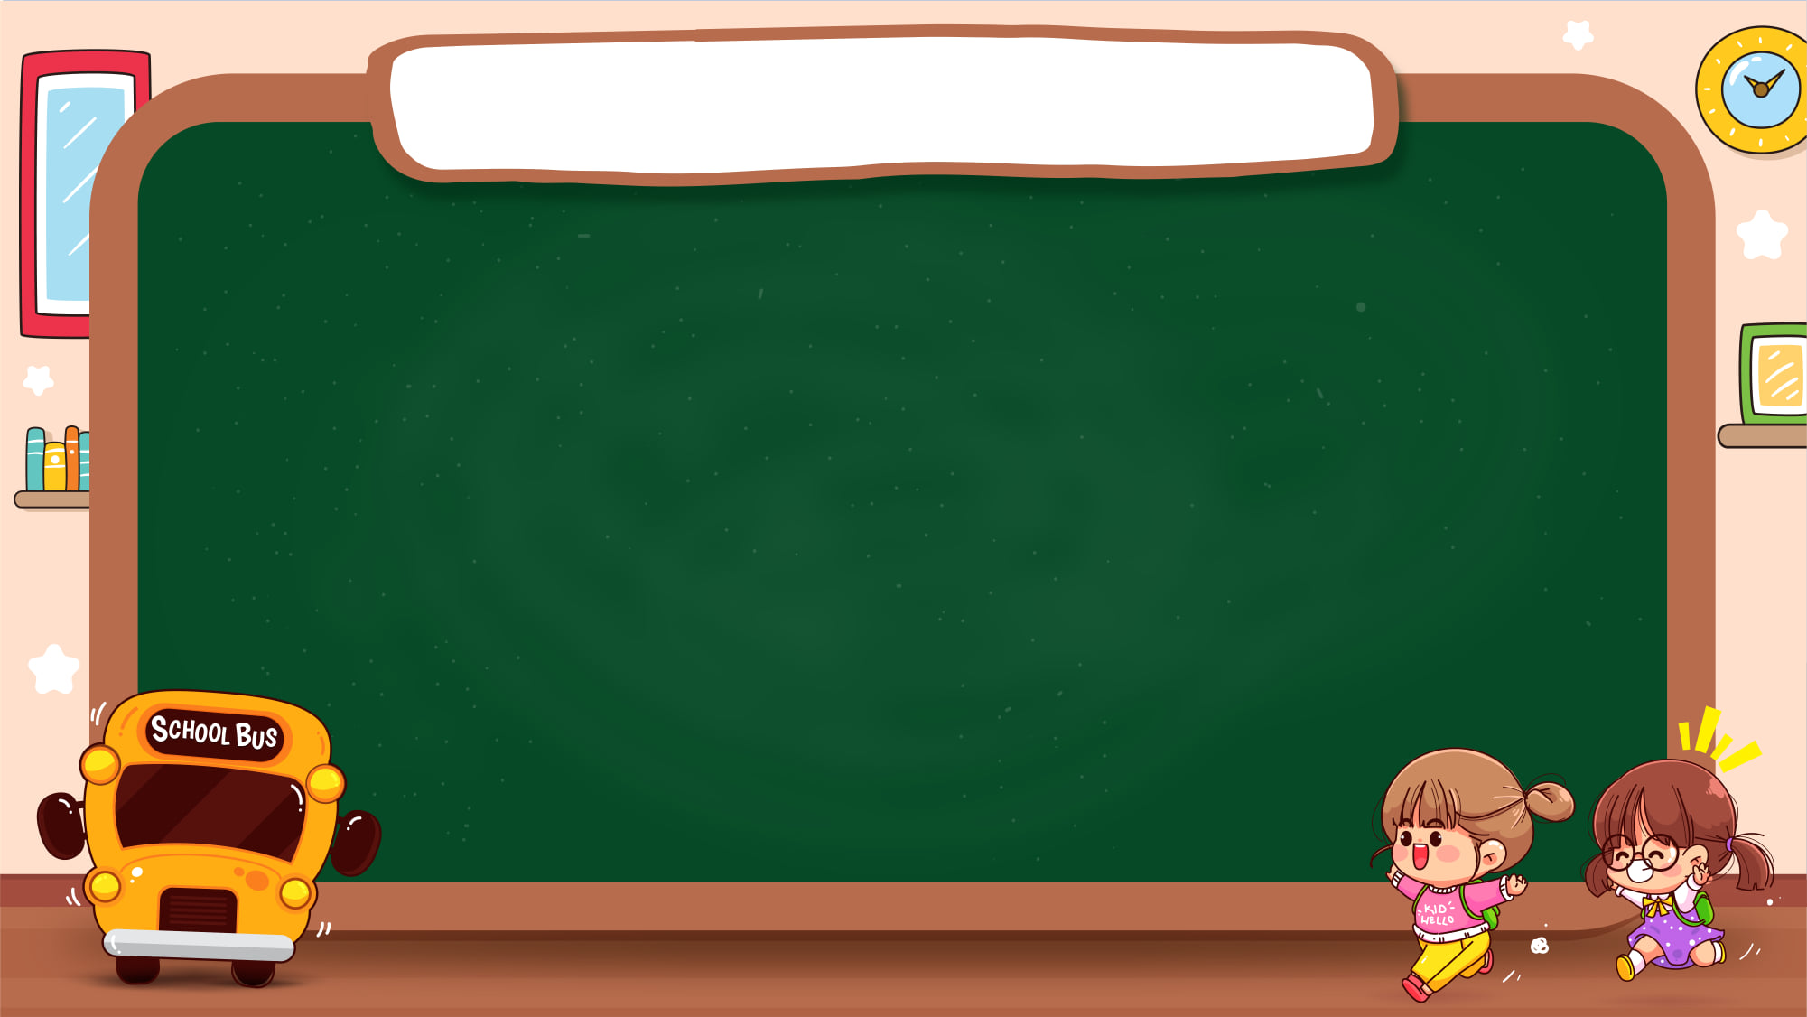





Adverb of frequency
always
100%
usually
90%
often
70%
sometimes
50%
never
0%

Slide 16
Sentence Patterns
Adverb of frequency
S + adverb + verb
My dad usually watches TV in the morning.

Slide 17
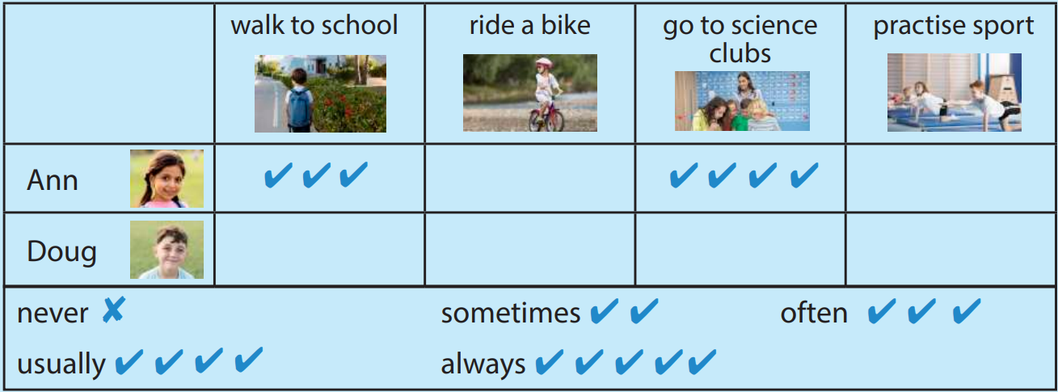


4 Now look and complete the chart.

Slide 18

03
PRACTICE

Slide 19

5 Read and write.
Minh’s Day
This is my friend, Minh. He(1) ____________ (usually/ get up) at 6.30 in the morning. He(2) ____________ (always/ have) breakfast with his mum and dad. His mum drives him to school. Minh finishes school at 4 p.m. He(3) ______________ (sometimes/ visit) his grandma in the afternoon. In the evening, Minh(4) ____________ (usually/ do) his homework. Then he(5) ____________ (often/ play) chess with his dad. He goes to bed at 10.30 at night.
usually gets up
always has
sometimes visits
usually does
often plays

Slide 20
Tic-Tac-Toe
1
2
3
1
2
3
4
5
6
4
5
6
7
8
9
7
8
9
Adverbs of frequency

Slide 21
1
How often do you walk to school?
100%
90%
I always walk to school.
70%
50%
BACK TO GAME
0%

Slide 22
2
How often do you do your homework?
100%
90%
I always do my homework.
70%
50%
BACK TO GAME
0%

Slide 23
3
How often do you go to science clubs?
100%
90%
I never go to science clubs.
70%
50%
BACK TO GAME
0%

Slide 24
4
How often do you do arts and crafts?
100%
90%
I never do arts and crafts.
70%
50%
BACK TO GAME
0%

Slide 25
5
How often do you ride a bike?
100%
90%
I usually ride a bike.
70%
50%
BACK TO GAME
0%

Slide 26
6
How often do you play a musical instrument?
100%
90%
I sometimes play a musical instrument.
70%
50%
BACK TO GAME
0%

Slide 27
7
How often do you play sports?
100%
90%
I sometimes play sports.
70%
50%
BACK TO GAME
0%

Slide 28
8
How often do you have fun with your friends?
100%
90%
I often have fun with my friends.
70%
50%
BACK TO GAME
0%

Slide 29
9
How often do you wear a uniform?
100%
90%
I usually wear a uniform.
70%
50%
BACK TO GAME
0%

Slide 30
04
PRODUCTION

Slide 31
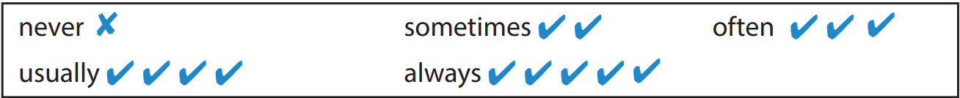
6 Write five sentences about your day. Use the questions to help you.
What time do you get up?
How do you go to school?
What do you do in the afternoon?
What do you do in the evening?
What time do you go to bed?

Slide 32

6 Write five sentences about your day. Use the questions to help you.
What time do you get up?
I always get up at 6.00 am.

Slide 33

LET’S TALK!

Slide 34
05
WRAP-UP &
ASSESSMENT

Slide 35
Adverb of frequency
always
100%
usually
90%
often
70%
sometimes
50%
never
0%
Notes:
- Teacher clicks each percentage to show up the corresponding adverbs of frequency.

Slide 36

Unit 3: School life
Lesson 3 – Part 4,5,6
What have we learnt today?
Review vocabulary: do homework, go to science clubs, have fun, play a musical instrument, walk to school, wear a uniform
Grammar: Adverbs of frequency(always, usually, often, sometimes, never)
I often walk to school, but I sometimes ride my bike.
Notes:
-Giáo viên yêu cầu học sinh nhắc lại nội dung bài học hôm nay. Sau đó, giáo viên mới hiển thị nội dung đã được học.

Slide 37

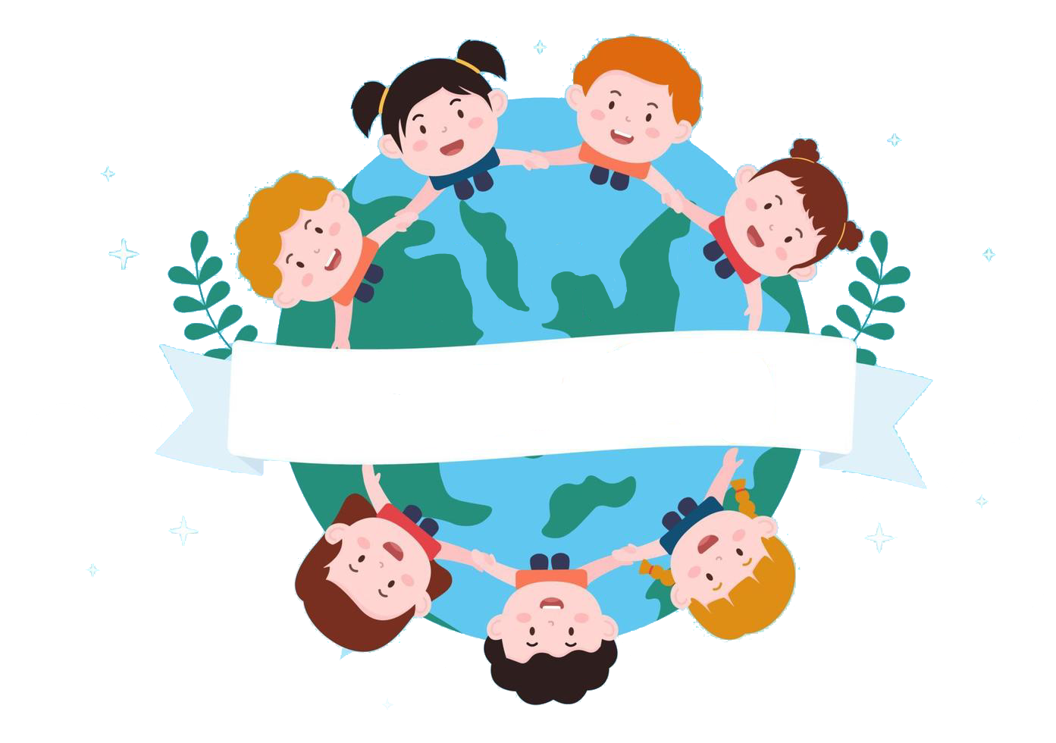
Thank you
& goodbye!

