Slide 1









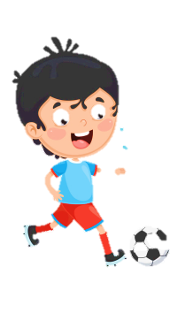
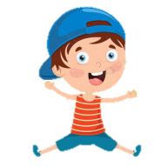
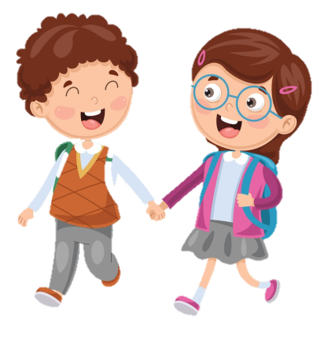



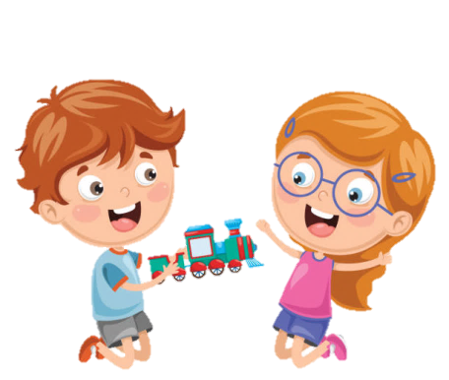






Slide 2






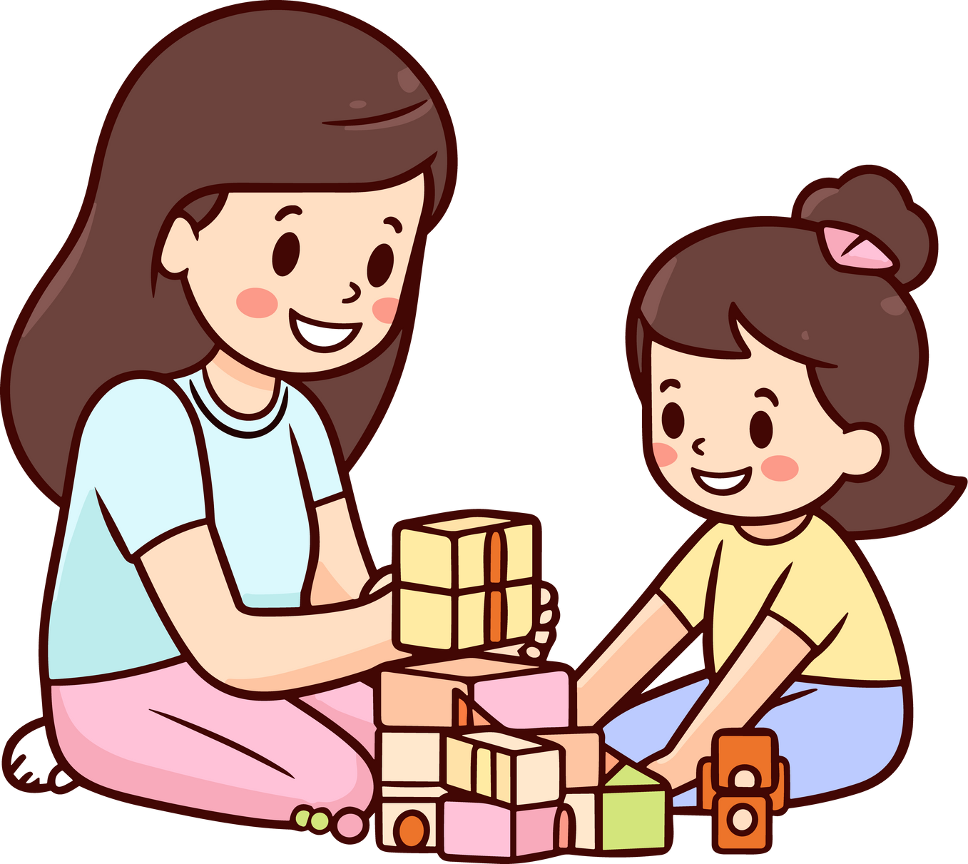

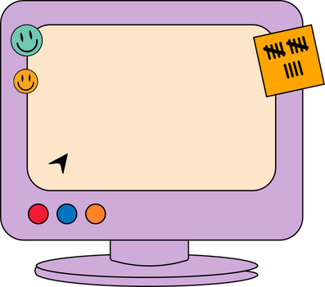

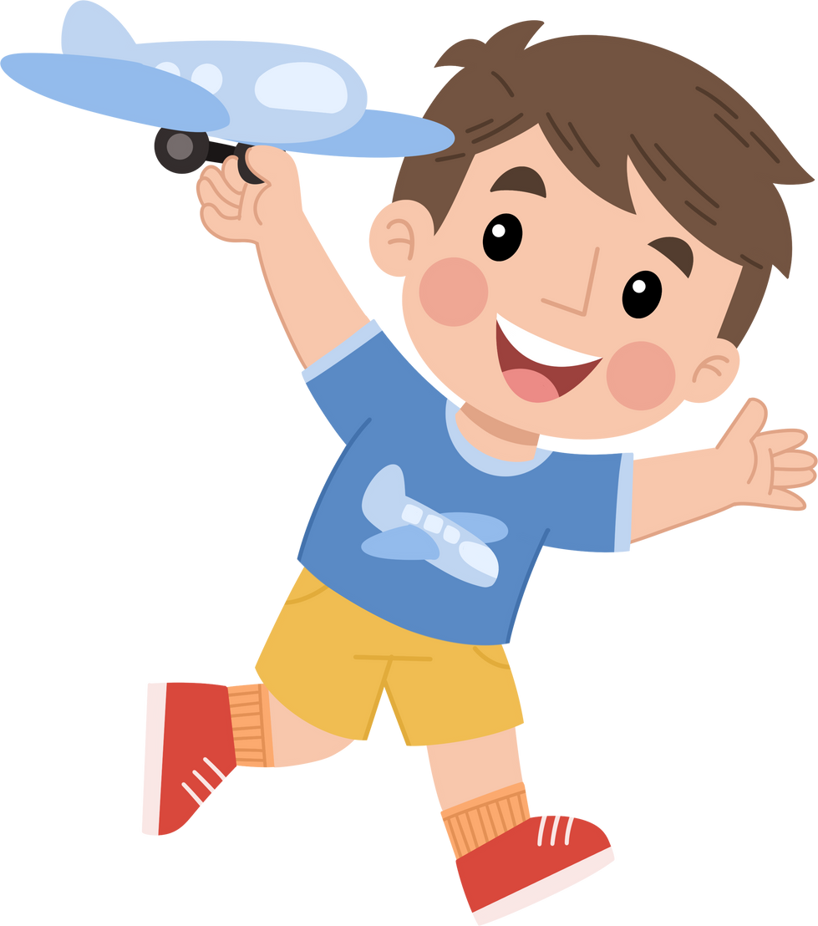
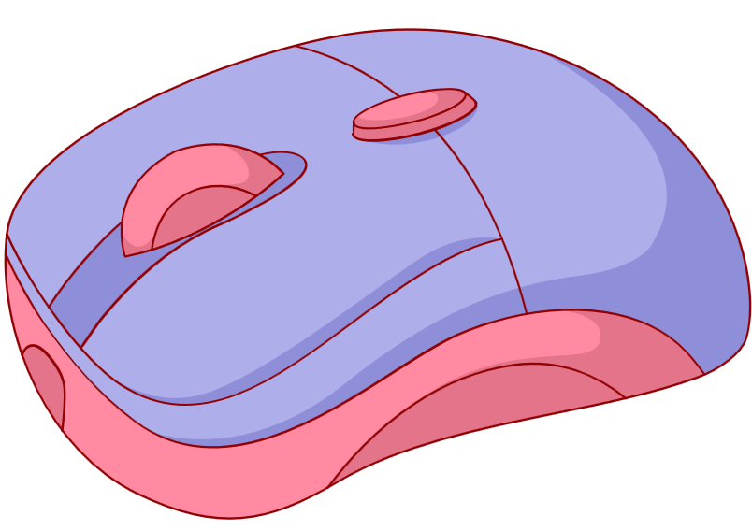
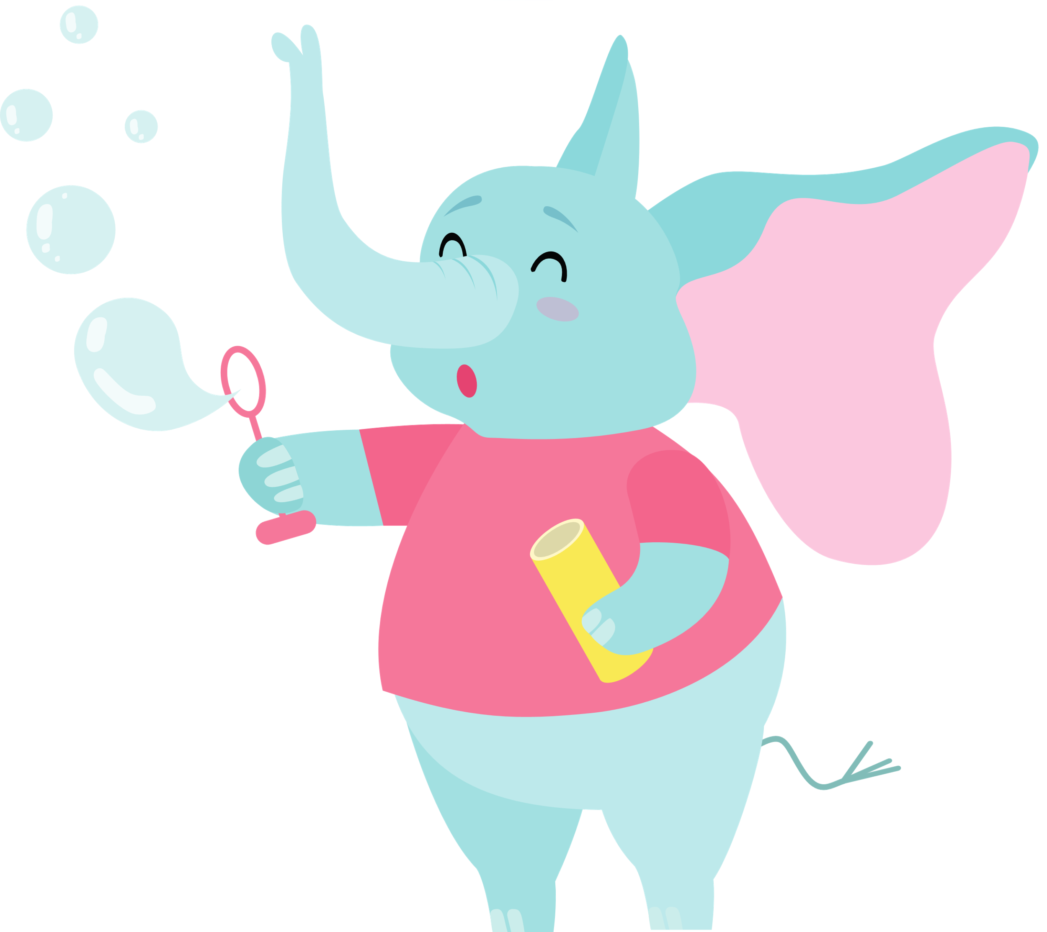



Unit 2
My Favorite Things
FUNTIME AND PROJECT
(period 2)

Slide 3









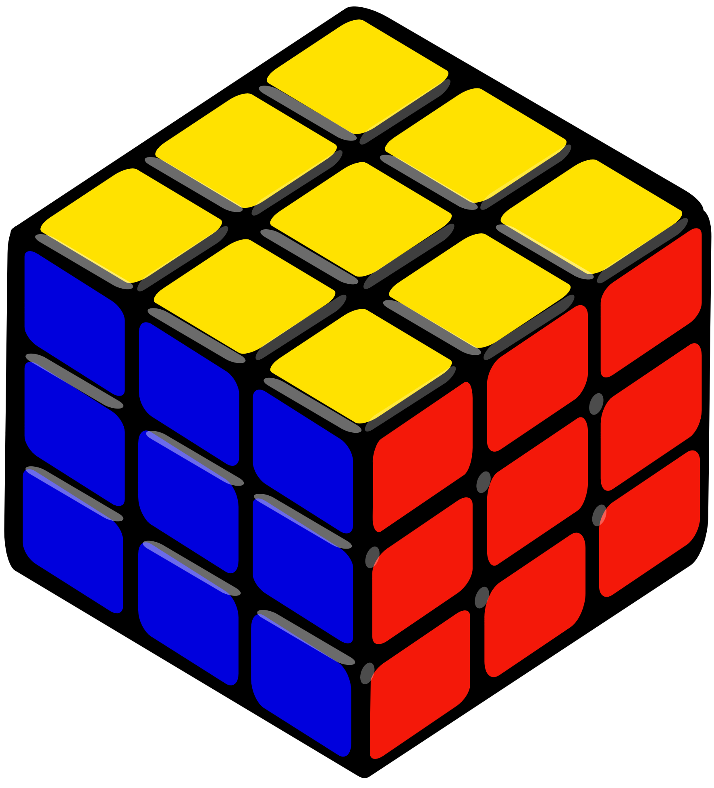
1
Warm-up
2
Review & Practice
Tables
of content
3
Project
4.
Wrap-up and Assessment

Slide 4


1
Warm-up

Slide 5



Slide 6
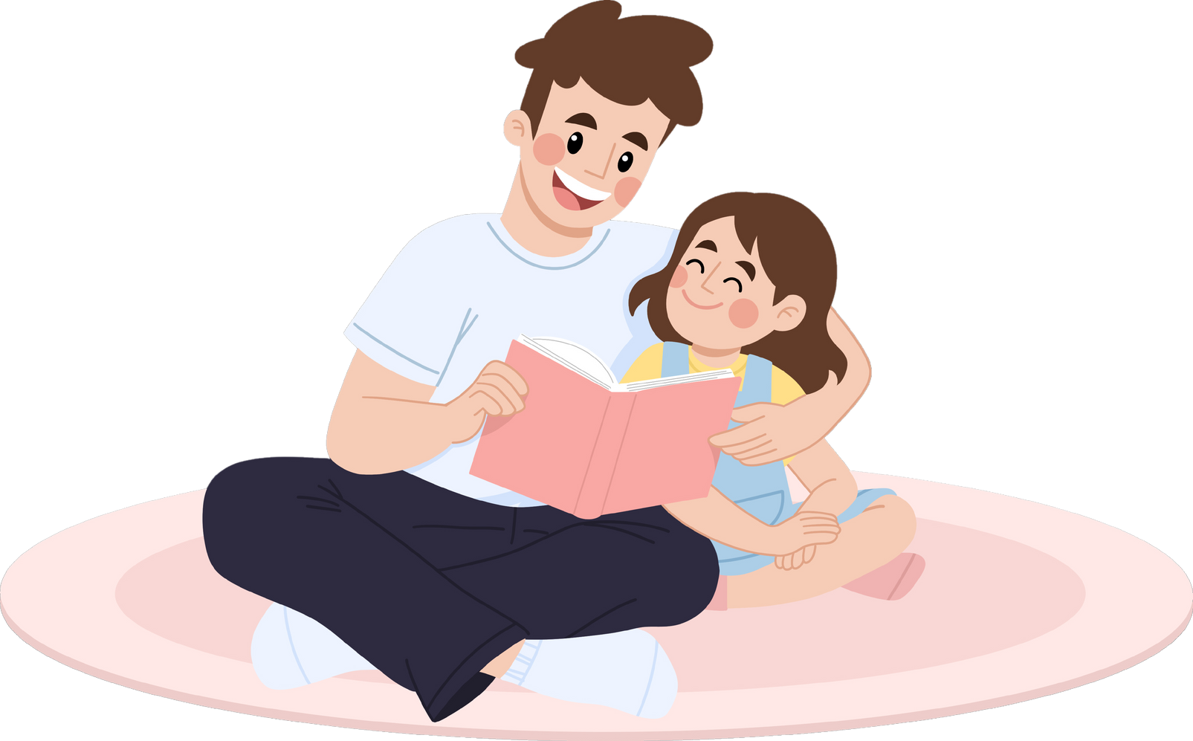


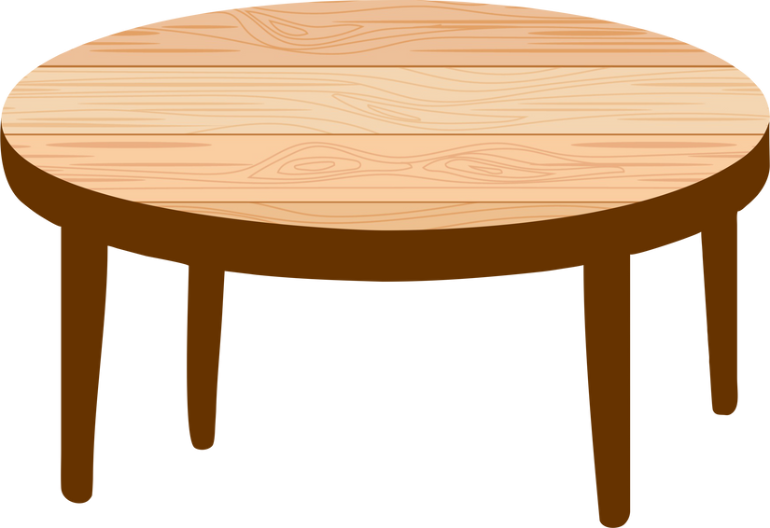

2
Review & Practice

Slide 7
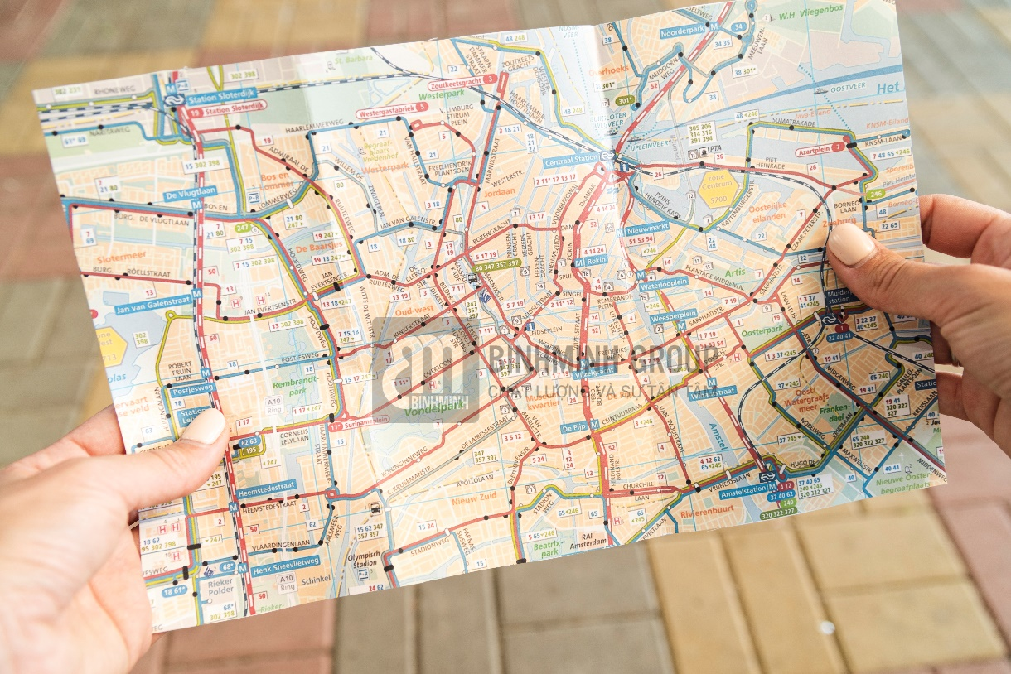
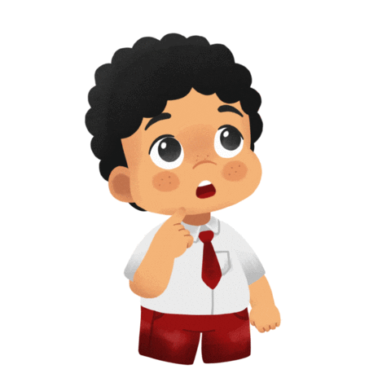



A
P
M

Slide 8
M
A
P

Slide 9
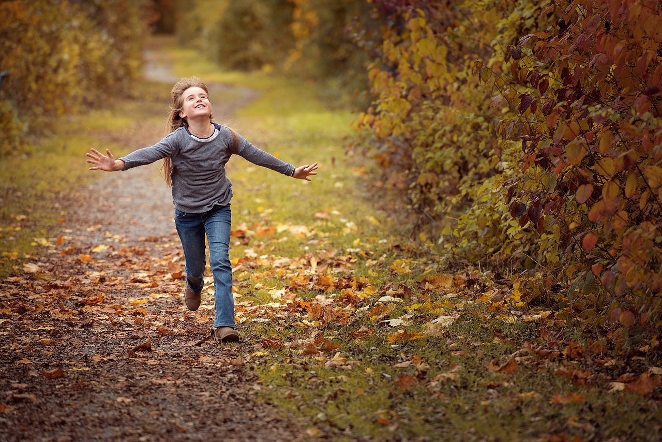
N
G
V
O
I
M

Slide 10
M
O
V
I
N
G

Slide 11
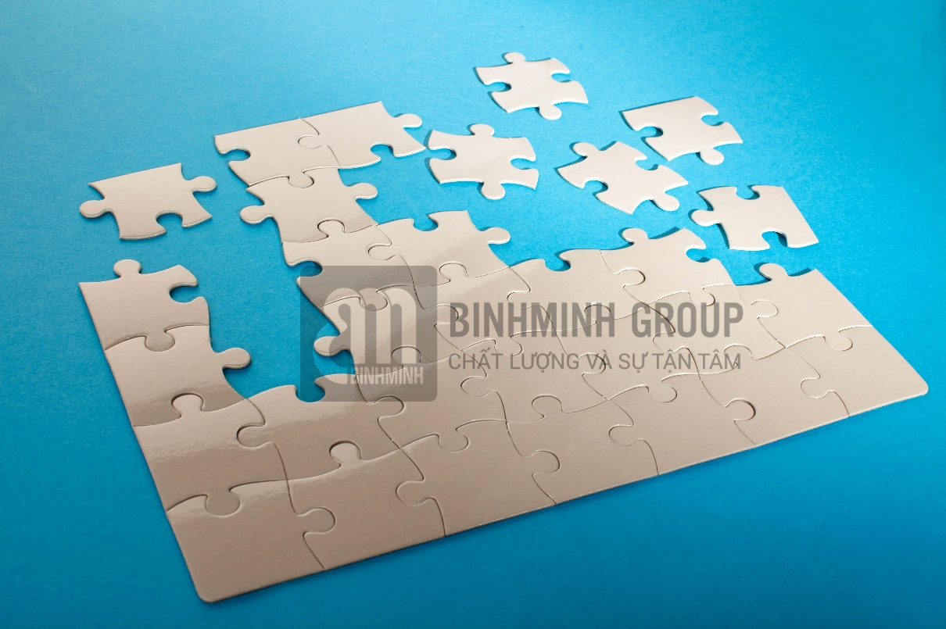
Z
P
U
Z
L
E

Slide 12
P
U
Z
Z
L
E

Slide 13
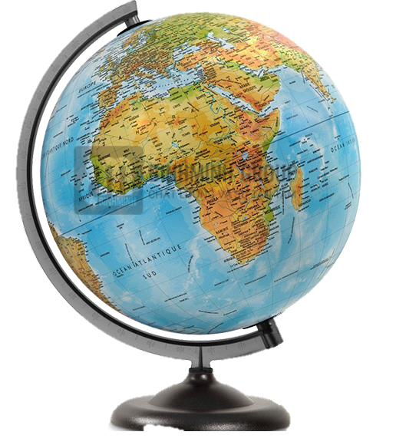
B
G
O
L
E

Slide 14
G
L
O
B
E

Slide 15
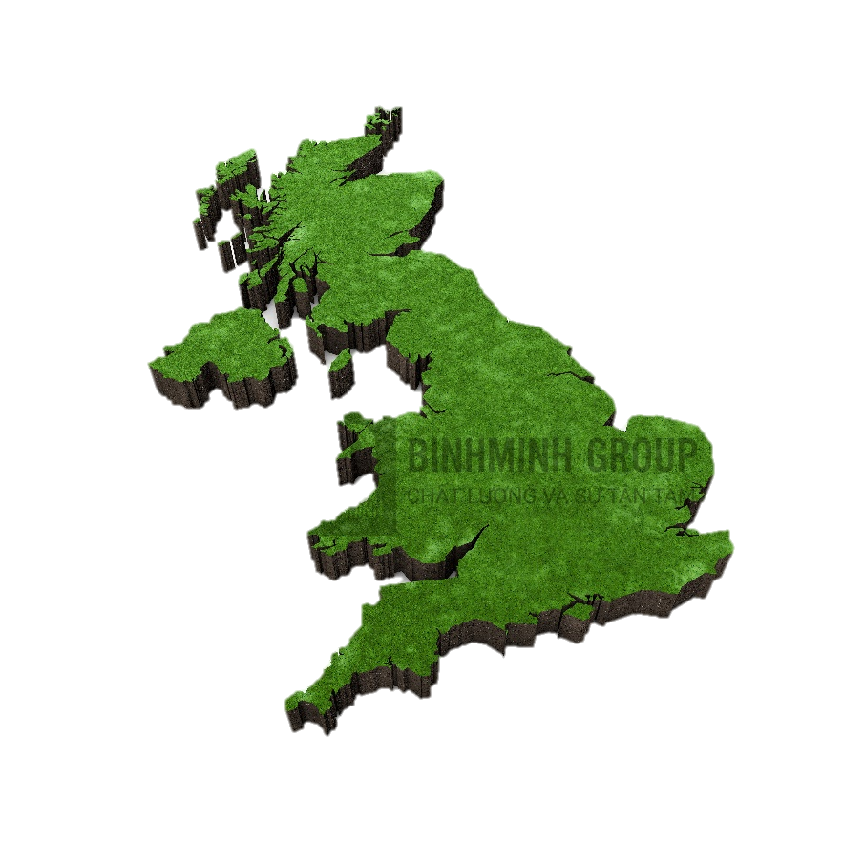
T
U
O
C
N
R
Y

Slide 16
C
O
U
N
T
R
Y

Slide 17
3
Project

Slide 18
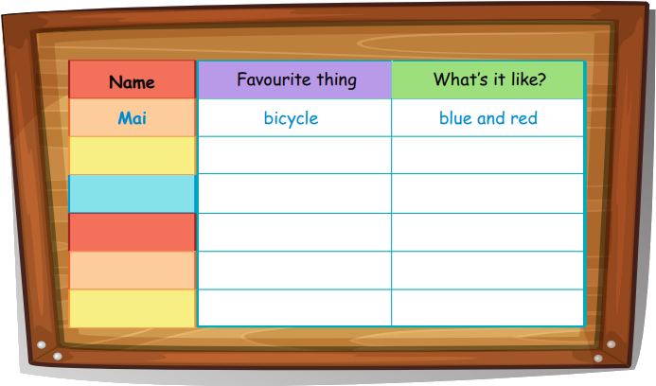
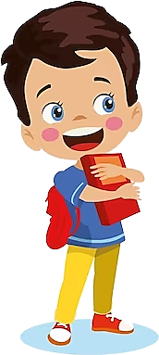
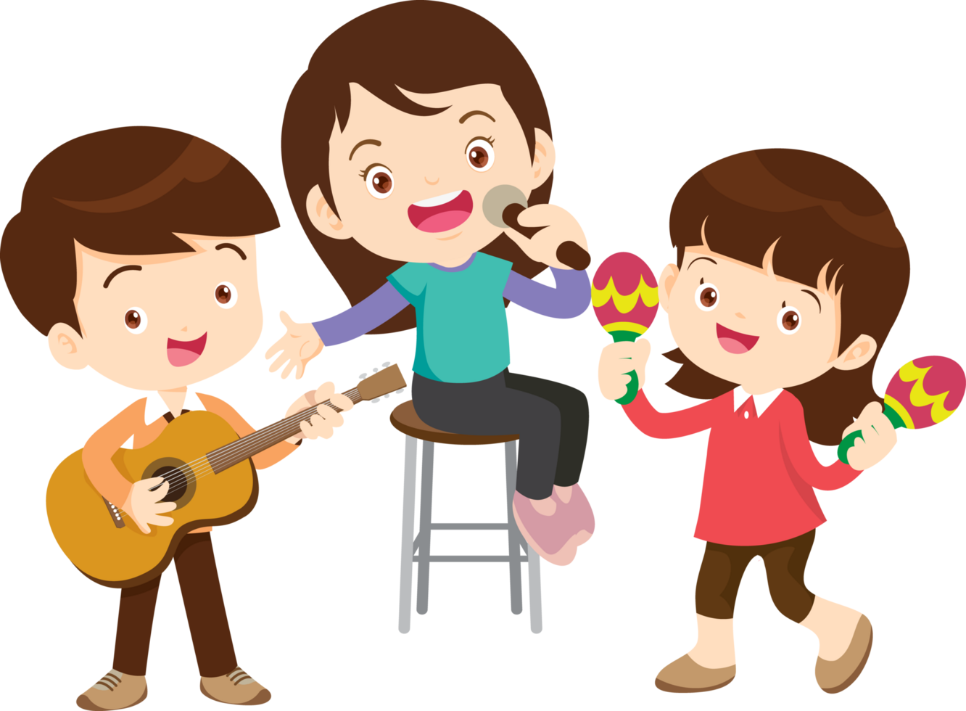
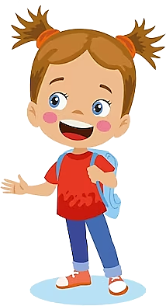
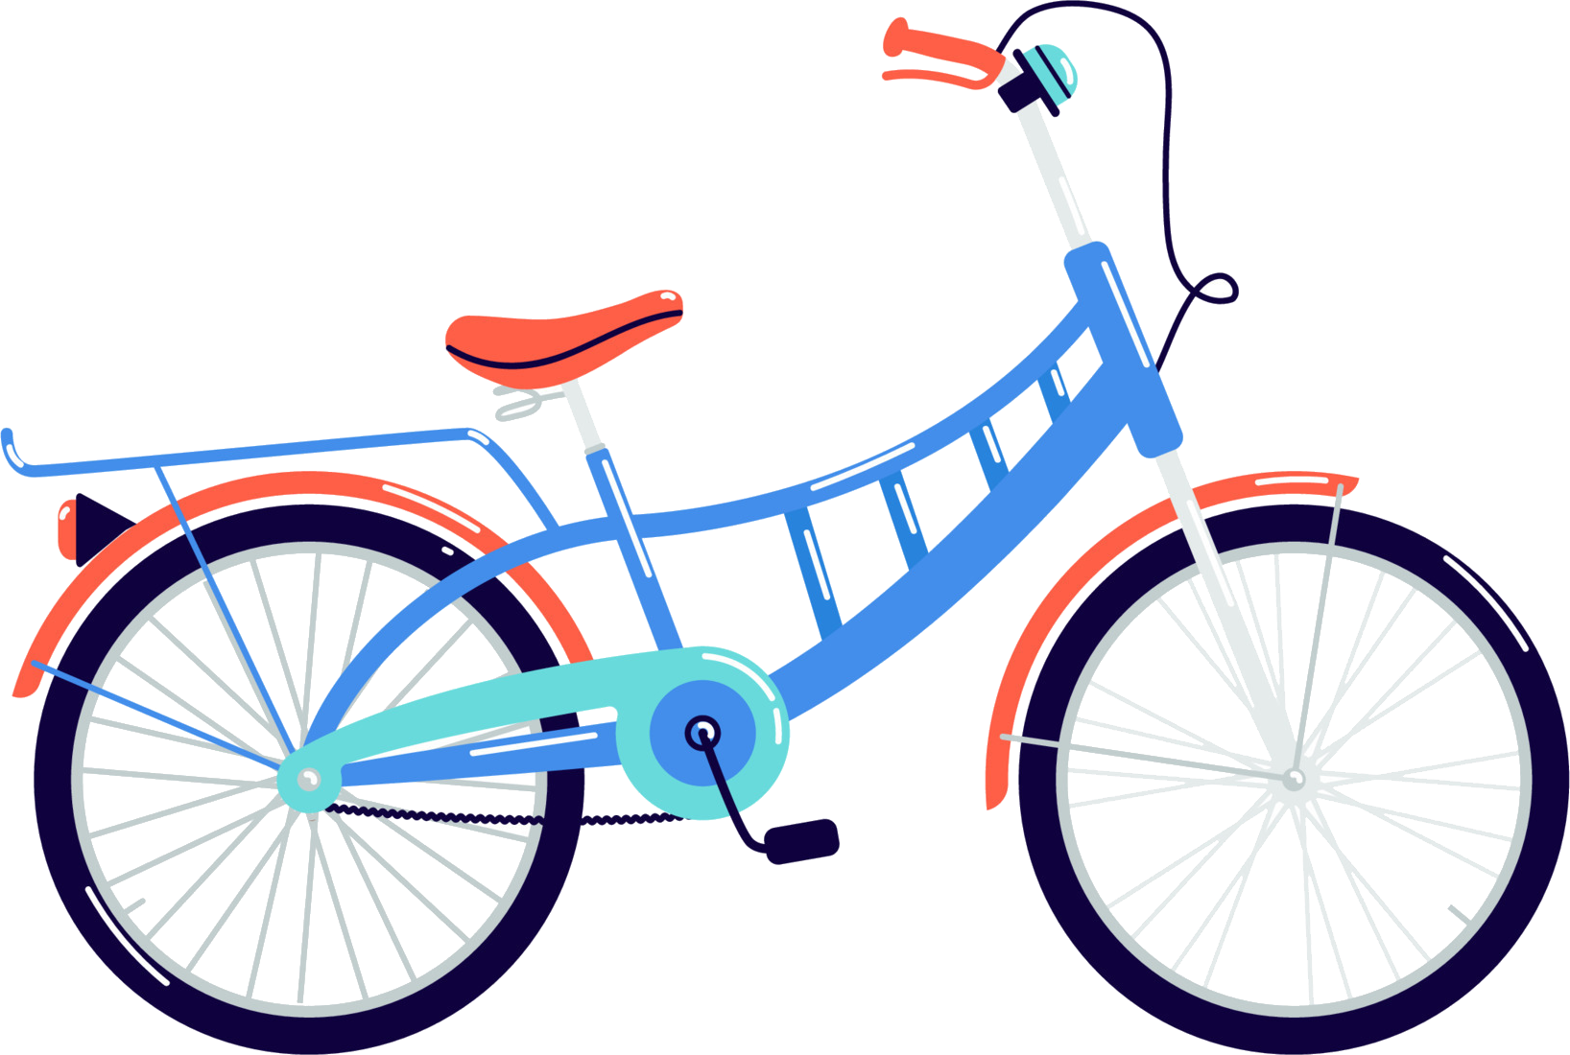
4 Do a class survey.
What’s your favourite thing?
What’s it like?
My favourite thing is my bicycle / I like my bicycle.
It’s blue and red.

Slide 19
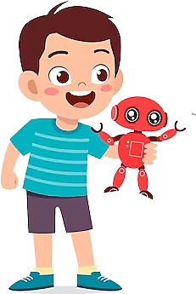
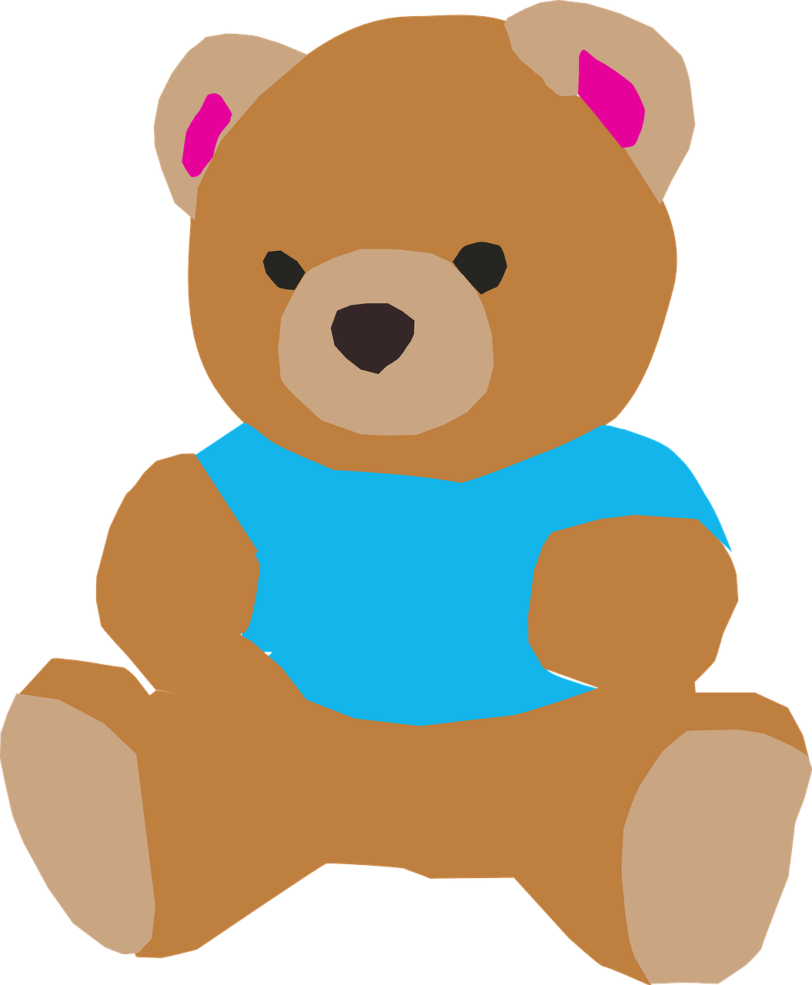
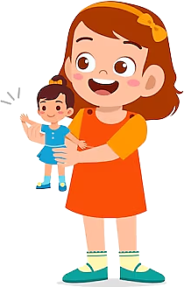



What is your favourite thing, Trang?
My favourite thing is my teddy bear.
What is it like?
It is brown and old.

Slide 20
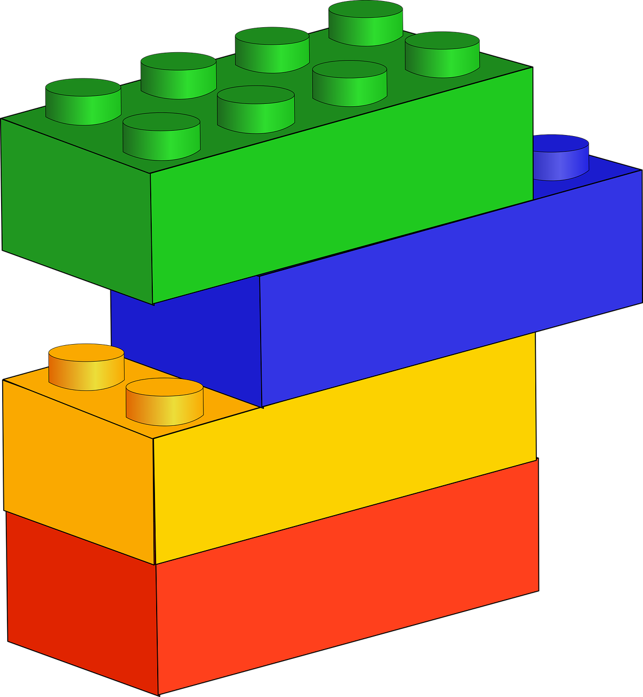
What was your favourite thing, when you were young, Lan ?
My favourite things were my blocks.
What were they like?
They were so colourful.

Slide 21
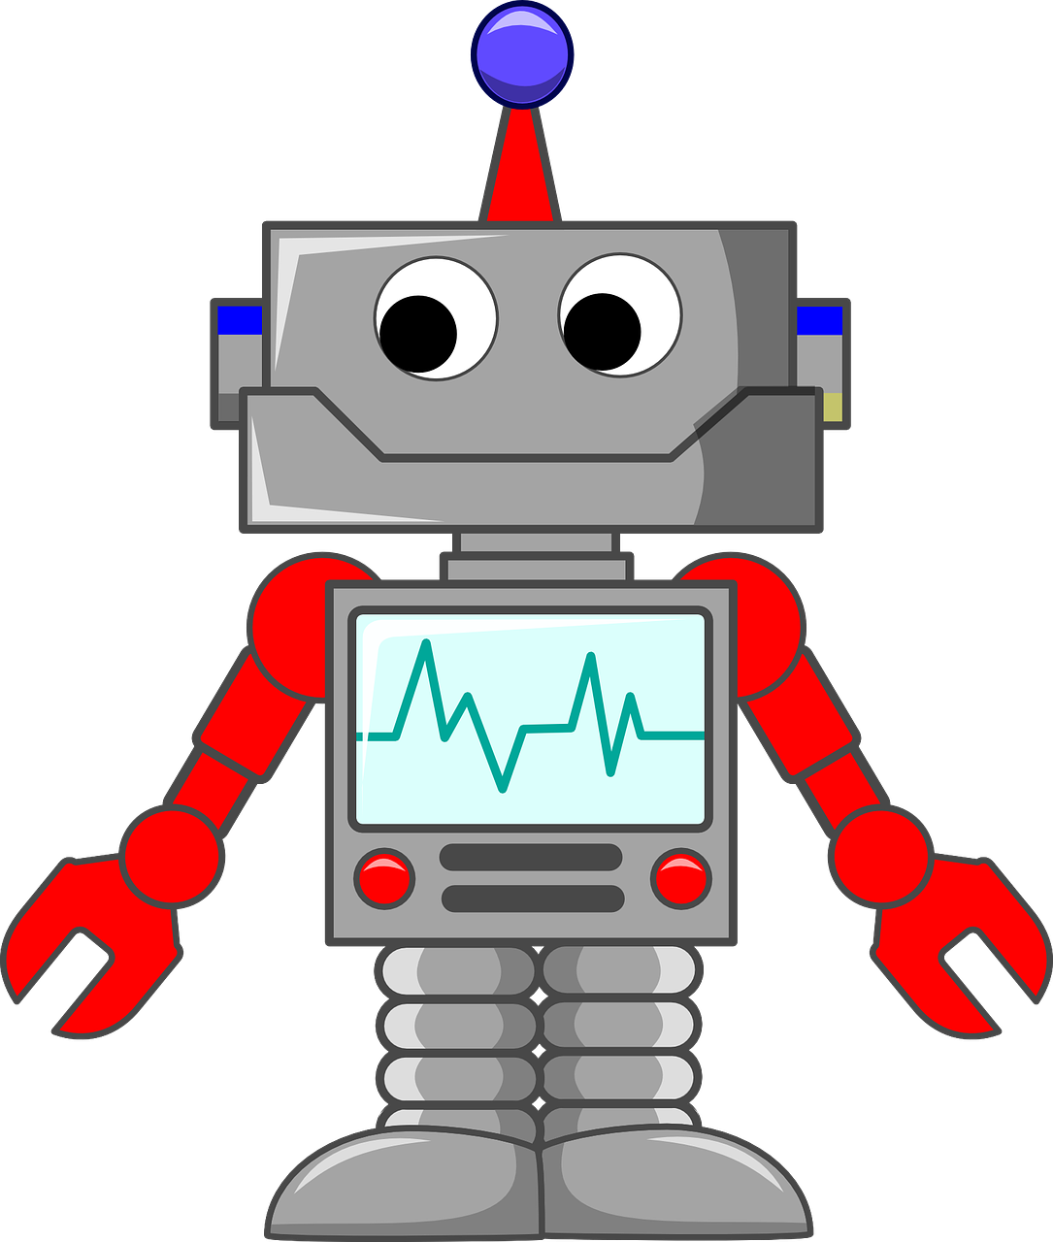
When Minh was seven years old, what was his favourite thing?
It was grey and red.
What was it like?
It was a robot.

Slide 22
Trang
teddy bear
brown and old
Lan
blocks
colourful
Minh
robot
grey and red

Slide 23


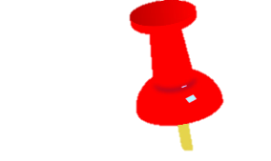


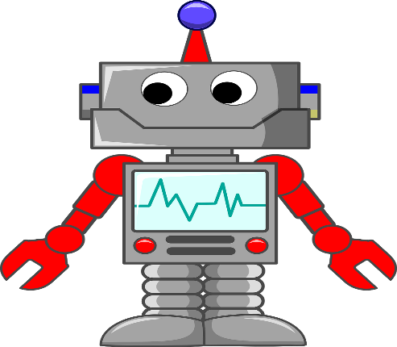
5 Report the survey.
Mai’s favourite thing is her bicycle. It’s blue and red.
Trang’s favourite thing is her teddy bear. It’s brown and old.
Minh’s robot is his favourite thing. It is red and grey.

Slide 24



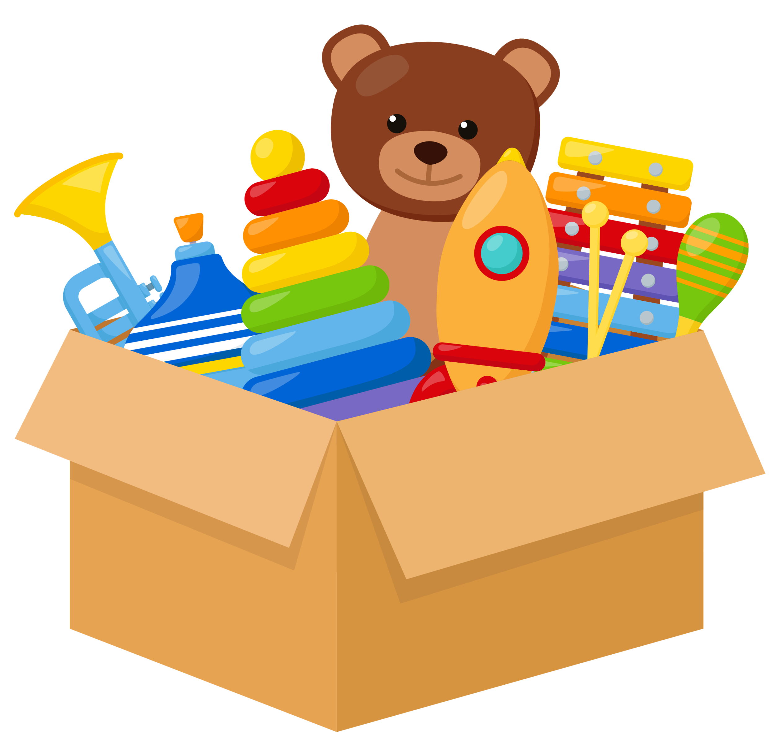
Wrap-up &Assessment
4

Slide 25





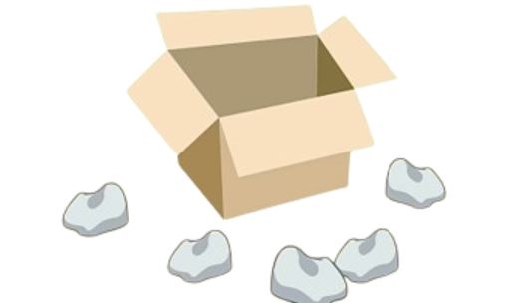

Look and tick
country
ocean
river
✔
map
globe
cup
✔
✔
computer
speaker
microphone
under
behind
outside
✔

Slide 26
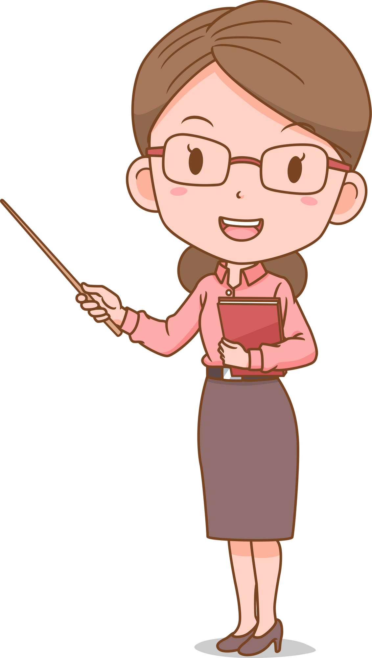
Wrap-up
Unit 2: My Favorite Things
Funtime and Project
What have we learnt today?
Vocabulary Review
puzzle, computer, piece, typewriter, photo, country, map, moving, scare, globe, spider
Structures Review
What is your favourite thing?
- My favourite thing is my teddy bear.
2. What is it like? – It’s brown and old.

Slide 27

Thank you
for your attention!

