Slide 1

Unit 4: Travel
Lesson 3.1
Page 54

Slide 2
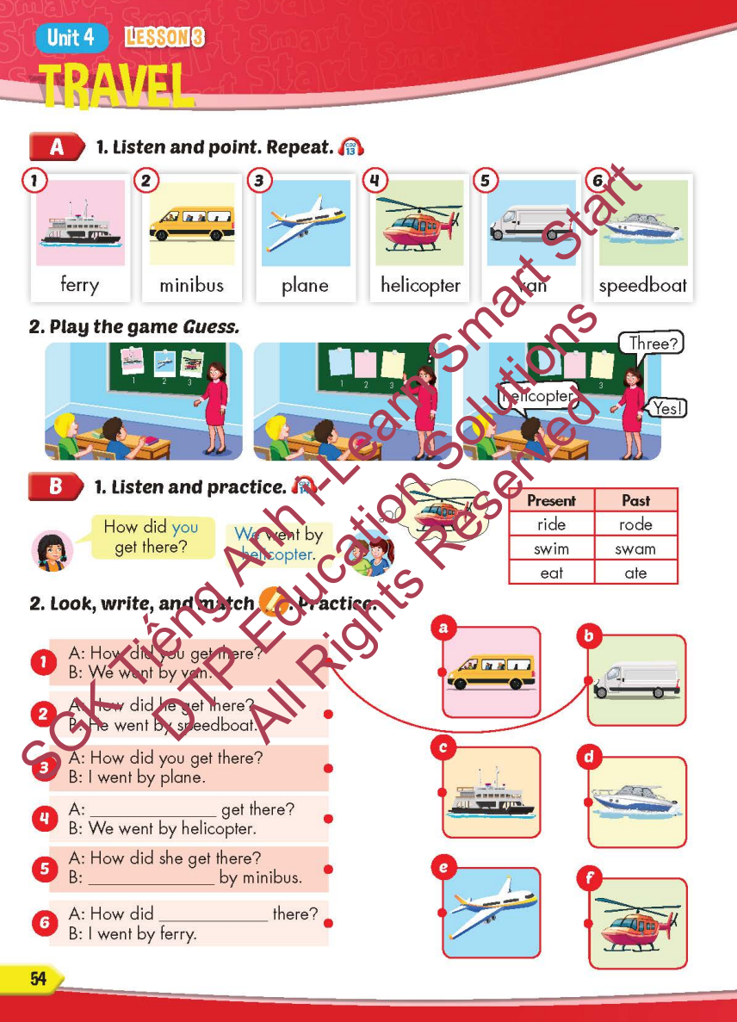
Lesson Outline
Warm-up
Vocabulary
Structure
Consolidation
Wrap-up

Slide 3
Objectives
By the end of this lesson, students will be able to…
Vocabulary: Pronounce and use the words related to the topic properly: ferry, minibus, plane, helicopter, van, speedboat
Structure: How did you get there? - We went by helicopter.

Slide 4

It’s time to learn …

Slide 5

New words
ferry, minibus, plane,
helicopter, van, speedboat

Slide 6

Presentation

Slide 7


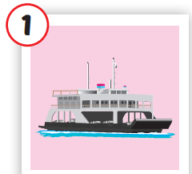
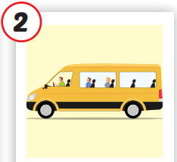
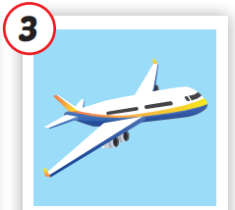
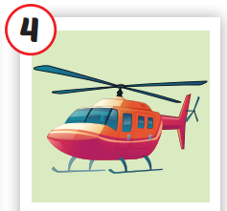
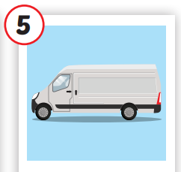
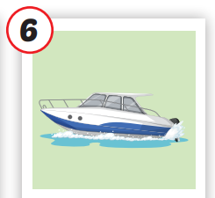






/ˈferi/
phà
/ˈmɪnibʌs/
xe buýt nhỏ
/pleɪn/
má bay
/ˈheləˌkɑːptə/
trực thăng
/væn/
xe tải nhỏ,
có mui
/ˈspiːdboʊt/
tàu thủy cao tốc
Notes:
Click vào hình A. 1. Listen and point. Repeat để cho cả audio full chạy

Slide 8
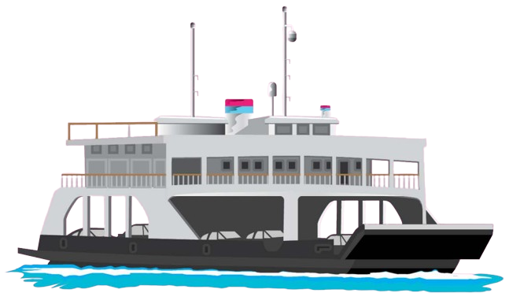
/ˈferi/
phà

Slide 9
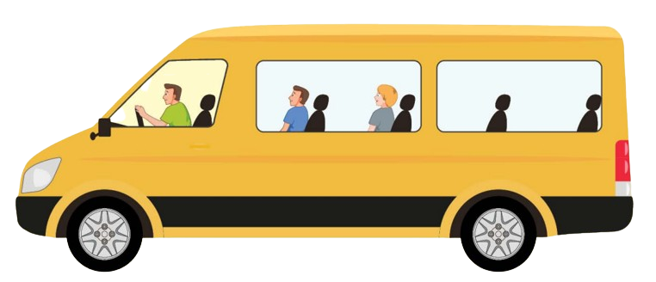
/ˈmɪnibʌs/
xe buýt nhỏ

Slide 10
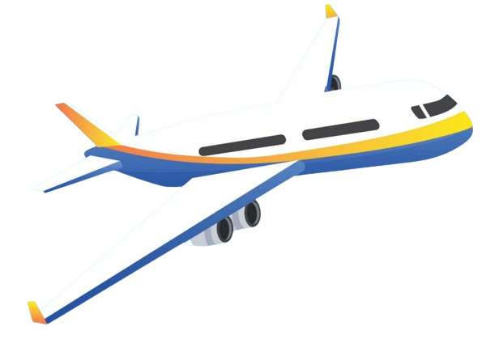
/pleɪn/
má bay

Slide 11
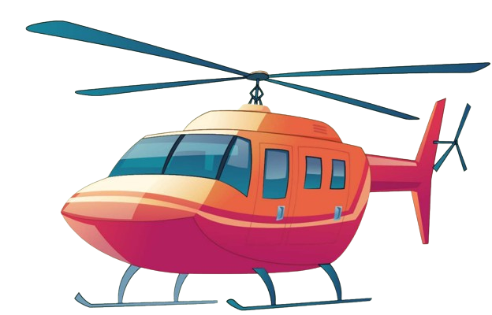
/ˈheləˌkɑːptə/
trực thăng

Slide 12
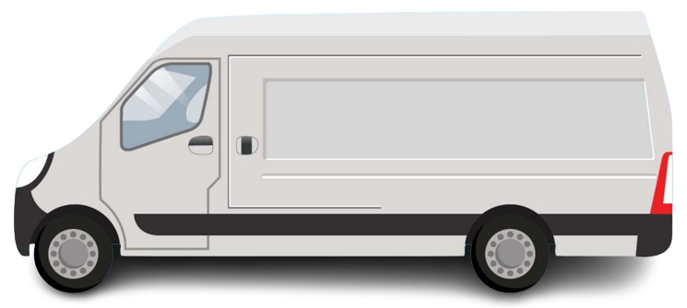

/væn/
xe tải nhỏ,
có mui

Slide 13
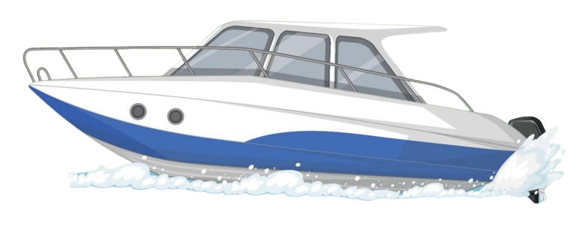
/ˈspiːdboʊt/
tàu thủy cao tốc

Slide 14

Lesson 3
Stay positive and have a nice day!

