Slide 1

Unit 4: Travel
Lesson 2.1
Page 51

Slide 2
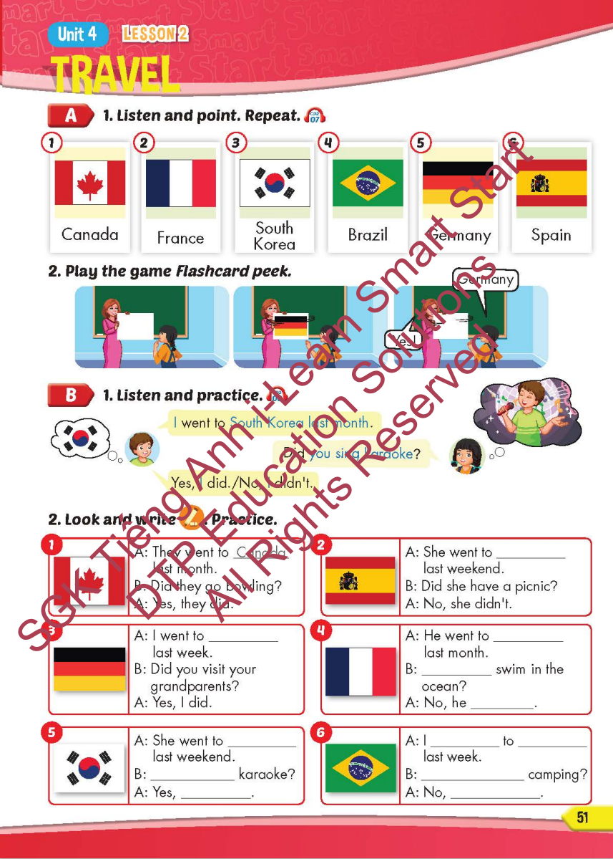
Lesson Outline
Warm-up
Vocabulary
Structure
Consolidation
Wrap-up

Slide 3
Objectives
By the end of this lesson, students will be able to…
Vocabulary: Pronounce and use the words related to the topic properly: Canada, France, South Korea, Brazil, Germany, Spain
Structure: I went to South Korea last month.
- Did you sing karaoke?
- Yes, I did./No, I didn't.

Slide 4

It’s time to learn …

Slide 5

New words
Canada, France, South Korea,
Brazil, Germany, Spain

Slide 6

Presentation

Slide 7


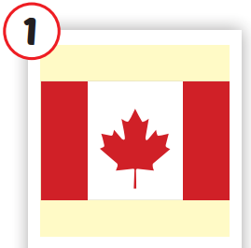
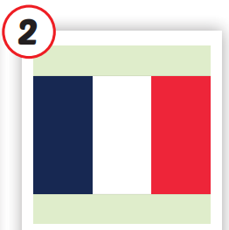
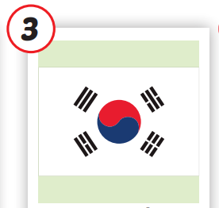
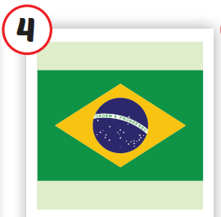
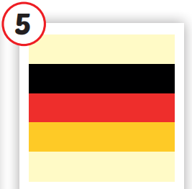
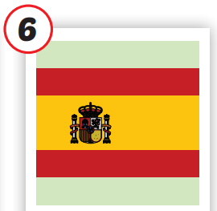







/ˈkænədə/
nước Canada
/fræns/
nước Pháp
/ˌsaʊθ kəˈriːə/
nước Hàn Quốc
/brəˈzɪl/
nước Brazil
/ˈdʒəːrməni/
nước Đức
/speɪn/
nước Tây Ban Nha
Notes:
Click vào hình A. 1. Listen and point. Repeat để cho cả audio full chạy

Slide 8


/ˈkænədə/
nước Canada

Slide 9


/fræns/
nước Pháp

Slide 10


/ˌsaʊθ kəˈriːə/
nước Hàn Quốc

Slide 11
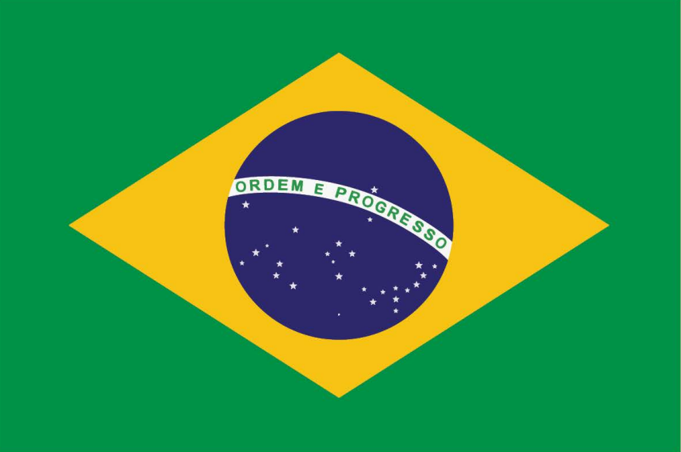
/brəˈzɪl/
nước Brazil

Slide 12


/ˈdʒəːrməni/
nước Đức

Slide 13

/speɪn/
nước Tây Ban Nha

Slide 14

Enjoy your day!

Slide 15

Lesson 3
Stay positive and have a nice day!

