Slide 1

Unit 4: ACTIVITIES
Review and Practice
Page 61

Slide 2
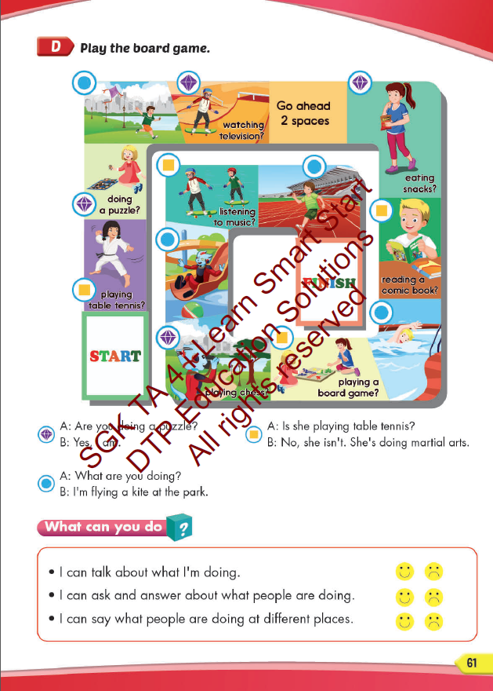
Lesson Outline
Warm-up
Speaking
Consolidation
Wrap-up

Slide 3
Objectives
By the end of this lesson, students will be able to say what they or other people are doing an activity at some different places. Vocabulary:
Activities: listen to music, watch television, play table tennis, do martial arts, skate, play chess, play a board game, do a puzzle, read a comic book, eat snacks, take photos, play video games. Places: library, stadium, park, water park, market, swimming pool. studio, soccer field, arcade, skate park, coffee shop.
Structure:
What are you doing? What are they doing?
I’m swimming at the pool. They’re swimming at the pool.
What is he/she doing?
He/she swimming at the pool.

Slide 4

CONSOLIDATION

Slide 5
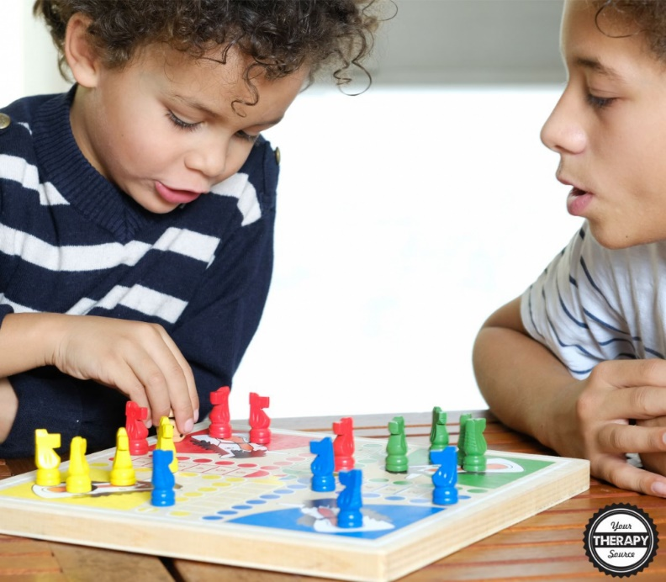
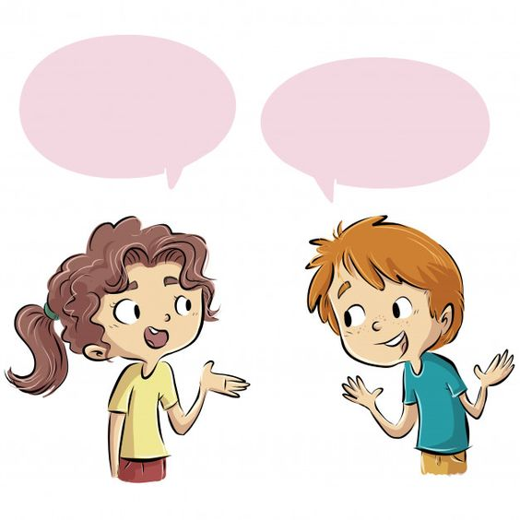
Are they watching television?
No, they aren’t. They’re playing chess.

Slide 6
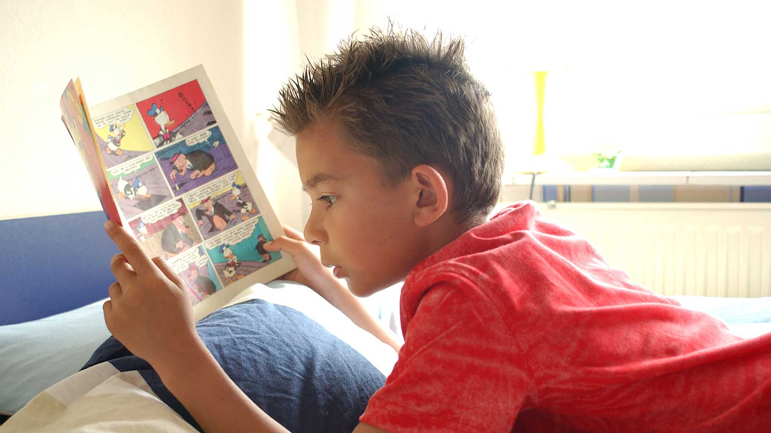
What is he doing?
He’s reading a comic book.

Slide 7
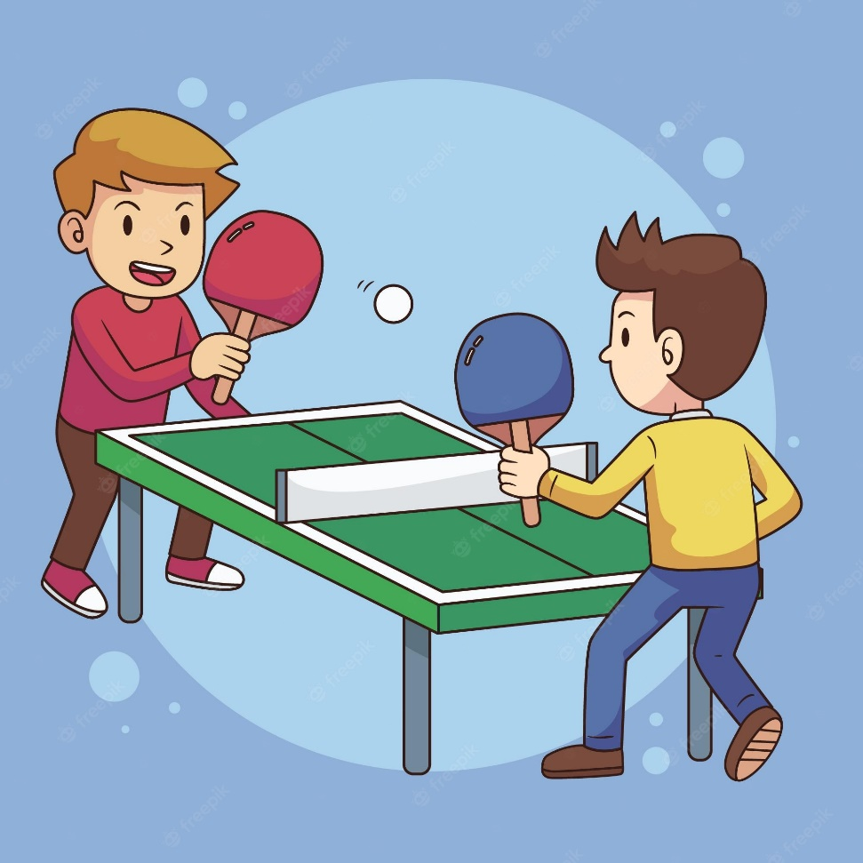
What are they doing?
They’re playing table tennis.

Slide 8
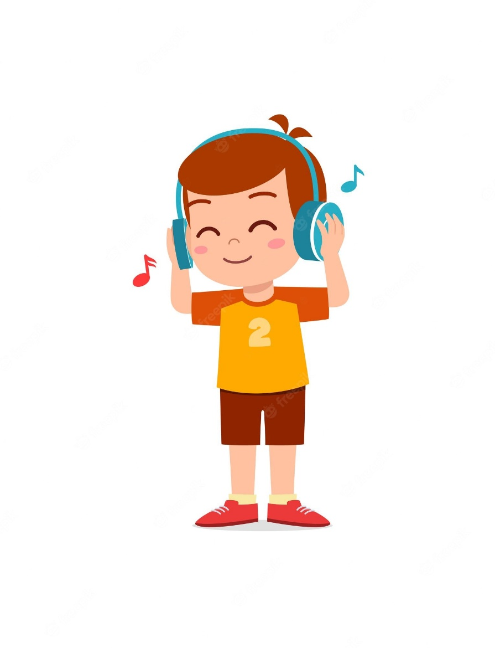
Is he listening to music?
Yes, he is.

Slide 9
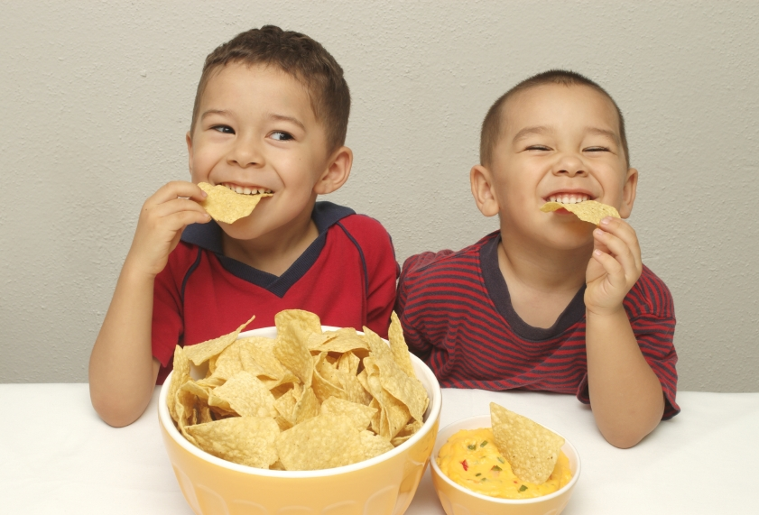
What are they doing?
They’re eating snacks.

Slide 10

Lesson 3
Stay positive and have a nice day!

