Slide 1

Unit 4: ACTIVITIES
Lesson 4
Page 59

Slide 2
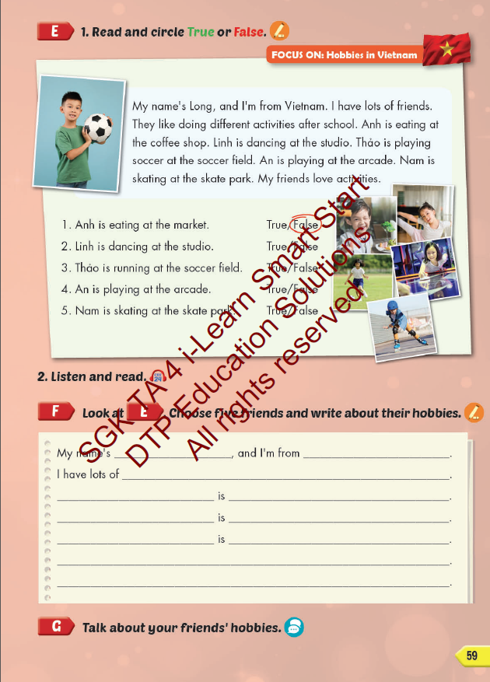
Lesson Outline
Warm-up
Reading
Writing
Consolidation
Wrap-up

Slide 3
Objectives
By the end of this lesson, students will be able to read hobbies in Vietnam, write and talk about their hobbies.
Vocabulary: studio, soccer field, arcade, skate park, coffee shop.
Structure:
What's she doing?
She's dancing at the studio.
What are they doing?
They're playing soccer at the soccer field.

Slide 4

It’s time to learn …

Slide 5

Reading

Slide 6



Underline keywords in each statement.
Read the text carefully and find information.

Slide 7
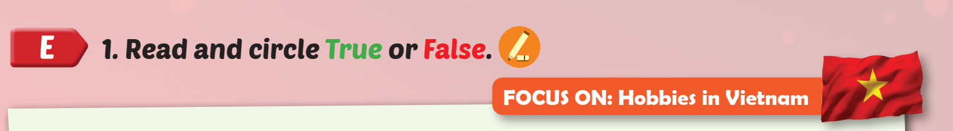
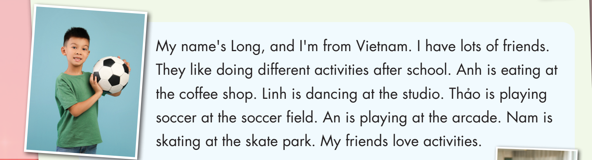

Slide 8

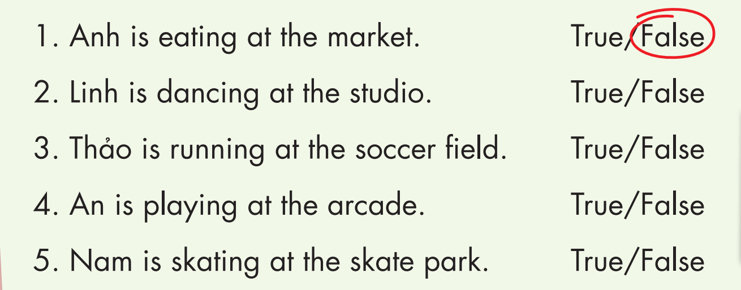

Slide 10



Slide 11
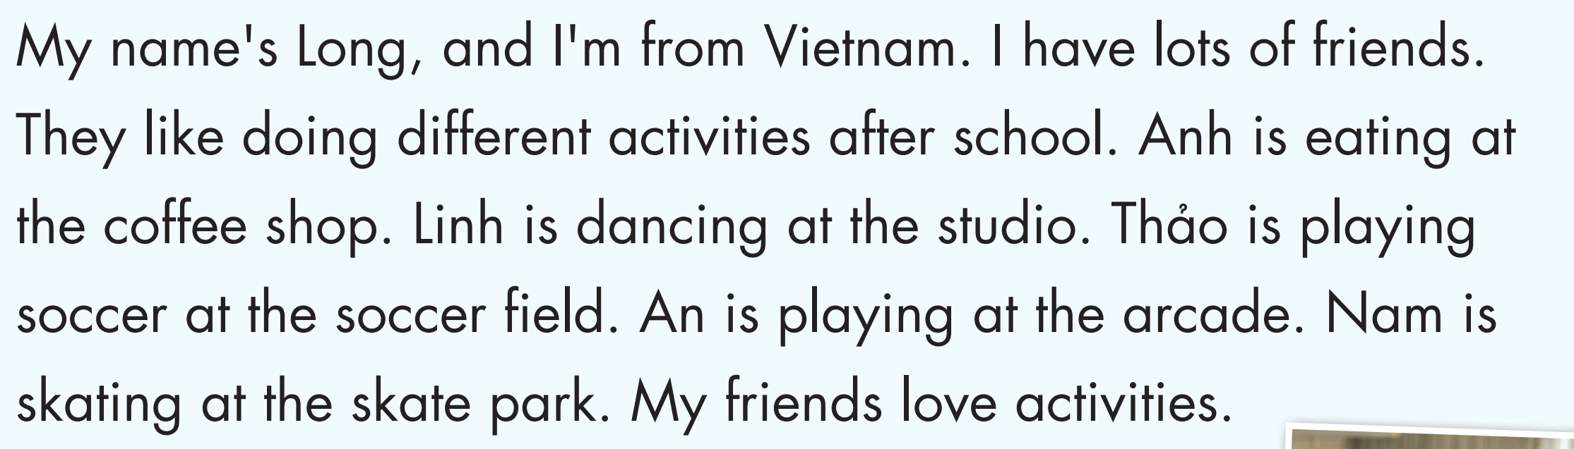
READ AND COMPLETE
Long
Vietnam
friends
doing
eating
coffee shop
studio
soccer field
arcade
skate park

Slide 12
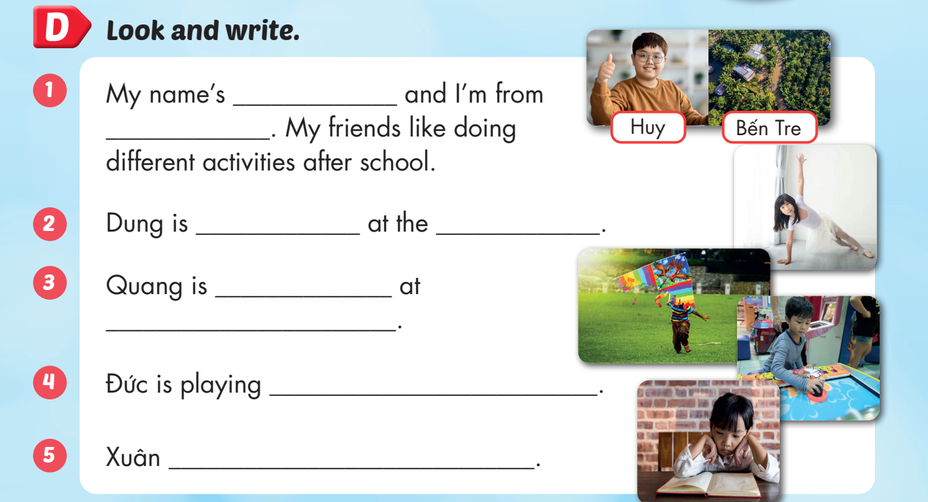
Huy
Bến Tre
dancing
studio
flying a kite
soccer field
games at the arcade
is reading at home

Slide 13

Enjoy your day!

