Slide 1
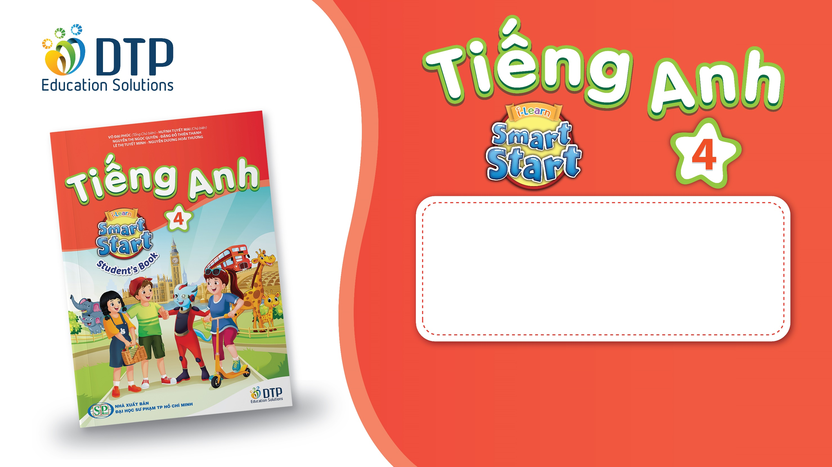
Unit 4: ACTIVITIES
Lesson 2.2
Page 52

Slide 2
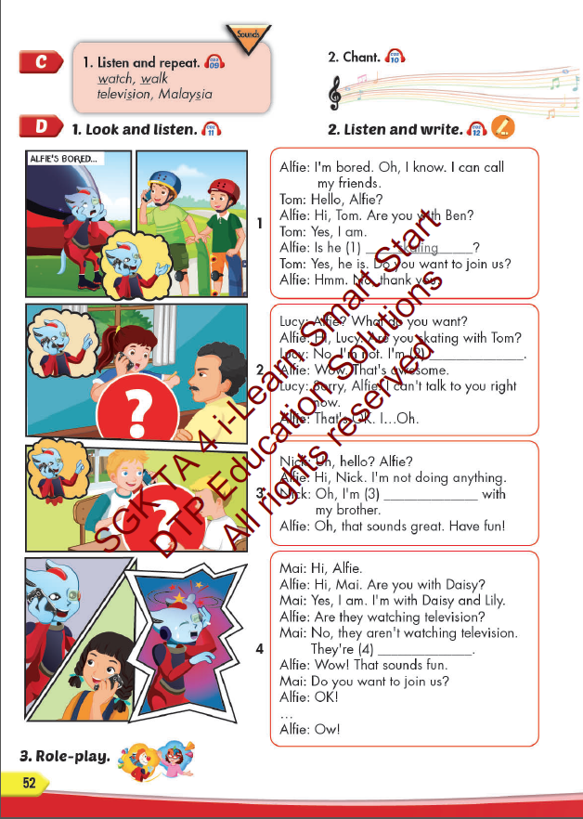
Lesson Outline
Warm-up
Listening
Consolidation
Wrap-up

Slide 3
Objectives
By the end of this lesson, students will be able to pronounce the sounds /w/, and /ʒ/; and practice asking and answering what they are doing.
Vocabulary: listen to music, watch television, play table tennis, do martial arts, skate, play chess.
Structure:
Is he playing chess?
– Yes, he is.
Are they doing martial arts?
- No, they aren’t. They’re skating.
Phonics: /w/, watch, walk; /ʒ/, television, Malaysia

Slide 4

WARM UP

Slide 5


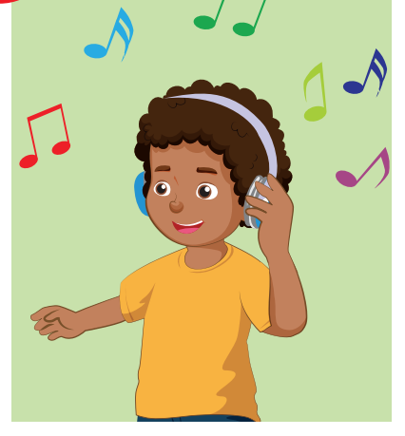

Look. Choose the correct answer.
A
play board game
B
listening to music
C
skate

Slide 6
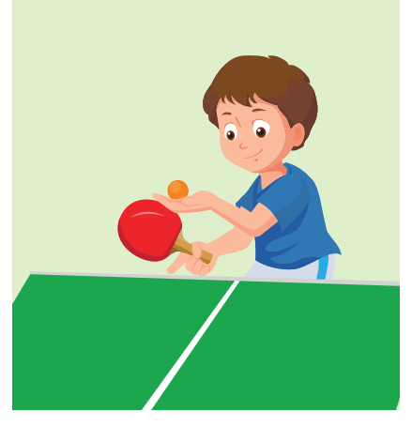
Look. Choose the correct answer.
A
skate
B
play chess
C
play table tennis

Slide 7
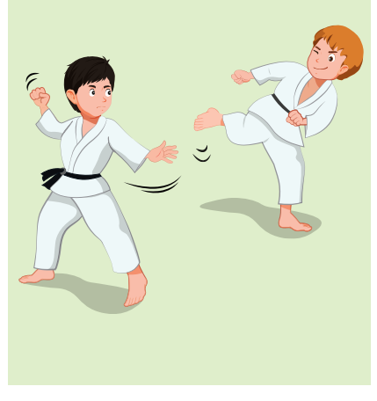

Listen. Choose the correct answer.
Click on A, B, C box to check the correct answer
A
B
C
Click on the speaker icon to hear the sound

Slide 8
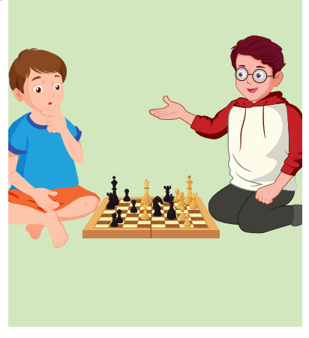
Listen. Choose the correct answer.
A
B
C
Click on the speaker icon to hear the sound

Slide 9
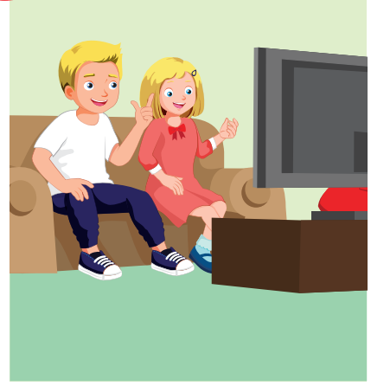
Listen. Choose the correct answer.
A
B
C
Click on the speaker icon to hear the sound

Slide 10

Lesson 3
Stay positive and have a nice day!

