Slide 1






















Slide 2
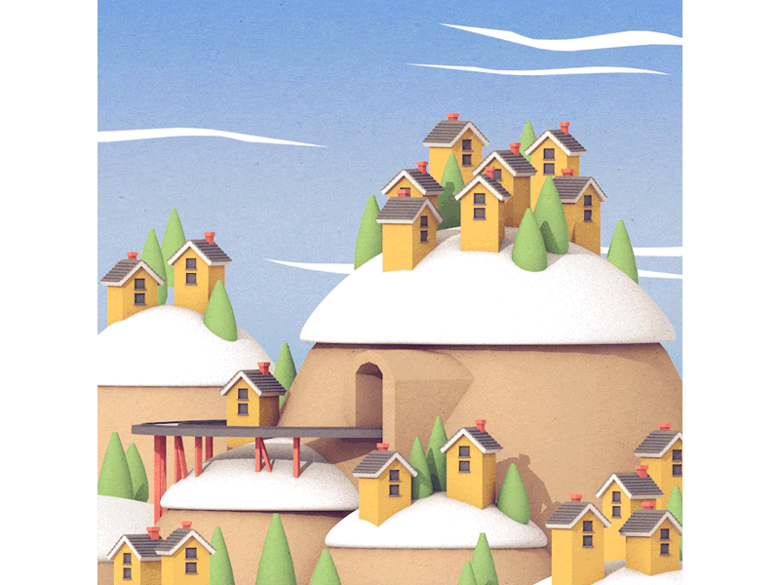

Unit 12: COOL PLACES
Lesson 3
Task 7, 8, 9

Slide 3

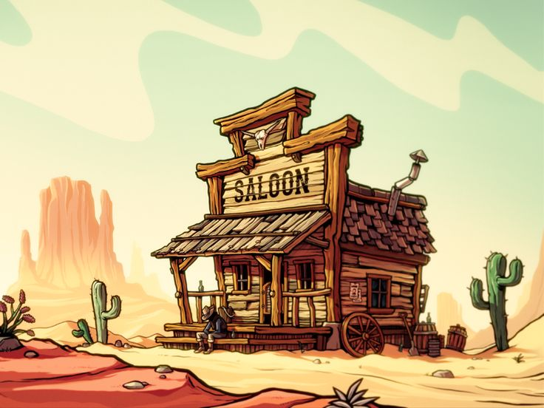
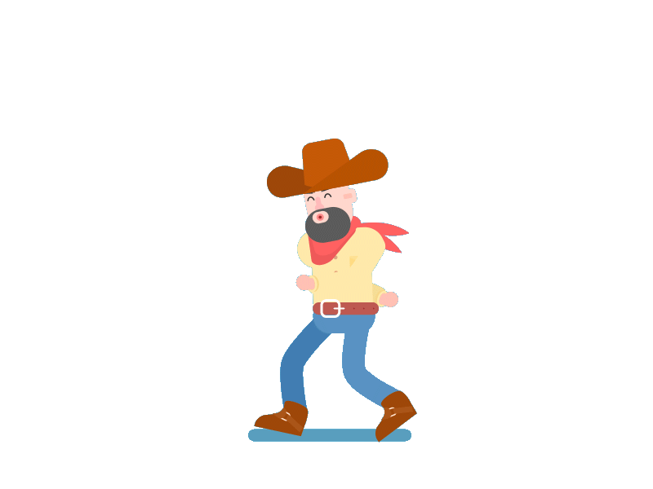
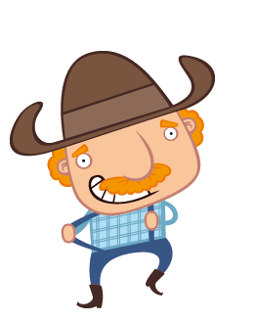
1. WARM-UP
Cowboy game

Slide 4

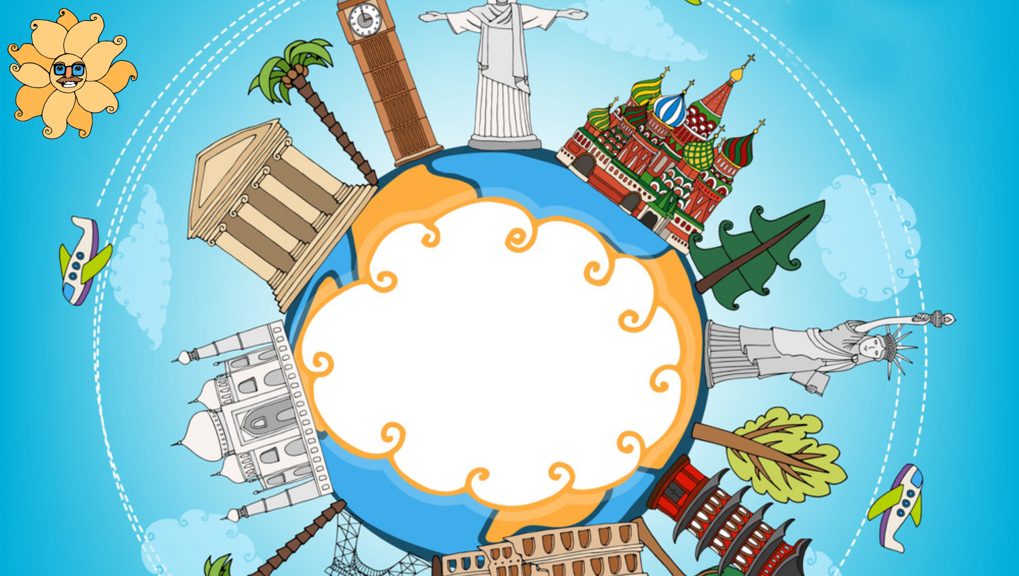
2. PRESENTATION

Slide 5

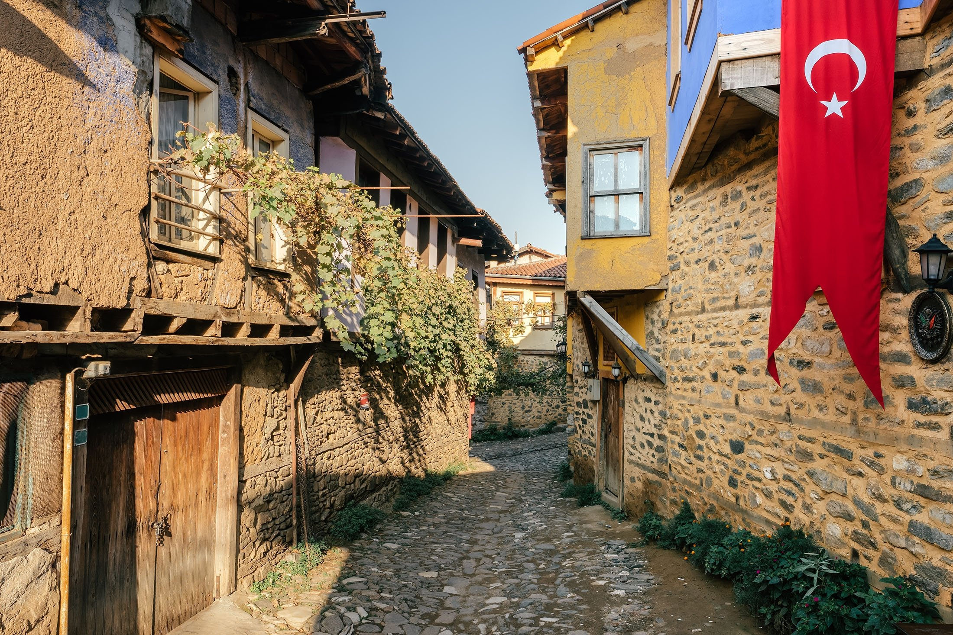


7. Listen and repeat.
village
Turkey
We were in an old village in Turkey last week.

Slide 6
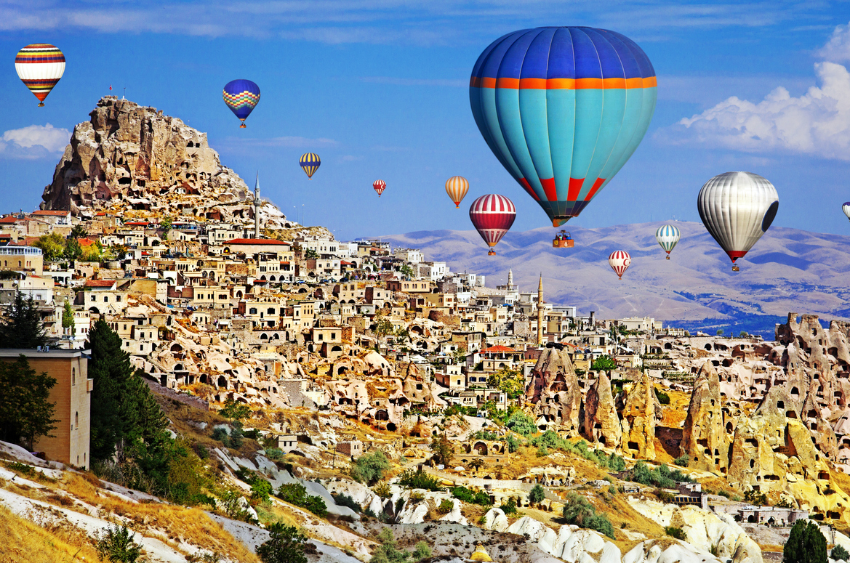
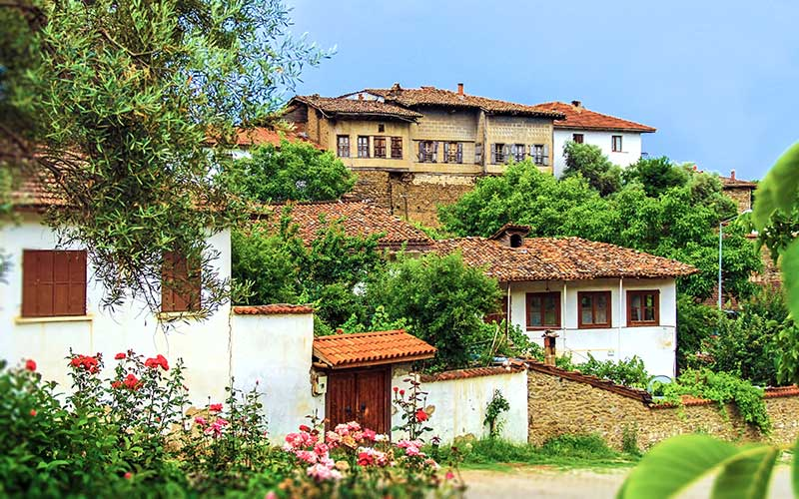
8. Listen and chant.
Village, village, village!
We were in an old village.
Turkey, Turkey, Turkey!
We were in beautiful Turkey.
We were in a beautiful village in beautiful Turkey.

Slide 7
3. PRACTICE

Slide 8
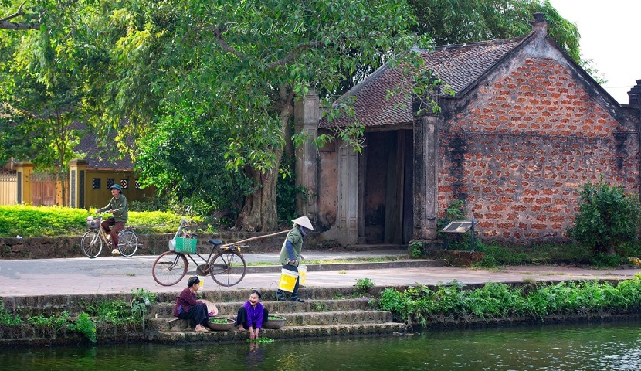
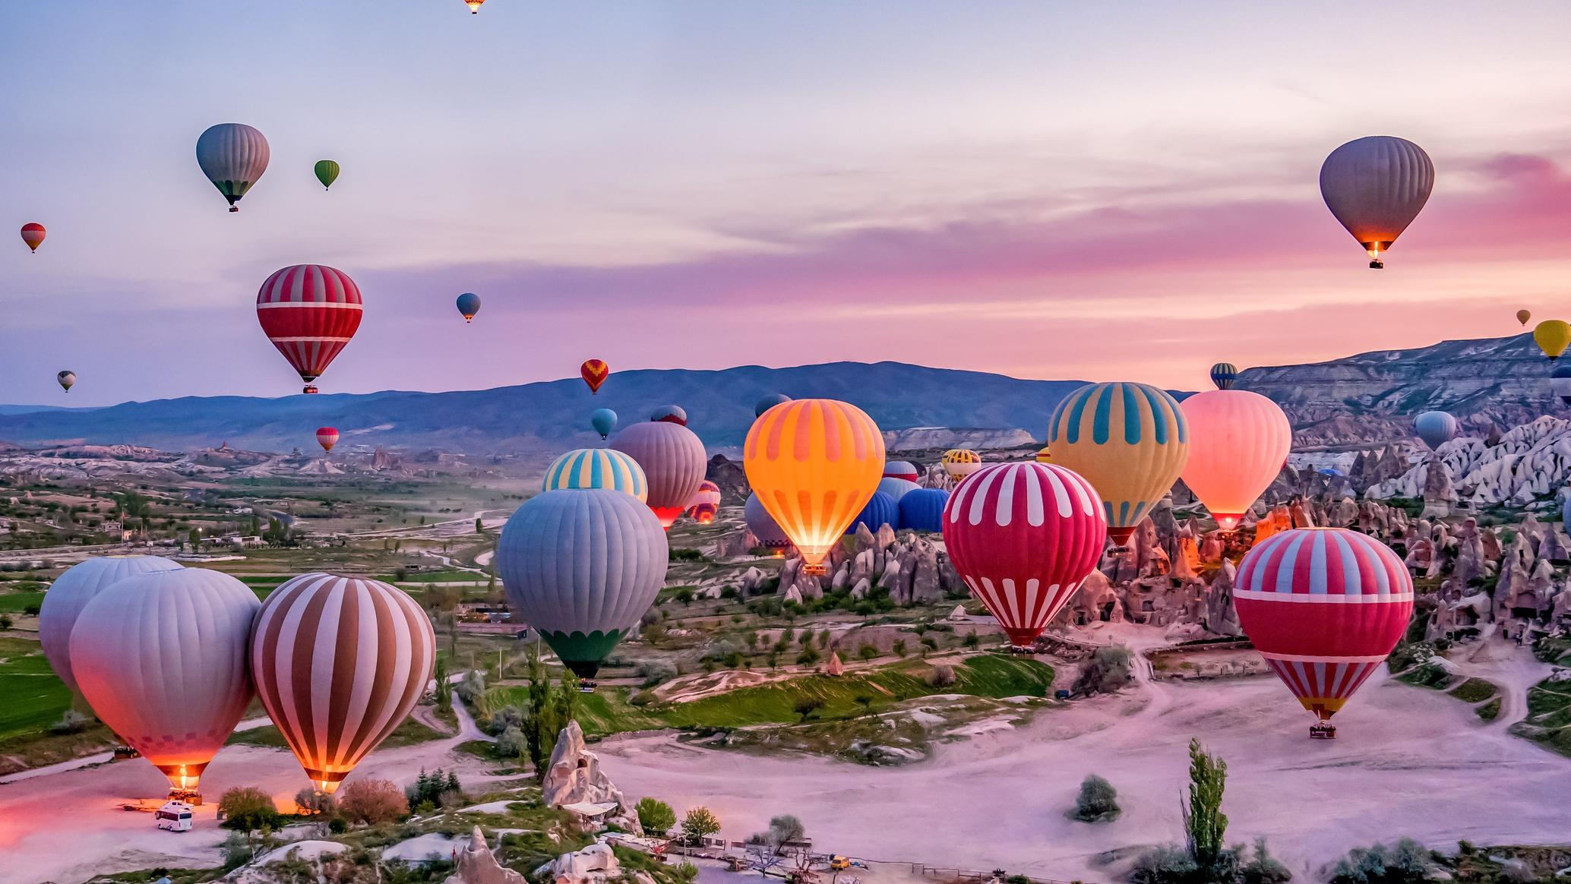
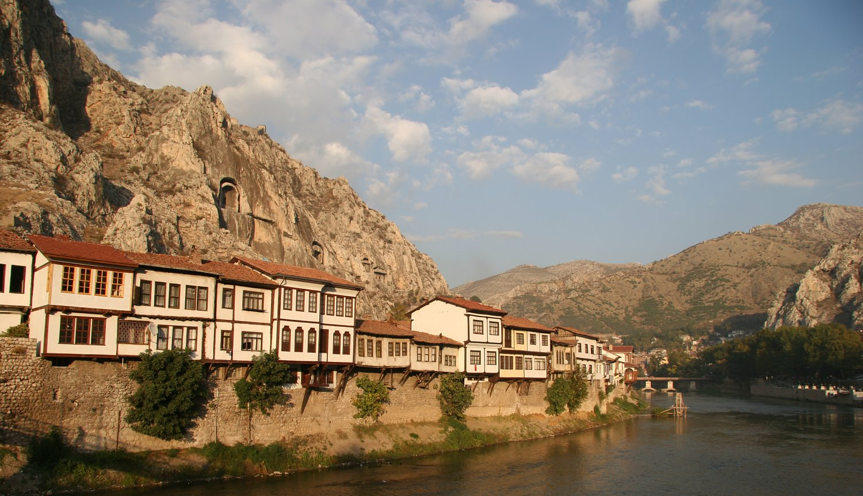
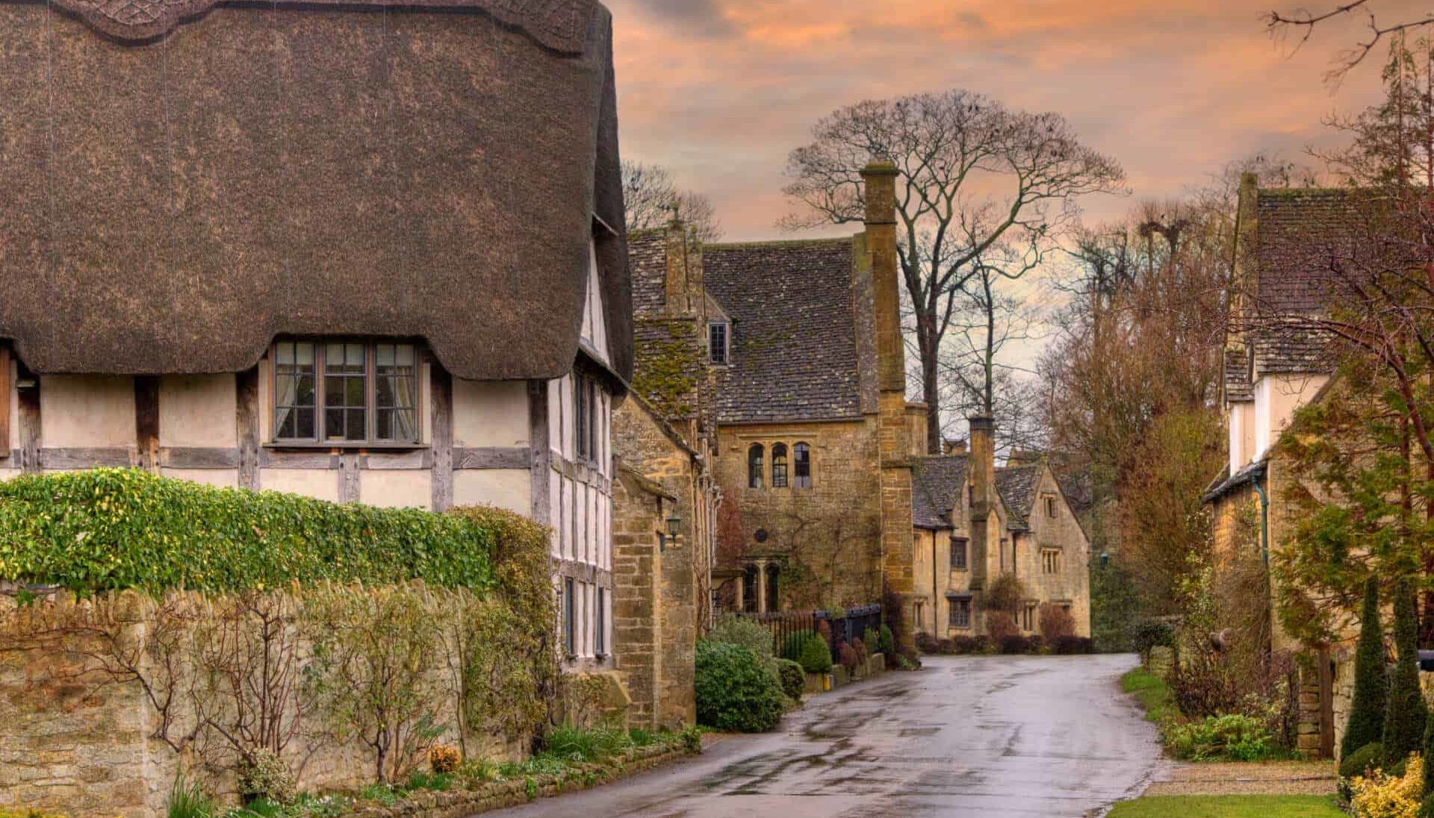
9. Say it!
1. He was in an old village in Vietnam.
2. Her trip to Turkey was interesting.
3. Our trip to a village in Turkey was wonderful.
4. My trip to the village last week was awesome.

Slide 9
4. PRODUCTION

Slide 10
5. ASSESSMENT

Slide 11
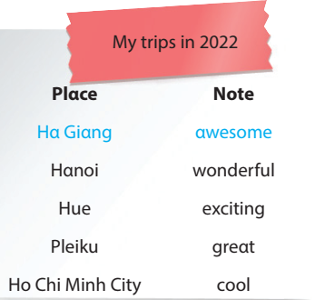
Look and write.
How was her trip to Ha Giang?
__________________________
2. How was her trip to Hanoi?
__________________________
3. How was her trip to Hue?
__________________________
4. How was her trip to Pleiku?
__________________________
5. How was her trip to Ho Chi Minh city?
__________________________
It was awesome.
It was wonderful.
It was exciting.
It was great.
It was cool.

Slide 12
UNIT 12: COOL PLACES
LESSON 3: PERIOD 3
What we learnt today:
Pronunciation:
/v/: village
/ɜː/: Turkey

Slide 13




Thank you
& goodbye!

