Slide 1





















Slide 2




Unit 12: Cool places
Lesson 3
Task 4, 5, 6

Slide 3

1. Warm up
Fishing
Notes:
Chuẩn bị các tấm thẻ có ghi tính từ, danh từ, động từ. Mặt sau các tấm thẻ có gắn nam châm.
Chuẩn bị các cần câu có gắn nam châm ở đầu.
Nhóm gồm 4 học sinh từ 4 nhóm sẽ cùng lúc câu cá. Khi câu được tính từ thì dán lên bảng.
Khi thời gian kết thúc, nhóm câu được nhiều hơn sẽ chiến thắng.
This game requires a bit of prep, but is hours of fun and can be reused for other word groups like nouns and verbs. You’ll need a deck of flashcards, some magnets and a fishing rod. Here’s how to play:
Write a noun, adjective or verb on each card. The words need to be clearly readable from a short distance.
Attach paper clips to each card.
Attach another magnetic clip to a children’s fishing rod.
Scatter cards face up on the floor.
Encourage students to ‘fish’ the adjectives from the pile, with students taking turns controlling the rod. They’ll need to distinguish between the adjectives and non-adjectives before they can fish one out. Once they correctly fish out an adjective, you could also ask them to name an object that could be described using that word.

Slide 4

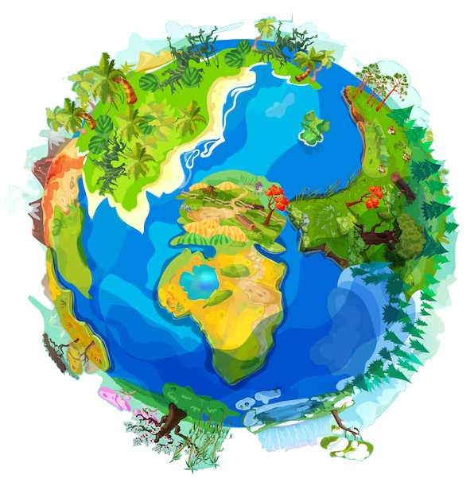

2. REVIEW

Slide 5





awesome
wonderful
Listen and repeat.
exciting
boring

Slide 6
3. PRACTICE

Slide 7

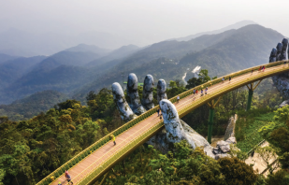
4. Listen and repeat.
How was your trip to America?
- It was exciting.
2. How was your trip to Vietnam?
- It was awesome.

Slide 8
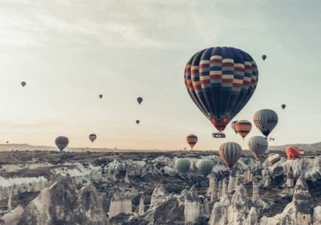


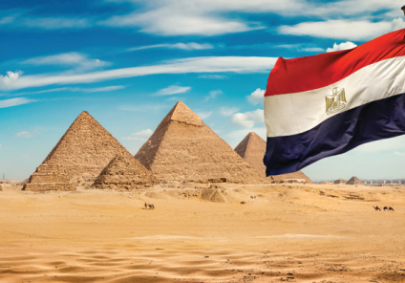


5. Look and say.
How was your trip to Turkey?
It was exciting.
1. your trip to Turkey/ exciting
2. His trip to Egypt/ awesome

Slide 9

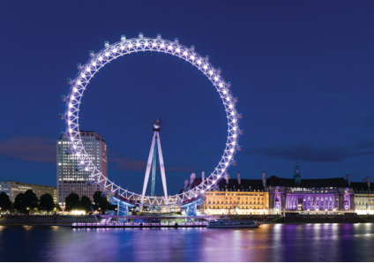
5. Look and say.
How was …
It was …
3. Her trip to Vietnam/ wonderful
4. Their trip to England/ boring

Slide 10
4. PRODUCTION

Slide 11
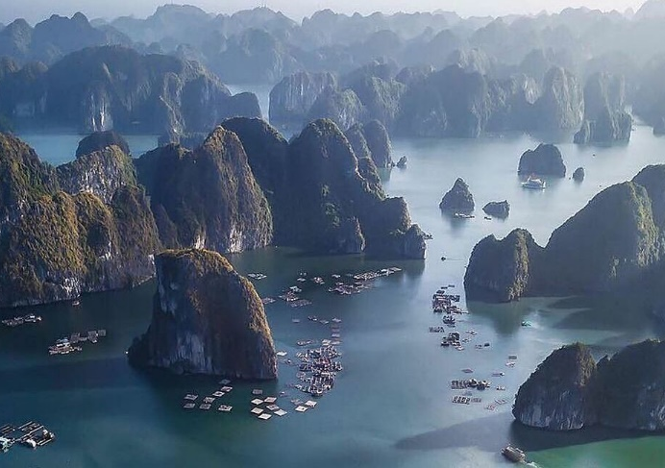
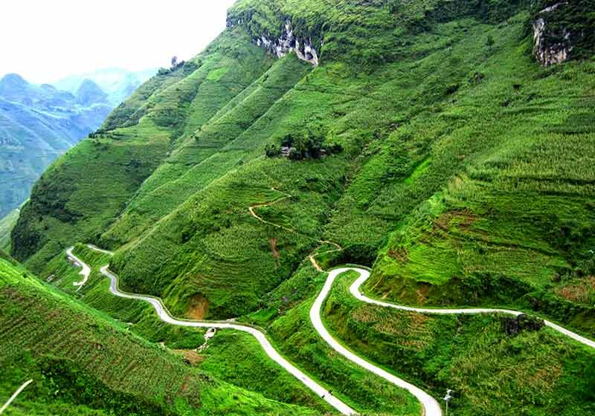
6. Let’s talk.
Where were you last summer?
I was at Ha Long Bay in June, and I was in Ha Giang in July.
How was your trip to Ha Giang?
It was awesome.

Slide 12
5. ASSESSMENT

Slide 13





Look and write.
your trip to/ ?/ exciting
__________________________________
2. his trip to/ ?/ cool
__________________________________
3. their trip to/ ?/ wonderful
__________________________________
4. her trip to/ ?/ awesome
__________________________________
5. our trip to/ ?/ great
__________________________________
How was your trip to America? – It was exciting.
How was your trip to England? – It was cool.
How was your trip to Egypt? – It was wonderful.
How was your trip to Turkey? – It was awesome.
How was your trip to Vietnam? – It was great.

Slide 14
UNIT 12: COOL PLACES
LESSON 3: PERIOD 2
What we learnt today:
1. Vocabulary:
awesome, exciting, wonderful, boring
2. Structure:
- How was your trip to America last week?
- It was interesting.

Slide 15




Thank you & goodbye!

