Slide 1






















Slide 2






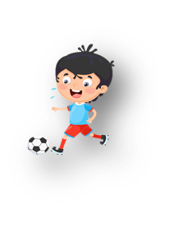




Unit 11: Before our time
Lesson 1: Task 1, 2, 3

Slide 3
1
Warm up
Answer the questions
Guess “ Weather“
Notes:
Warm-up:
Lead in: Photo time!
-T shows the picture about a rock which is drawn a lot of different shapes and gives students some questions: What can you see? Is it in the past or nowsaday?
- T calls SS to answer and check their answers.
- T asks SS to look at 4 squares and tick what they can see.
- T introduces that they will learn about “ some past time” today.
- Write on the board “Before our time” and introduce the lesson.

Slide 4

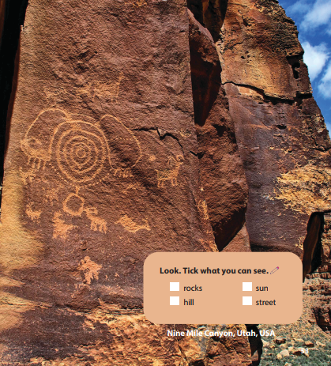
Look. Tick what you can see.

rocks
sun
hill
street
Notes:
Lead in: Photo time!
-T shows the picture about a rock which is drawn a lot of different shapes and gives students some questions: What can you see? Is it in the past or nowsaday?
- T calls SS to answer and check their answers.
- T asks SS to look at 4 squares and tick what they can see.
- T introduces that they will learn about “ some past time” today.
- Write on the board “Before our time” and introduce the lesson.

Slide 5
2
Presentation

Slide 6


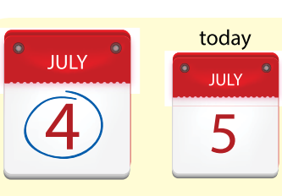


yesterday
Notes:
Task 1: Listen and point. Repeat. (Track 11.1)
- Use flashcards to introduce the vocabulary of the lesson.
- Say the words for students to repeat in the chorus.
- Say a word for students to repeat then point.

Slide 7
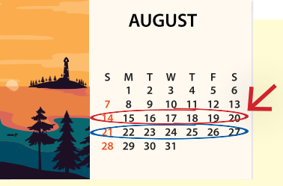
last week

Slide 8
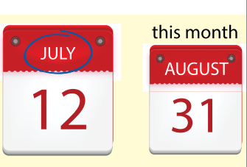
last month

Slide 9
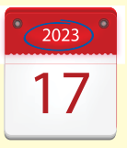
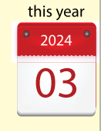
last year

Slide 10

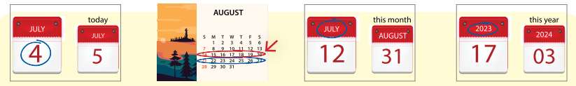
1. Listen αnd point. Repeαt. Tr. 11.1
yesterday
last week
last month
last year
Notes:
- Play track 11.1 for the students to listen to, point to, and repeat the words in chorus and groups.

Slide 11
3
Practice

Slide 12


2 Listen αnd reαd. Circle. TR.11.2
Leon: We were at the museum yesterday.
Lisa: Cool! I was at the museum last week. It was fun.
Leon: Our history lesson at the museum was great!
Leon was at the museum yesterday./ last week.
Lisa was at the museum yesterday./ last week.
Notes:
Sldie này ko có phần nghe, It was fun

Slide 13

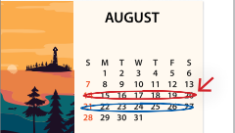

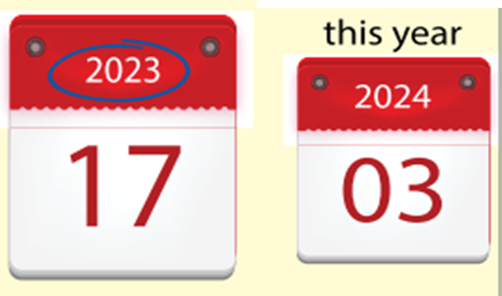
3. Write αnd sαy.
s
t
r
d
y
1. _ e _ _ e _ _ a _
y
2. l _ _ _ w _ _ k
a
s
t
e
e
l
l
r
s
4. _ _ s _ _ e a _
t
a
t
3. _ a _ _ _ _ _ t h
m
o
n
y
Notes:
Task 3: Write and say :
- Look at the picture and let SS spell the letters which are missing and say the word.
- Call SS to say aloud in front of the class.

Slide 14
4
Production

Slide 15







Lucky number
Notes:
- Work in groups.
- Ask SS to play a small game “ Lucky number”.
- Introduce the rule of the game:
(2 teams choose the number and answer, then T can ask SS to make a sentence with this word. Then they move the board with the numbers and letters to choose the points for their team. No point for bomb. Which team has more points will be a winner.)
- Check and give feedback.

Slide 16



Look and answer
a
yesterday
b
last year
c
last month

Slide 17

Look and answer
a
yesterday
b
last year
c
last month

Slide 18
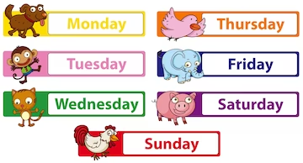
Look and answer
a
last year
b
last week
c
last month

Slide 19

Look and answer
a
last week
b
last year
c
last month

Slide 20


1
2
3
4
5
a
+1
+2
+3
+2
b
+5
+2
+4
c
+3
+1
+5
+3
+5
d
+1
+5
+4
+3
e
+2
+4
+1
+4

Slide 21
5
Assessment

Slide 22

4. Mαtching
1
last week
2
last month
3
last year
4
yesterday

Slide 23
UNIT 11: BEFORE OUR TIME
LESSON 1 – PERIOD 1
What we learnt today
yesterday
last week
last month
last year
Vocaburary

Slide 24




Thank you & goodbye!

