Slide 1








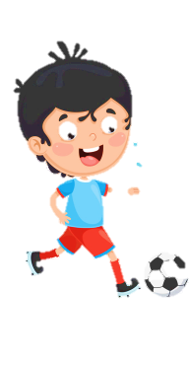
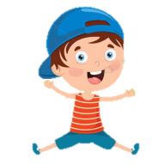
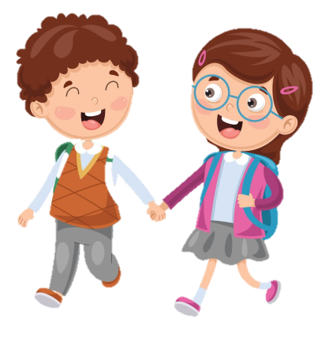




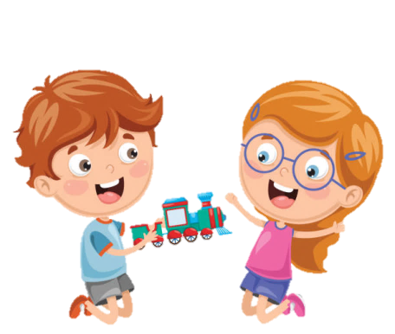





Slide 2





Table of contents
01
02
Warm - up
Presentation
05
04
Production
03
Practice
Wrap-up & Assessment

Slide 3
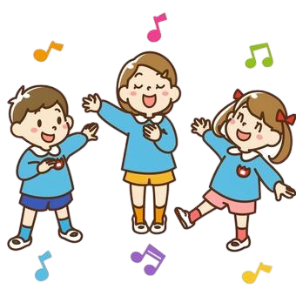
01
Warm up
Food tasting

Slide 4
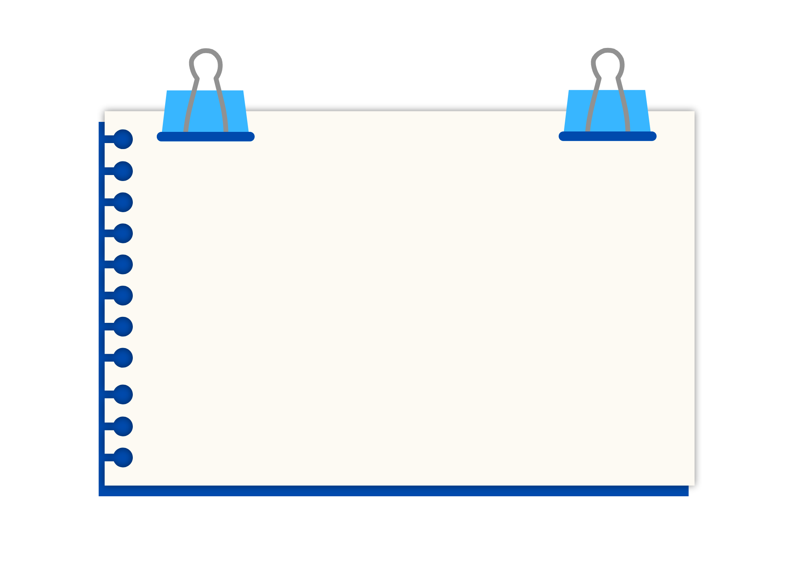
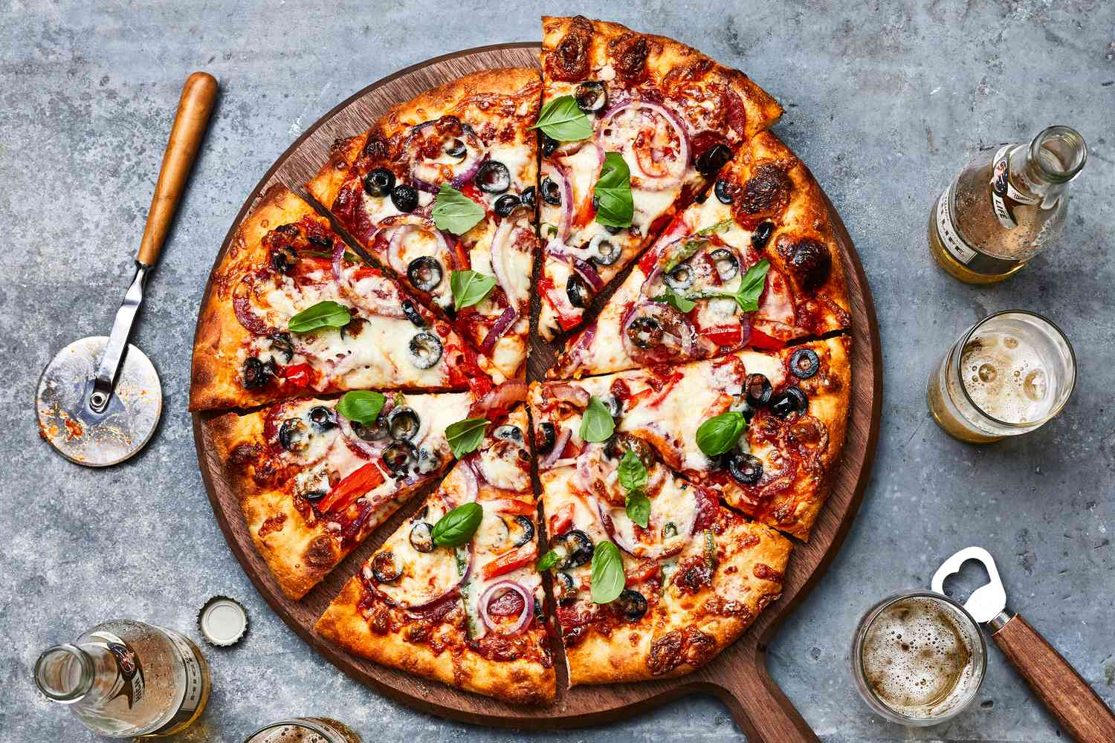
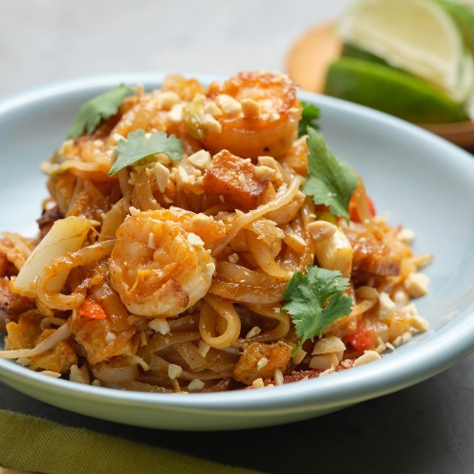
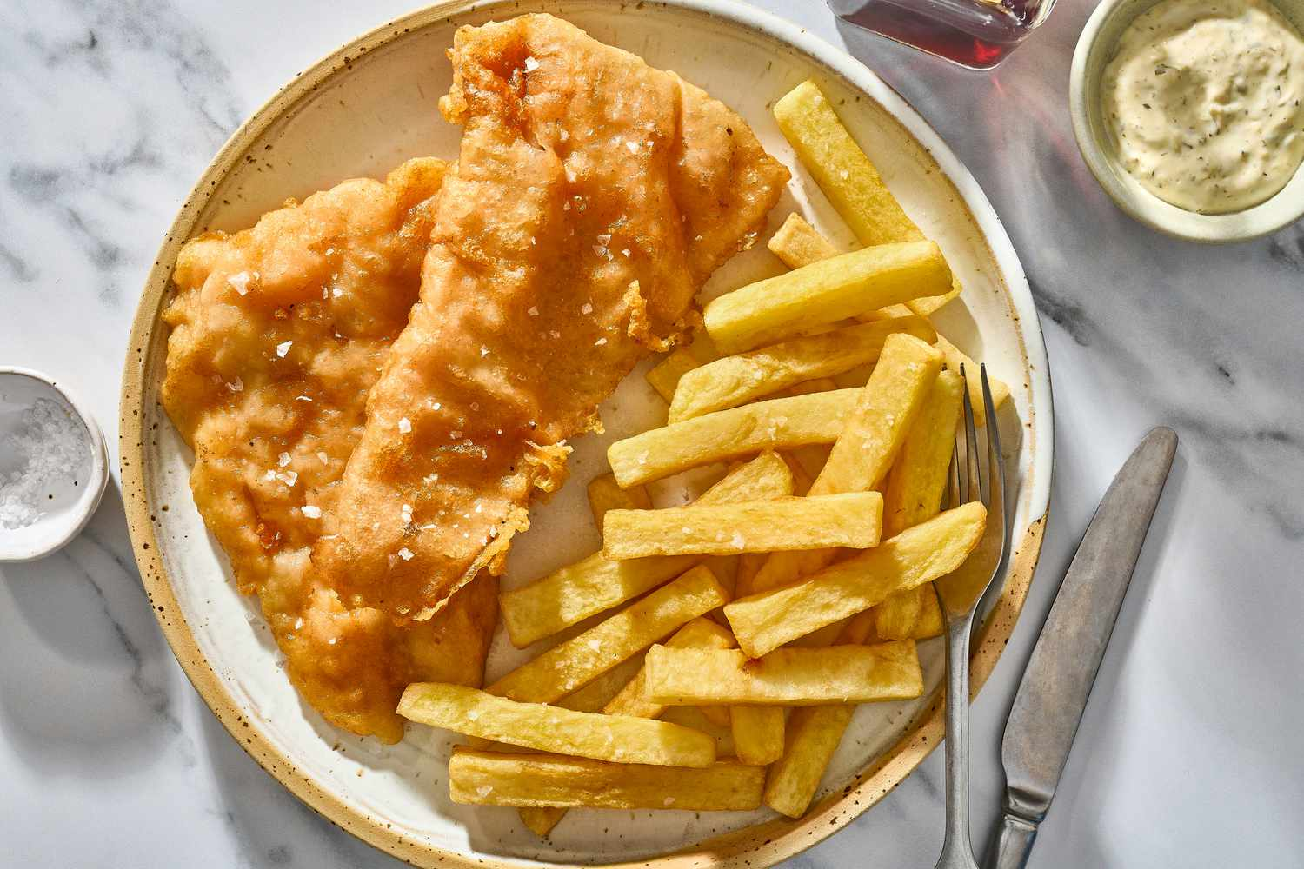
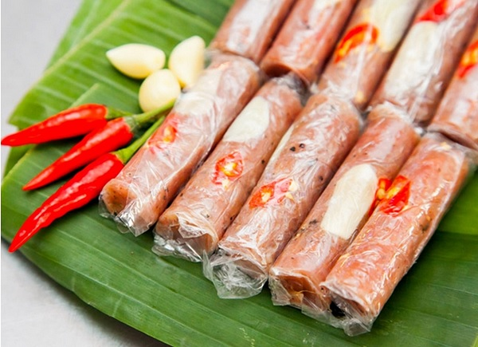
pizza
pad Thai
fish and chips
nem chua

Slide 5
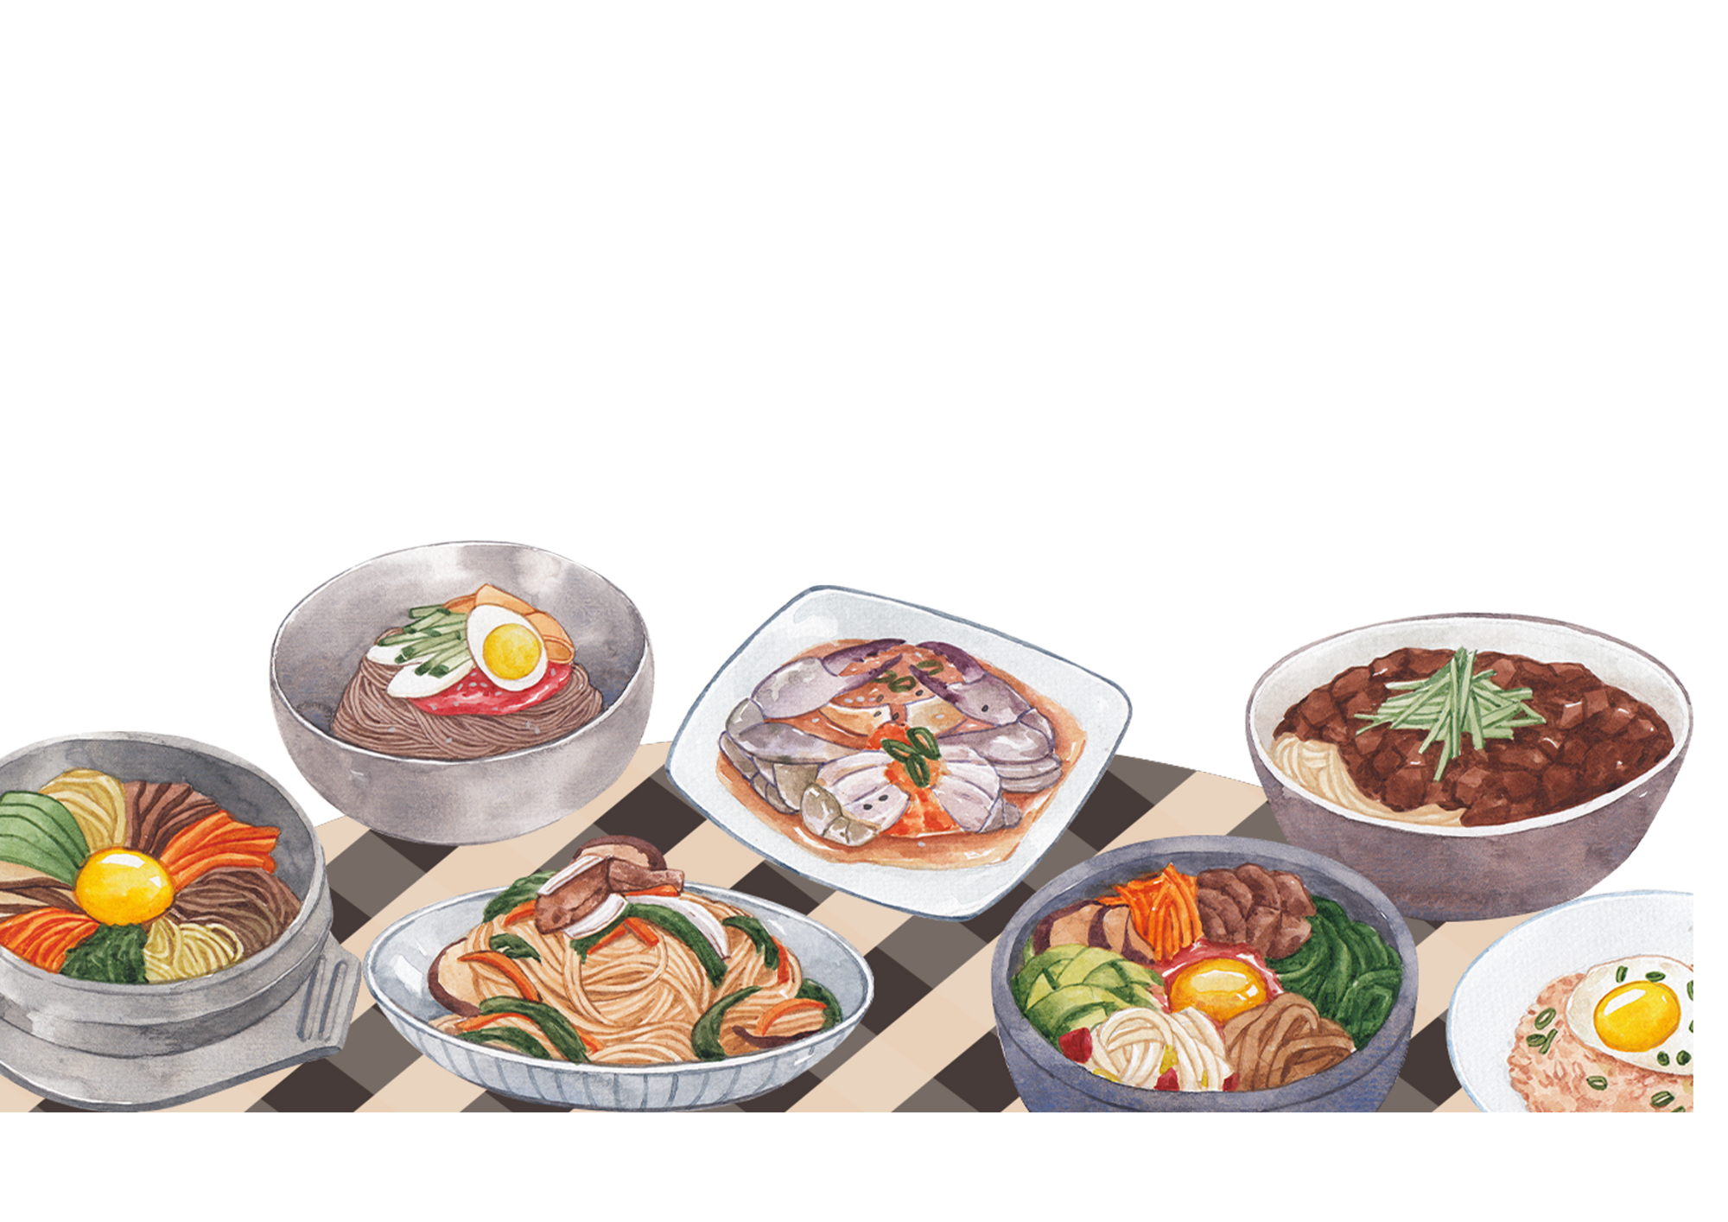
Unit 6: FOOD
Lesson 3 – Task 1, 2, 3

Slide 6
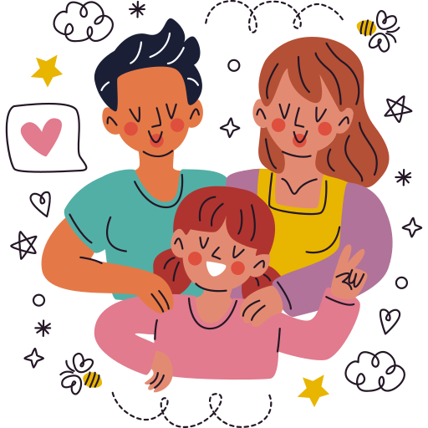
02
PRESENTATION

Slide 7
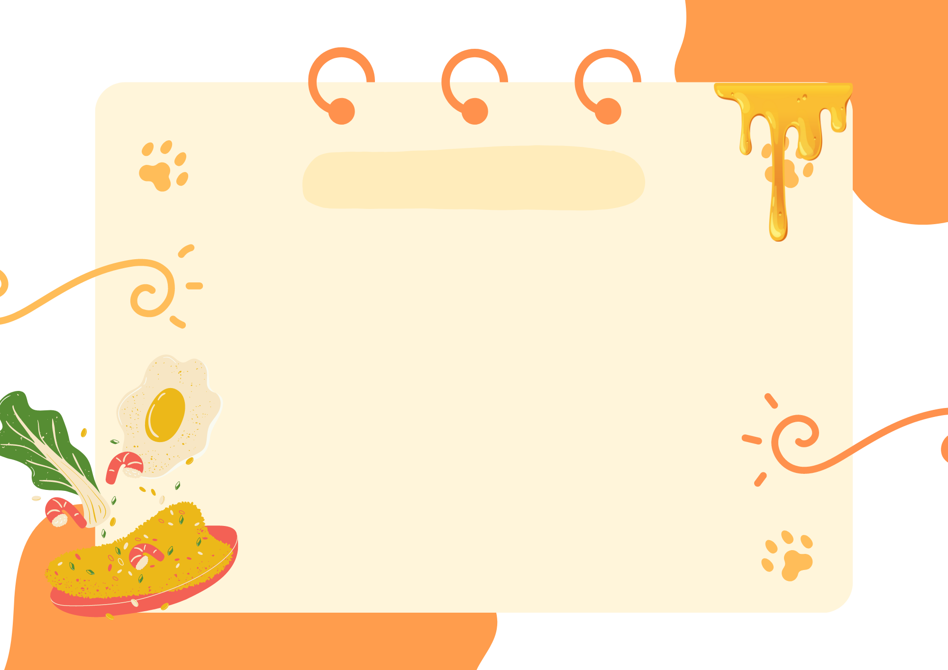
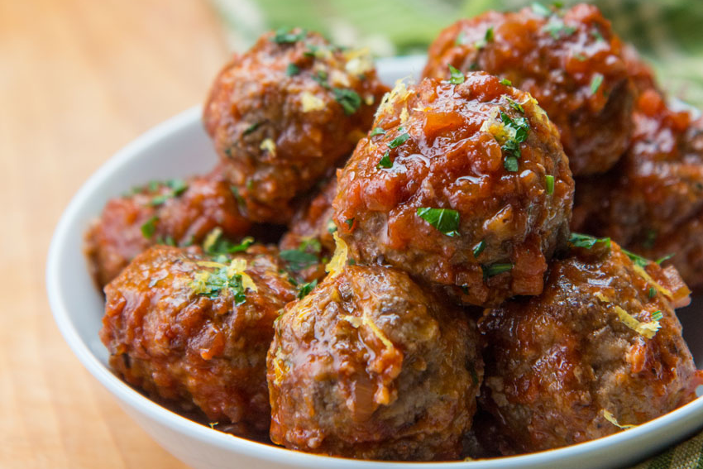

meatballs
/ˈmiːt.bɔːlz/

Slide 8
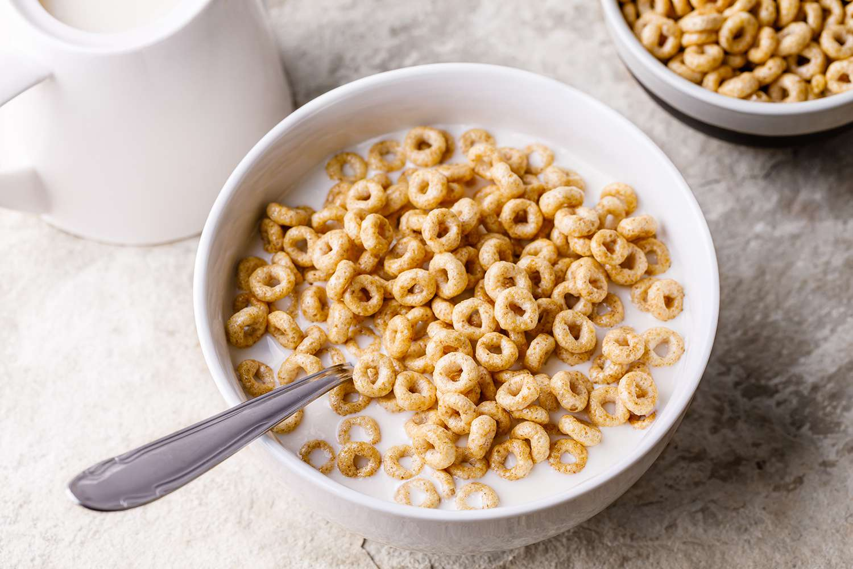
cereal
/ˈsɪə.ri.əl/

Slide 9
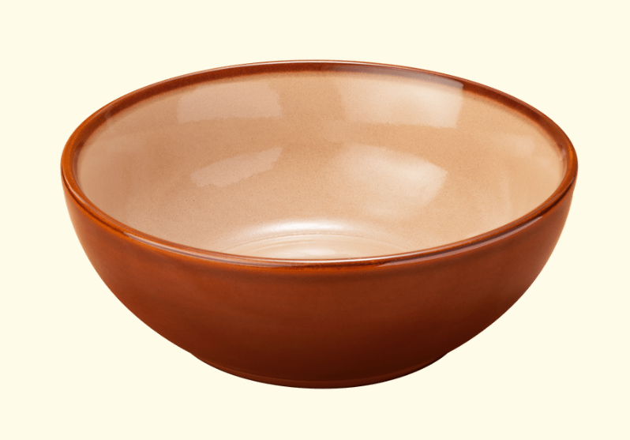
bowl
/bəʊl/

Slide 10
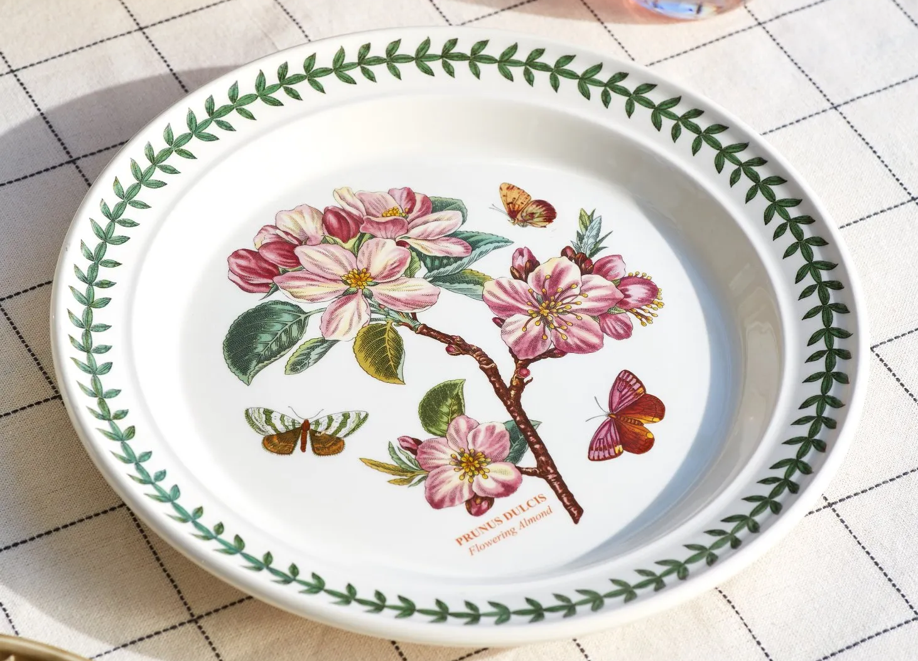
plate
/pleɪt/

Slide 11
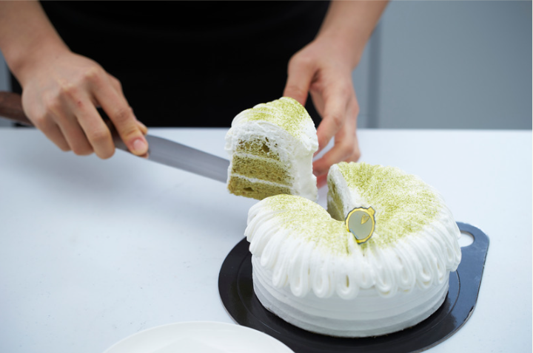
piece
/piːs/

Slide 12
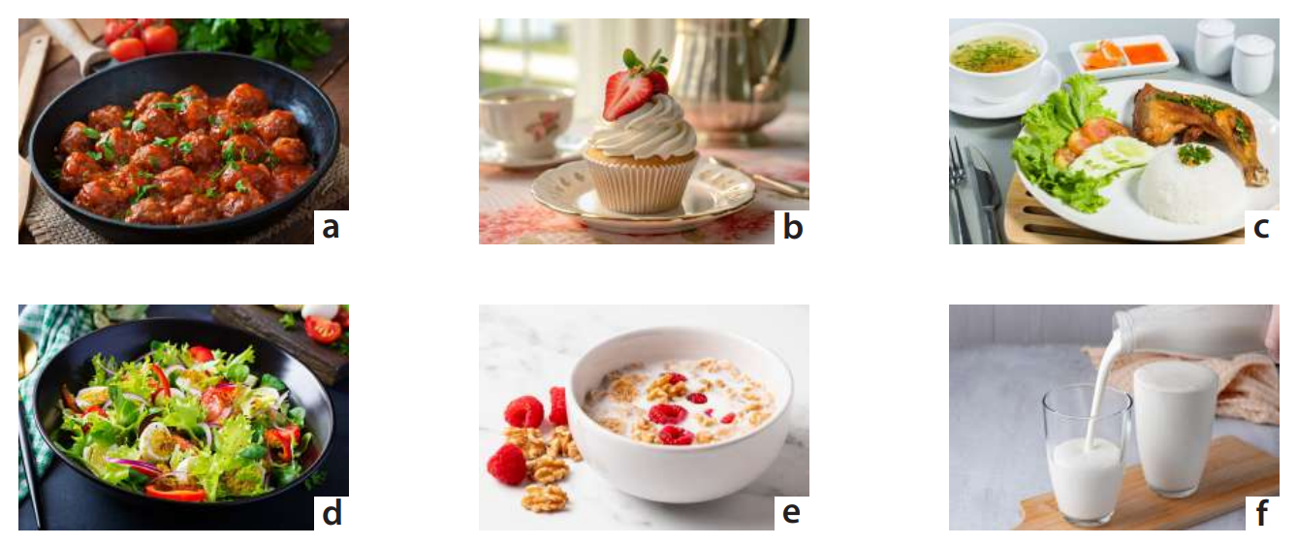
1 Look and say.
meatballs
cupcake
rice, chicken, vegetables
salad
cereal
milk

Slide 13
03
PRACTICE

Slide 14
2 Listen and match.
1 Minh’s favourite meal is
a lunch.
2 Nam’s favourite meal is
b dinner.
3 Lan’s favourite meal is
c breakfast.

Slide 15
3 Listen again and write.
fruits | salad | milk | cupcake | rice | chicken
1 Minh often has got:
a bowl of cereal with many _____
a glass of _____
fruits
2 Nam often has got:
pieces of _____
a lot of vegetables
a ______ for his dessert
milk
chicken
3 Lan often has got:
a lot of _____
a few meatballs
a plate of ______
cupcake
rice
salad

Slide 16
04
PRODUCTION

Slide 17
Create a mind map about your favourite meal.
Work in pair.
Favourite meal:
DINNER
beef
rice
eggs
fried chicken
salad

Slide 18
05
WRAP-UP & ASSESSMENT

Slide 19
I am made from milk.
Complete the sentences with the given words.
of / often / a / have / bowl / I / soup /.
-----------------------------------------
I am yellow.
I can be eaten with bread.
I often have a bowl of soup.
2. often / He / a / of / plate / salad / has /.
-----------------------------------------
He often has a plate of salad.

Slide 20
I am made from milk.
Complete the sentences with given words.
3. chicken / has / pieces / often / of / some / She /.
-----------------------------------------
I am yellow.
I can be eaten with bread.
She often has some pieces of chicken.
4. for / They / often / lunch / have / rice /.
-----------------------------------------
They often have rice for lunch.

Slide 21
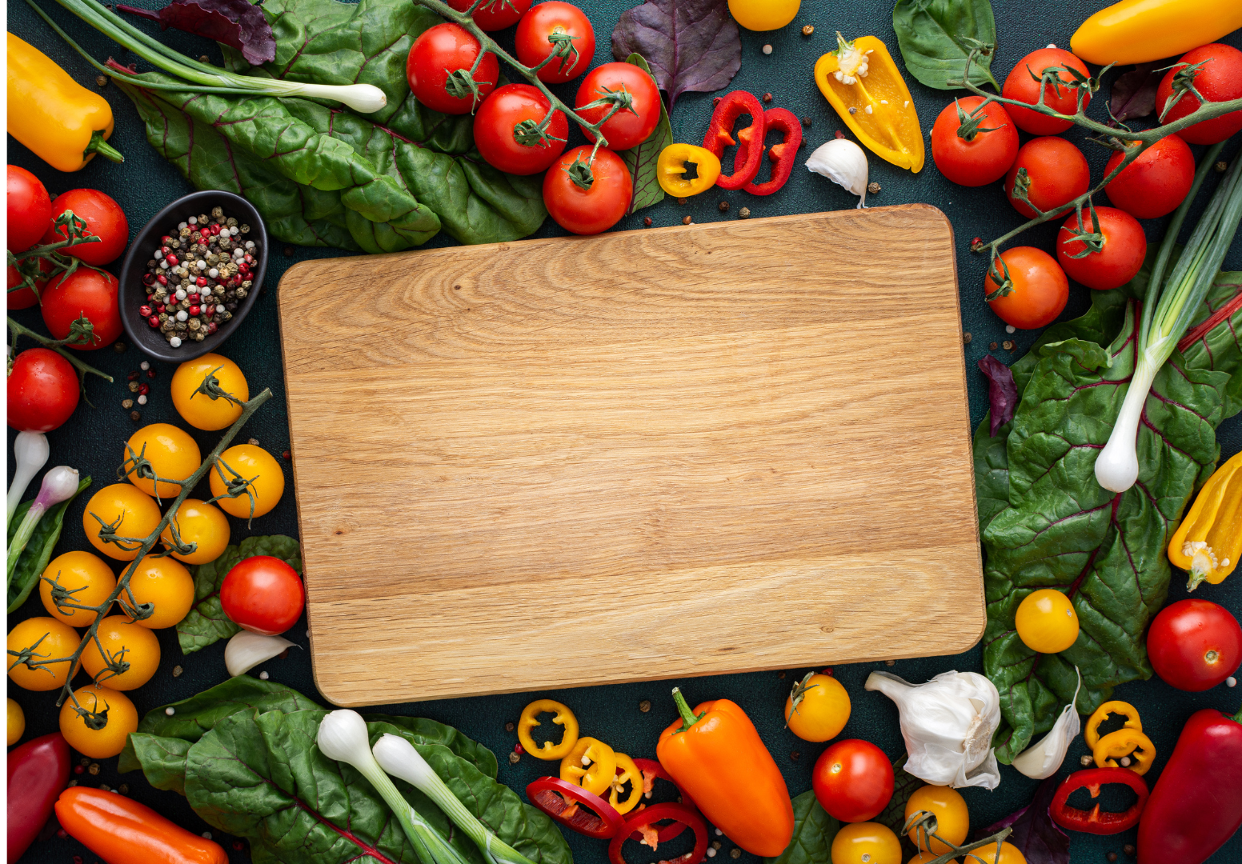
Unit 6: Food Lesson 3 – Part 1,2,3
What have we learnt today?
● Speaking skills: What food can you see?
● Listening skills: What’s your favourite meal?

Slide 22

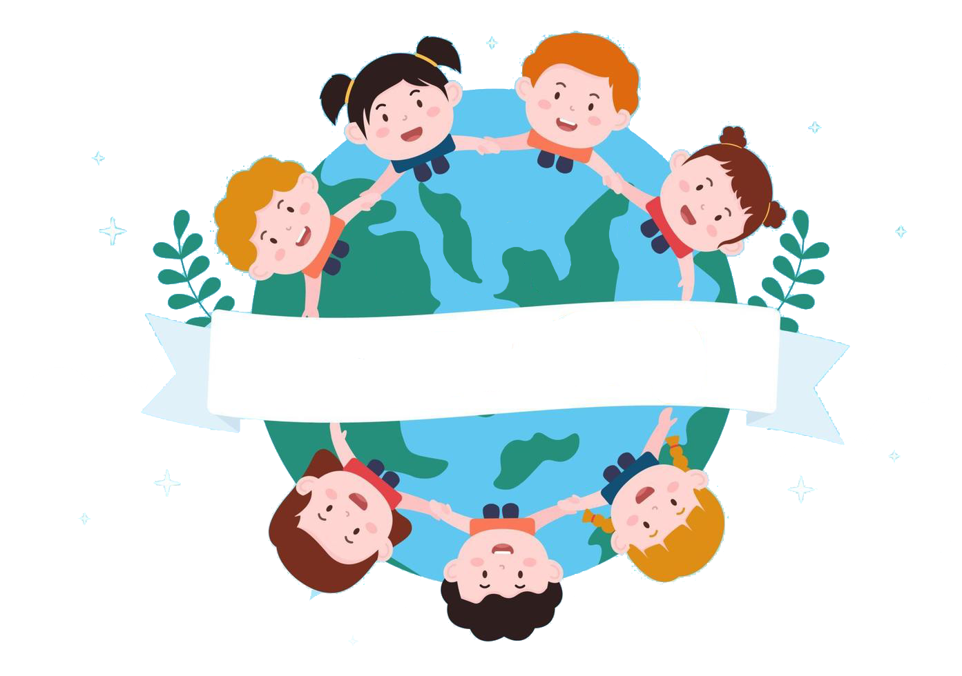
Thank you
& goodbye!

