Slide 1








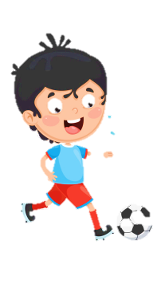












Slide 2





Table of contents
01
02
Warm - up
Presentation
05
04
Production
03
Practice
Wrap-up & Assessment

Slide 3

01
Warm up
Game “Stop the bus”

Slide 4

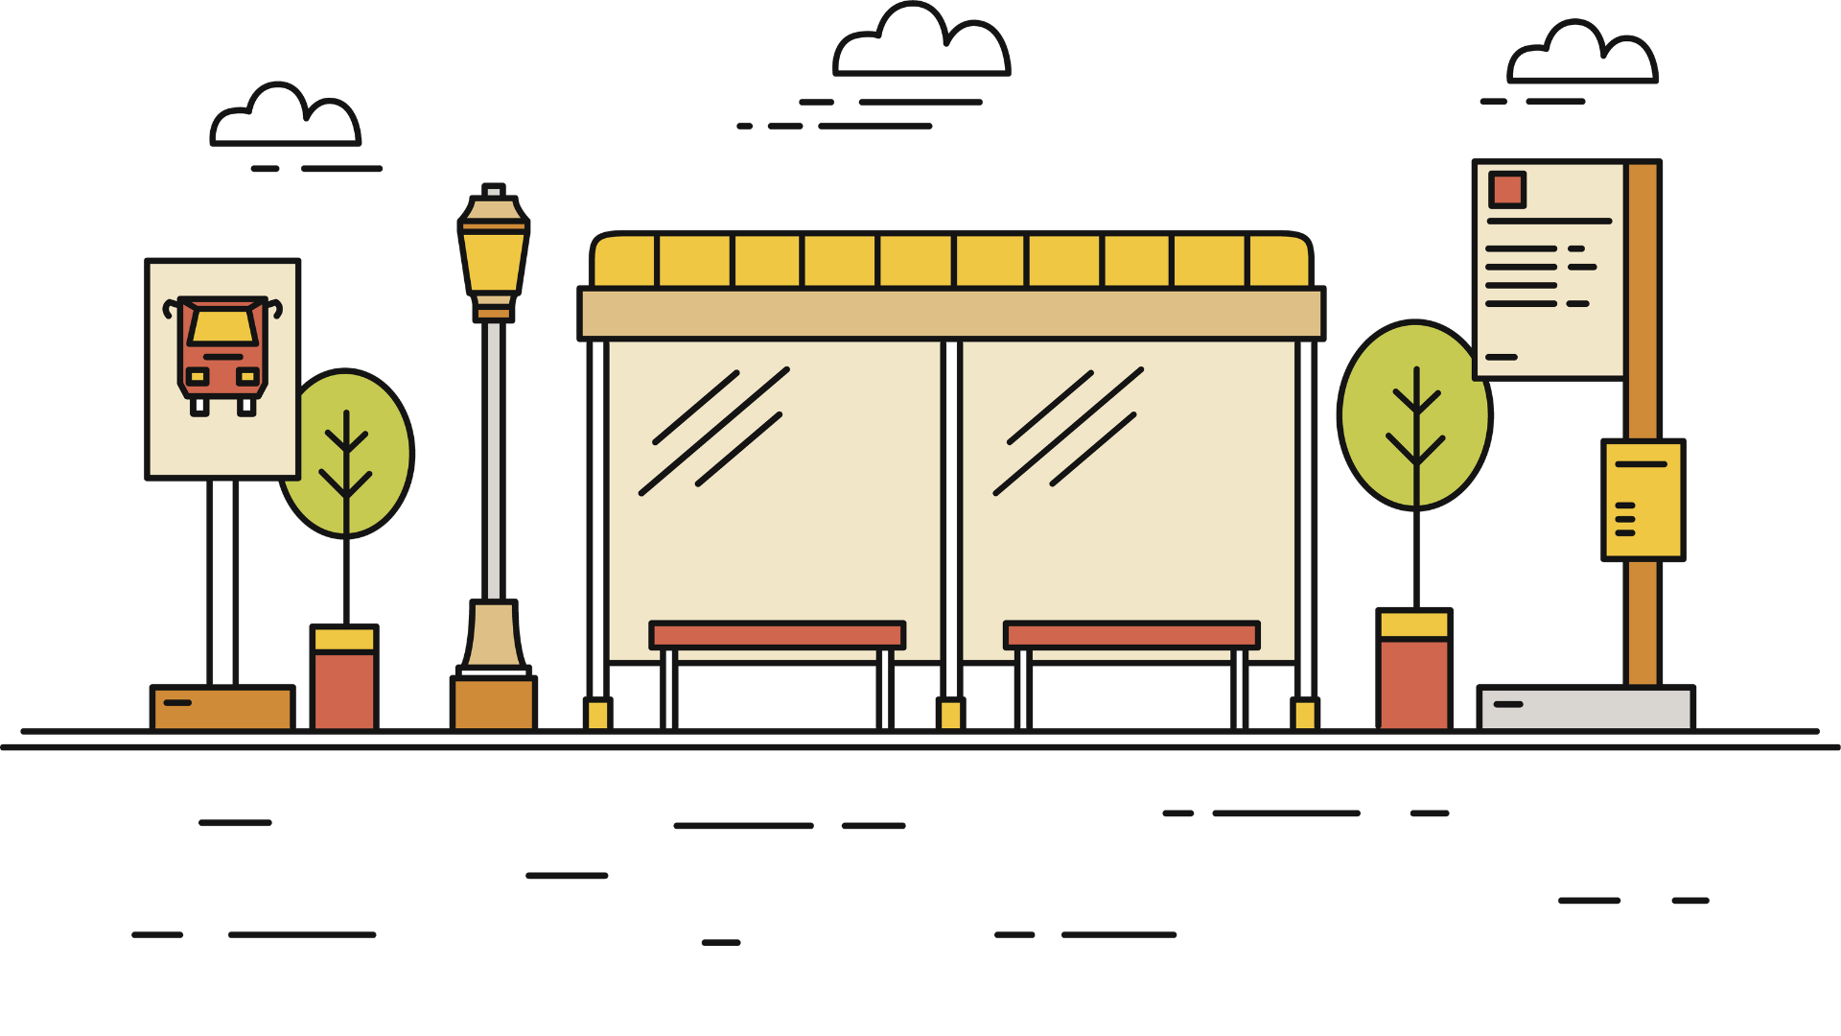

Describe the taste of ____

Slide 5
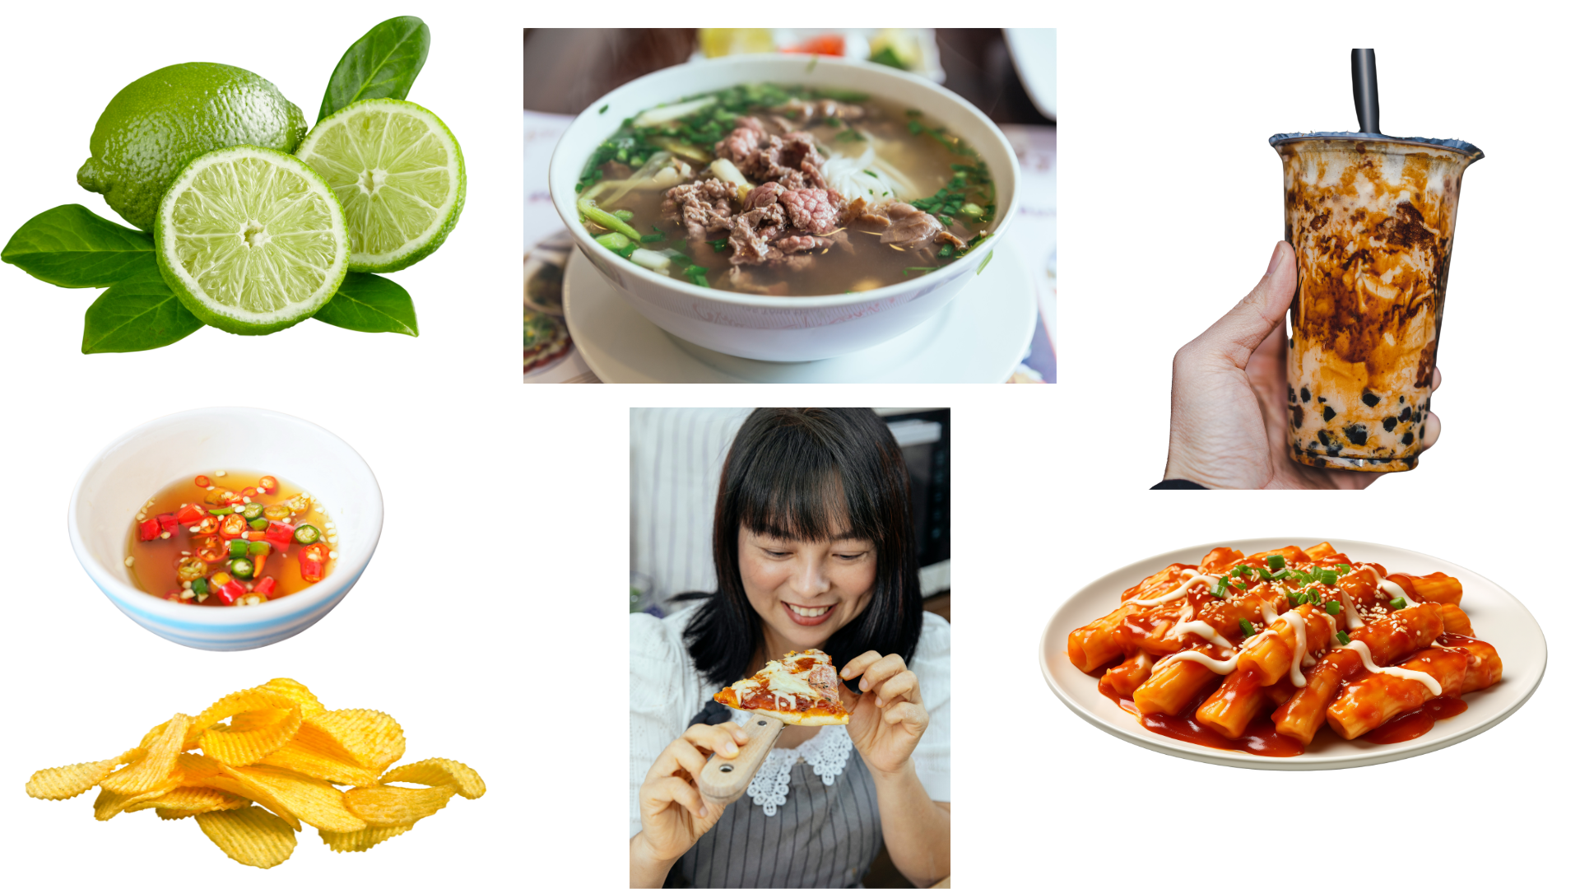
sour

Slide 6
delicious

Slide 7
spicy

Slide 8
sweet

Slide 9
salty

Slide 10
tasty

Slide 11
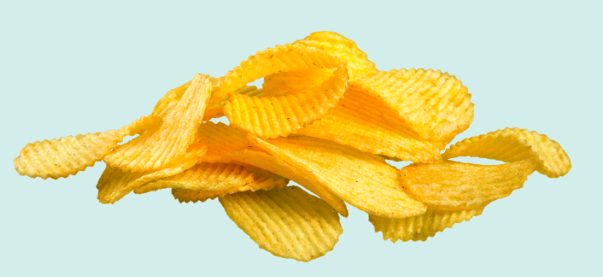
crispy

Slide 12
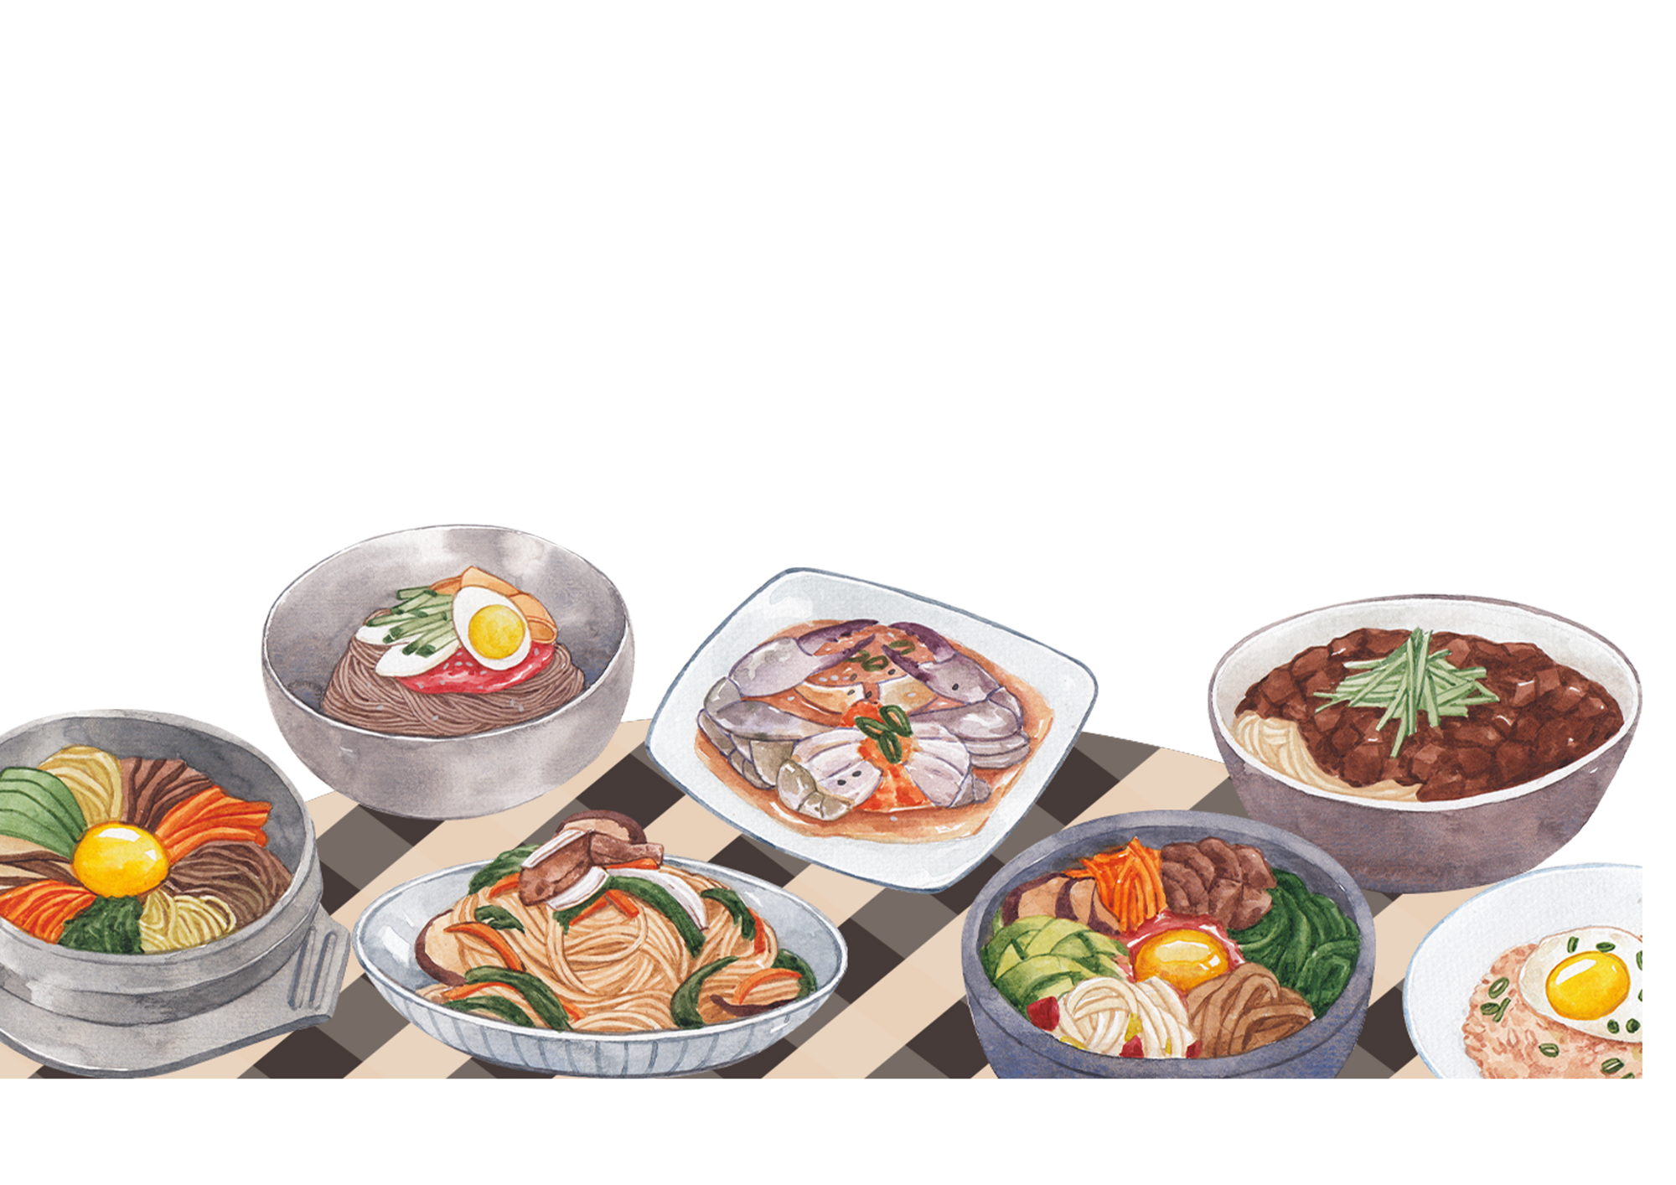
Unit 6: FOOD
Lesson 2 – Task 4, 5, 6

Slide 13

02
PRESENTATION

Slide 14


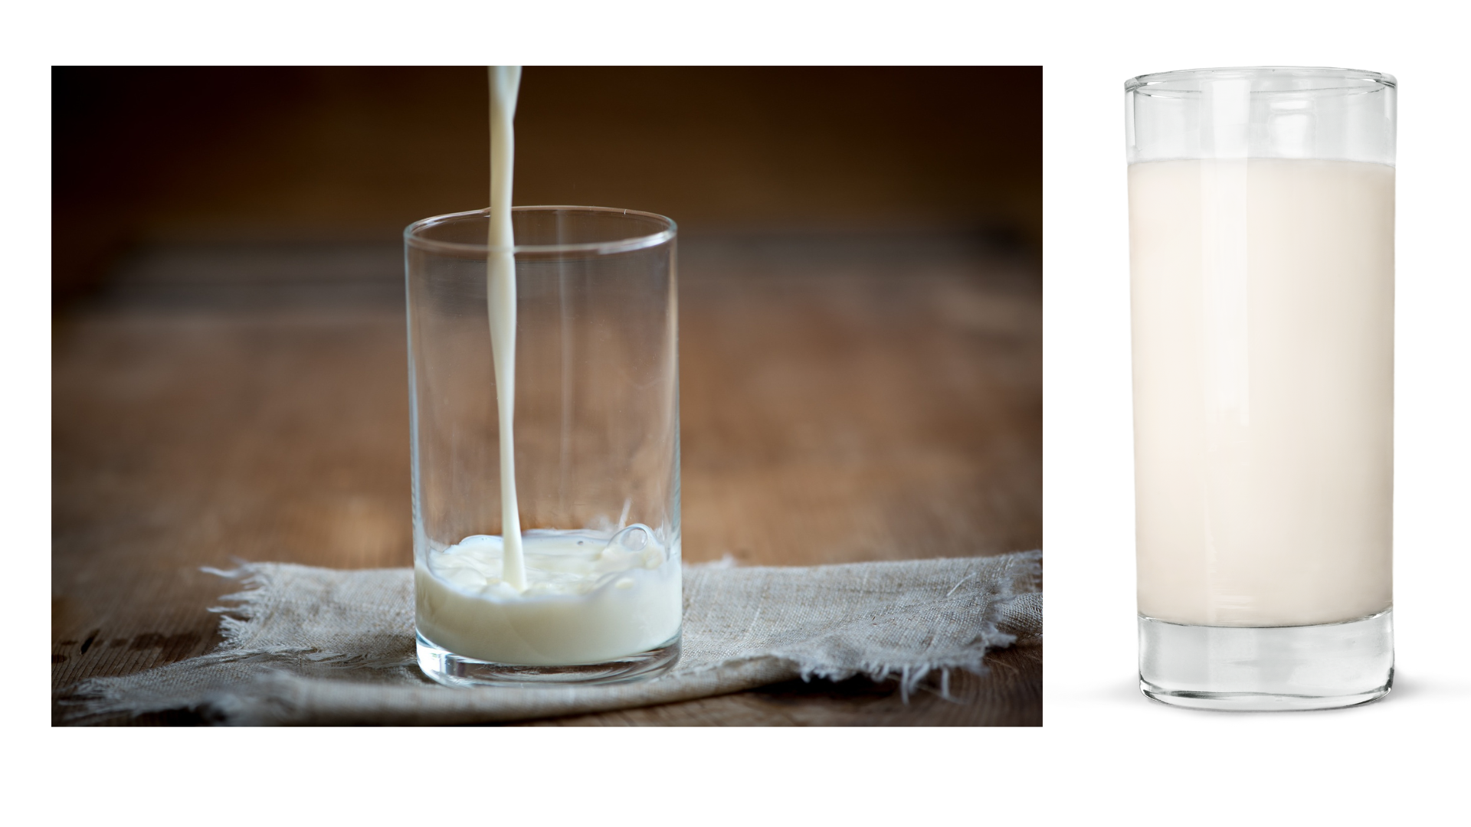

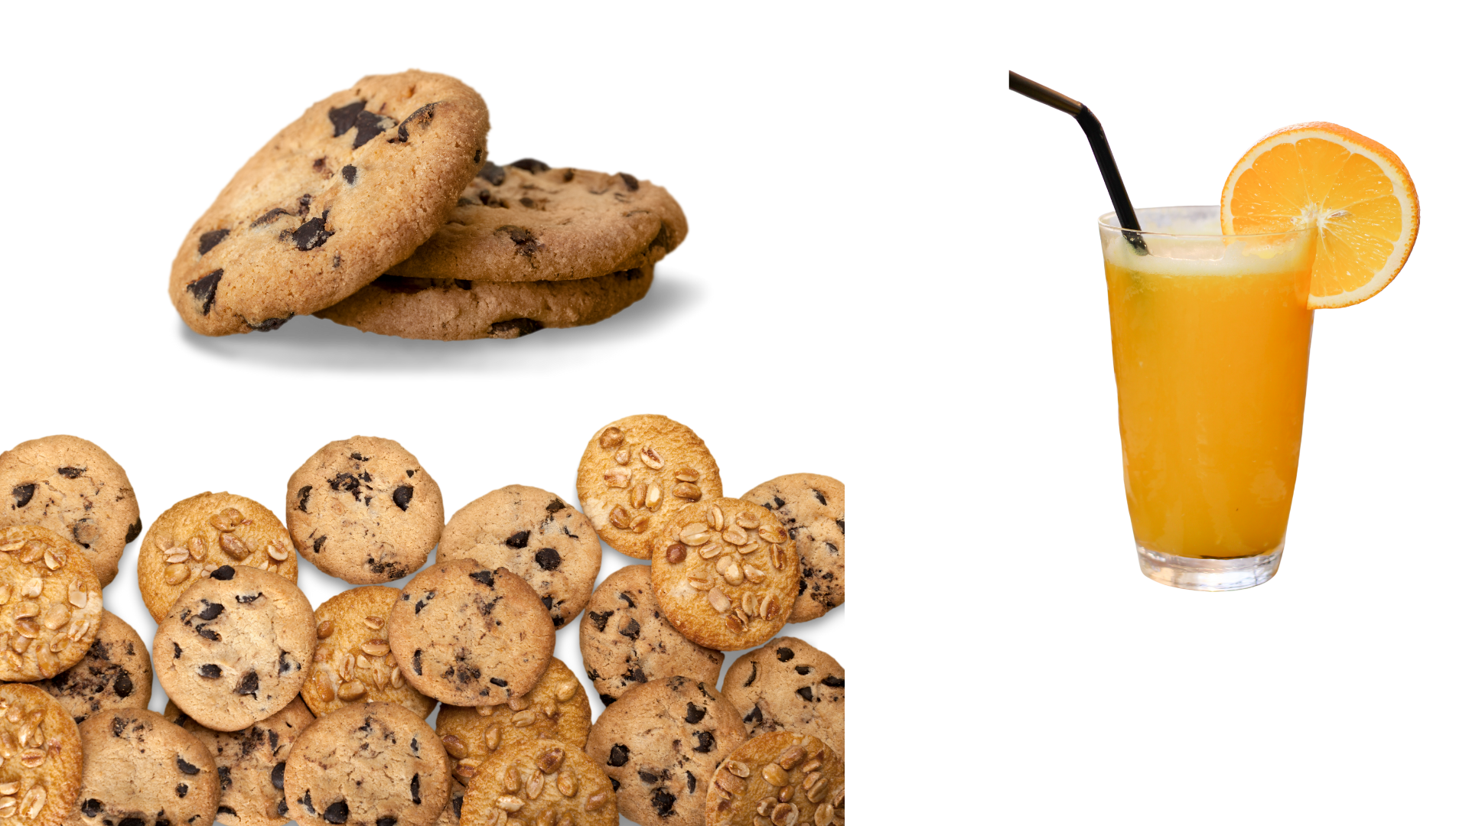



4 Listen and read.
There’s a little milk in the glass.
Let’s have a few biscuits with our orange juice.
Notes:
Thứ tự thực hiện:
Nghe + nhìn tranh
HS đưa ra câu đã nghe
GV hiện câu => HS nhắc lại
GV yêu cầu HS chỉ ra lượng từ trong 2 câu => chạy hiệu ứng.

Slide 15
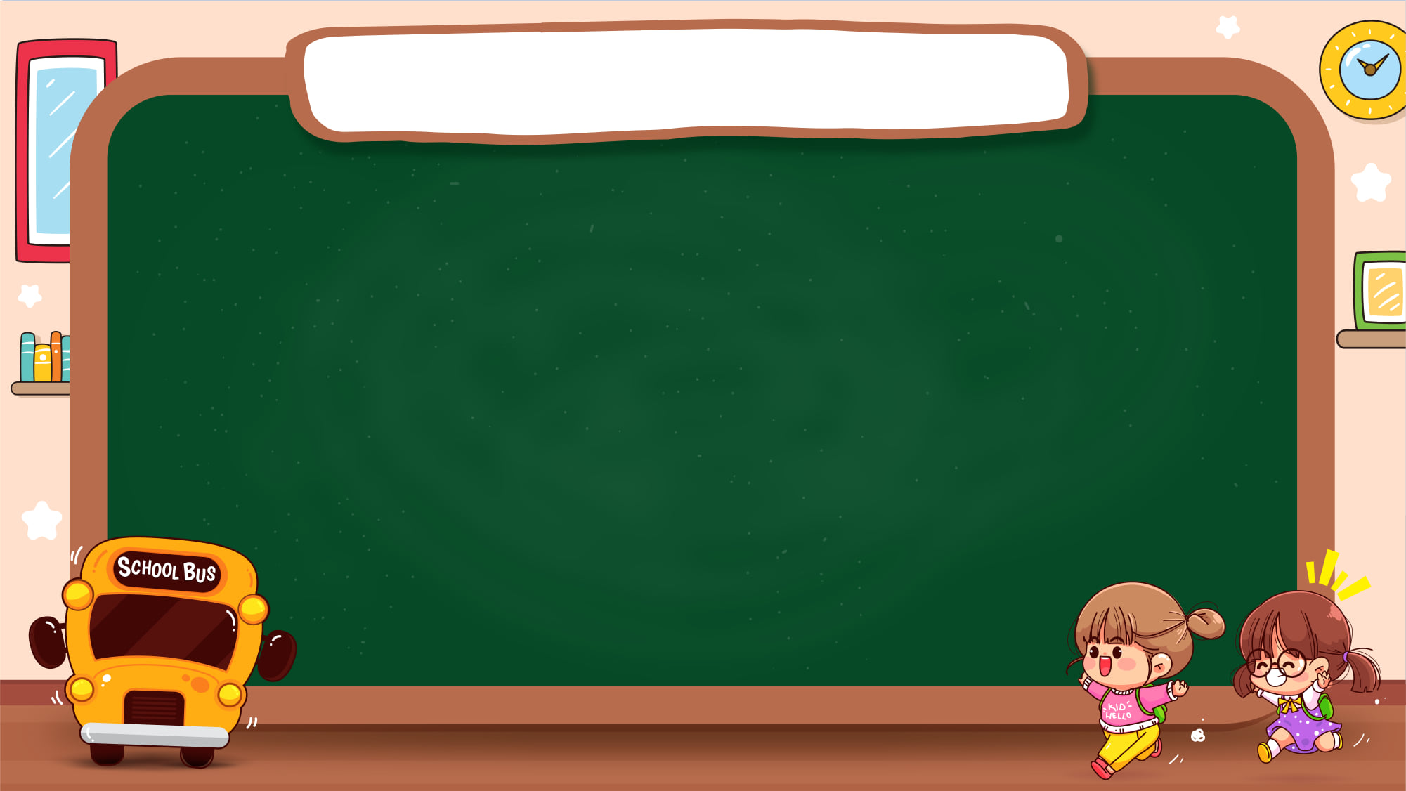




Quantifiers
a lot of
milk
a little
milk

Slide 16
Quantifiers
a lot of biscuits
a few biscuits

Slide 17
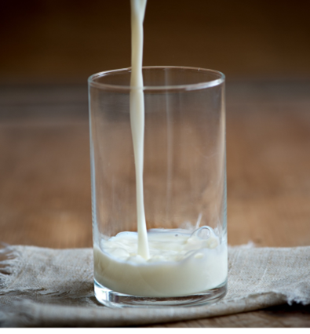
Quantifiers
a little
a few
There is a little milk.
There are a few biscuits.

Slide 18

4 Now, read, circle and say.
1. Can I have
a few
a little
ketchup, please?
2. Can we have
chips with our sandwich?
a few
a little
3. Marco always has
a few
a little
cheese on his bread.
4. Let’s buy
a few
a little
carrots for our carrot cake.

Slide 19
03
PRACTICE

Slide 20









QUIZ TIME
Answer the questions
Earn points
Win the quiz
LET’S START

Slide 21

LOOK AND CHOOSE
a. a few coffee
b. a little coffee
c. many coffee

Slide 22
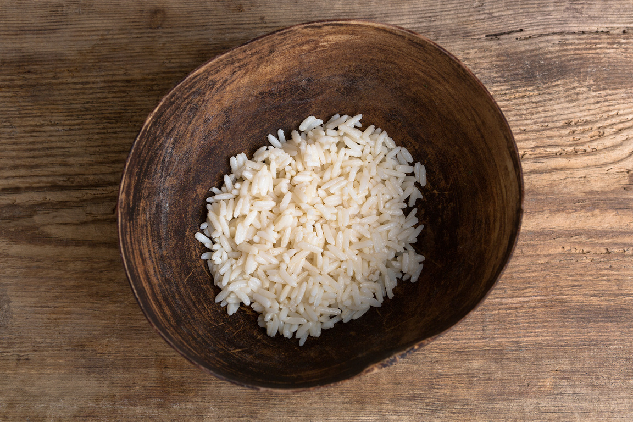
LOOK AND CHOOSE
a. a lot of rice
b. a few rice
c. a little rice

Slide 23
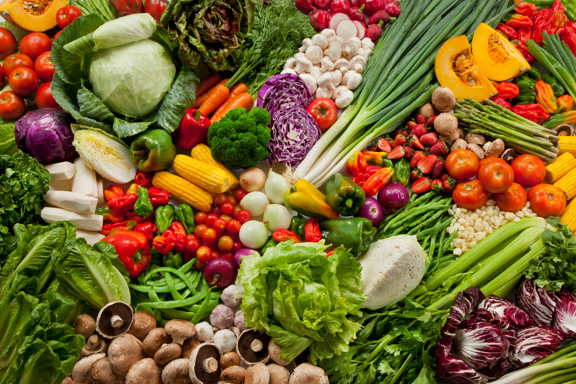
LOOK AND CHOOSE
a. a few vegetables
b. a little vegetables
c. a lot of vegetables

Slide 24
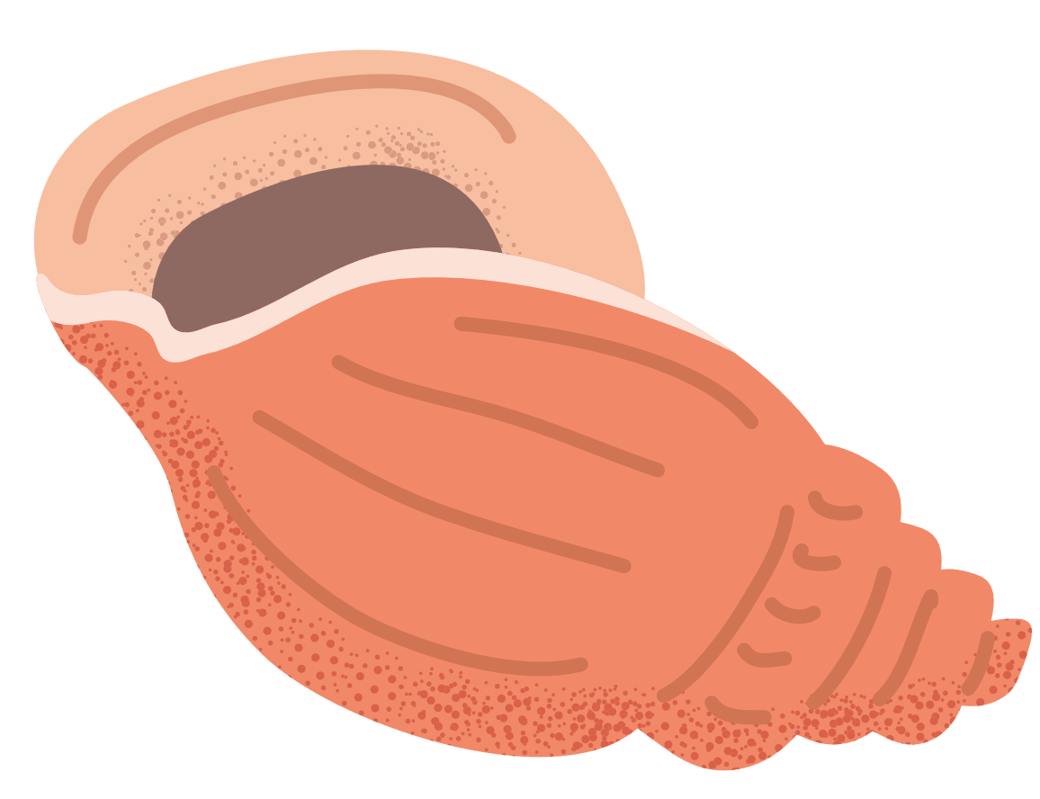
l
READ AND FILL IN THE BLANK
There _____ a few oranges in the fridge.
are

Slide 25
l
READ AND FILL IN THE BLANK
There _____ a little water in the glass.
is

Slide 26
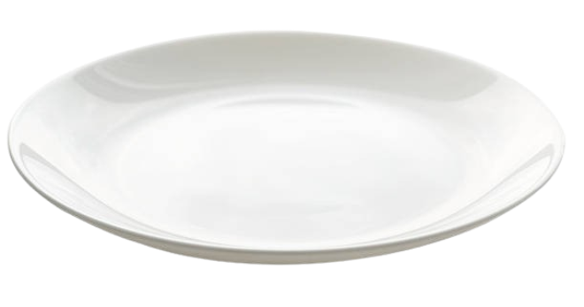
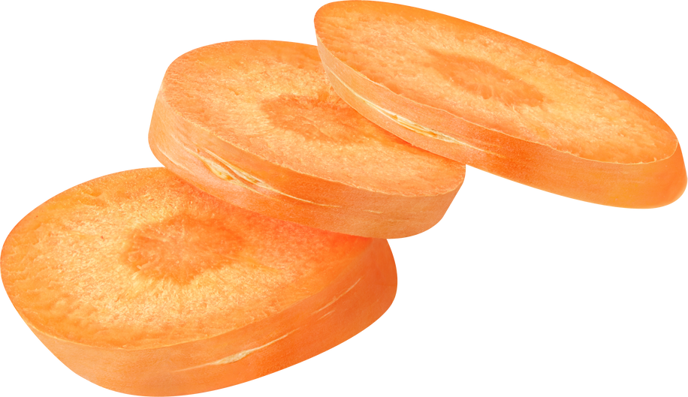
TRUE OR FALSE
a few
a lot of
He wants ______ carrots for dinner.
True
False
Notes:
Click LẦN 1 vào đáp án chính xác => đổi màu.
Click LẦN 2 vào đáp án chính xác => sửa lỗi sai.

Slide 27
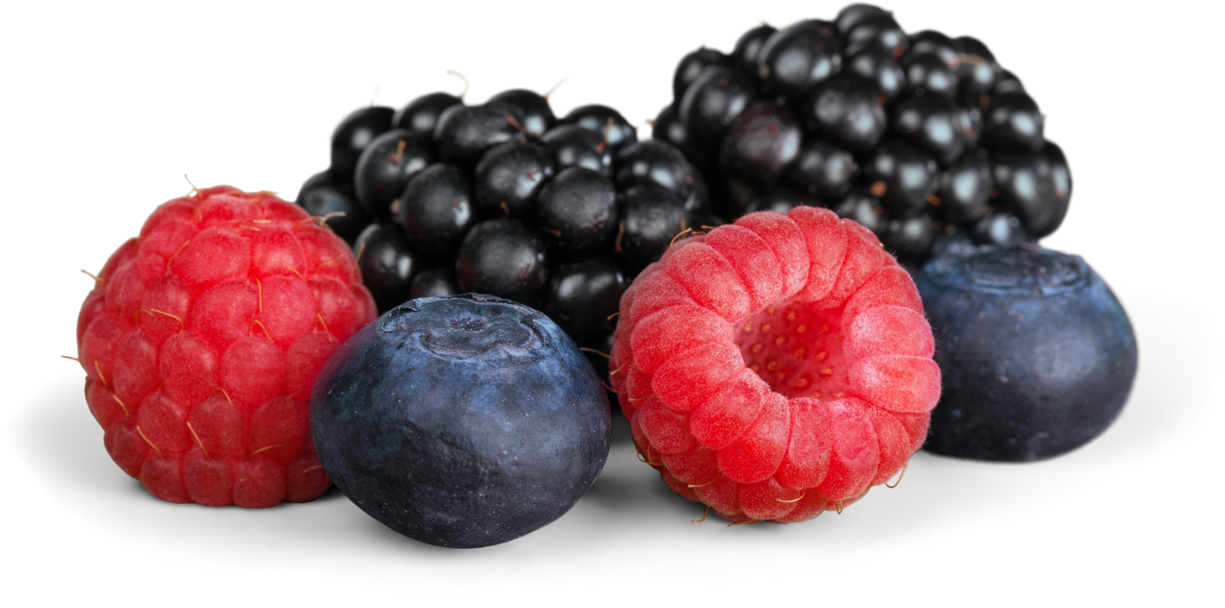
TRUE OR FALSE
They need a few berries for their juice.
True
False
Notes:
Click LẦN 1 vào đáp án chính xác => đổi màu.
Click LẦN 2 vào đáp án chính xác => sửa lỗi sai.

Slide 28
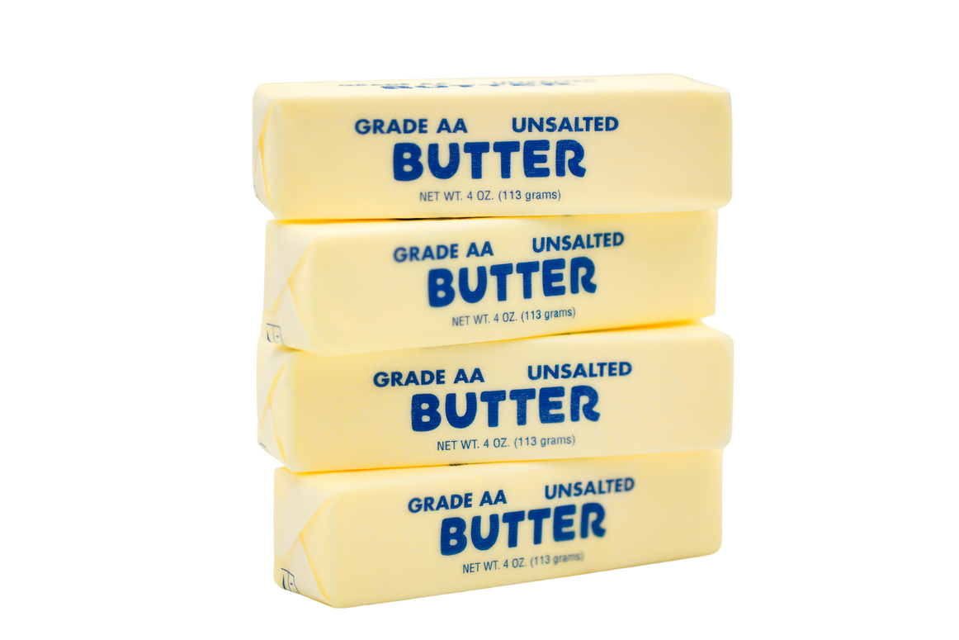
TRUE OR FALSE
a little
a lot of
Let’s buy ______
butter to make a cake!
True
False
Notes:
Click LẦN 1 vào đáp án chính xác => đổi màu.
Click LẦN 2 vào đáp án chính xác => sửa lỗi sai.

Slide 29

5 Put the words in the correct order to make sentences or questions
a few / We’ve / tomatoes / got / .
→ _____________________________________
2. coffee / want / a little / I / in / milk / my / .
→ _____________________________________
3. there / Is /a little/ for / me / rice / ?
→ _____________________________________
We’ve got a few tomatoes.
I want a little milk in my coffee.
Is there a little rice for me?

Slide 30
5 Put the words in the correct order to make sentences or questions
4. for / need / a little / We / cake / the / butter / .
→ _____________________________________
5. a little / drinks / He / with / lunch / his / juice / .
→ _____________________________________
6. a few / under / are / table / There / the / presents / .
→ _____________________________________
We need a little butter for the cake.
He drinks a little juice with his lunch.
There are a few presents under the table.

Slide 31
04
PRODUCTION

Slide 32


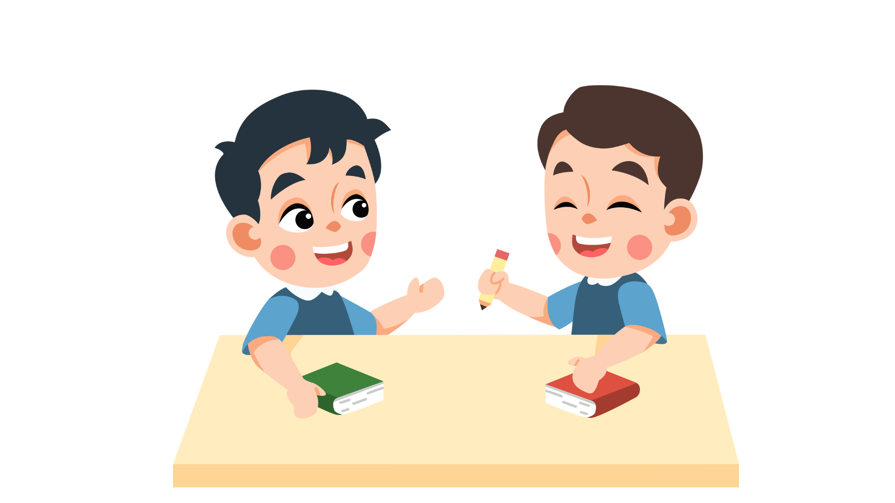
6 Let’s talk.
Talk to your partner about what you and your family often buy at the supermarket.
Use suggestions in the book to help you.
My mum often buys a few bananas.
I often buy a little cheese for my sandwich.

Slide 33
05
WRAP-UP & ASSESSMENT

Slide 34
Sort the foods to correct quantifiers
a little | a few
watermelons
chicken
water
chips
tomatoes
sandwiches
sugar
juice
meat
potatoes
Notes:
- Click vào các từ để đưa vào các cột tương ứng.

Slide 35
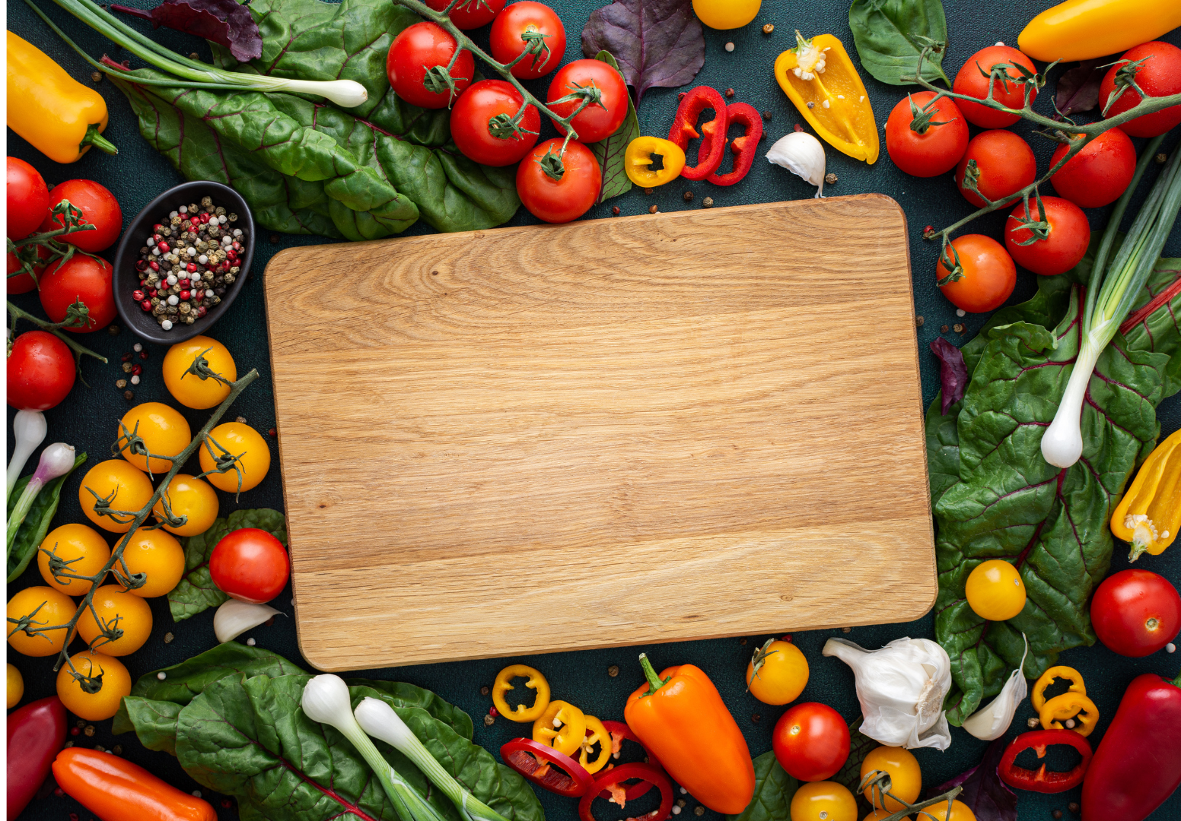
Unit 6: Food Lesson 2 – Part 4,5,6
What have we learnt today?
Review Vocabulary: crispy, delicious, salty, sour, spicy, sweet, tasty
Grammar: a few, a little
There are a few sandwiches.
There is a little water.

Slide 36


Thank you
& goodbye!

