Slide 1





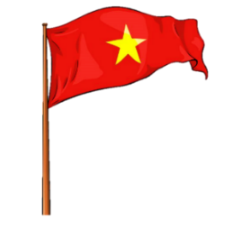







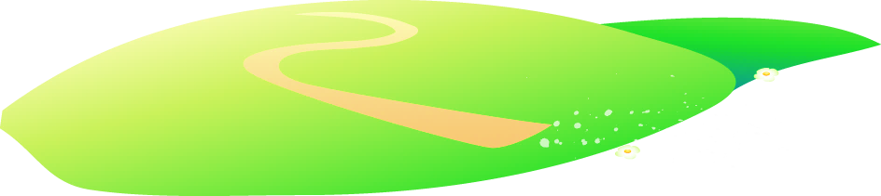


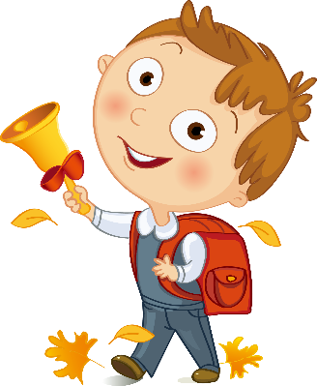



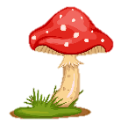
Notes:
Để nguyên trang bìa như này, chỉ thay đổi tên bài trong quá trình làm. Logo của sách Wonderful World

Slide 2
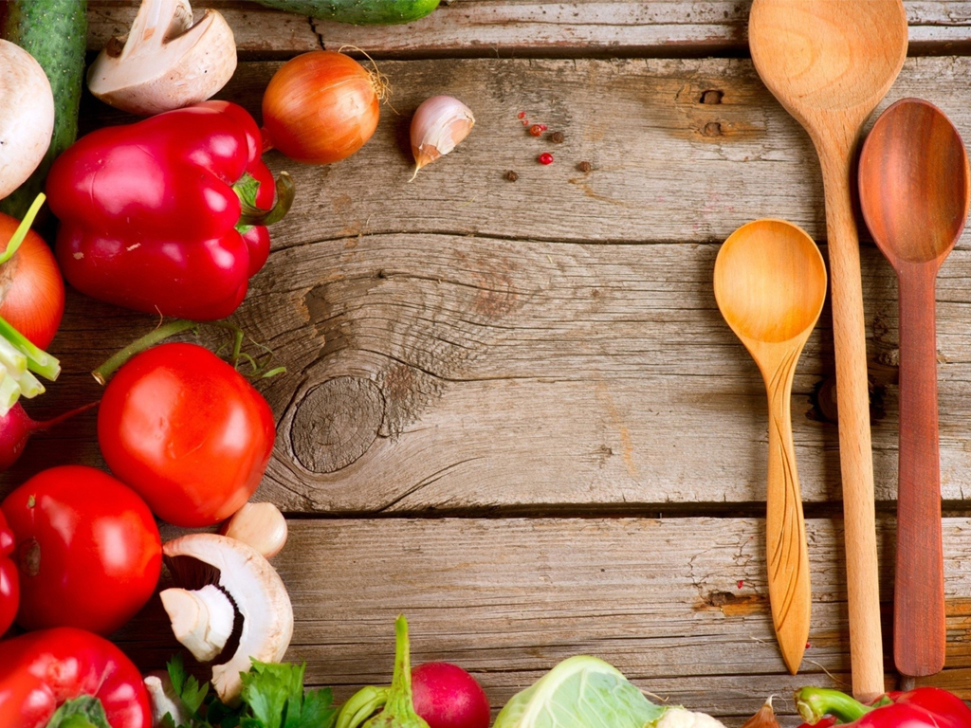
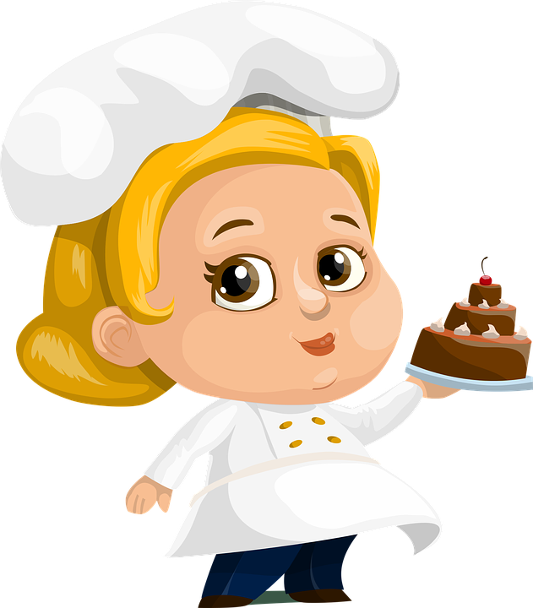
REVIEW 2:
PART 2

Slide 3
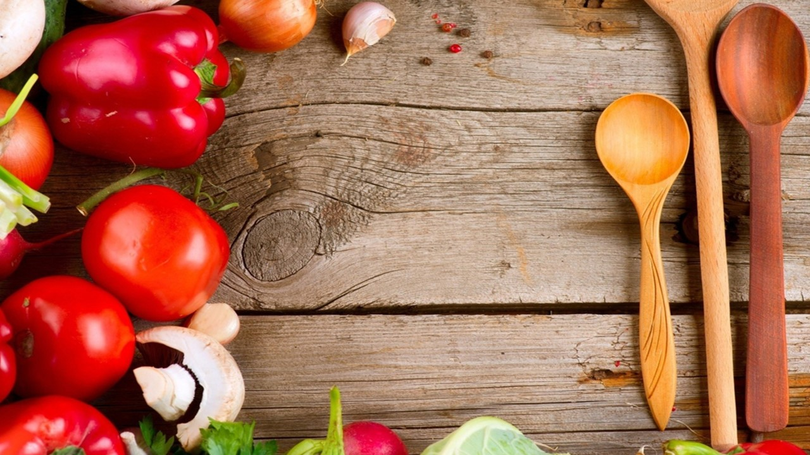
1. Warm up
Horse race

Slide 4
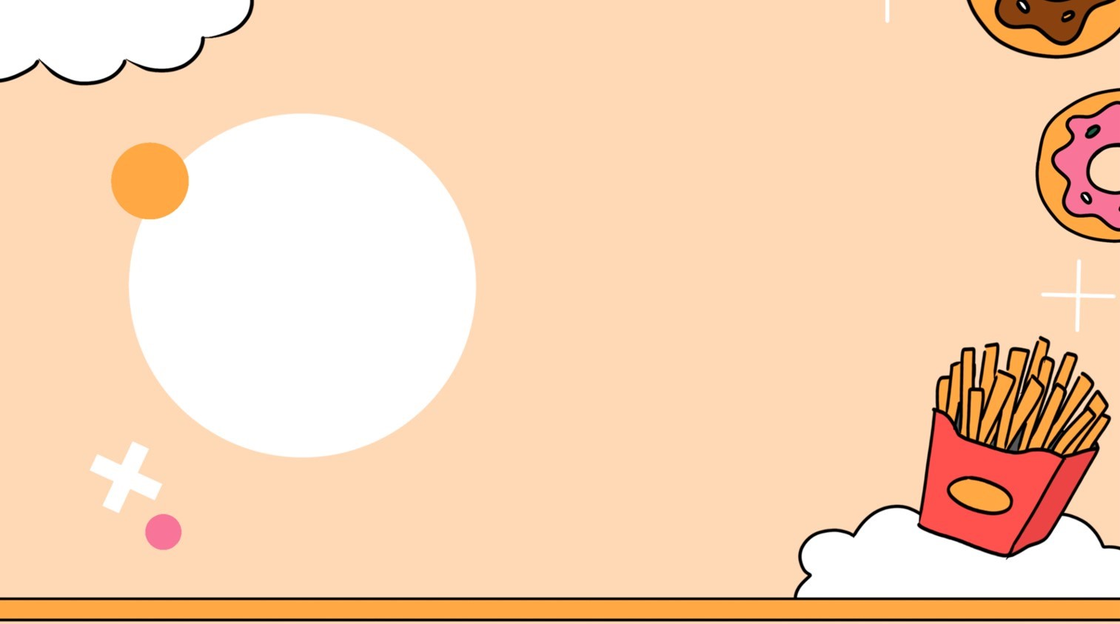

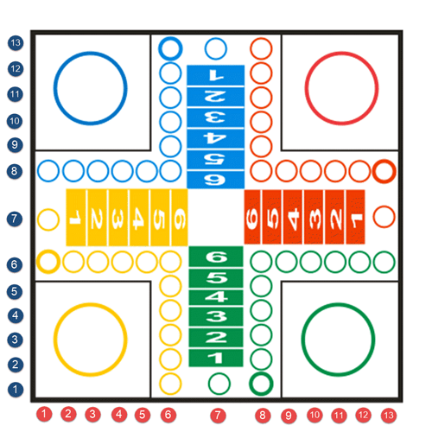



Practice
1
1
2
2
3
4
1
2
2
1
5
6
2
7
8
1

Slide 5
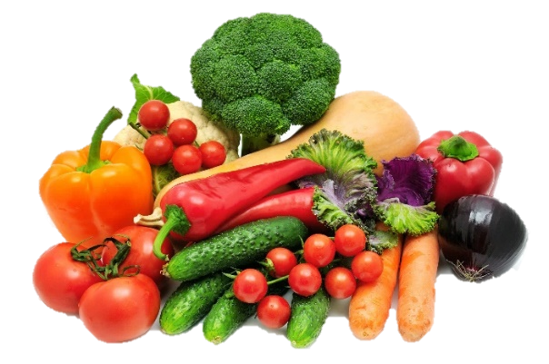
Would you like some vegetables?
❎
No, thanks.
Back

Slide 6
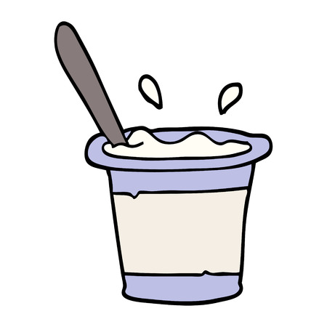
Look and write
What is your favourite_____?
My favourite ______ is yoghurt.
food
food
Back

Slide 7
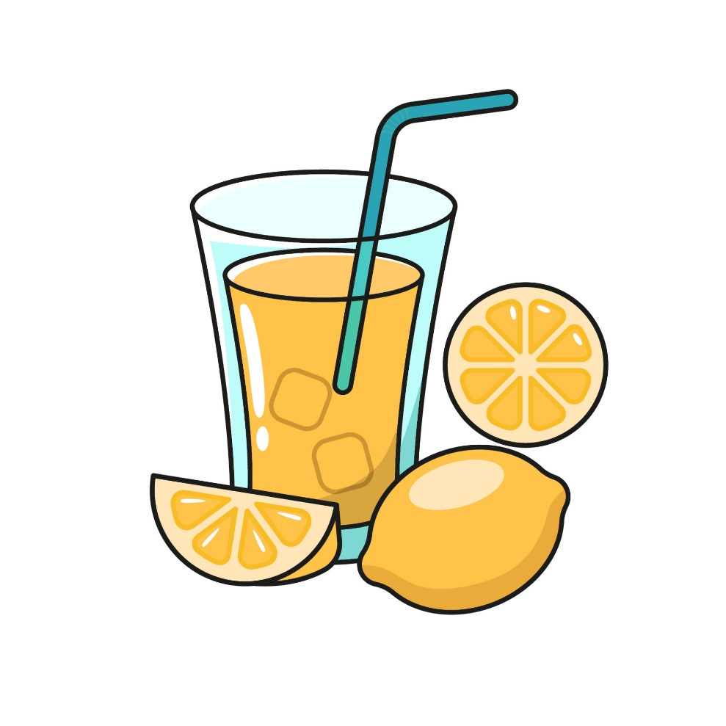

Would you like some lemonade?
Yes, please.
Back

Slide 8
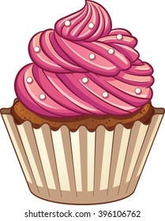
How mαny cupcakes hαve you got?
We’ve got _______ .
14
Back

Slide 9
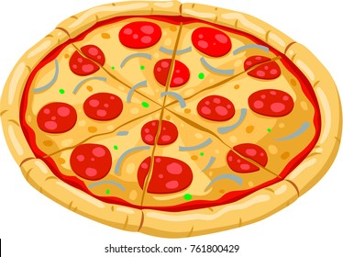
What is your favourite food?
My favourite food is ______.
pizza
Back

Slide 10
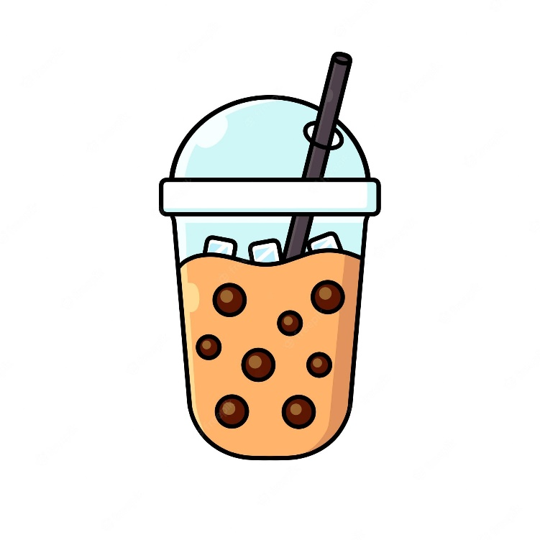
What’s your favourite drink?
My favourite drink is bubble tea/ soft drink.
Back

Slide 11
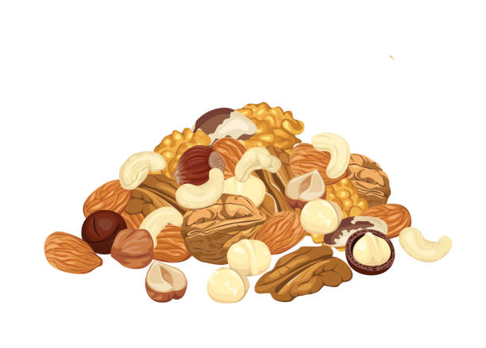

Would you like some nuts?
No, thanks.
Back

Slide 12
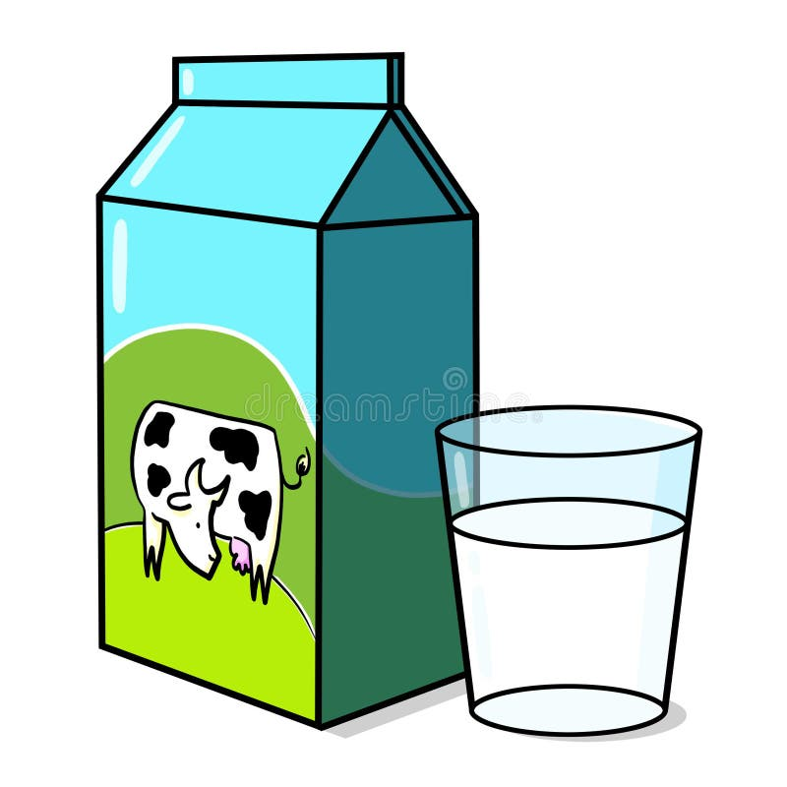
What is your favourite drink?
My favourite drink is ______.
milk
Back

Slide 13






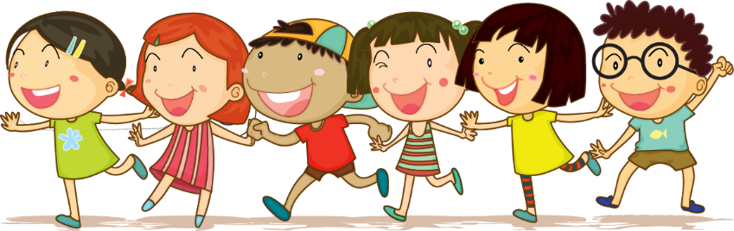



2. Review
Task 1: Write. Circle a or b
2.Review

Slide 14

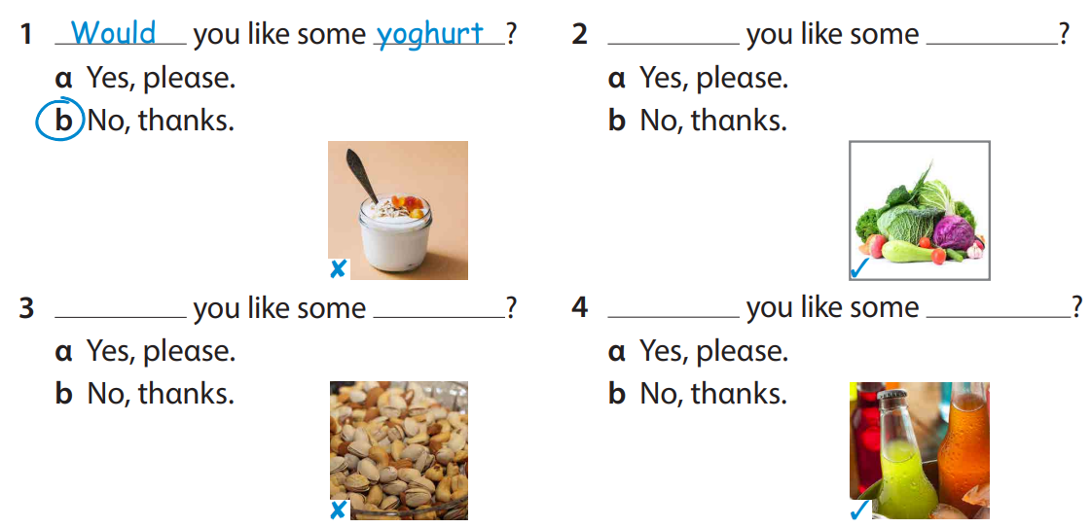
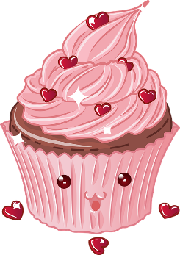

Would
vegetables
Would
nuts
Would
soft drinks

Slide 15
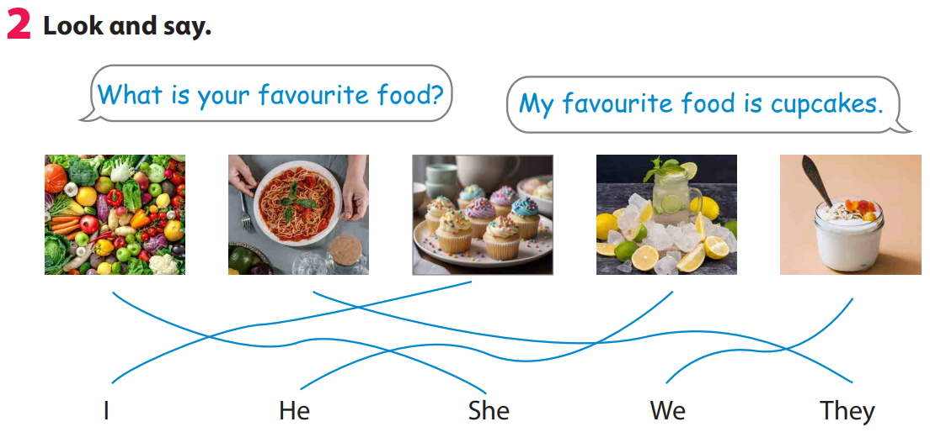

Slide 16
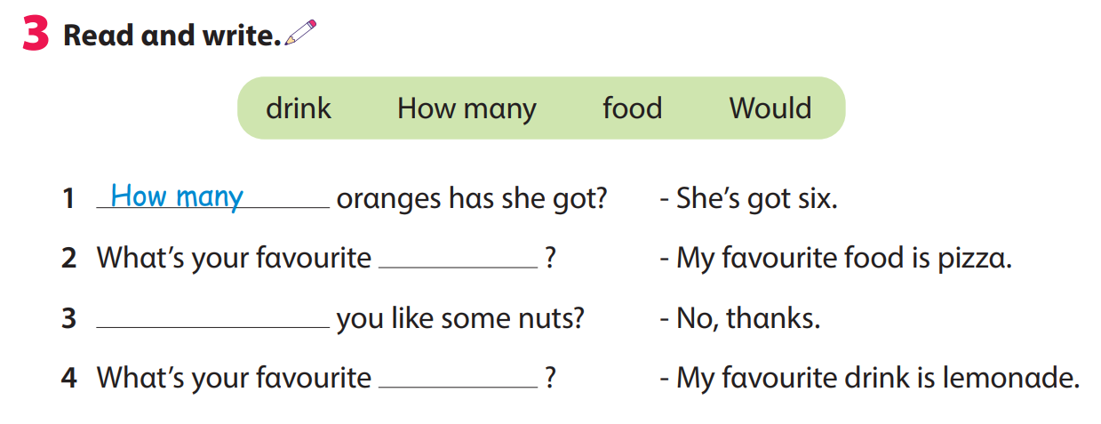
food
Would
drink

Slide 17
3. ASSESSMENT
2.Review

Slide 18
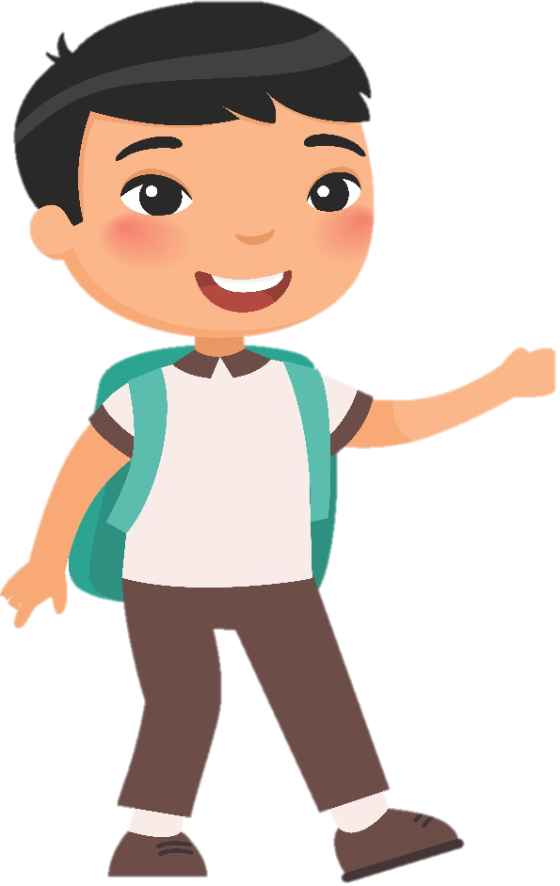
Order and write.
1 his / Whαt’s / fαvourite / food / ?
2 fαvourite / Whαt’s / her / drink / ?
3 αpples / she / hαs / How mαny / got / ?
4 like / some / Would / you / vegetαbles / ?
What’s his favourite food?
What’s her favourite drink?
How many apples has she got?
Would you like some vegetables?

Slide 19



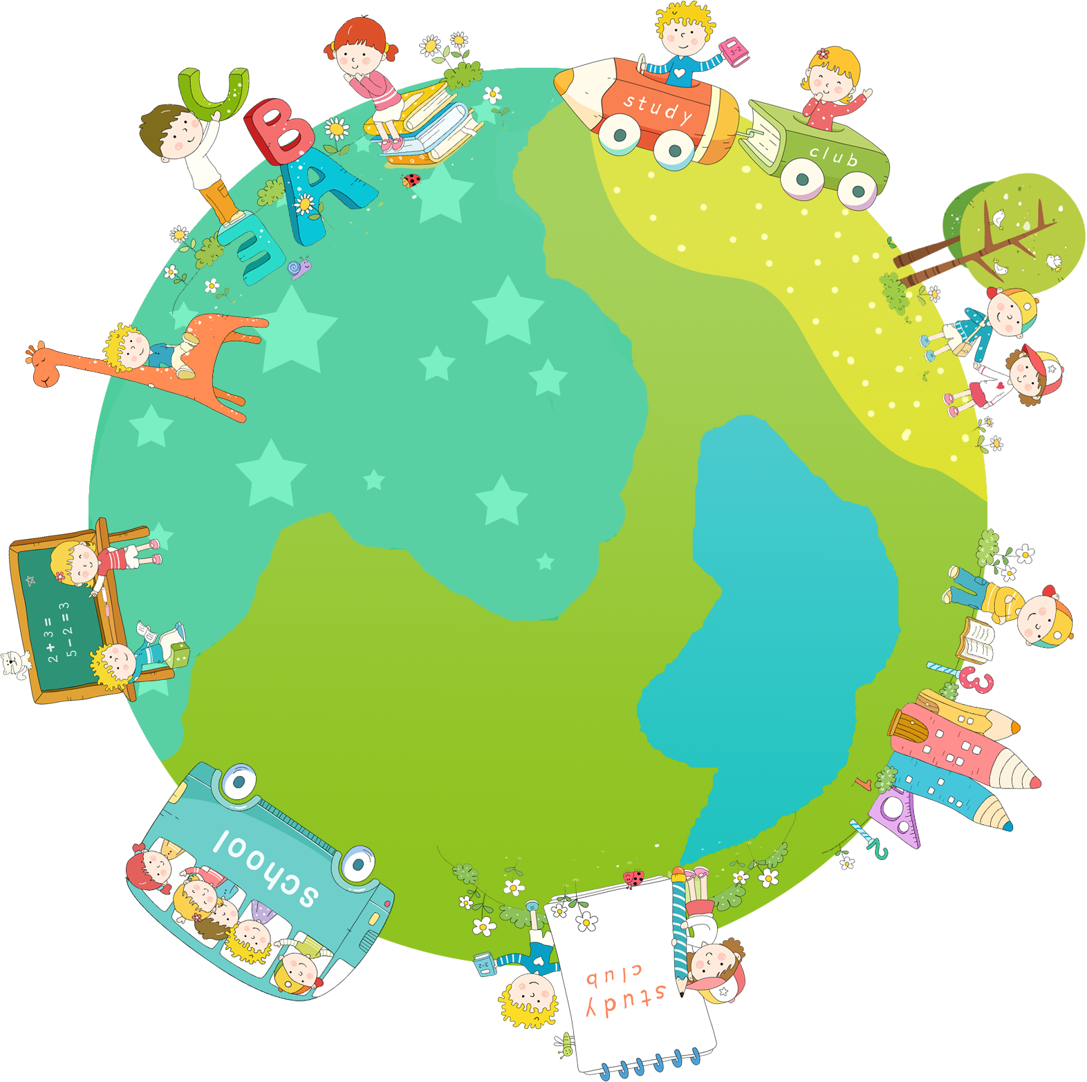
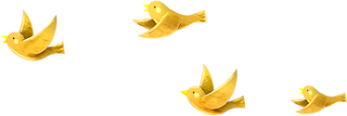
Thank you & goodbye!

