Slide 1










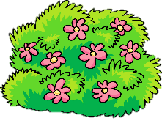
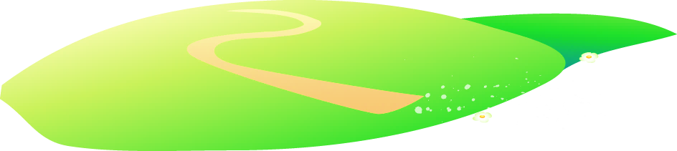



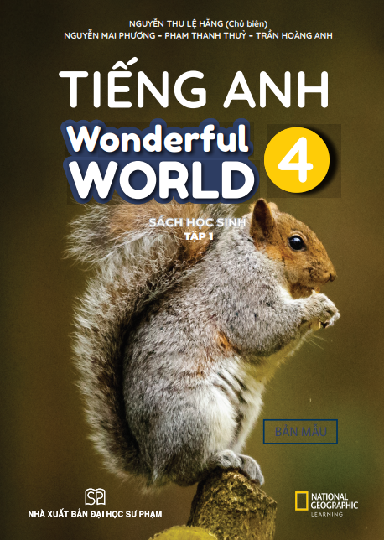


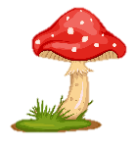
Notes:
Để nguyên trang bìa như này, chỉ thay đổi tên bài trong quá trình làm. Logo của sách Wonderful World

Slide 2
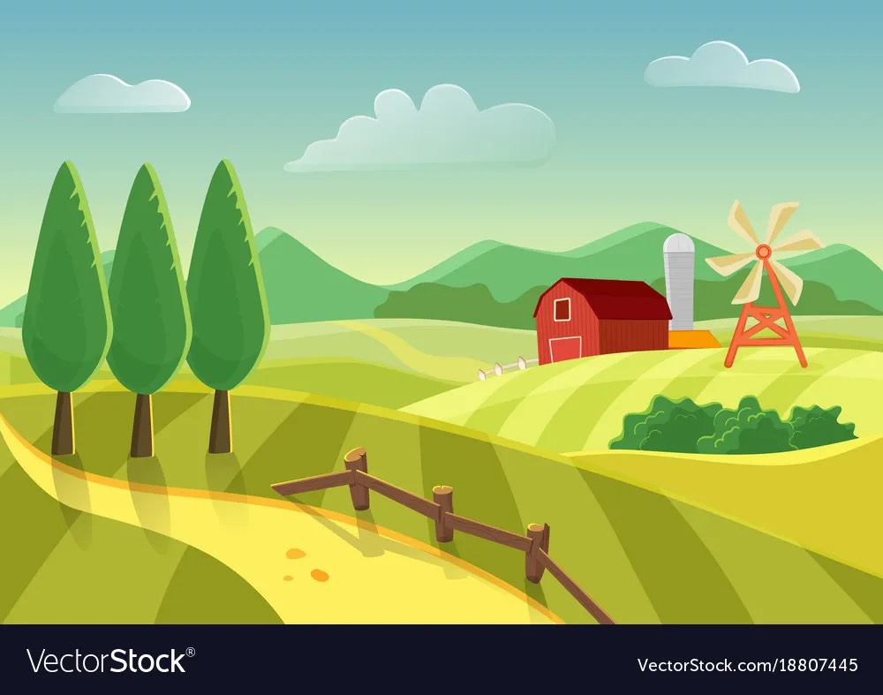

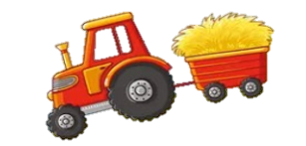
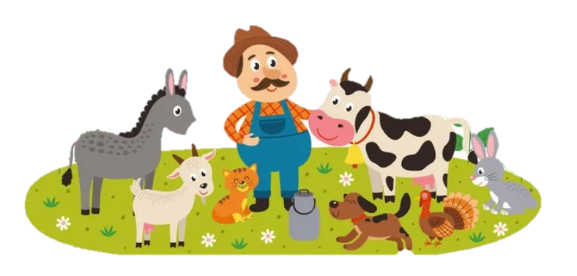
Unit 3. On the farm
Lesson 1. Task 4 5 6

Slide 3
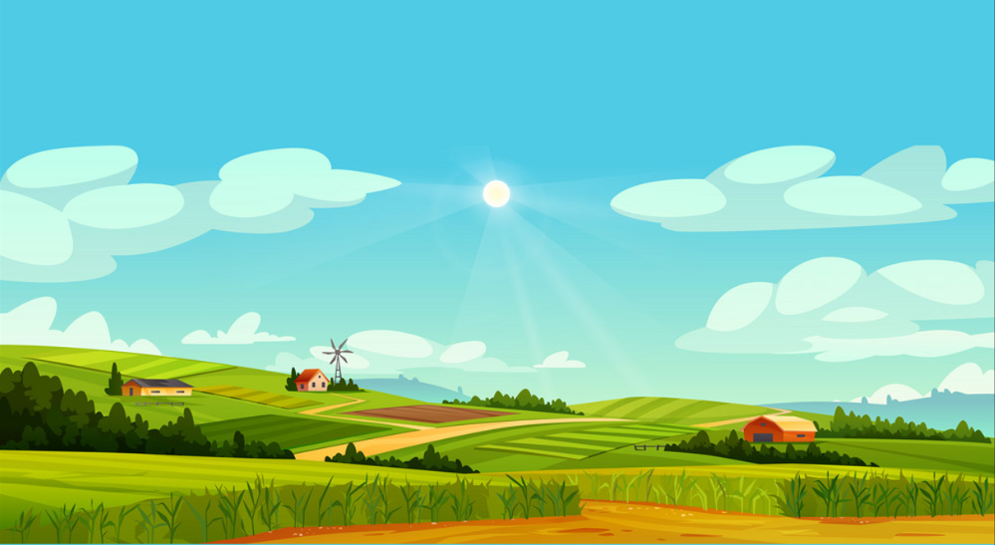
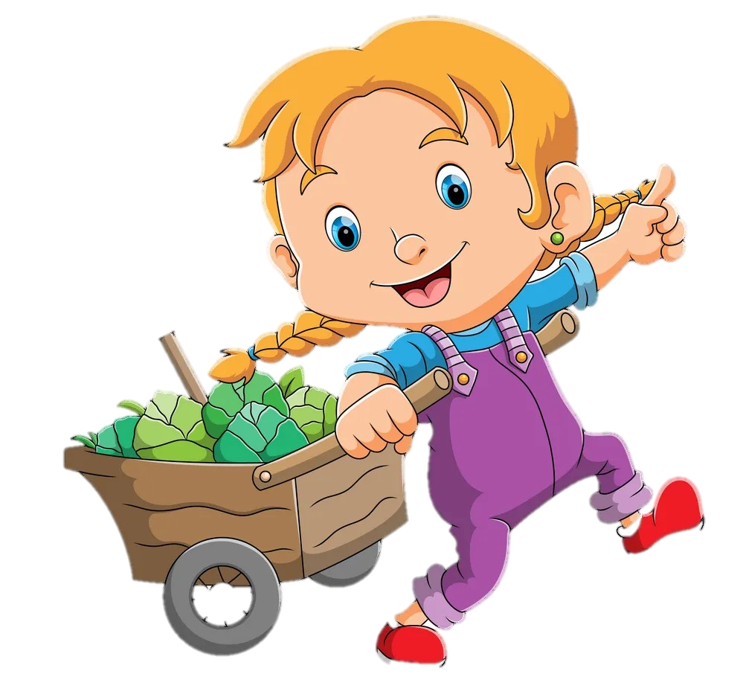
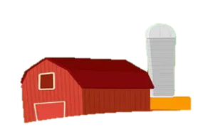
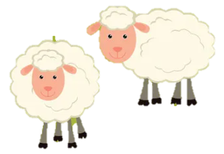
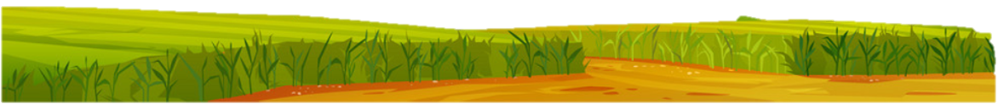
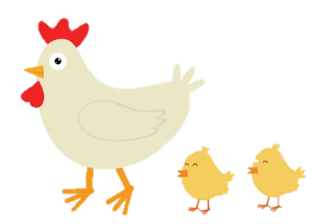
1
Warm Up

Slide 4
Let’s go to our farm.
2
Presentation

Slide 5

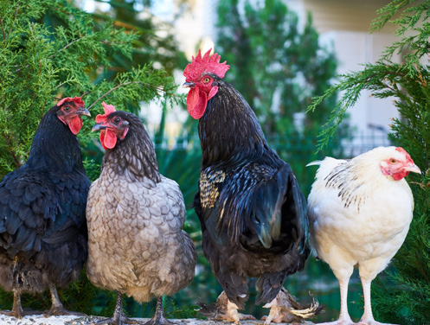
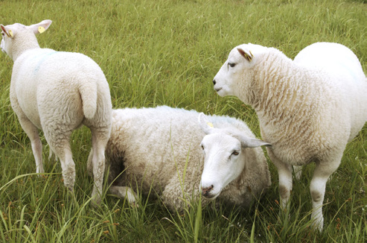
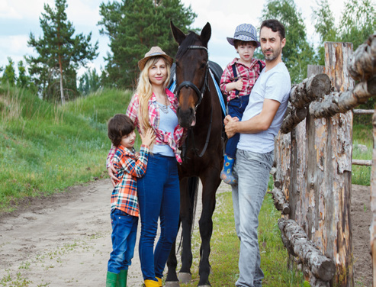
4 Listen and repeat.
’ve got = hαve got
1. We’ve got some chickens.
2. We’ve got some sheep.
3. We’ve got a horse.

Slide 6
3
Practice

Slide 7


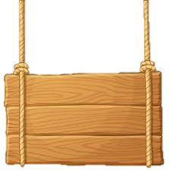
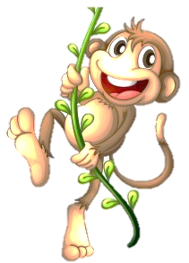

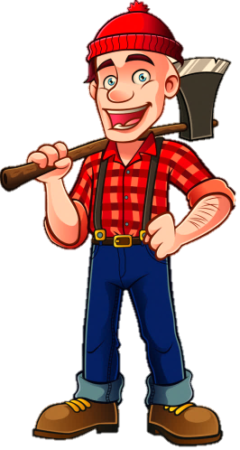
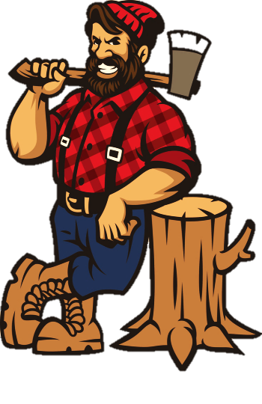
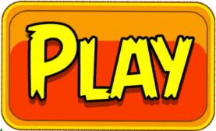
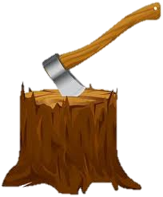
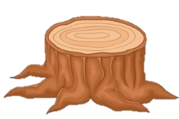

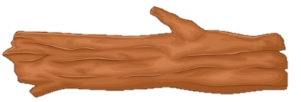

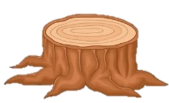
PROTECT
THE JUNGLE

Slide 8


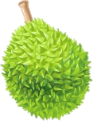


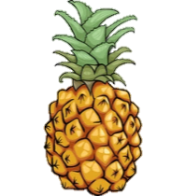
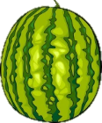


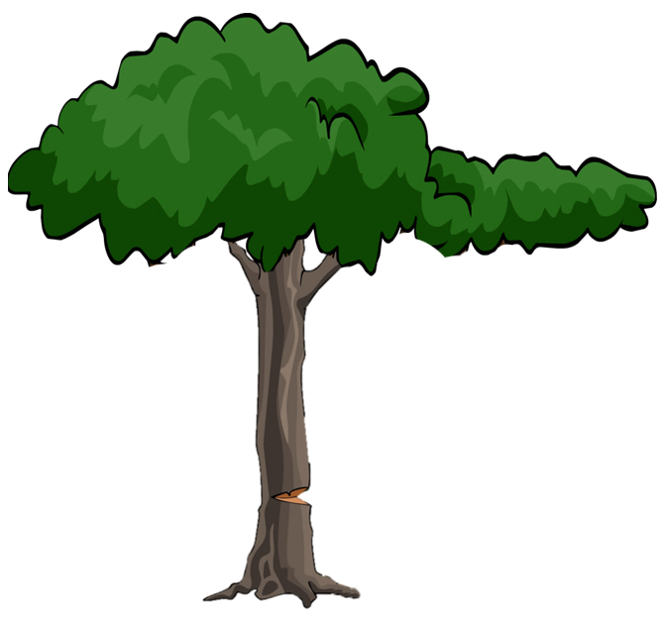










1
2
3
5
4
Notes:
Nhấn vào số để chọn câu hỏi. Sau khi trả lời đúng nhấn nút BACK để quay trở lại và thả quả để tiêu diệt lâm tặc bằng cách nhấn vào con khỉ trên cây tương ứng.

Slide 9

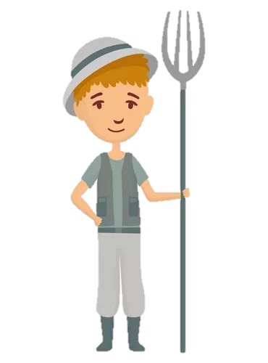
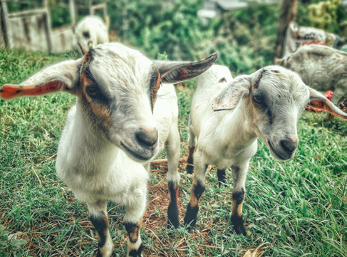
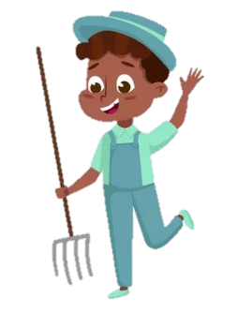
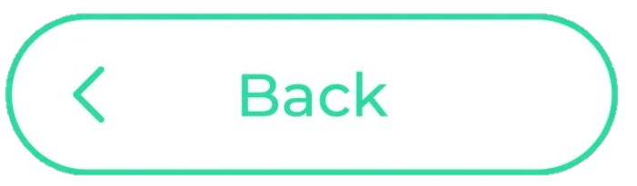
5
Point and say.
We/ some goats.
We’ve got some goats.

Slide 10
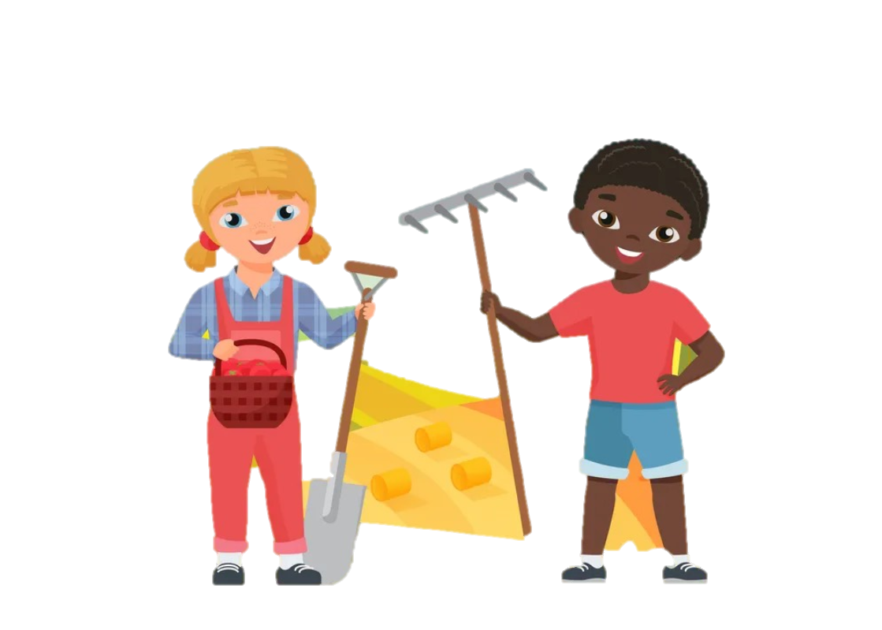
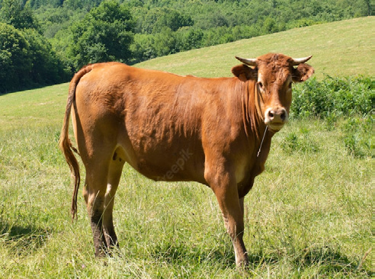
5
Point and say.
We’ve got a cow.
We/ a cow..

Slide 11

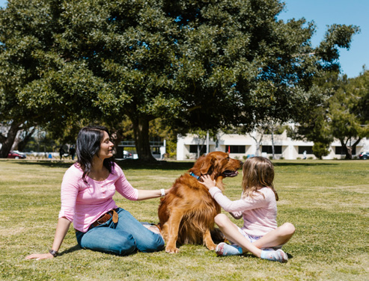
5
Point and say.
We/ a dog
We’ve got a dog.

Slide 12
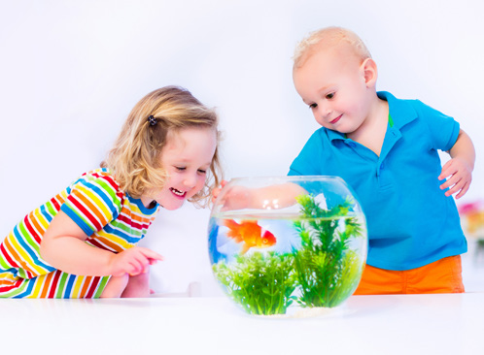
5
Point and say.
We/ a fish
We’ve got a fish .

Slide 13

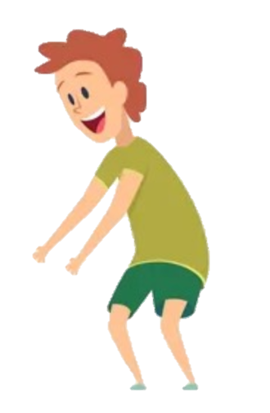
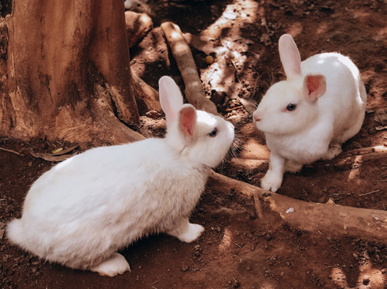
5
Point and say.
We/ two rabbits
We’ve got two rabbits.

Slide 14
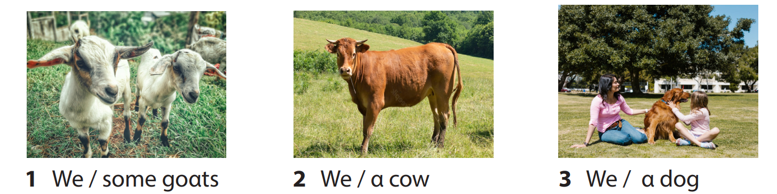
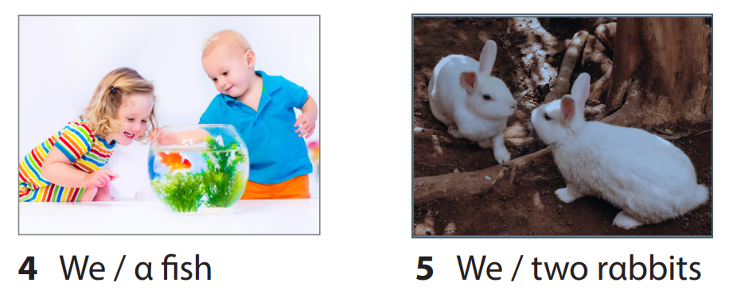
5 Point and Say.
5.We’ve got two rabbits.
3.We’ve got a dog.
1. We’ve got some goats.
2.We’ve got a cow.
4.We’ve got a fish.

Slide 15
4
Production

Slide 16
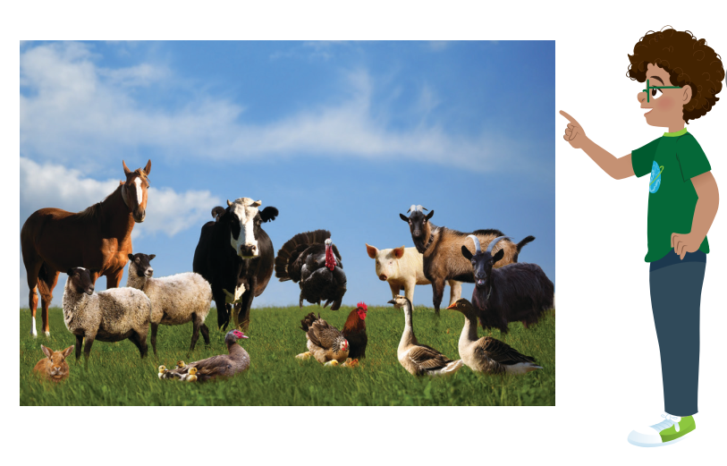
6. Let’s talk.
My farm
We’ve got α horse
on the fαrm. It’s
brown αnd tαll.

Slide 17
5
Assessment

Slide 18
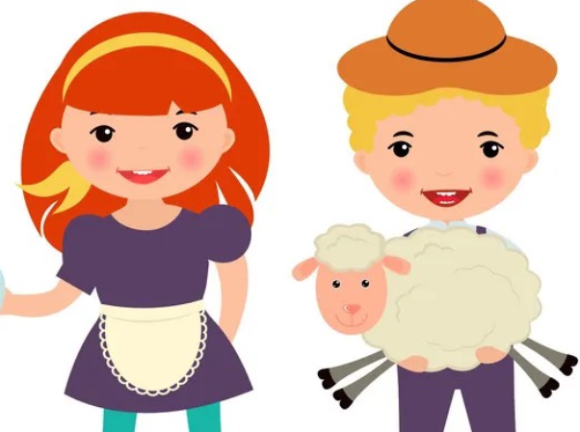
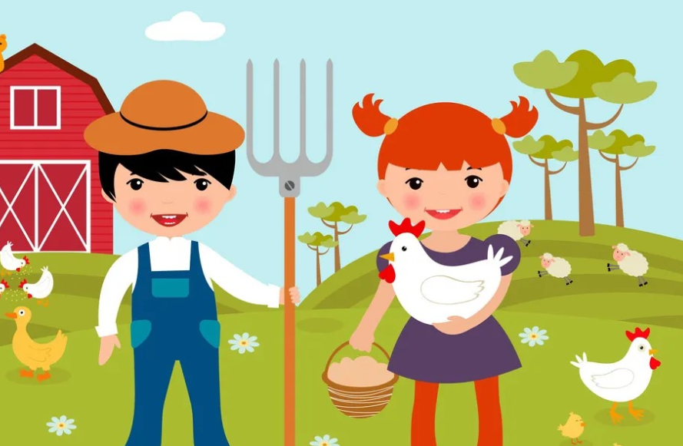
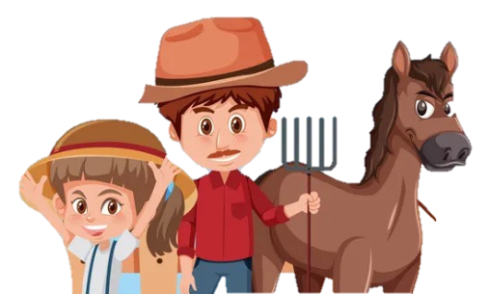
Look, read and write.
1. We’ve got …………………….
a sheep
2. We’ve got …………………….
some chickens
3. We’ve got …………………….
a horse

Slide 19
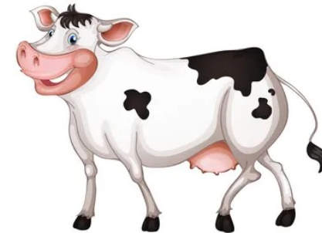
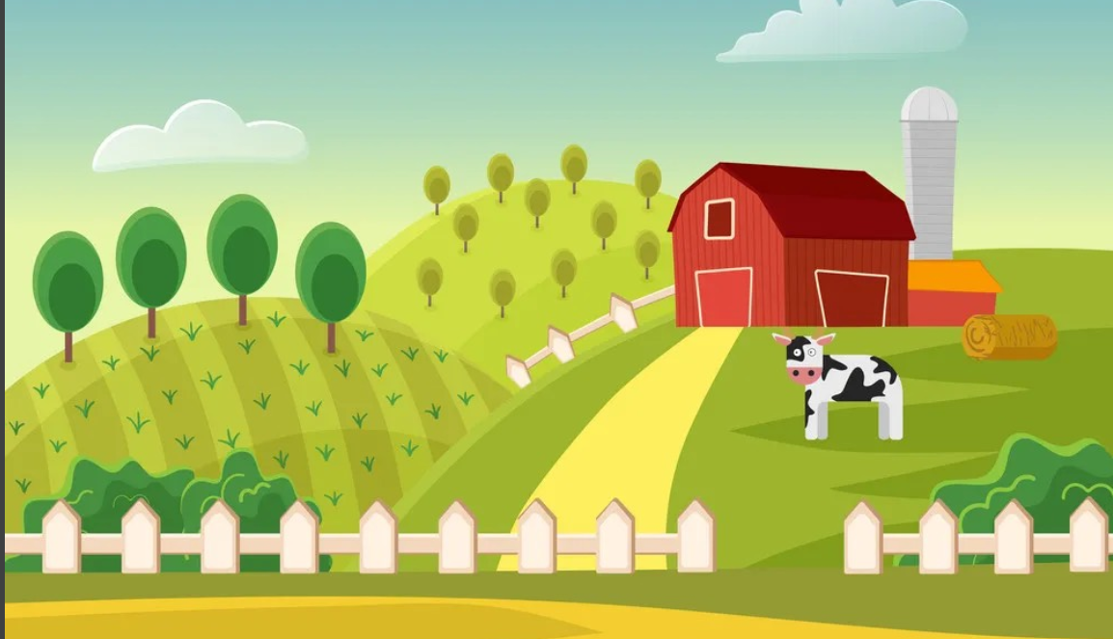
Look and write.
We’ve got …………………… on the …………………. It’s big and tall.
a cow
farm

Slide 20

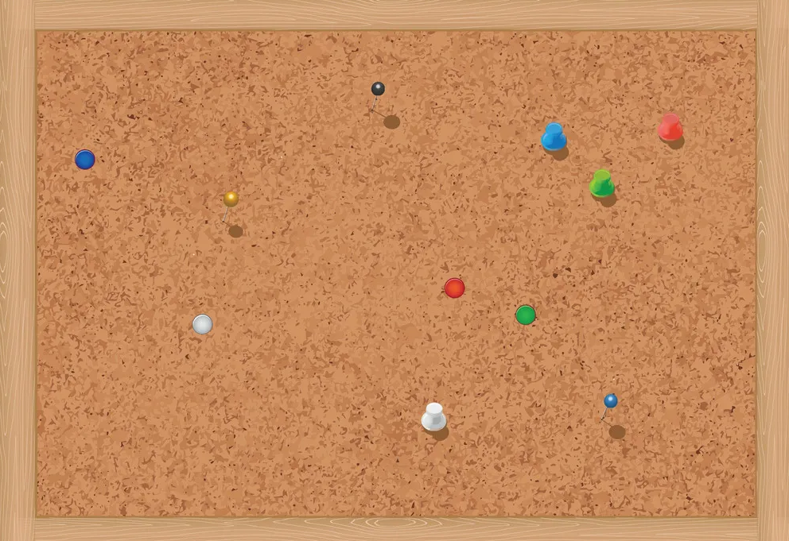
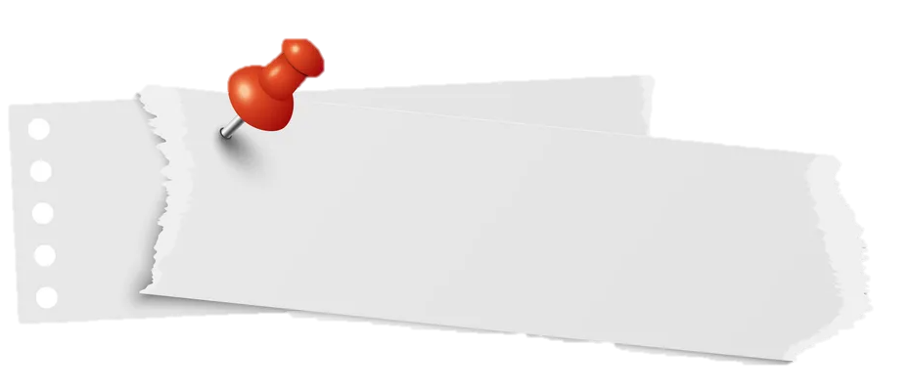
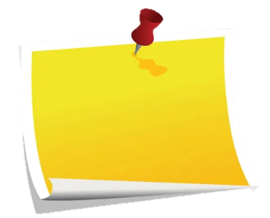

REMEMBER
Structures
We’ve got some goats.
‘ve got = have got

Slide 21


Thank you
& goodbye!

