Slide 1






















Review 6
Part 1

Slide 2










1.Warm up

Slide 3

Odd one out
Example
River
Tree
Saturday

Slide 4
Odd one out
sunny
spring
rainy

Slide 5
Odd one out
wet
get up
climb

Slide 6
Odd one out
Monday
Friday
April

Slide 7
Odd one out
autumn
summer
bus

Slide 8
Odd one out
river
bike
rock

Slide 9
Odd one out
have lunch
river
water

Slide 10
Odd one out
Sunday
motorbike
train

Slide 11
2.Review

Slide 12



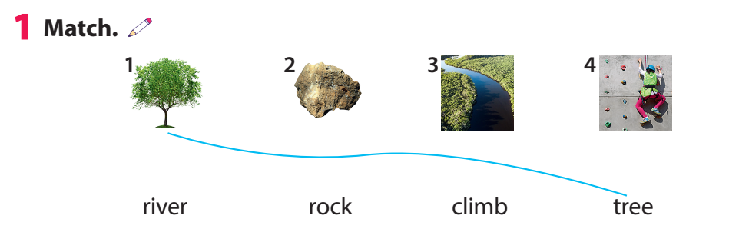

Slide 13
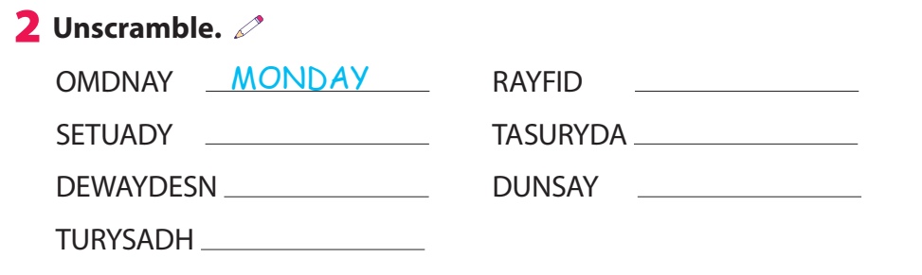
FRIDAY
TUESDAY
SATURDAY
WEDNESDAY
SUNDAY
THURSDAY

Slide 14
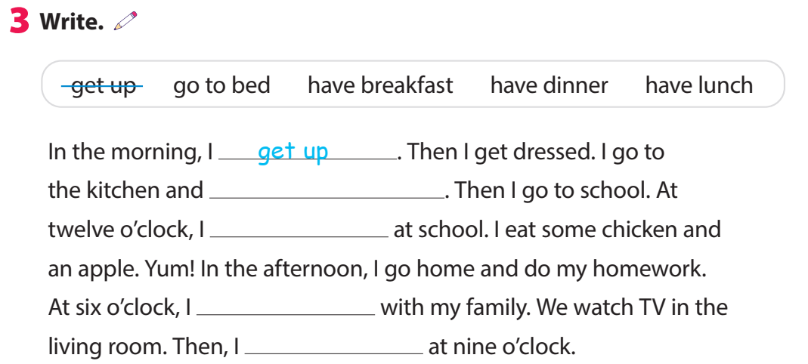
have breakfast
have lunch
have dinner
go to bed

Slide 15
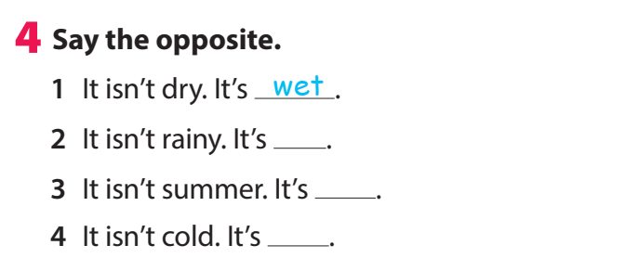
sunny
winter
hot

Slide 16
3.Extra activity

Slide 17



Task 1:Write .
Who find more words will be the winner!
Nature | Activities | Weather | Days | Transport
tree
hot
hot
tree

Slide 18
Task 2: Odd the letter out and say.
.
Let’s find the word
It’s Sunday.
Example:
Sunaday

Slide 19


Odd the letter out and say.
It’s rainy.
rainey

Slide 20

Odd letter out and say.
It’s motorbike.
mfotobike

Slide 21
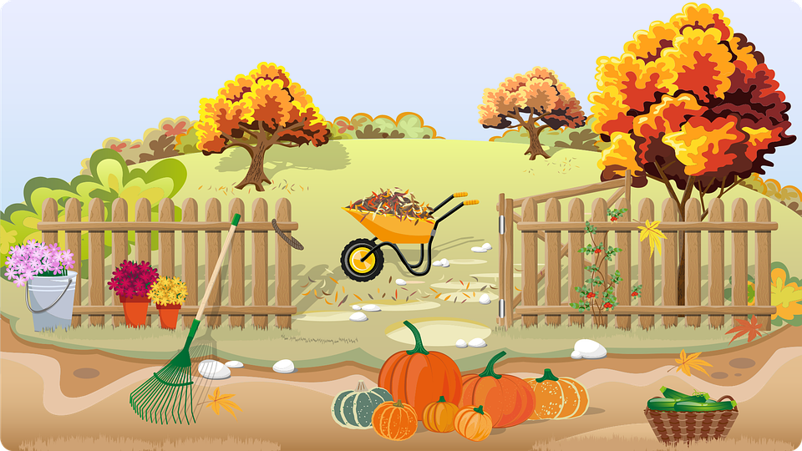
Odd the letter out and say.
It’s autumn.
autunmn

Slide 22

Odd letter out and say.
It’s
have breakfast.
have braeakfast

Slide 23
Odd the letters out and say.
It’s Wednesday.
Wendnsesday

Slide 24




Thank you & goodbye!

