Slide 1









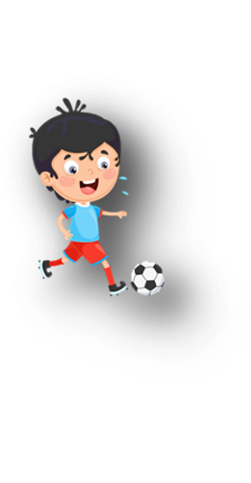




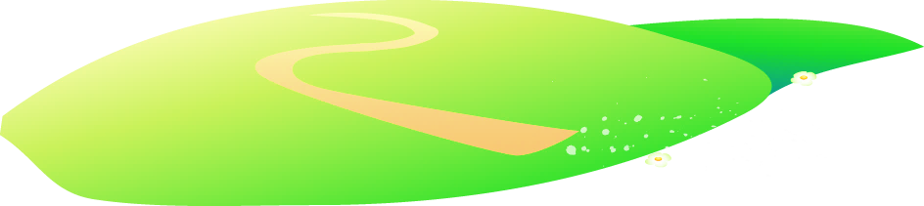


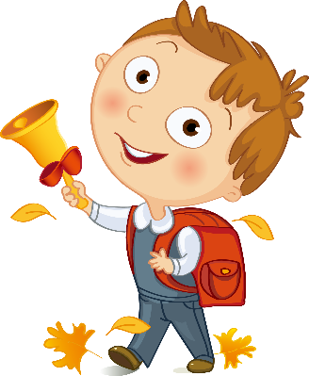



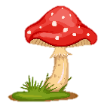
Unit 11
My day
Lesson 1 – Task 4,5,6

Slide 2






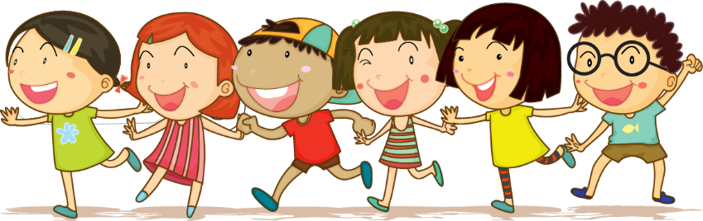



1 Warm up

Slide 3
(https://www.youtube.com/watch?v=2EdpL06MIfE)

Slide 4
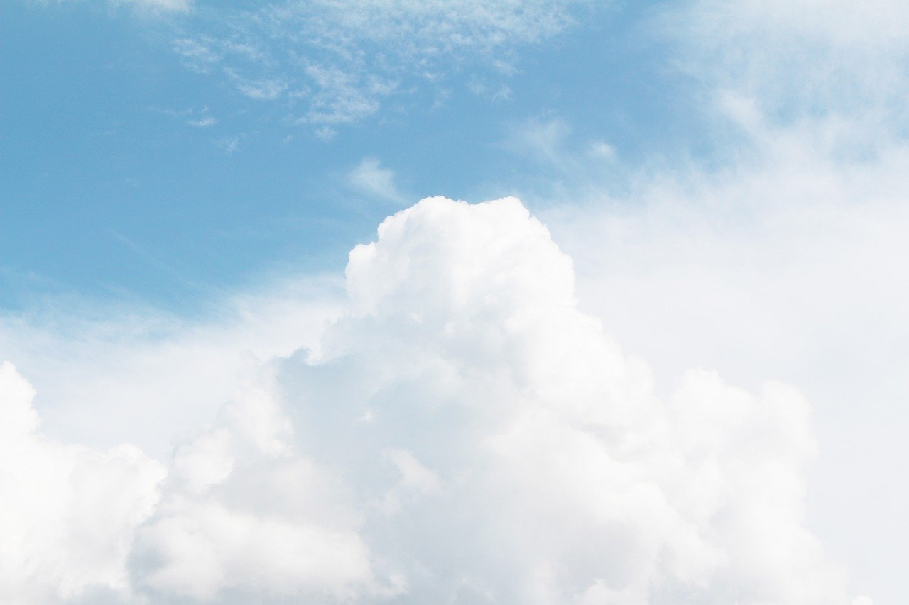
1. The day after Thursday is ________.
2. The last day of the week is ________.
3. The beginning of the week is ________.
4. The day with the letters w-y-e-a-n-d-e-s is ________.
5. The day before Sunday is _________.
6. The day between Monday and Wednesday is _________.
7. The day before Friday is _________.
Fill in the blank
Monday
Sunday
Friday
Wednesday
Tuesday
Thursday
Saturday

Slide 5
2 Presentation

Slide 6

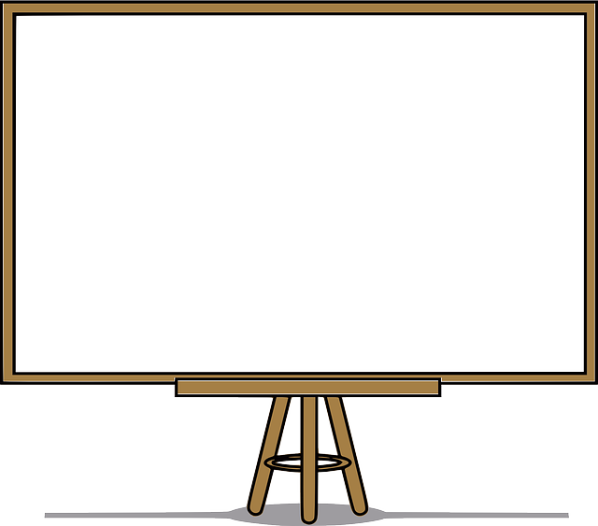
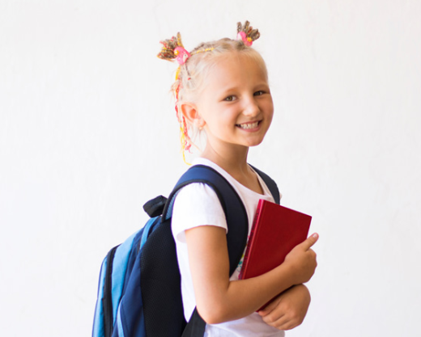
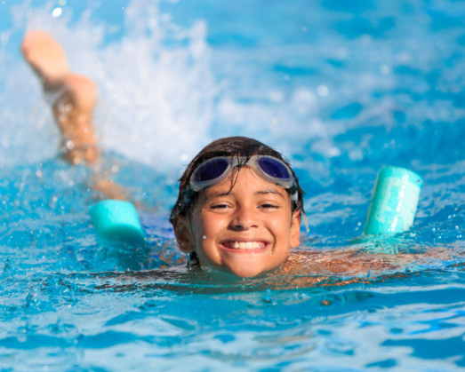
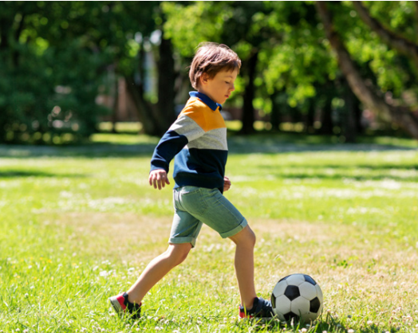
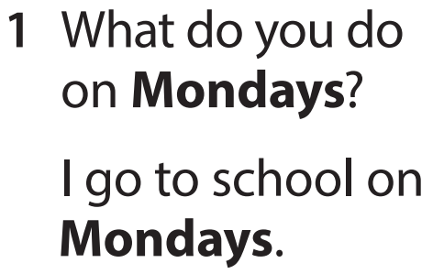
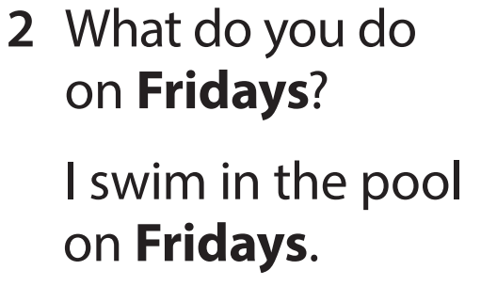
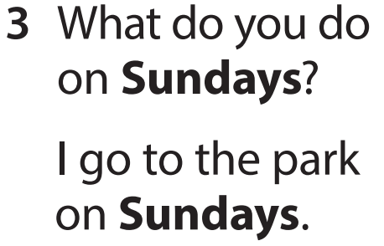
Task 4 Listen and repeat.

Slide 7

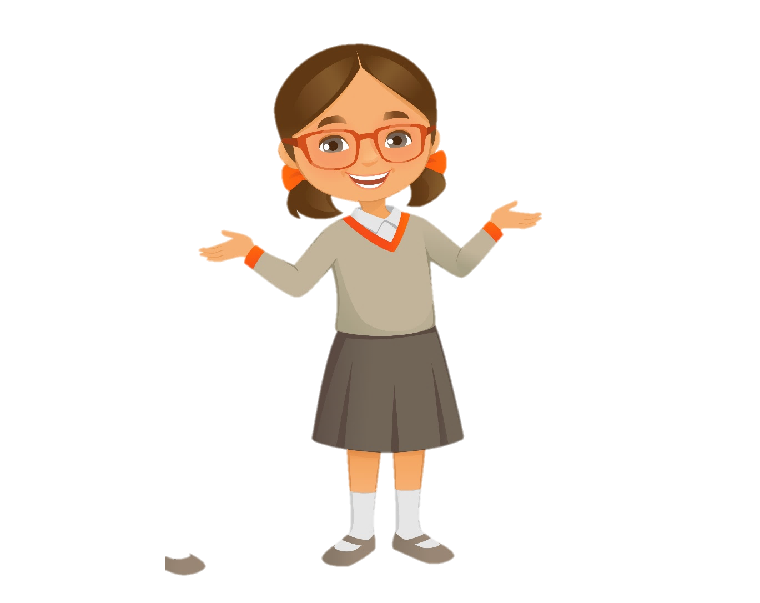
Mondays
Wednesdays
What do you do on _______?
I _______ on _______.
Saturdays
Fridays
Tuesdays
Sundays
Thursdays

Slide 8
3 Practice

Slide 9

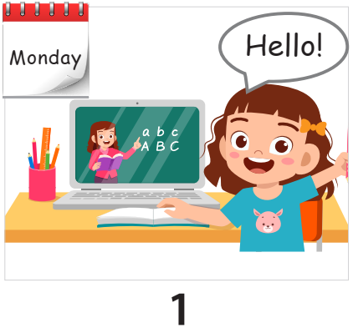
Task 5 Look and say.
What do you do on Mondays?
I go to English class on Mondays.

Slide 10
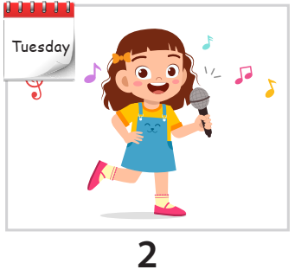
Task 5 Look and say.
What do you do on Tuesdays?
I sing on Tuesdays.

Slide 11
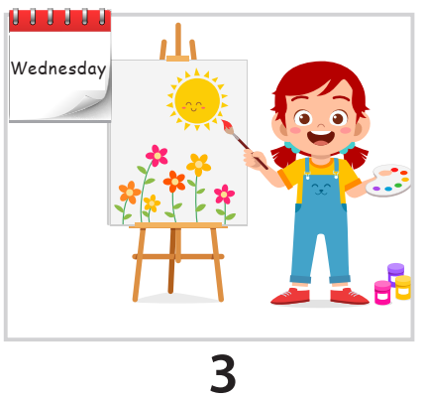
Task 5 Look and say.
What do you do on Wednesdays?
I paint on Wednesdays.

Slide 12
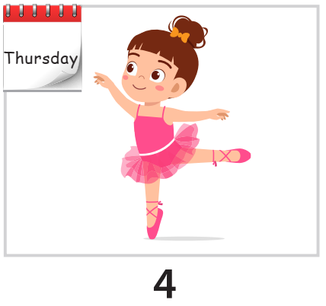
Task 5 Look and say.
What do you do on Thursdays?
I dance on Thursdays.

Slide 13
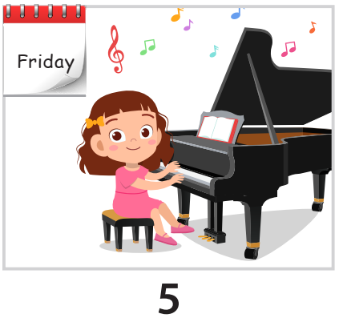
Task 5 Look and say.
What do you do on Fridays?
I play the piano on Fridays.

Slide 14
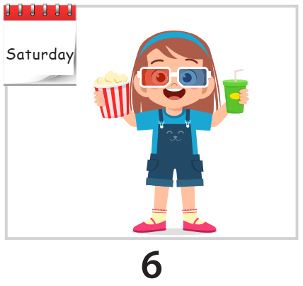
Task 5 Look and say.
What do you do on Saturdays?
I go to the cinema on Saturdays.

Slide 15
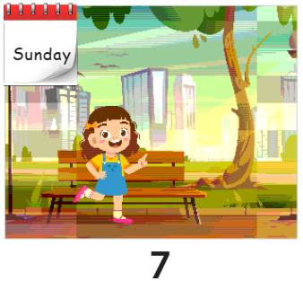
Task 5 Look and say.
What do you do on Sundays?
I go to the park on Sundays.

Slide 16
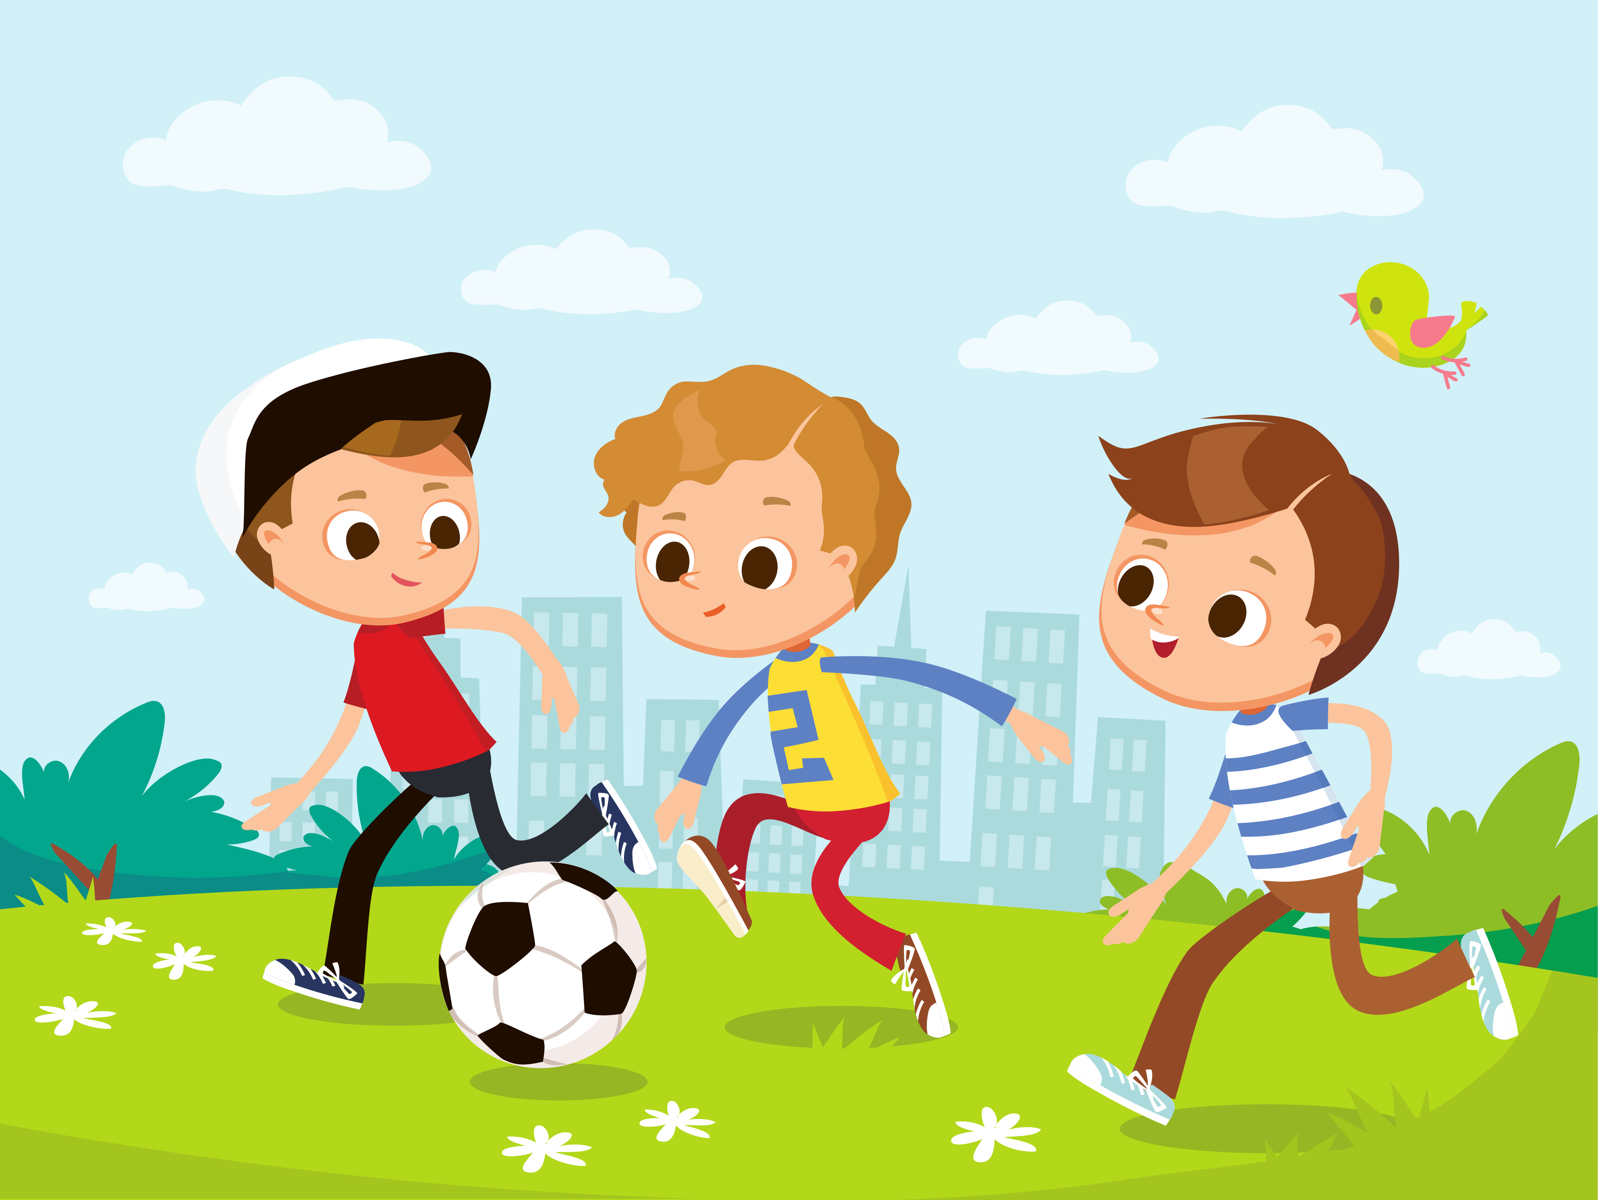
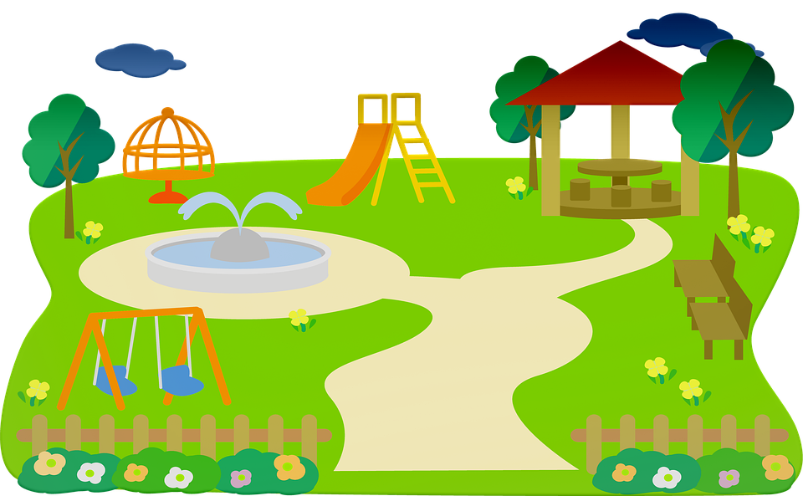
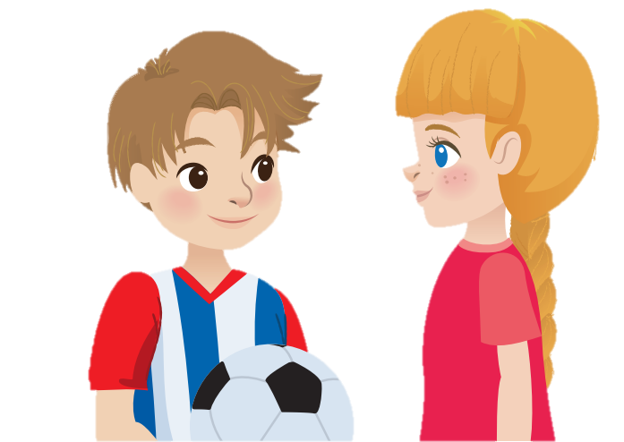
Task 6 Let’s talk.
What do you do on Sundays?
I paint.
And you?
I play football.

Slide 17
4 Production
Draw and say

Slide 18
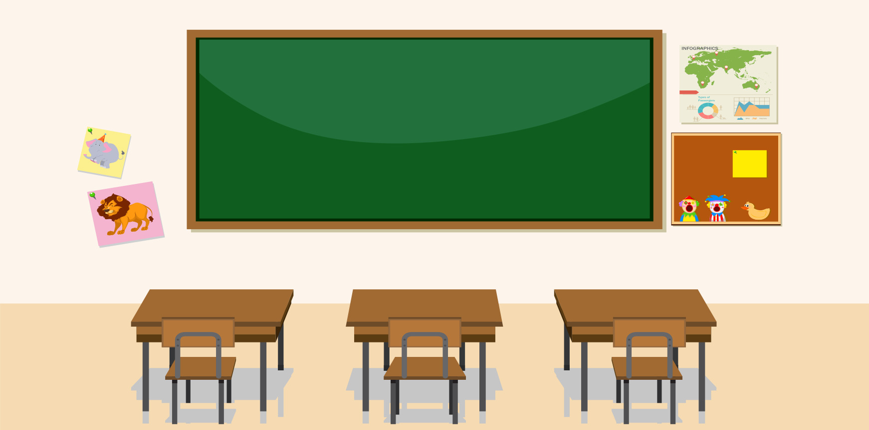
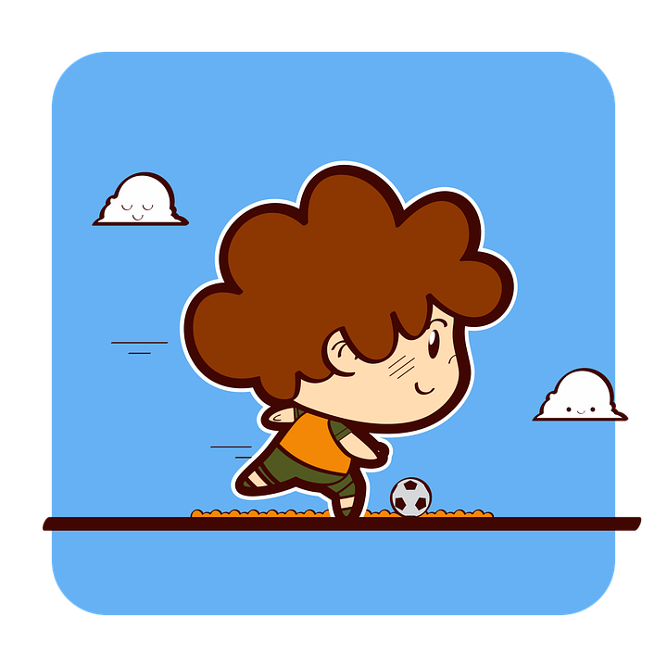
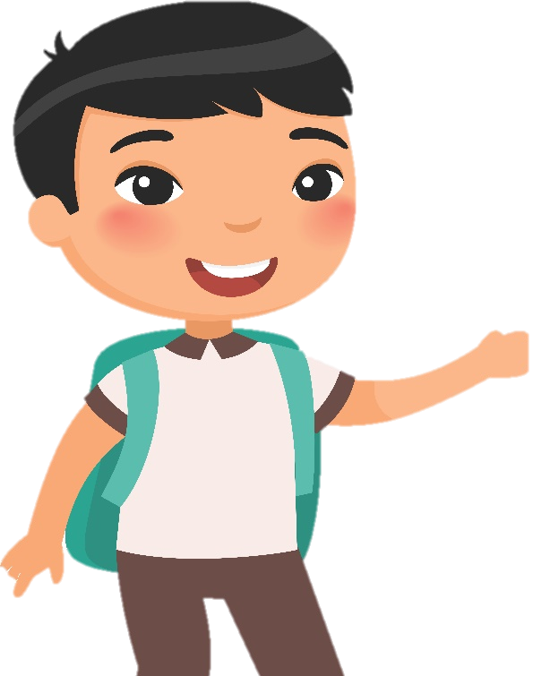
I play football on Saturdays.

Slide 19
5 Assessment

Slide 20

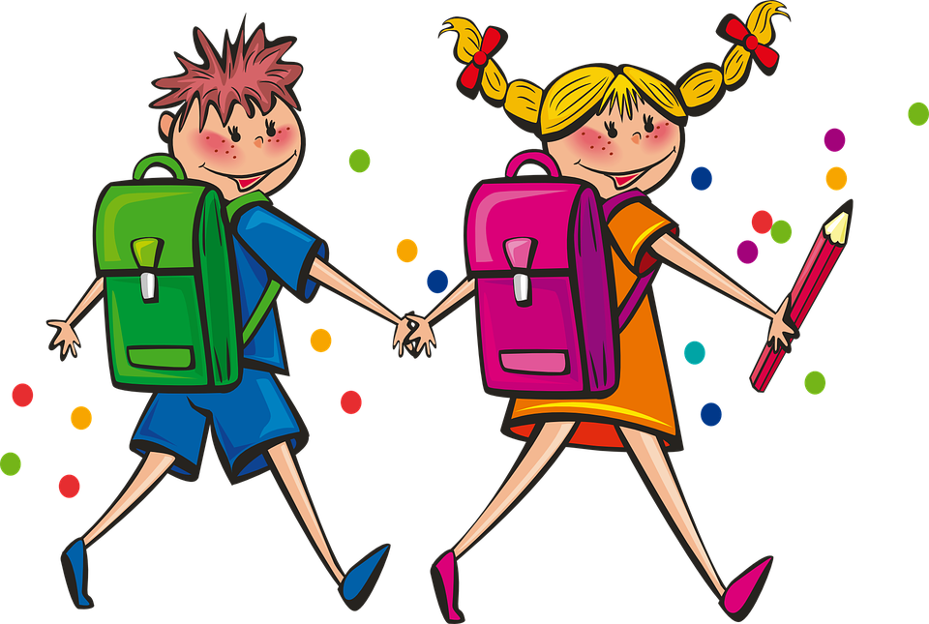
What do you do on Mondays?
Look and choose
1 I go to school on Mondays.
2 I play football on Mondays.
3 I go to school on Tuesdays.

Slide 21
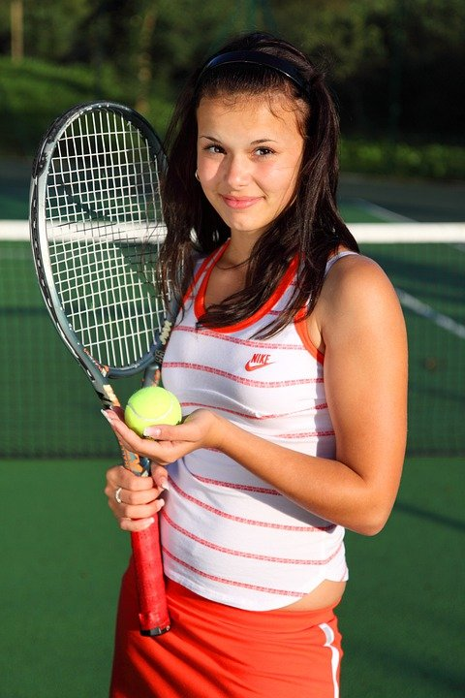
What do you do on Sundays?
Look and choose
1 I play volleyball.
2 They play piano.
3 I play tennis.

Slide 22
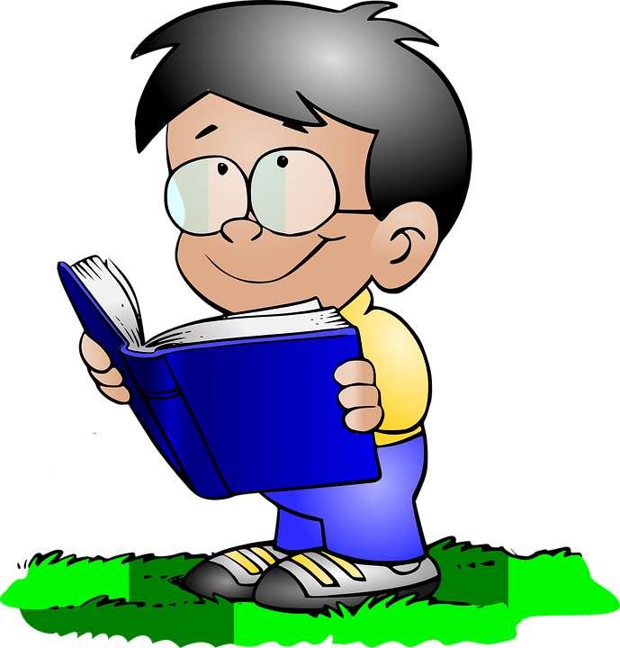
What do you do on Tuesdays?
Look and choose
1 I listen to music.
2 I read books.
3 I dance with my friend.

Slide 23
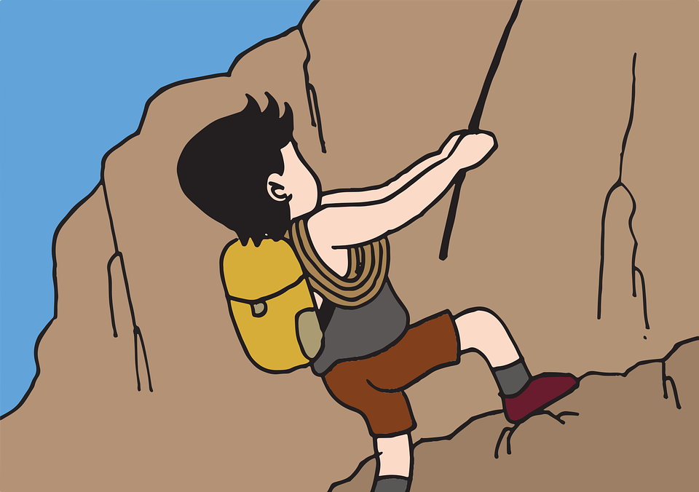
What do you do on Saturdays?
Look and choose
1 I climb trees on Saturdays.
2 I climb rocks on Saturdays.
3 I go to the gym on Saturdays.

Slide 24
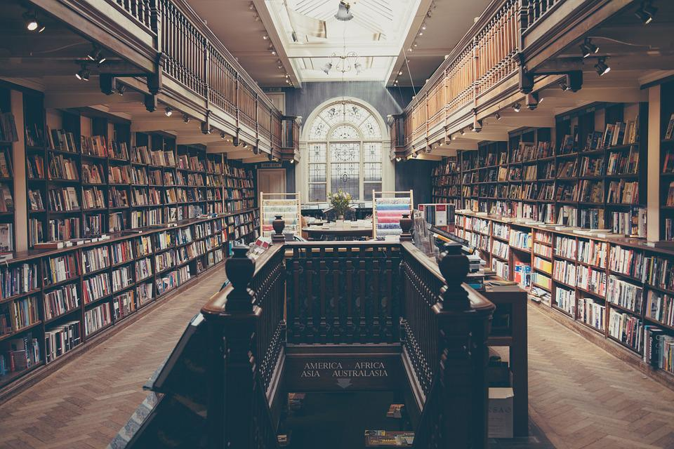
What do you do on Fridays?
Look and choose
1 I go to the library.
2 I go to the playground.
3 I go to the theater.

Slide 25


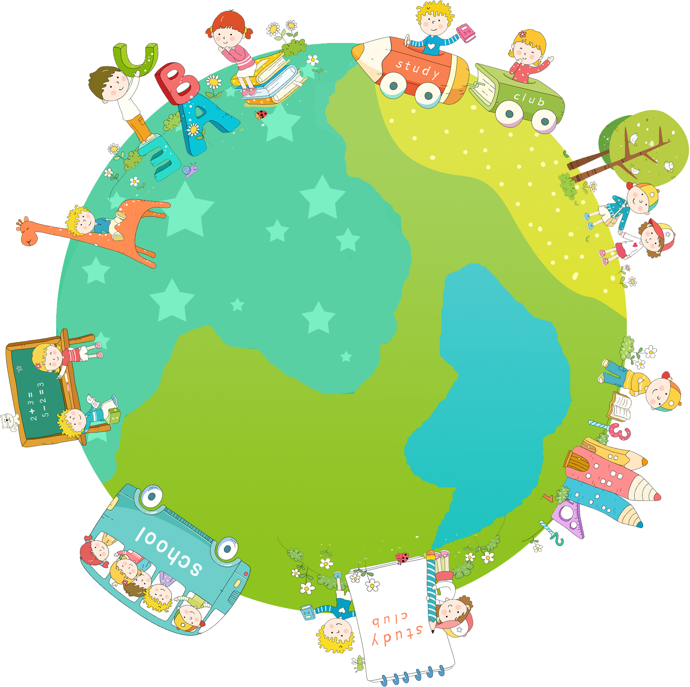

Thank you & goodbye!

