Slide 1























Slide 2

Unit 10
OUR WORLD
Lesson 2. Task 1 2 3

Slide 3

1
Warm Up
LISTEN TO THE SONG

Slide 4
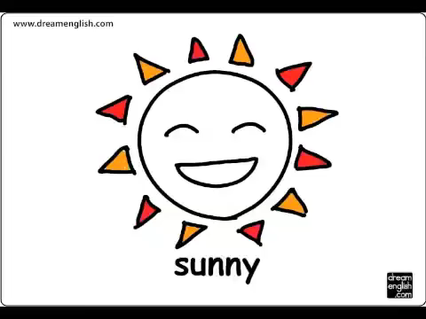

Slide 5

2
Presentation
Task 1. Listen, point and repeat.

Slide 6
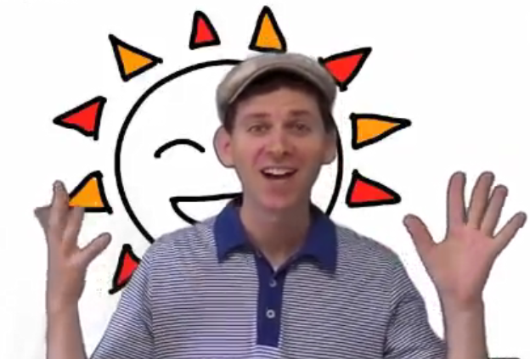
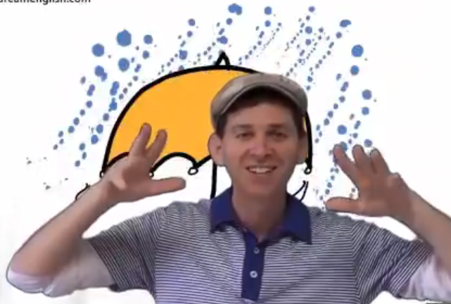
It’s rainy.
How is the weather in the song?
It’s sunny.

Slide 7

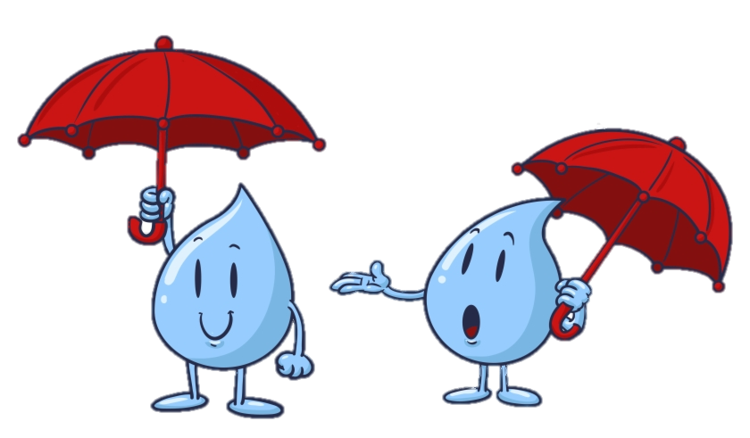
It’s rainy.

Slide 8

It’s sunny.

Slide 9
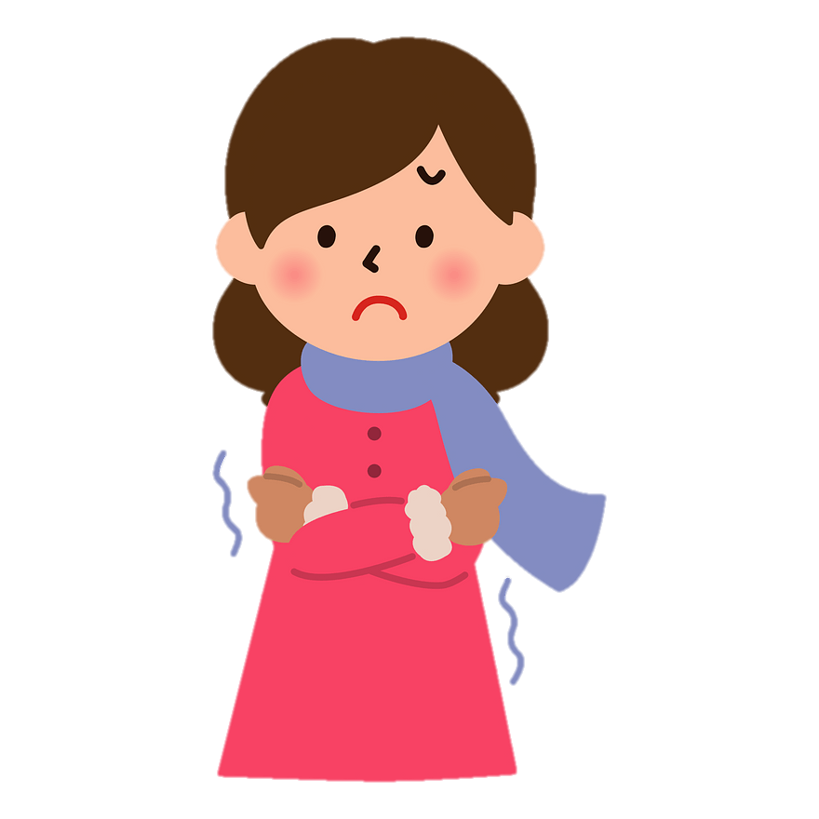
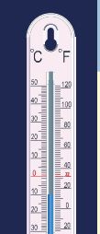
Listen and click the correct sentence.
It’s cold.
It’s hot.
It’s cold .

Slide 10
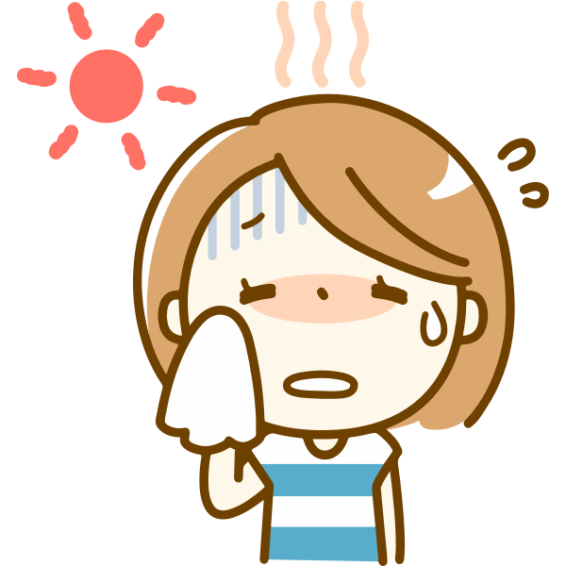
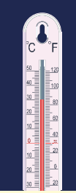
It’s hot.

Slide 11

a. winter
summer
It’s………………………
b. summer

Slide 12
It’s summer.

Slide 13

It’s winter.

Slide 14
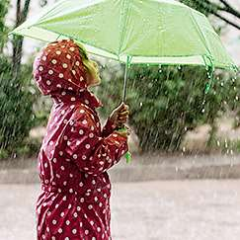
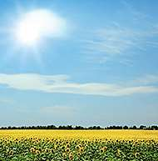
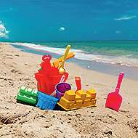
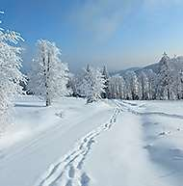
It’s …
cold.
hot.
rainy.
sunny.
summer.
winter.

Slide 15

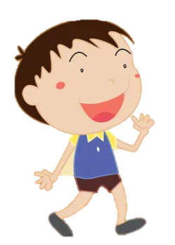
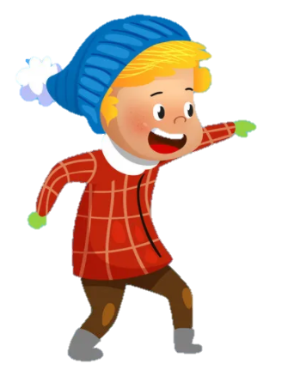
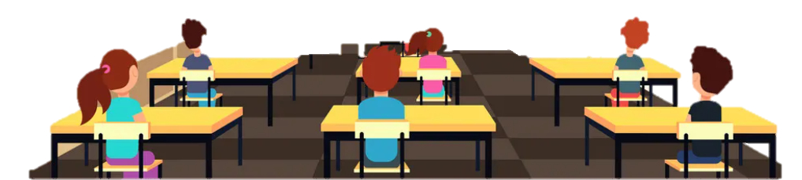
VOCABULARY CHECKING GAME
DO THE ACTIONS AND GUESS
Yes, I’m throwing the snow flake.
It’s winter.
Notes:
Sts do the action to describe the words.
Let other guess -→ say the words.

Slide 16
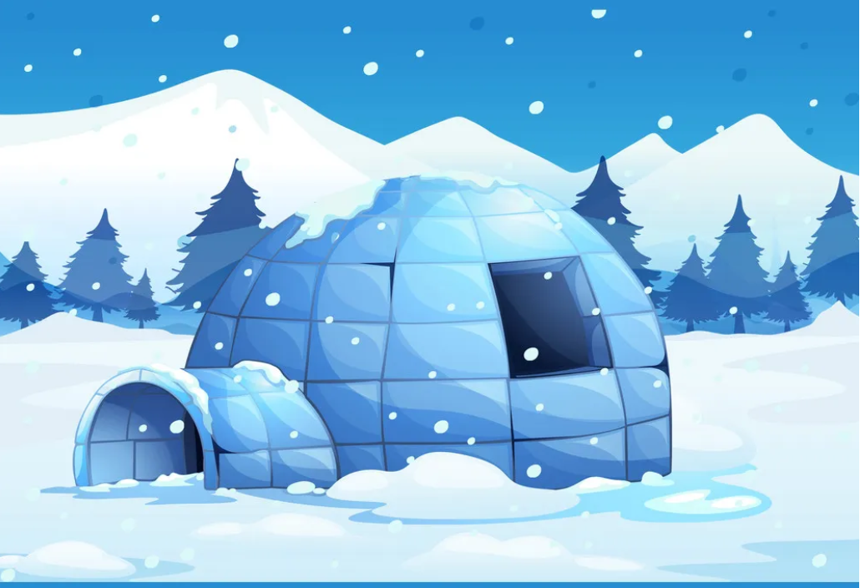
It’s winter.
It’s cold .

Slide 17


desert
It’s hot.

Slide 18
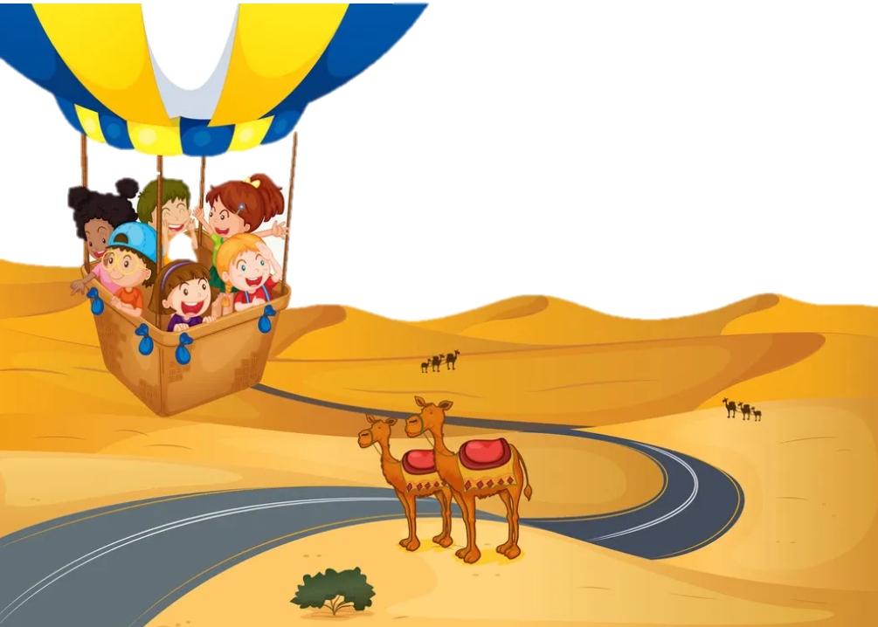
3
Practice

Slide 19
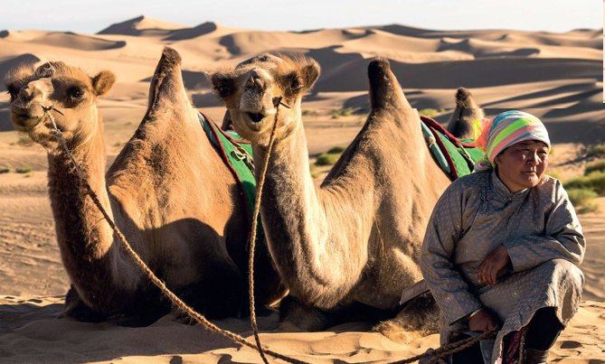


LISTEN AND FILL
Peter: Look! Where are they?
Lisa: They are in the Gobi Desert.
Peter: Is it (1)......................?
Lisa: Yes, it’s hot in summer and it’s cold in (2)……………...
Peter: Do they (3)……………. a lot of water?
Lisa : Yes, they do. It’s very (4)…………..
WEATHER REPORTER
hot
winter
drink
sunny

Slide 20
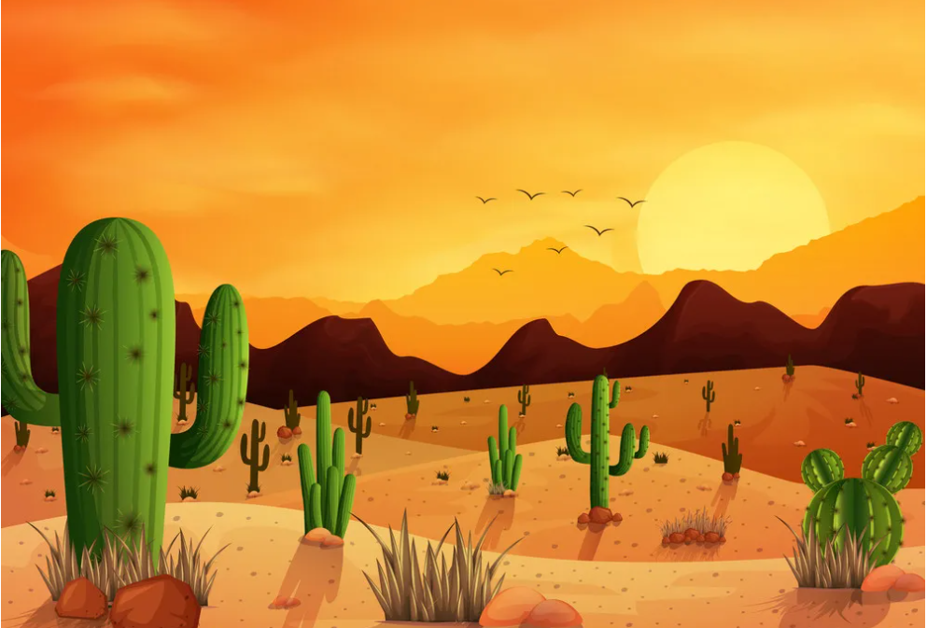
2. Listen and tick.
1. In summer, it's hot in the Gobi Desert.
2. In winter, it isn't cold in the desert.
3. It's very sunny in the desert.
✓
Yes
No
Yes
✓
No
✓
Yes
No
Notes:
THIẾT KẾ HOẠT ĐỘNG TƯƠNG TÁC

Slide 21

LOOK AND MATCH
cold
hot
sunny
Summer
Winter
hot
sunny
cold
Notes:
Tick the words with the correct pictures

Slide 22
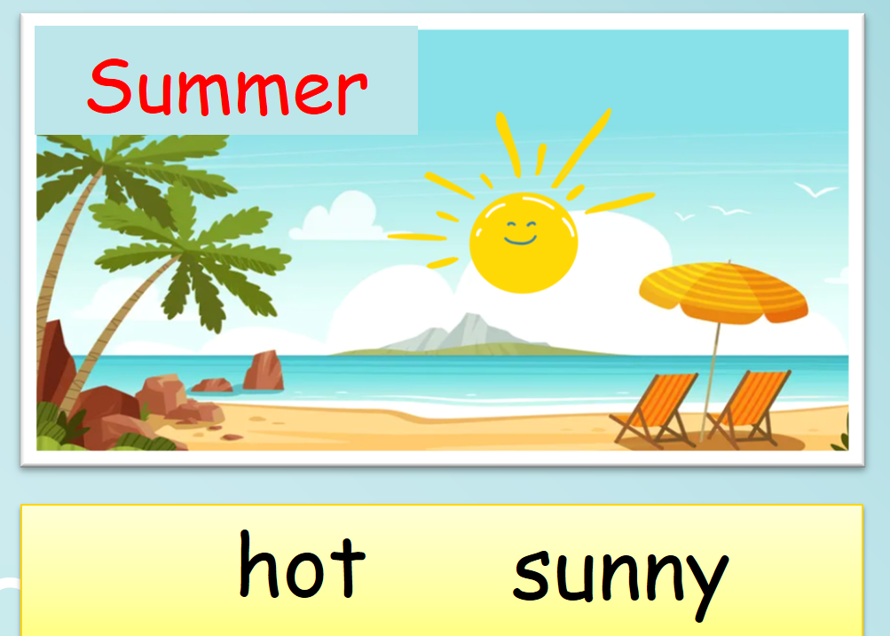

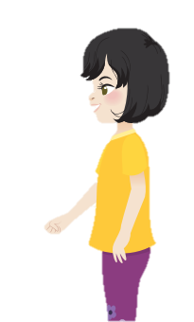
3 TALK
It’s summer.
I swim in the river.
It’s hot and sunny.

Slide 23

Production
4
Weather and seasons wheel

Slide 24
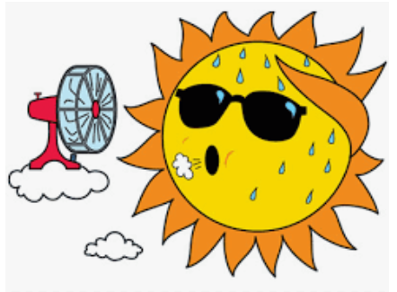

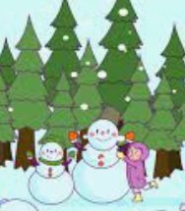



hot
rainy
Draw and spin the pencil to say
winter
cold
summer
sunny

Slide 25
Assessment
5

Slide 26
Look at the pictures and circle A or B
1 |  | A. It’s summer. B. It’s winter.
2 |  | A. It’s rainy. B. It’s sunny.
3 |  | A. It’s summer. B. It’s winter.
Notes:
HOẠT ĐỘNG TƯƠNG TÁC SLIDE 26,27

Slide 27
4 |  | A. It’s cold. B. It’s hot.
5 |  | A. It’s cold. B. It’s hot.

Slide 28




Thank you & goodbye!

