Slide 1





















Unit 8
My Town
Lesson 2 – Task 7,8,9

Slide 2






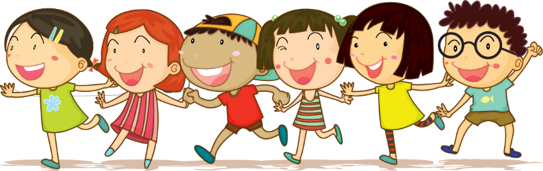



1 Warm up
Jumbled words

Slide 3
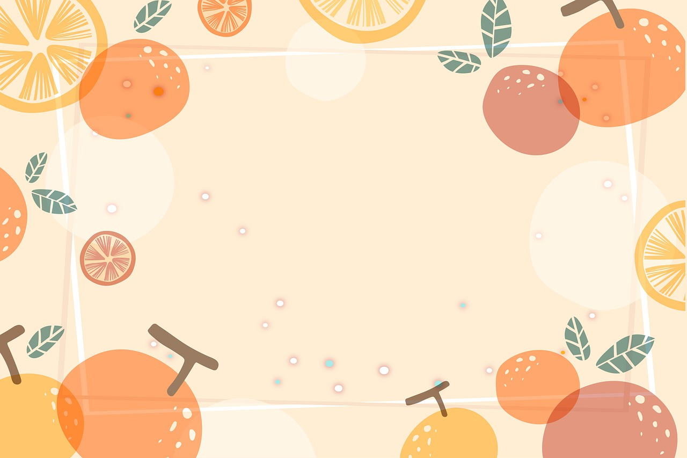
What word is it?
m | r | a | k | e | t
It’s market.

Slide 4
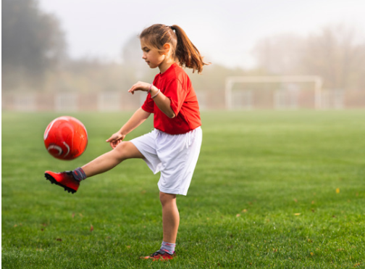
What word is it?
p | a | l | y
It’s play.

Slide 5
What word is it?
o | o | p | l
It’s pool.

Slide 6
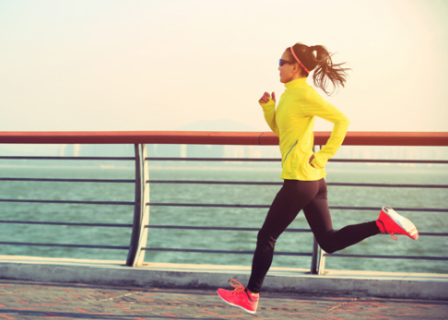
What word is it?
n | r | u
It’s run.

Slide 7
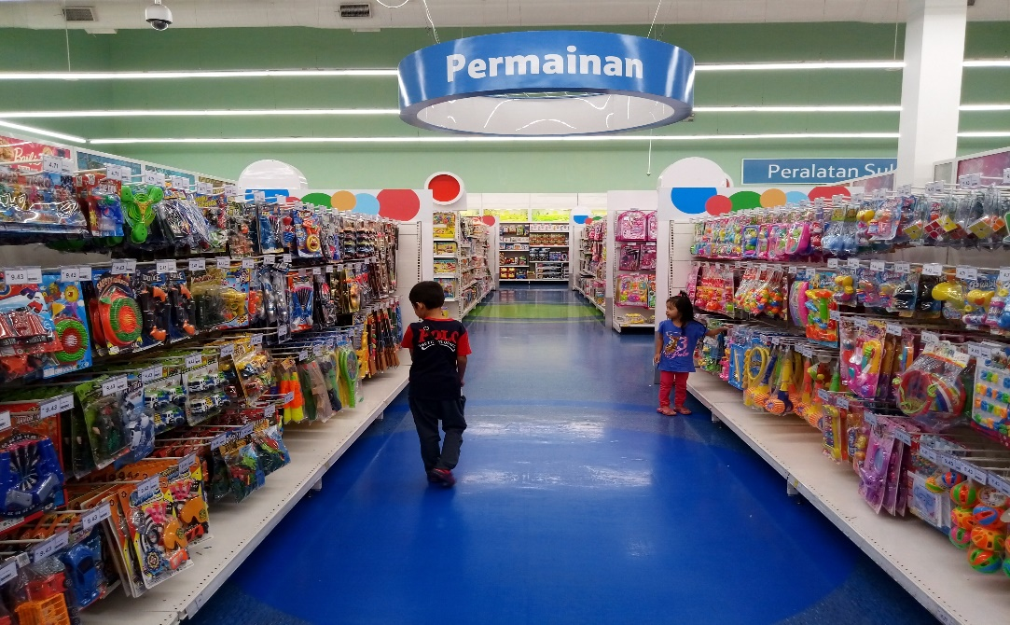
What word is it?
p | o | h | s | y | o | t
It’s toy shop.

Slide 8
What word is it?
p | l | y | a | g | r | o | d | n | u
It’s playground.

Slide 9
What word is it?
r | k | p | a
It’s park.

Slide 10
2 Practice

Slide 11

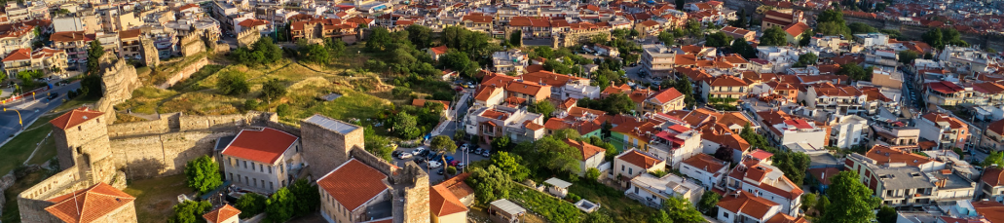
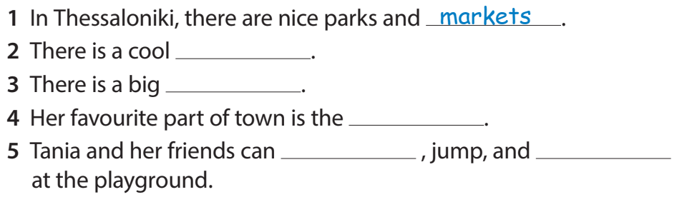
Let’s guess!
toy shop/swimming pool.
zoo/pool
playground/theater.
swim/run
play/sing

Slide 12
Task 7. Listen and write
toy shop
pool
playground
run
play
Notes:
HOẠT ĐỘNG TƯƠNG TÁC. HS NGHE VÀ CHỌN TỪ ĐIỀN VÀO CHỖ TRỐNG

Slide 13
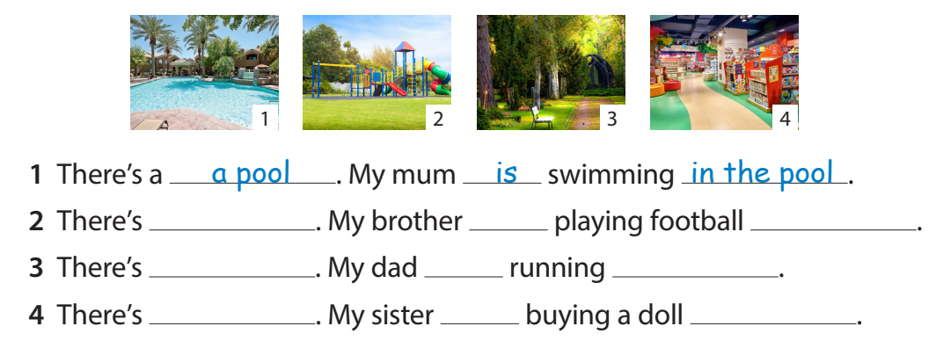
Task 8. Look and write.
1 There’s a ______. My mum ____ swimming _____________.
2 There’s __________. My brother ___ playing football ____________.
3 There’s ___________. My dad __ running ____________.
4 There’s ___________. My sister __ buying a doll ___________.
pool
is
in the pool
a playground
is
at the playground
a park
is
in the park
a toy shop
is
at the toy shop

Slide 14
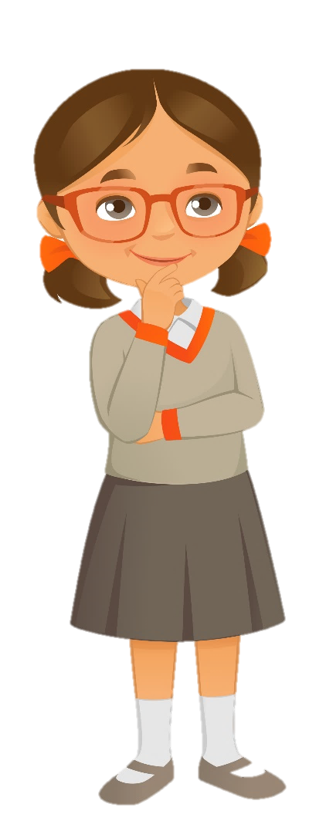
Quick check
Find mistakes in these sentences
Notes:
Bỏ

Slide 15
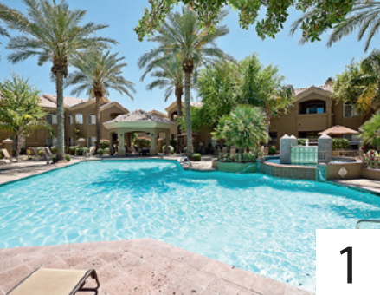
Find mistakes in the sentence
1 There’s a poool. My brother is swiming in the pool.
-> There’s a pool. My brother is swimming in the pool.

Slide 16
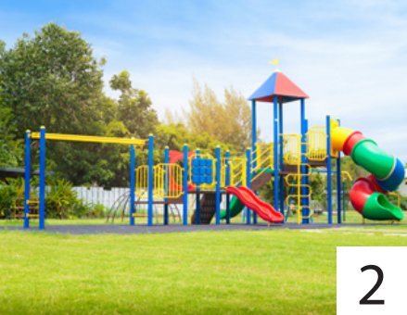
Find mistakes in the sentence
2 There’s a museum. My dad is playing football in the pool.
-> There’s a playground. My dad is playing football at the playground.

Slide 17
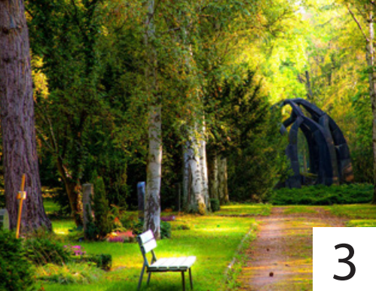
Find mistakes in the sentence
3 There’s a museum. My sister are running at the park.
-> There’s a park. My sister is running in the park.

Slide 18
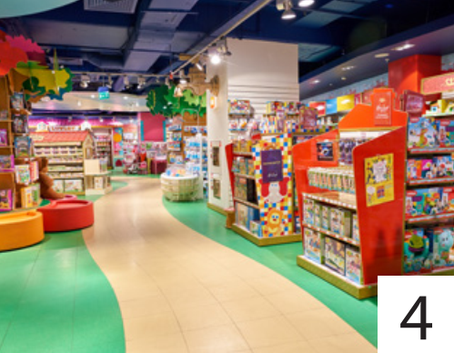
Find mistakes in the sentence
4 There’s a park. I are buy a doll at the toy shop.
-> There’s a toy shop. I am buying a doll at the toy shop.

Slide 19
3 Let’s talk

Slide 20

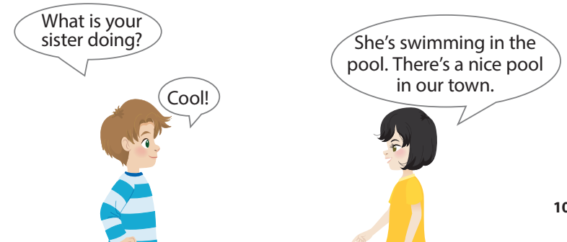


Task 9. Let’s talk.

Slide 21
Project
 | The place | What is she/he doing?
Mum
Dad
Brother
Sister
…
Notes:
-Ask Ss to work in pairs to ask and answer questions about what a family member is going and/or what they are doing.
-Ask some volunteers to read his/her
dialogue in front of the class.

Slide 22
4 Assessment

Slide 23
Finish the sentence
Ex. There’s a park, ___________________.
I’m running in the park

Slide 24
Finish the sentence
1 There’s a playground, ___________________.

Slide 25
Finish the sentence
2 There’s a market, ___________________.

Slide 26
Finish the sentence
3 There’s a zoo, ___________________.

Slide 27
Finish the sentence
4 There’s a museum, ___________________.

Slide 28
Finish the sentence
5 There’s a theater, ___________________.

Slide 29




Thank you & goodbye!

